Slide 1

Assessment, Standardisation and Moderation -
ensuring consistency in teacher assessment
KS2 / KS3

Slide 2

Timetable

Slide 3

2015 No. 1309 (W. 113)
EDUCATION, WALES
The National Curriculum (Moderated
Arrangements for the Second Assessment
Key Stage and Third Key Stage) (Wales) Regulations 2015
Timetable
(B) that the school moderation cluster group meet at least once in every school year either during the spring or summer term.

Slide 4
By the end of January:
‘Assessment Leaders' to ensure that each school within the cluster is aware of the requirements of standardisation and moderation and the resources available.
Final cluster moderation meeting dates sent to GwE.
eirianharris@gwegogledd.cymru
GwE Challenge Advisers will attend one moderation meeting in each cluster and report back to the cluster, the LA and GwE.
External verification of teacher assessment – Key Stages 2 and 3
Welsh Government guidance document on statutory assessment(October 2016)
In 2014/15 external verification of mathematics and science was trialled with a small sample of schools. In 2015/16 the programme focused on the verification of English, Welsh and Welsh second language. Verification of mathematics and science will be repeated on a full scale in 2016‒2017.
Timetable

Slide 5

Estyn
Recommendations:
Consider a wider range of pupils' work in assessing and moderating levels - Oracy and Reading
Giving due consideration to the level of support, the drafting processes, the impact of teachers' marking and adequacy of the evidence in awarding final levels
- Books

Slide 6
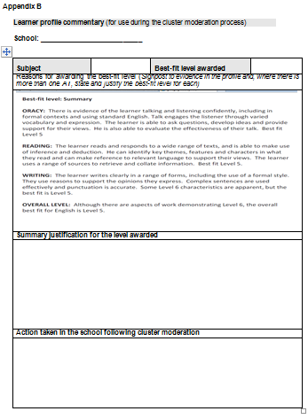
Estyn
Recommendations:
Focus on pupils’ work on borderline levels in schools and in cluster meetings
Make sure that all levels are reviewed and appropriately modified after internal and cluster moderation and before submitting the final levels
Refer to standardised materials in assessment, standardisation and moderation in schools and in cluster meetings.

Slide 7

GwE
Continue build upon the good practice that exists
Clear school / cluster timetable for the year
Good practice would be to include all teachers in internal moderation within the primary school
Small schools: come together as ‘mini clusters' before the final cluster moderation meeting
Secondary schools: moderate with other high schools

Slide 8

1 pupil’s BOOKS at Level 4 and Level 5 in the primary and Level 5 and 6 in the secondary for each core subject.

Slide 9
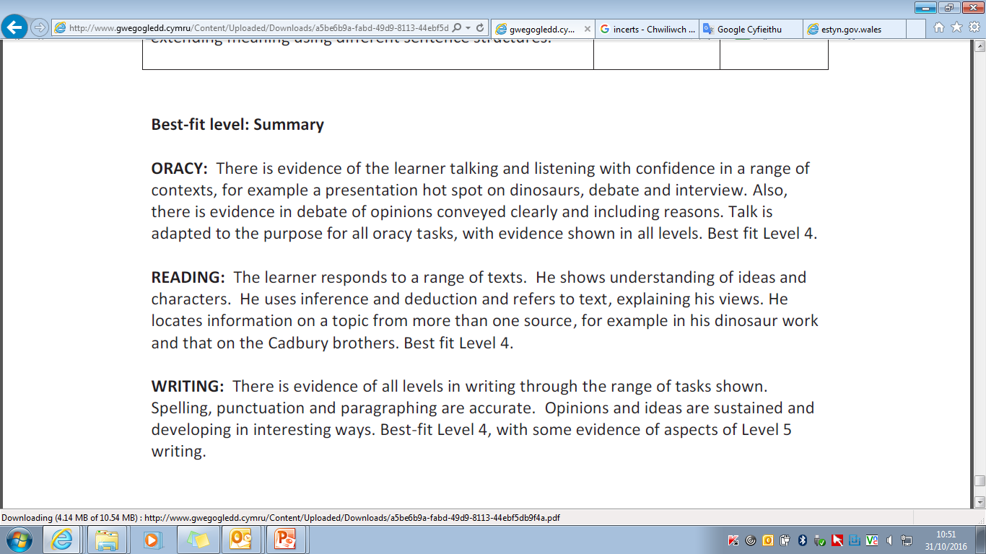
A brief Commentary explaining why the level was awarded. NO MORE THAN 200 WORDS

Slide 10
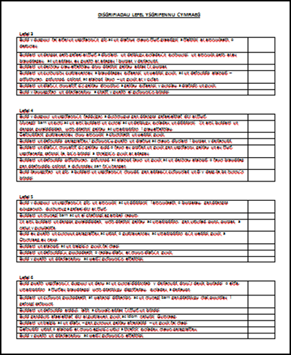
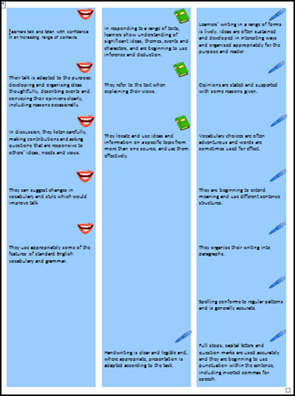
Evidence should be in the pupil's book - but this will require a clear reference to the tasks highlighted - date etc. ("post its" useful)

Slide 11

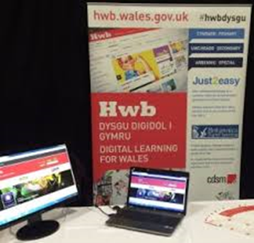
Incerts Snap can be used, apps like Book Creator on I-Pad as 'profiles' or to preserve evidence orally.
Possibility for schools if they wish, to upload oracy and reading evidence onto the Hwb + platform.
To do this, you need to collect Hwb e-mail addresses of teachers within the cluster that will need access to the folder and send them to sionedhywelthomas@gwegogledd.cymru

Slide 12
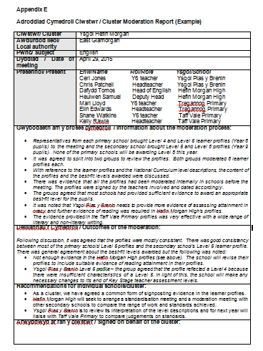
Cluster moderation meetings
Participation of all schools in the cluster moderating process is important
Sufficient time / status is given to internal and cluster moderation – a morning or afternoon to each subject
Heads / SMT to play a role in the process - chairing meetings, keep minutes etc.

Slide 13
Clear leadership and expectations
Oracy / reading - headphones, wi-fi,
Pupils’ books - brief commentary
Give a specific time to discuss and agree on one pupil’s level
Refer to the level descriptions and national exemplar materials
Written feedback for each school (Appendix B)
That key messages of the cluster moderation process will be recorded and sent to the schools in the cluster
(Appendix D)

Slide 14
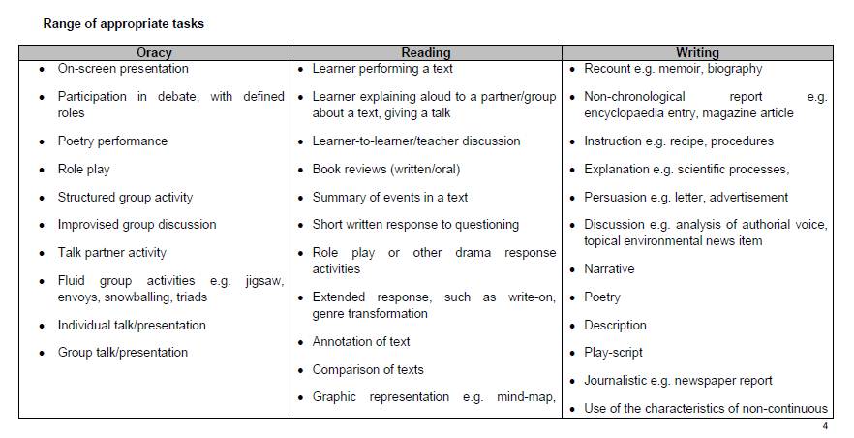
Sufficient evidence across the range to enable others to determine levels. National guidance for each topic on the GwE web site.

Slide 15
Typically, a learner at the lower end of a level shows mainly characteristics of that level across a range of work, but may still show characteristics of the previous level in some aspects of the work.
A learner securely within the level demonstrates the characteristics of that level across a range of work.
A learner at the top end of a level demonstrates clearly characteristics of that level across a range of work with a some examples of characteristics of the next level.
Best-fit judgement

Slide 16
Sufficient evidence across the range
Oracy: individual, pair, group
Primary evidence –i-Pad or camera
etc. (video preferable to audio)
Secondary evidence – teacher assessment sheet/commentary
Reading:
Literary and non-literary with a range of contexts
Writing:
Literary and non-literary with a range of contexts
Language

Slide 17
The whole year’s work
Sufficient evidence to cover the whole range programme of study and skills
Using and applying
Measures and money, shape, position and movement and handling data, evidence must include a range of appropriately challenging tasks within number
Range of maths activities
Real-life contexts
Cross-curricular work
Mathematics

Slide 18
Science / Thematic book, and / or work folder
Evidence from across a range of science - Interdependence of organisms, the sustainable Earth and How things work
Evidence that the pupil has mastered the range of communication and enquiry science skills at the level awarded (including Planning, Developing and Reflecting)
Evidence of full investigations
Science

Slide 19
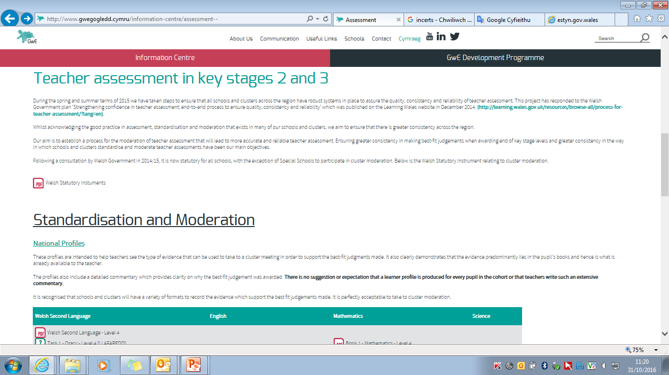
Exemplar Learner profiles
National Guidance
Resources for the chair
Profile Commentary Template
Template for commentary/feedback to be used during the moderation process
Cluster moderation minutes template and exemplar
Level description stickers
Level description tick sheets
By 2017: national standardised portfolios
http://www.gwegogledd.cymru/information-centre/assessment--

Slide 20

Any questions or any support required?
SionedHywelThomas@gwegogledd.cymru
DafyddRhys@gwegogledd.cymru (Flint\Wrexham Hub)
RichardWatkins@gwegogledd.cymru (Conwy\Denbigh Hub)
RhianMairJones@gwegogledd.cymru (Gwynedd\Anglesey Hub)

