Slide 1
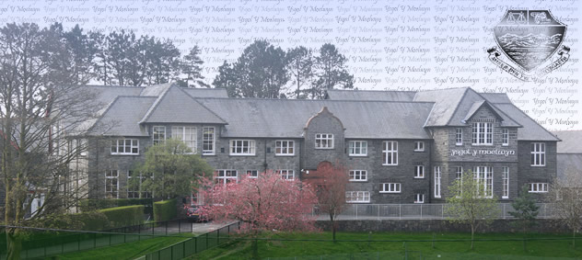
Datblygu sgiliau llafar disgyblion yn Saesneg
Developing pupils’ oracy skills in English

Slide 2
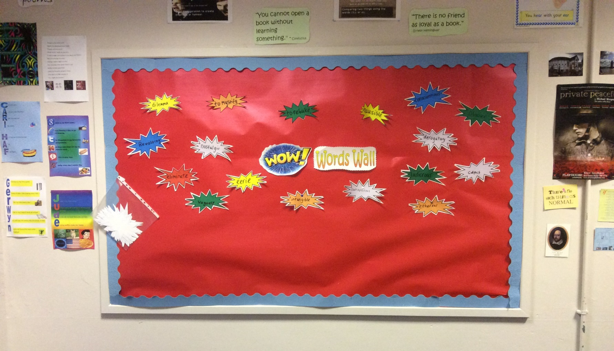
Enghraifft o ‘Wow words wall’

Slide 3
Tasgau cyfnod cofrestru
Based on Ian Gilbert’s Little Book of Thunks.
Resource adapted from: TES.
https://www.tes.com/teaching-resource/thunks-6022495

Slide 4
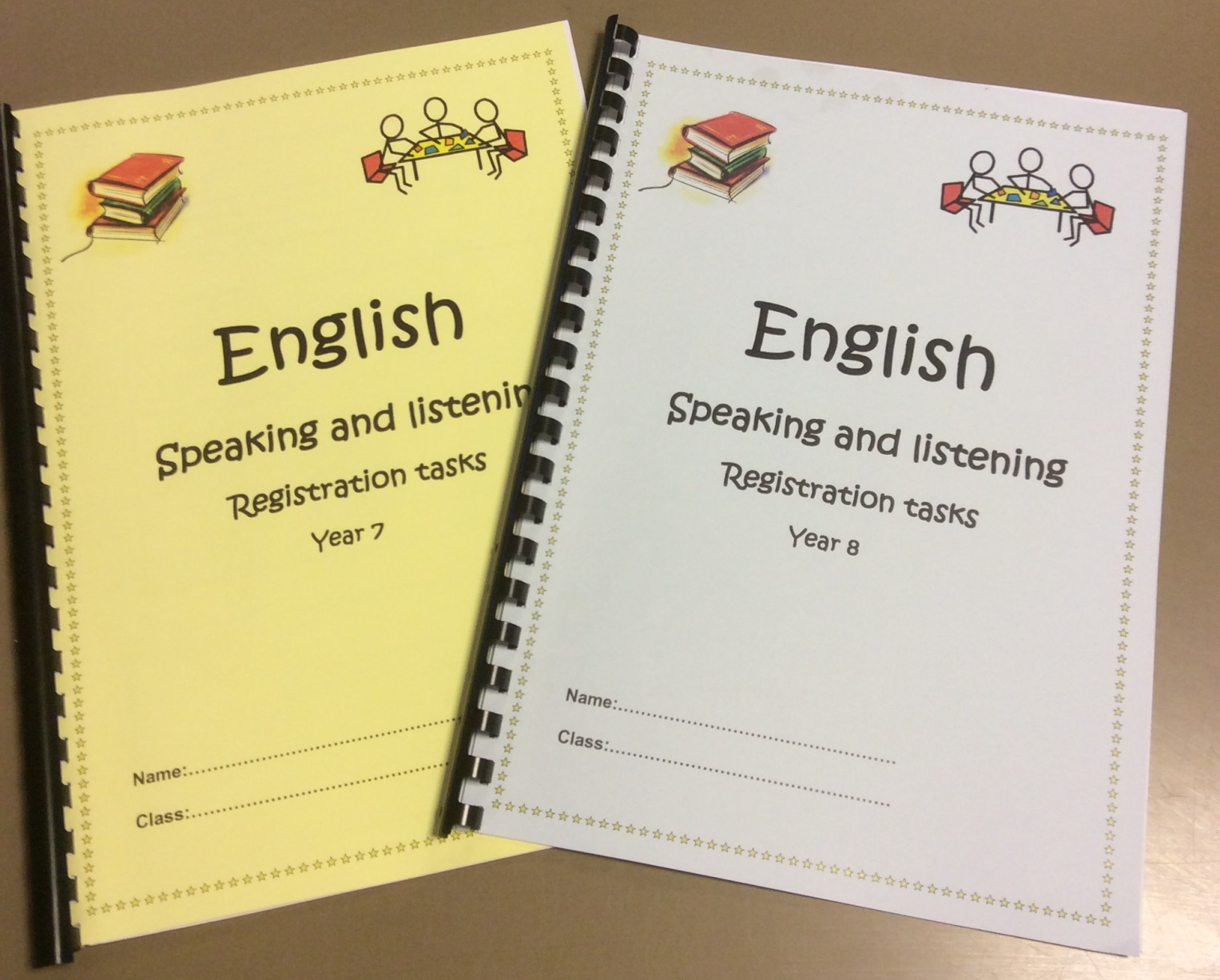

Slide 5
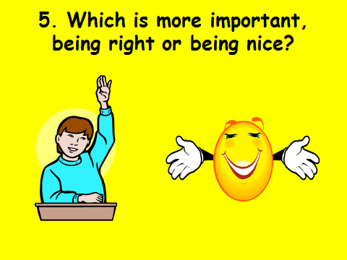

Slide 6
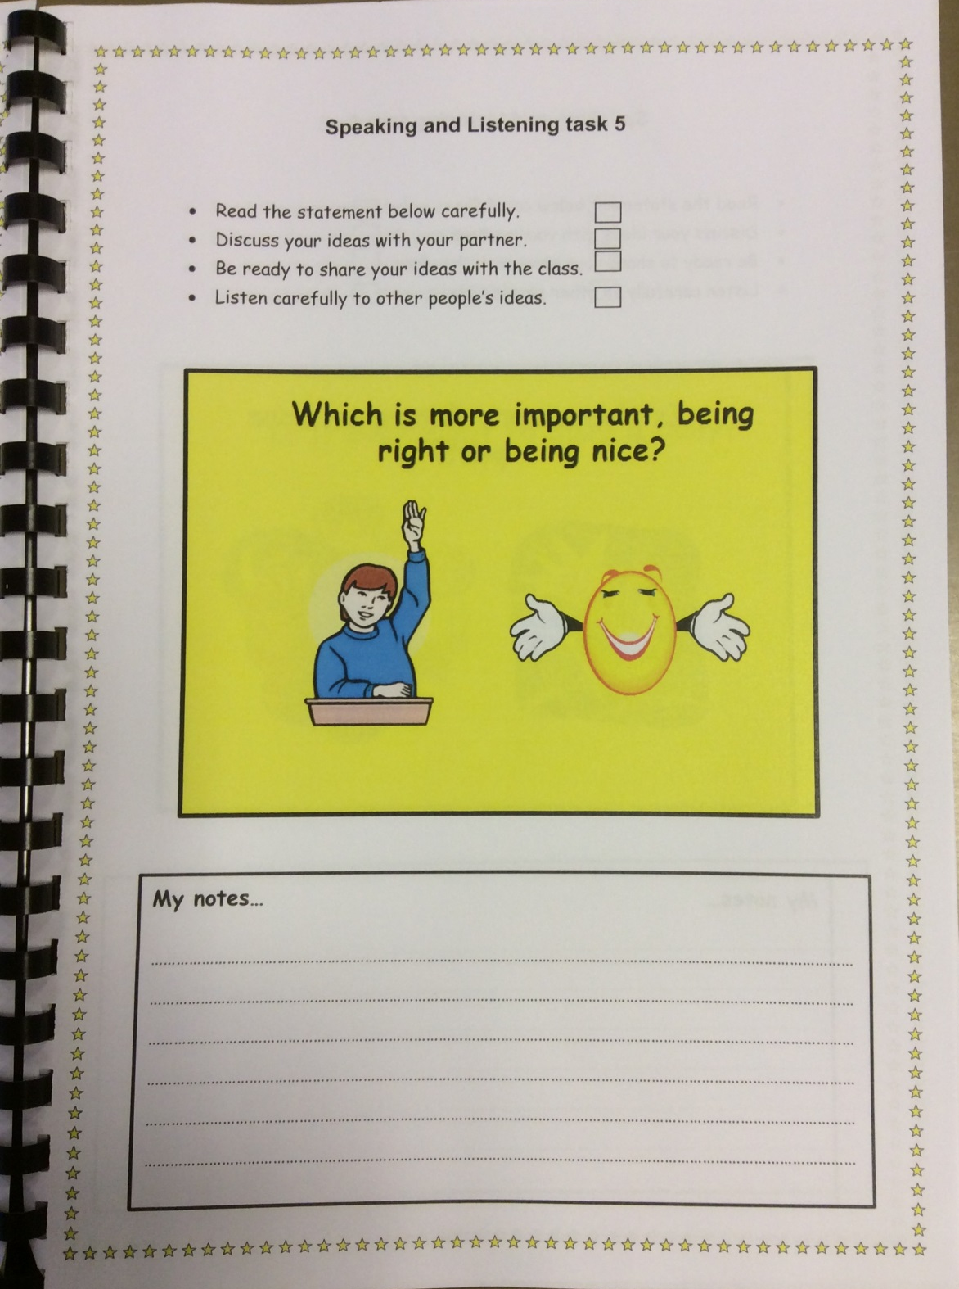

Slide 7
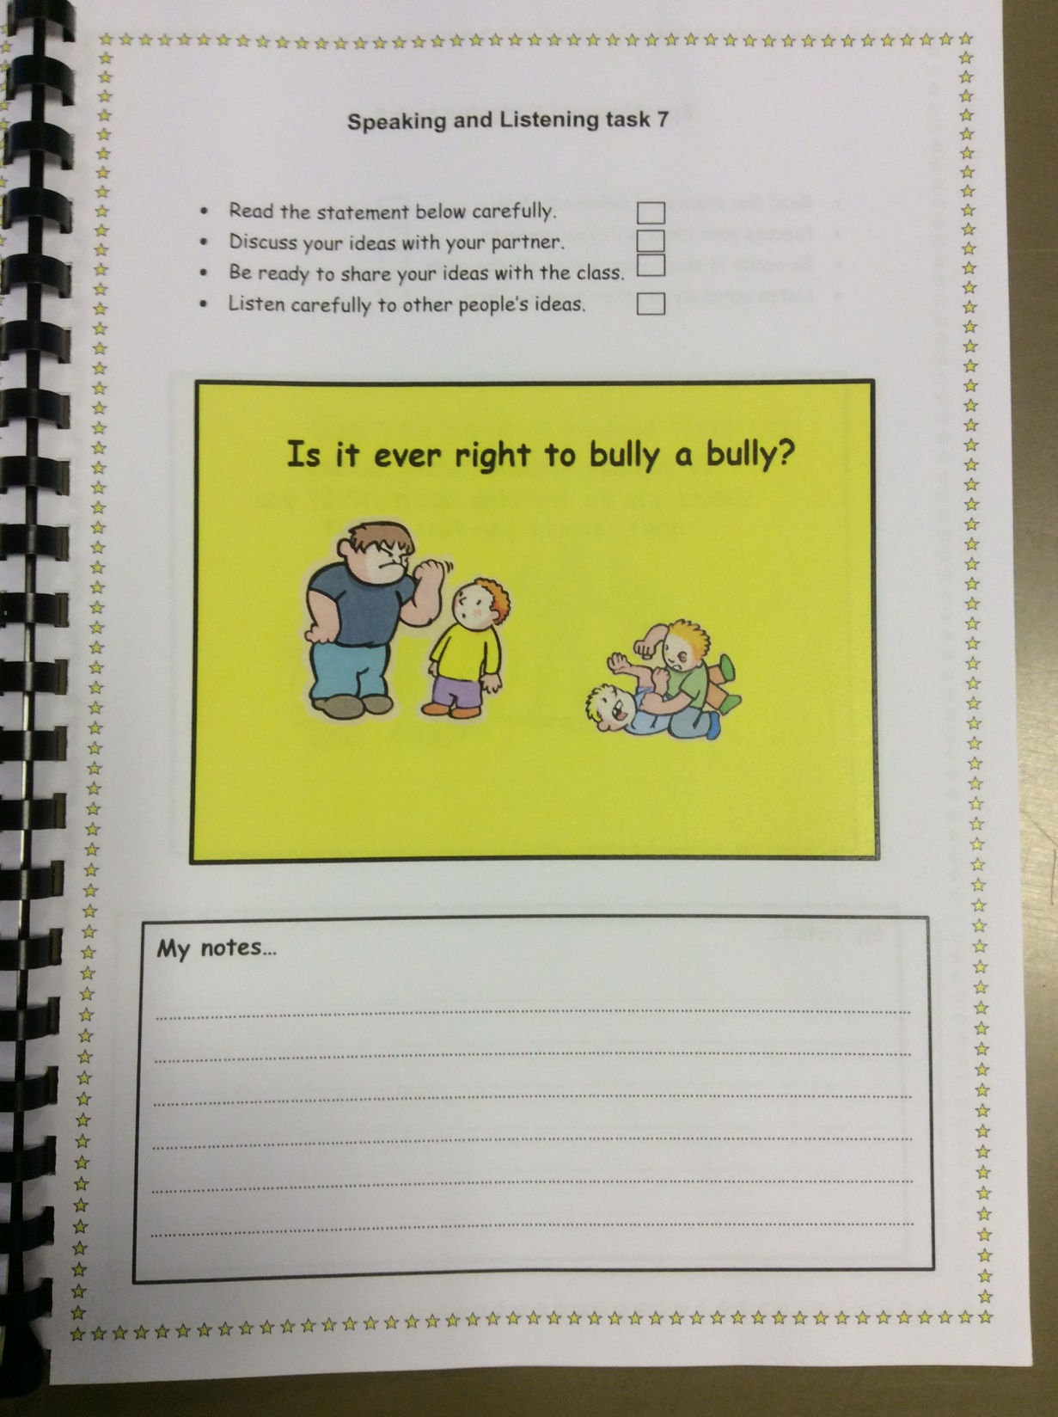

Slide 8
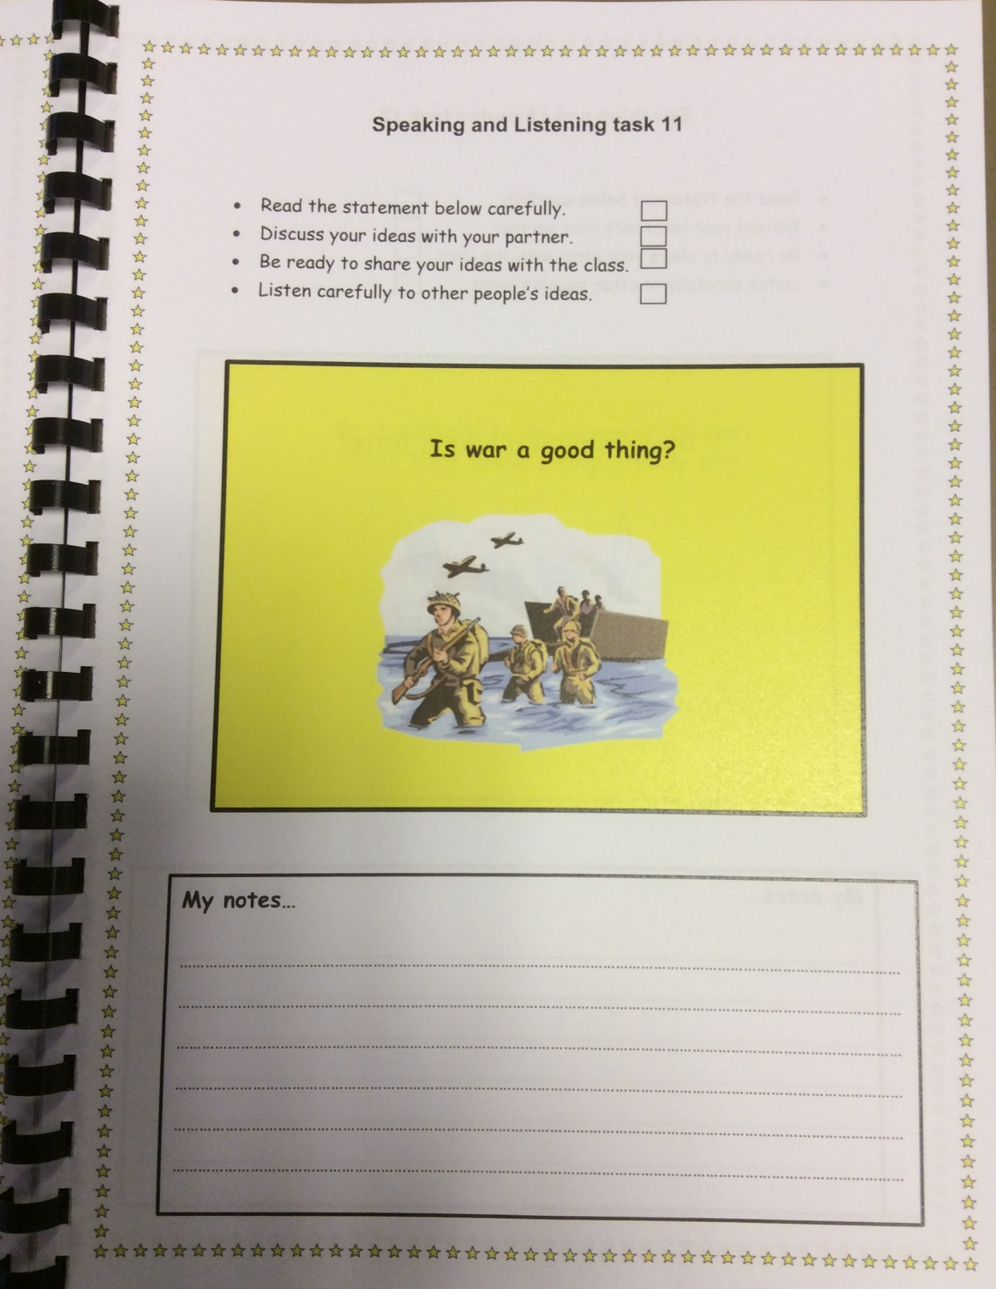

Slide 9
Talk the Talk Workshop
http://www.talkthetalkuk.org/

Slide 10
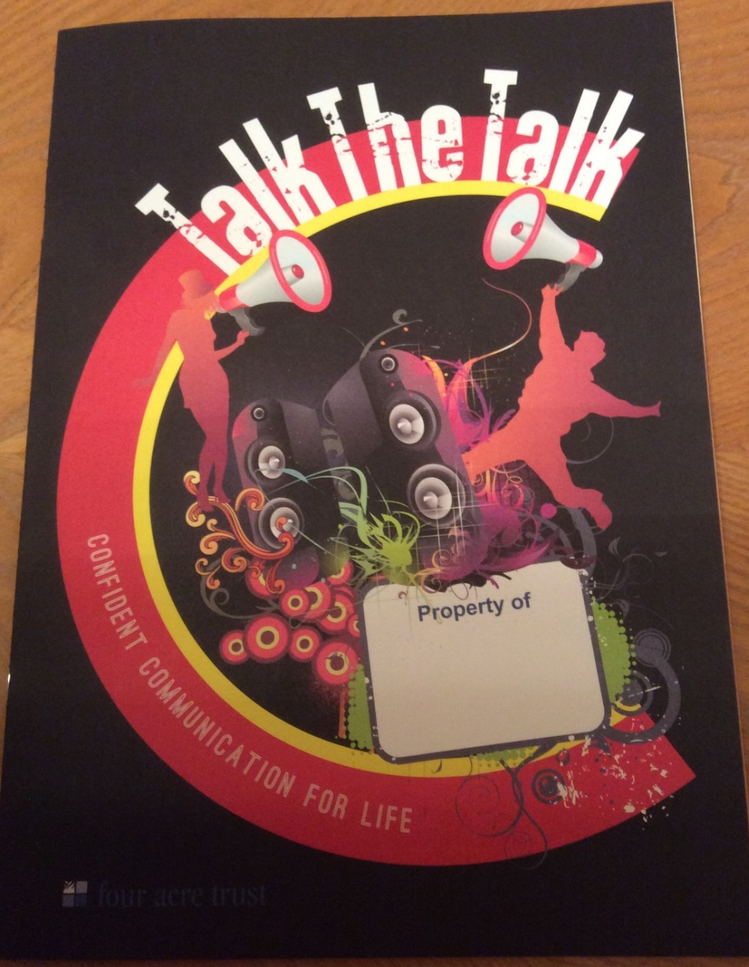

Slide 11
