Slide 1
Collaborative Institute for Education Research, Evidence and impact (CIEREI) Sefydliad Cydweithredol ar Gyfer Ymchwil, Tystiolaeth ac Ardrawiad Mewn Addysg February 2017

Slide 2
 | THE CIEREI VISION
COLLABORATIVE | To foster collaborative working drawing the perspective and knowledge of stakeholders and to bring together a group of researchers and practitioners with similar ambitious goals.
INSTITUTE | To bring together groups and centres & build Research and Practice networks.
EDUCATION | To improving the outcomes for pupils (standards and wellbeing) through educational settings
RESEARCH | To find out what works & why
EVIDENCE | To build local capacity to apply a greater range of evidence-based practices & support innovation and evaluation of practice.
IMPACT | To improve academic and wellbeing outcomes for children, teachers and parents, and the impact of schools.

Slide 3
Increasing basic numeracy fluency: SAFMEDS
Dr Stacey Hunter, BCBA
Dr Carl Hughes, BCBA-D
School of Psychology, Bangor University
Dr Richard Watkins
Regional School Effectiveness and Improvement
Service for North Wales (GwE)

Slide 4
Learning principles from Precision Teaching evidence
The learner knows best (the child is always right)
Monitoring learning often, helps learning happen
Making learning visible (charts) - helps learning happen
Immediate feedback helps learning happen
Mastery learning – prerequisite skills Fluency (national tests)- helps learning stick
Rhyl Learning Community: Identified the need to improve maths fluency
Notes:
The learner knows best, if the student is not progressing then the form of teaching is not appropriate for that particular individual.
Rate is used as a measure – number of responses per minute
Each timing is recorded and students scores are also charted
The timing element allows to assess not only acquisition but fluency
Providing immediate and corrective feedback has been shown to be vital in learning.

Slide 5
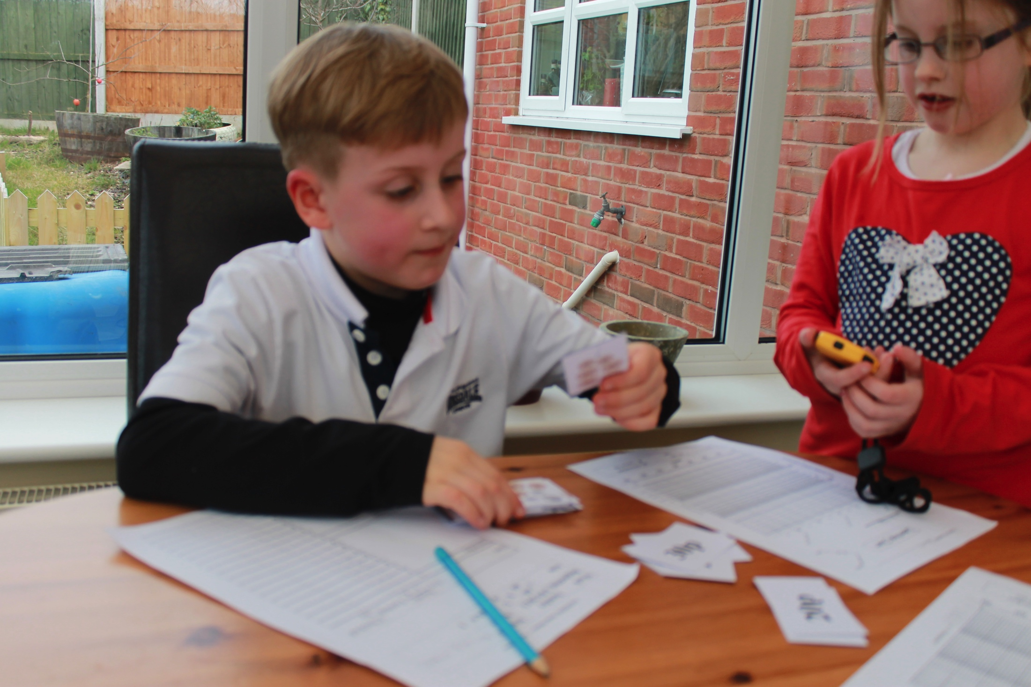
What is SAFMEDS?
Focused Flashcards: SAY ALL FAST MINUTE EVERY DAY SHUFFLED
Question (front) Answer (back)
FAST - One minute
Say aloud
Correct / not yet pile
Notes:
SAFMEDS – which stands for say all fast minute everyday shuffled are a set of flashcards which was developed by Graf and Lindsley are a practice and assessment procedure to help students learn key facts (Graf & Lindsley 2002). SAFMEDS have a question on the front of the card and the corresponding answer on the back, this provides the learner immediate feedback. SAFMEDS are usually timed in one minute time frames, this allows fluency to be measures, it also adds a game element for the learner. Learners record their scores on tables and SCC this allows the student and teacher to monitor daily learning and also provides a visual representation of their learning.

Slide 6
Myths about how we learn: What the evidence says Potts, Eshleman & Cooper, 1983
Myth | Fact
Thinking is good as saying | Saying aloud = better learning
Best to learn in parts | Working with all = better learning
Start slow and build up | Go fast = better learning
Try make few or no errors | High errors = better learning
Understand first then learn | Learn first leads to understanding later

Slide 7
Who does SAFMEDS work for?
Everyone
All ages
Different topics
Different groups – classwide / small groups / one to one
Peer tutoring

Slide 8
Research using SAFMEDS to increase numeracy skills
Tier 1 – Classwide use of SAFMEDS
Tier 2 – Small group use of SAFMEDS
Tier 3 - One-to-one use of SAFMEDS

Slide 9
Using SAFMEDS Class-Wide Increasing primary school students maths skills
Notes:
218 primary school students aged 6-11 took part in this research. The research was conducted in North wales. In Wales new maths test were introduced into the curriculum, the SAFMEDS were based on the new tests. All teachers and students were fully trained in the use of SAFMEDS prior to the intervention. All students completed a pre-test which was developed by the researcher which used the same questions as the SAFMEDS, students were given 10 minutes to complete the pre-test. Students worked in pairs completing the SAFMEDS, with one student taking the role as the timer and the other student completing the SAFMEDS. Students would look at the question and say the answer out loud, they would then turn the card over to see if they had answered correctly. If the student had answered correctly they would place the card in their correct pile, however if the student answered the question incorrectly they would then read the correct answer out loud and put the card in their not yet pile. After the one minute timing the student would stop and count both piles, the students would record their answers on their table and after completing all four one minute timings the student would then chart their best score.
After the 4 week intervention all students completed the post-test which was identical to the pre-test. Students also completed the same test one month and six months after the post-test.

Slide 10
Results – Year 2
A child
Sig. Change
Notes:
Classwide results – primary school

Slide 11
Results – Year 7

Slide 12
Rhyl Learning Community RLC Results so far…
Current project
10 schools
10 student per school
Up skilling TAs
Assessments
Observations / ongoing support

Slide 13
Year 7 – Addition with decimals

Slide 14
Year 2 - Addition

Slide 15
Interest in joining the SAFMEDS project?
Deliverables :
Training
Assessments
Resources
In-depth support for 10 students per school , Impact reports
Cluster Model: min. 20 schools
Year 2 focus on basic skills fluency
Costing model – 1 child’s PDG

Slide 16
Two Proposals for 2017-18
Large Scale SAFMEDS basic skills fluency evaluation
School cluster model – yr 2 basic skills focus
PDG / eFSM lower band on national tests
Training, support, amessments, materials,
Headsprout Early Reading: Trans-Regional implementation Primary Project (NorthWORTS-TRIPP)
Minimum 20 primary schools (hope for MANY more)
significant number of pupils score in the lower band of national reading tests and/or eFSM pupils are deemed to be struggling readers.

Slide 17
Interest in CIEREI / SAFMEDS projects Drichard Watkins (GwE): richardwatkins@gwegogledd.cymru Dr Stacey Hunter: stacey.hunter@bangor.ac.uk Dr Carl Hughes: c.hughes@bangor.ac.uk

