Slide 1

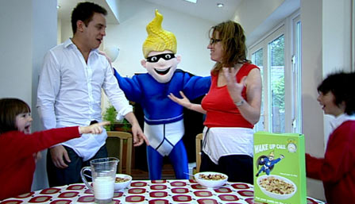
Enterprise and Employability Challenge

Slide 2
The Aim
Create branding and marketing for a new product by
  Creating a name
  Slogan
  Marketing

Slide 3
Your task will be..........
Create a name and slogan for the product
Create a character to represent the product
Create the packaging (Box, cover etc)
Marketing material
Presentation for prospective customers

Slide 4
You have 1 hour…….

