Slide 1
For goal setting to be effective, it’s important that you follow the SMART principle:
S – specific
M – measurable
A – agreed
R – realistic
T – time phased

Slide 2
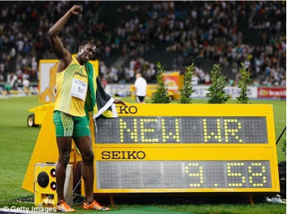
● SPECIFIC – Goals must be clear and specific. You therefore know exactly when you have achieved your goal.
● MEASURABLE – Goals need to be assessed and therefore they need to be measurable. The more specific they are the more measurable they are likely to be.

Slide 3
● AGREED - Goals that teachers / coaches and performers have talked about and shared are more likely to be achieved, because there is a common interest.
● REALISTIC – Goals must be within reach of the performer so that motivation remains high. But if they are too easy it can be de-motivating because the performer may not try as hard. They must be challenging but realistic.

Slide 4
● TIME PHASED – Goals should be split into short term goals leading to long term goals. You need to set yourself a date where you want to have achieved your goal so that you have a time frame to work towards. This ensures goals remain realistic and achievable.

Slide 5
Here is an example of an individual goal and objectives…
●My goal is to improve the standard of a year 7 pupil’s reading by holding morning reading sessions with the pupil for a whole term.
I will achieve this goal by:
Ensuring I am present and on time for each reading session.
Identifying the pupil’s common errors.
Choosing suitable books for the pupil to target these errors.
Here is an example of a group goal and objectives…
● Our goal is to send boxes with Christmas presents to children in Romania via ‘T4U’.
We will achieve this goal by:
Ensuring we work together effectively and complete our individual tasks.
Raising awareness within the school to ensure everyone knows why we are collecting the Christmas boxes.
Advertising and encouraging pupils to collect regularly in the weeks leading up to the date when we send the Christmas boxes.

Slide 6
My goal and objectives
• My goal is .........................
• I will achieve this goal by:
-
-
-

