Slide 1
Intensifying the curriculum
Leadership teaching and learning projects at Ysgol Bryn Deva

Slide 2
School Context
Ward where school situated WIMD 193 out of 1909 – 10%
FSM% - 37%/ 27%; EAL% - 23%
300+ children and 48 staff
CSI rising – quartile 4 for the past 2 years
FPI – quartile 3 past 2 years
FFT – rank 13

Slide 3
Curriculum Leadership Journey
Curriculum leaders in place – child-led and thematic curriculum
Support from GwE
Shared working with primary schools both in Connah’s Quay and further afield
George Telfer Leadership Experience/ Reflective Practice conference
Core Values
Series of projects aimed at intensifying curriculum experiences – led by staff at all levels
Approach to Estyn June 2016

Slide 4
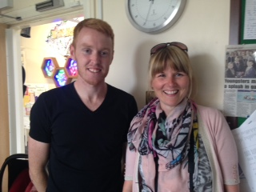
Touching the Sky
Project: Improving well-being and concentration 2015-2018
Identified issue: A majority of pupils in KS2 were overweight or unfit, a minority pupils in Y3 had entered KS2 with poor concentration a majority had below-average numeracy skills
Staff: Lucy Smith and Steve Thomas (teachers)
Impact: Fitness testing in May 2016 showed that a many pupils in KS2 have improved their fitness, Y3 had made the greatest improvements
Pupils in Y3 made strong improvements in their numeracy scores in May 2016

Slide 5
Playground Project
Project: Improving behaviour at lunchtime 2015-16
Identified issue: A minority of pupils were not enjoying purposeful play at lunchtimes, this was having a negative impact on their well-being and concentration, especially evident in Y5
Leaders: Dave Hall (teacher) and Shirley Davies (mid-day supervisor)
Impact: Very strong improvement in perceptions of playtime and purposeful play in Y5
Improved well-being in Y5 and improved concentration
Fewer incidents of fall-outs at lunchtimes
Improved mid-day well-being

Slide 6
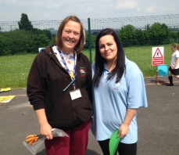
Foundation Phase Outdoor Play
Project: Improving outdoor provision in the Foundation Phase 2015-16
Identified issue from data/self-evaluation: Foundation Phase yard was empty of resources and rarely utilised for structured play
Leaders: Beth Jones and Stacey Cutler (teaching assistants)
Impact: Very strong impact upon pupil well-being, concentration, engagement and social and problem-solving skills

Slide 7
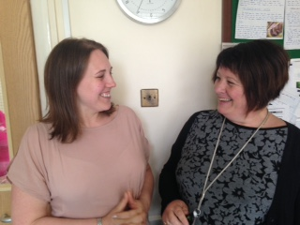
More able learners
Project: Improving level 5+ outcomes in KS2 2014-16
Identified issue: Only a few pupils at the end of KS2 were getting level 5+ in all assessed subjects
Leaders: Faye Sullivan (Y56 Curriculum leader) and April Hughes (Y56 teacher)
Impact: Strongly improved pupil outcomes in level 5+ across all subjects in 2015 and 2016
A few pupils attaining level 6+ in English or maths in 2015 and 2016

Slide 8
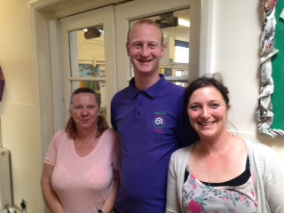
Families and Schools Together
Project: Improving family engagement 2015-16
Identified issue from data/ self-evaluation: A minority of pupils entering reception came from families who were unable to support their learning to some extent
Leaders: Kate Simpson, Antony Pitt and Cherie Stanley (teaching assistants)
Impact: Surveys showed very strong improvements in family functioning (such as child behaviour at home) and social support, and improved academic performance of pupils involved in FAST

Slide 9
Further projects
There are many, many more examples including:
Early entitlement
Forest School
Digital competence
Improving numeracy
Writing/ story-telling
SPAG
Guided reading
Nurture
Boys’ literacy in KS2
Notes:
Last 2 – one embedded one new

Slide 10
Leadership approach
©George Telfer

Slide 11
Clwb Seren Bach
Ysgol Bryn Deva`s Nurture Group
Notes:
quick overview of one such leadership project which both enhances and supports the curriculum

Slide 12
Responding to a need
Particularly challenging cohort
High percentage of pupils with SALT
Large class sizes
Very low Baseline
Predicted low FP outcomes
Response to immediate acute circumstances

Slide 13
Set up
Effective practice recognised by Estyn
Training and NGN
Staffing / responsibilities
Resourcing according to NGN guidelines
Sessions and protocol
Notes:
Gorse school Swansea, NGN trained provided us with the know how and principals to get started. 3 staff, NG manager responsible for planning and assessment, liaises with external agencies and NG panel meetings to decide the make u of the group. Member of SLT and

Slide 14
Assessment
Boxall Assessment as baseline, anonymous
Nurture panel meeting to determine the mix
Termly assessments by class teachers
Tracker
Notes:
Assessed by class teacher important that the same person reassesses
Introvert and extovert
Impact

Slide 15
Nurture Tracker
Raw scores are taken from the termly Boxall assessments
Dips in performance can occur, 4 terms max
 | 45 59 5055 57 | +12 | 24 46 43 41 42 | +18 | 18 8 8 5 8 | +10 | 17 6 3 6 15 | +2 | 50 35 19 25 47 | +3
 | 41 32 34 34 37 | -4 | 29 21 29 30 37 | +8 | 18 18 13 14 14 | +4 | 25 26 18 21 23 | +2 | 59 56 46 47 48 | +1
 | 56 71 | +15 | 58 58 | 0 | 11 4 | +7 | 4 7 | -3 | 7 7 | 0
 | 61 63 61 | 0 | 51 52 56 | +4 | 5 5 4 | +1 | 6 6 3 | +3 | 21 10 10 | +11
Start Date Jan 16
 | 51 61 61 | +10 | 40 52 42 | +2 | 11 18 20 | -9 | 18 16 16 | +2 | 32 28 44 | -10
 | 35 30 50 63 | +28 | 27 22 35 37 | +10 | 14 17 12 9 | +5 | 28 22 18 11 | +17 | 46 55 42 35 | +11

Slide 16
Impact
Boxall tracker, term on term
Anecdotal evidence class teachers
Parental questionnaires
AM session 57% FSM
9/21current or past pupils achieved FPI (given v low on entry)
4 achieved higher OC 6
Attendance of those who have or are accessing NG is higher then school average

Slide 17
What Estyn said!
“Provision in the recently established
Foundation Phase Nurture Group
is particularly effective in ensuring targeted
pupils are engaged in their learning” Estyn March 13
More recently ….
“Provision in the Clwb Seren Bach is highly effective in ensuring that pupils with
emotional and behavioural needs make very good progress.” Estyn 16

Slide 18
A creative approach to improving boys’ literacy
Lead Creative Schools application
River Dee focus for Y56
Identified issue in attainment between boys and girls
Movie of our ship-building project and launch of the Bryn Deva ship in April 2016

Slide 19
You’re very welcome to visit
Children’s books
Estyn Thematic Review
Next steps
Ysgol Bryn Deva, Linden Avenue, Connah’s Quay
01244 830080
EvansH345@hwbmail.net Helen Evans
bdhead@hwbcymru.net Tamasine Croston

