Slide 1
Using Teaching Assistants to improve the Quality of Learning and Teaching in Ysgol Emrys ap Iwan.

Slide 2
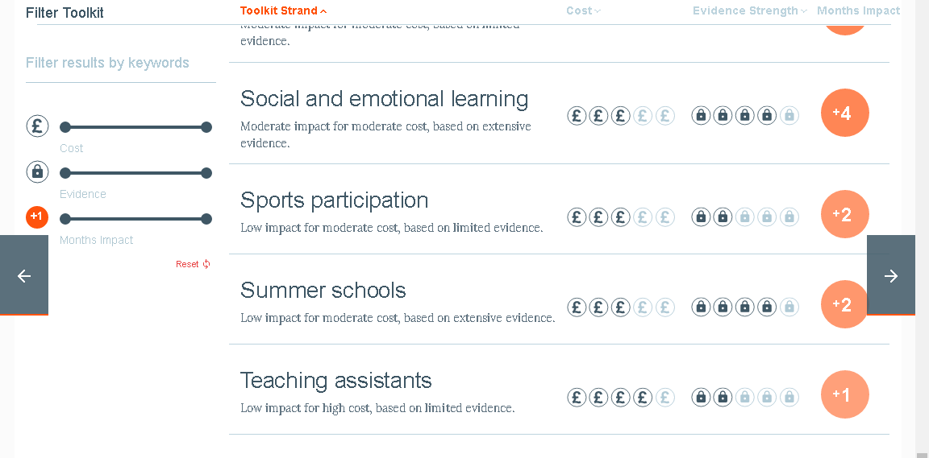
The starting point…
Teaching and learning in the school was deemed to be adequate in October 2013.
New Headteacher was appointed in January 2014.

Slide 3
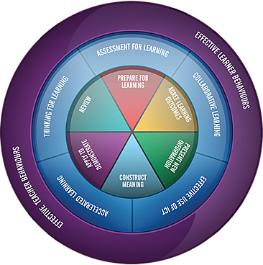
Whole School Learning and Teaching Policy

Slide 4

The Outstanding Teaching Assistant Programme (OTAP)

Slide 5
The Outstanding Teaching Assistant Programme (OTAP)
One of the OLEVI suite of programmes which have gained a National reputation for raising standards in teaching and learning.
Has been designed by experienced school leaders and teachers.
Facilitated via 2 OLEVI facilitators from a Teaching School in the West Midlands
Designed for Teaching Assistants who would like to develop their potential to have a wider impact on improving the quality of Teaching and Learning across school.

Slide 6
Programme objectives
To enable Teaching Assistants to:
Be more confident and have raised self esteem
Place a greater emphasis on the purpose and value of the lessons they support
Raise levels of engagement and achievement in learning
Have a greater impact on the planning and assessment of their learners
Demonstrate a higher level of understanding of teaching and learning

Slide 7
The OTAP content includes:
Understanding what an outstanding teaching assistant looks like?
Key definitions and audits of strengths and areas for development
New learning on differentiation
What is effective questioning?
Understanding the purpose and need for effective feedback
Creating, leading and presenting on an in school project
Action planning and evaluating (including lessons).

Slide 8
Facilitation…
The programme is facilitated and is designed to enable delegates to share ideas and strategies to help them move themselves and their schools forward.
The programme aims to empower delegates to take the lead in their role as a “learning assistant”.

Slide 9
For further information please contact Nikki Meredith at:
nmeredith@earls.dudley.sch.uk

Slide 10
What is the impact so far?

