Slide 1


Dysgu AC ADDYSGU – GWTHIO’R FFINIAU
16.02.2017

Slide 2
“Rhowch bysgodyn i ddyn ac fe fwydwch ef am ddiwrnod,
Addysgwch ef sut i bysgota ac fe fwydwch ef am weddill ei oes.”
“Give a man a fish and you feed him for a day,
Teach a man to fish and you feed him for a lifetime”
Lao Tzu

Slide 3
Notes:
Fideo ‘Stuck on an escalator’

Slide 4
Nid pa mor glyfar ydych chi sy’n penderfynu pa mor effeithiol ydych chi fel dysgwr.
Intelligence does not determine how effective you are as a learner.
“High achievers are not necessarily good real-life learners” Carol Dweck

Slide 5
Pam adeiladu’r gallu i ddysgu?
Why build Learning Power?
“It is about the whole person: their attitudes, values, self-image and relationships, as well as their skills and strategies. Being a good real-life learner means knowing what is worth learning; what you are good at (and not so good) at learning; who can help; how to face confusion without getting upset; and what the best learning tool is for the job at hand”
Guy Claxton Building Learning Power Tud 15

Slide 6
Dysgu mwy
Learn More
Gwell canlyniadau
Addysgu effeithiol
Torri cynnwys yn adrannau
Gwersi ychwanegol
Dysgu’n well
Learn Better
Datblygu sgiliau astudio
Cyflwyno dulliau cofio/adolygu
Addysgu effeithiol
Hinsawdd gadarnhaol ar gyfer dysgu
Datblygu gwell dysgwyr
Better Learner
Tu hwnt i roi canllawiau i ddatblygu sgiliau astudio
Dysgwyr yn datblygu eu hunain fel gwell dysgwyr
Datblygu aniannau /tueddiadau
Datblygol
Notes:
dy

Slide 7
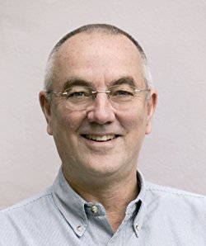
Gwella’r GALLu I ddysgu
Building Learning Power
Dyddiad / Date
2014-15 | Adnabod gwaith Guy Claxton
 | Ymchwil i hwyluso gwaith Cymunedau Dysgu Ysgol Glan Clwyd
2015-16 | Adnabod 12 aelod o staff i’w hyfforddi Hyfforddiant Hydref 2015 a Mehefin 2016 Ymchwil Gweithredol
 | Adolygiad o ddysgu
 | Athrawon Criw 1 yn arwain Cymunedau Dysgu
2016-17 | Creu CPA+
 | Creu Pencampwyr Pynciol
 | Adnabod 18 aelod o staff ar gyfer ail grwp hyfforddi Hyfforddiant Ionawr 2017 a Mehefin 2017 Ymchwil Gweithredol

Slide 8
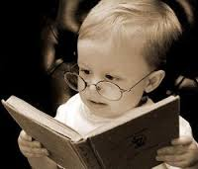
Aniannau Dysgu / Learning Dispositions
Ymrwymo’n emosiynol
Anian Gwydn (Resilient)
Mae dysgwyr llwyddiannus yn:
Effective Learners are:
Defnyddio amrywiaeth o strategaethau dysgu
Anian Dyfeisgar (Resourceful)
Ymrwymo’n gymdeithasol
Anian Cytbwysol (Reciprocal)
Cymryd cyfrifoldeb strategol
Anian Myfyriol (Reflective)

Slide 9
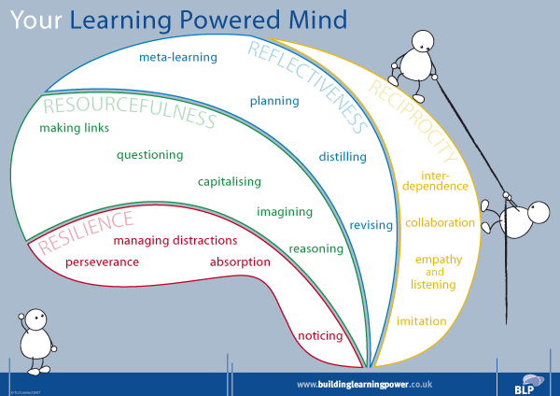
Trefnu’r aniannau / the Dispositions
Copyright TLO Limited 2014 | FCD1-Pri
9

Slide 10
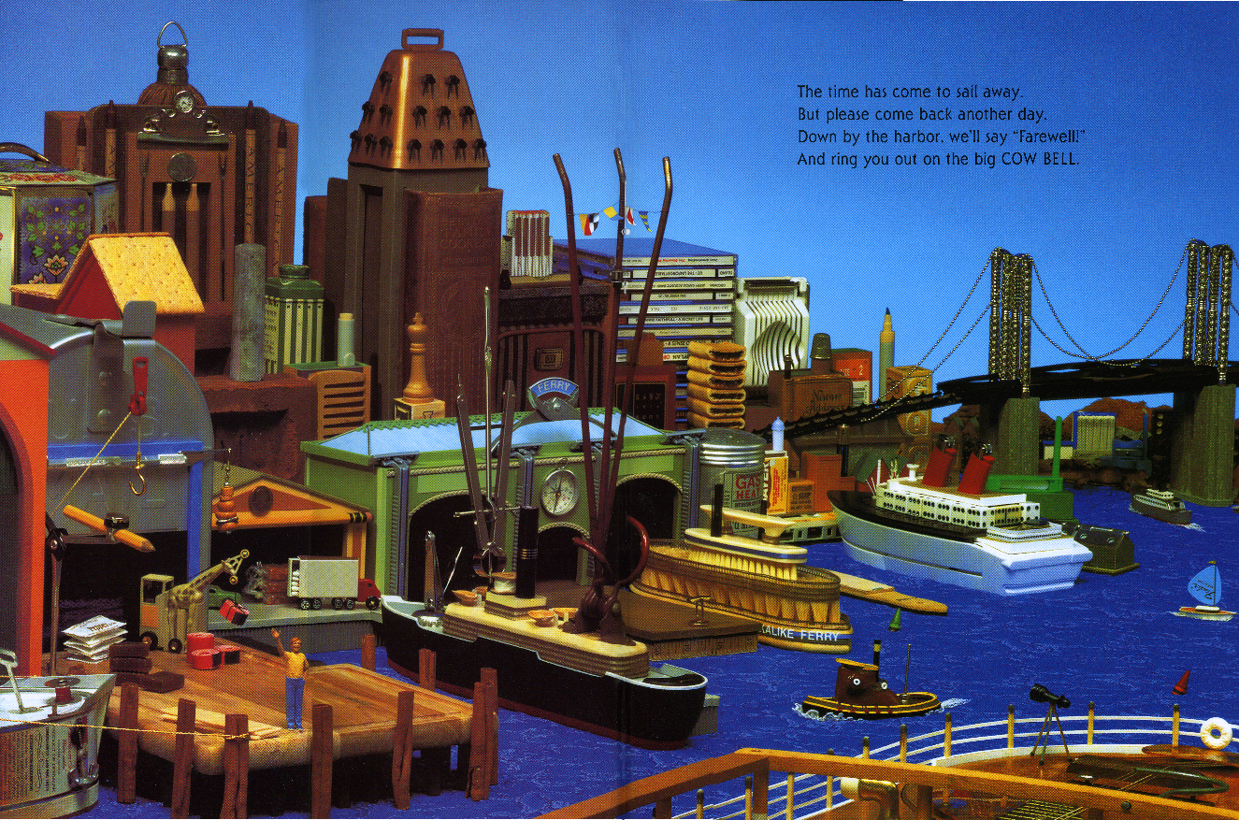
Day 3
Edrychwch yn ofalus ar y llun.
Beth ydych chi yn sylwi?
(3 munud)
Look carefully at the picture. What do you notice?
(3 minutes)

Slide 11
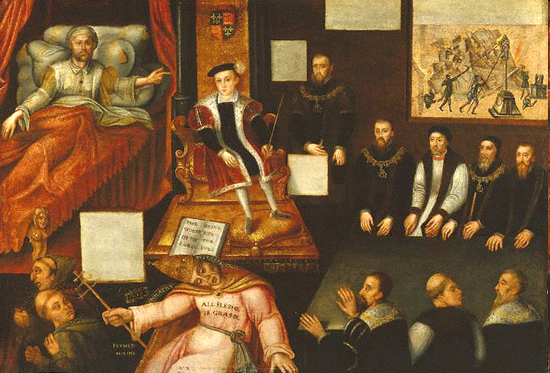

Slide 12
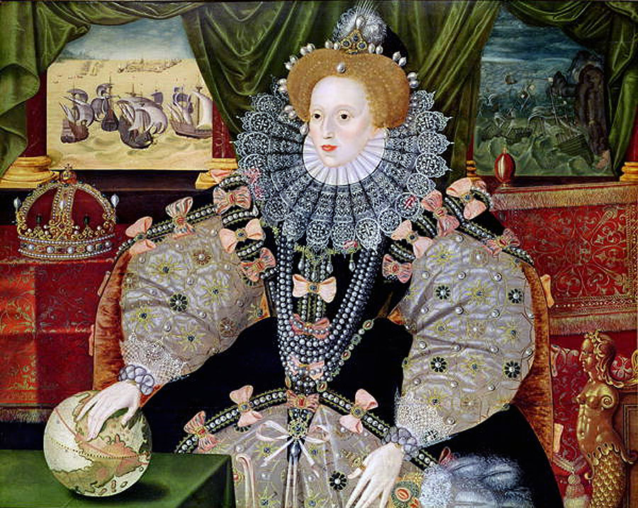
Notes:
B

Slide 13
IMPACT

Slide 14
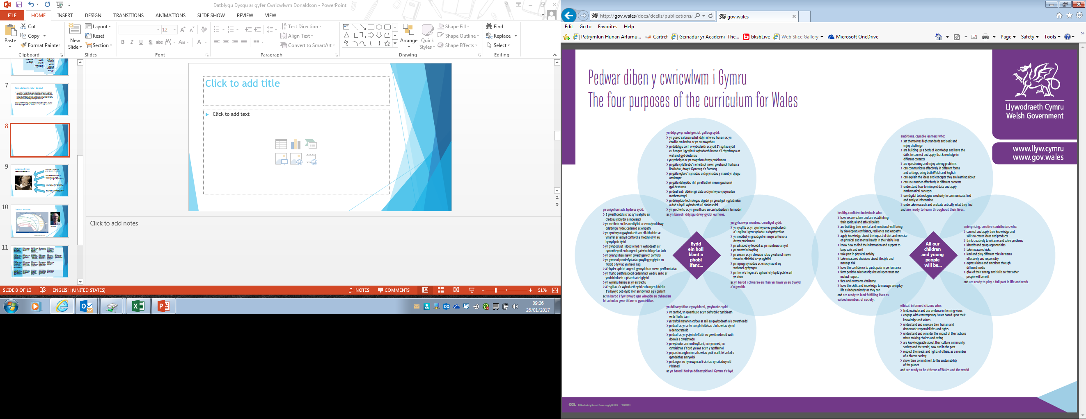
Cysylltu Creadigol Adnabod cyfleoedd Gwybodus
Cymhwyso Dadansoddi Mentro Parchu eraill
Ymholgar Ymchwilio Arwain
Datrys Problemau Gwerthuso Cydweithio
Cyfathrebu Beirniadol Gwerthuso
Egluro Hyder Llunio barn
Dehongli Penderfynu Ystyried achos ac effaith

Slide 15
Connect Creative Recognise opportunities
Apply Analyse Enterprising Respect Others
Investigate Research Leadership
Solve Problems Evaluate Collaboration
Communication Knowledgable Evaluation
Explain Confidence Forming opinions
Interpret Decide Consider cause and effect

