Slide 1
Lesson 1- Research methods

Slide 2
Planned outcomes from todays lesson
Define Primary and Secondary research.
Consider the advantages and disadvantages of each research method.
Discuss the impact of the advantages and disadvantages of each research method.
Define Qualitative Data and Quantitative Data.
Consider the advantages and disadvantages of each data type.
Discuss the impact of the advantages and disadvantages of each data type.

Slide 3
Primary research
Primary research is…..
Use the terms below to write a definition of primary research from what you already know.
Data
New
Notes:
Students to use the term on the right side to write their own definition of primary research as a class

Slide 4
Secondary research
Secondary research is…..
Use the terms below to write a definition of secondary research from what you already know.
Data
Existing
Notes:
Students to use the terms on the right side to write their own definition of secondary research as a class

Slide 5
Primary and Secondary research
Primary Research
Secondary Research
New and original research that has been carried out to address a specific question or issue.
Existing information and data that is collated or synthesises relating to a specific question or issue.

Slide 6
Card sort- Primary and secondary research

Slide 7
Card sort-Impacts of primary and secondary research.

Slide 8
Forms of data
There are two forms of data- Qualitative Data and Quantitative Data.
Watch the clip and write a definition for Quantitative Data.
Qualitative Data is the opposite of Quantitative Data- as a class come up with a definition for Qualitative Data.
Notes:
Link below explains quantitative data:
http://study.com/academy/lesson/what-is-quantitative-data.html

Slide 9
Advantages and disadvantages of data types.
Use the cards to decided the advantages and disadvantages of each data type.
Pair up with another member of the group- compare your answers.
As a class you will share this information.

Slide 10
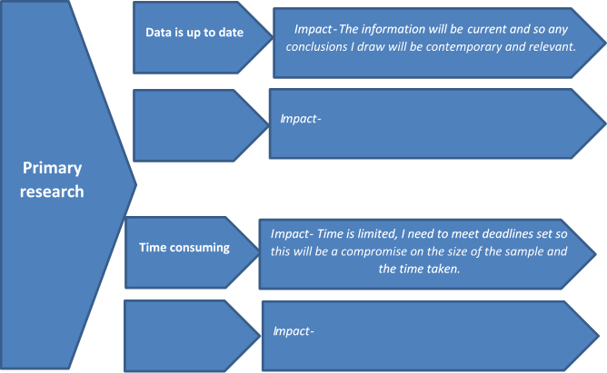
What are the impacts?
Notes:
Knowing the advantages and disadvantages of different types of research and data is important but understanding the impacts that they have on the research and data is more significant and will help students account for them.

Slide 11

Progress Check
Thumbs up for true down for false
Primary research is the most likely to be up to date.
Qualitative data can be difficult to generalise.
Secondary research is only research from the internet.
Primary research always includes small samples
Notes:
1- True- however some secondary research can still be current- it just needs to be checked.
2- Yes- small sample and information is individual specific.
3- No secondary research can be any existing information such as books or journals.
4- No some primary research can be on a large scale but this is off set by the time needed to complete it.

Slide 12
Progress check
What am I?
  I took a lot of time to gather and even more to analyse, the information gathered is hard to apply to the larger population but I am rich in detail and can ensure that all options are considered.
  I am sometimes called field research and I am always up to date, the problem is I take a lot of time .
Notes:
1- Qualitative data
2- Primary research

Slide 13


Just for fun….
Re +
AKA
Notes:
Also Known As Desk Research= Secondary research

