Slide 1
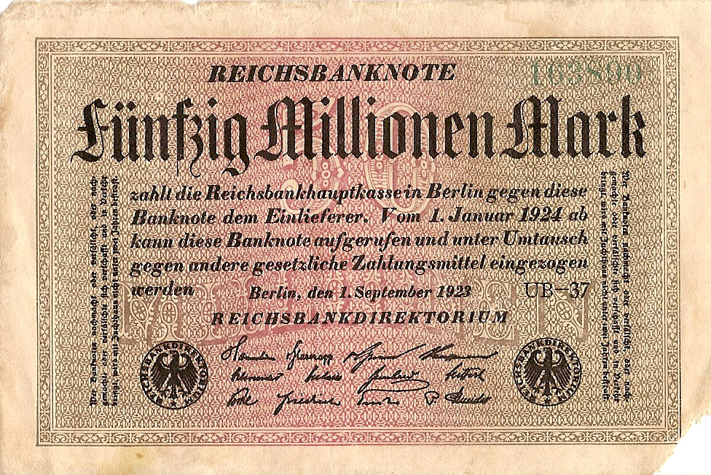
Recovery of the Weimar
Recovery from Hyperinflation

Slide 2
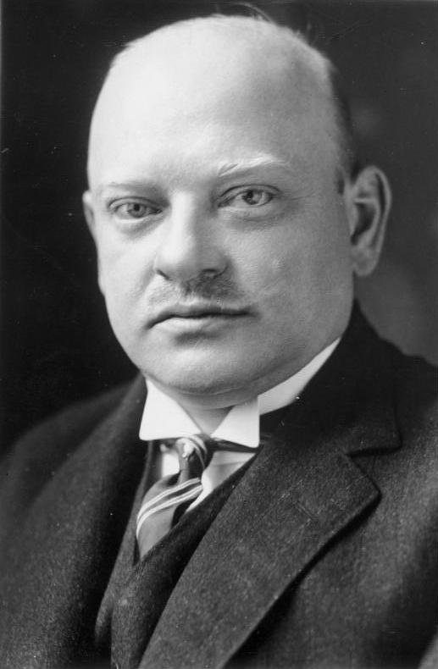
Learning Outcomes
To investigate how the Weimar economy recovered following the hyperinflation of 1923
To consider the role of Gustav Stresemann

Slide 3
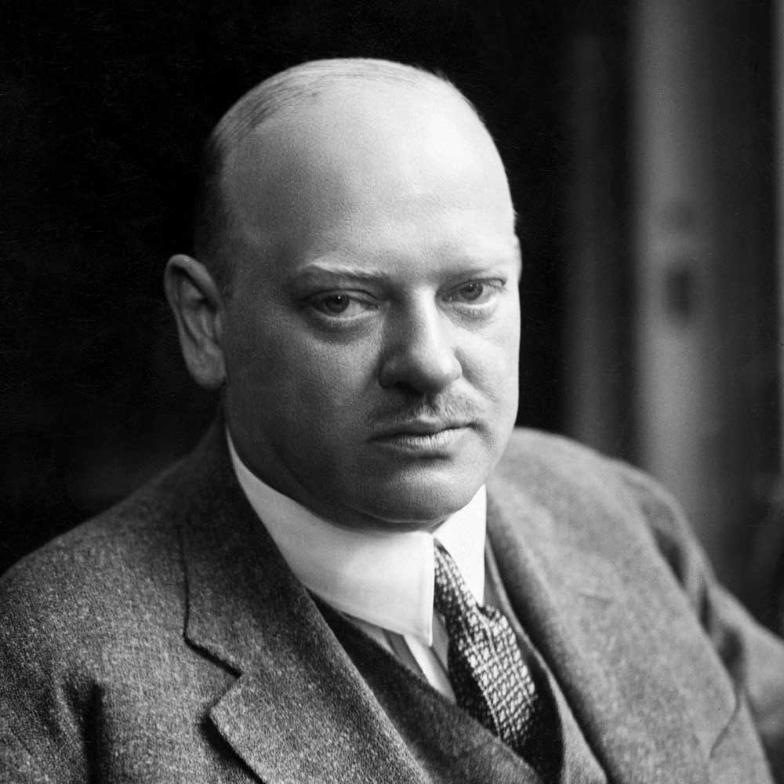
Gustav Stresemann 1878 – 1929
Gustav Stresemann was born in Berlin on 1878
He became a Reichstag deputy in 1906
He was appointed leader of the National Liberal Party in 1917
Appointed foreign secretary in 1923 until his death in 1929. Served as Chancellor from August to November 1923 during the invasion of the Ruhr
Died in October 1929, just before the Wall street crash and robbing, in many peoples opinion, Germanys last hope of maintaining democracy.

Slide 4
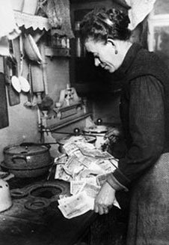
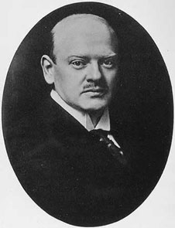
Hyperinflation proved to many that the old mark was of no use. Germany needed a new currency.
In September 1923, Germany had a new chancellor, Gustav Stresemann

Slide 5
Gustav Stresemann had been a nationalist, but he realised that something needed to be done to save Germany.
The most important thing he did in 1923 was to organise the Great Coalition of moderate, pro-democracy parties in the Reichstag. At last, Germany had a government that could make laws!

Slide 6
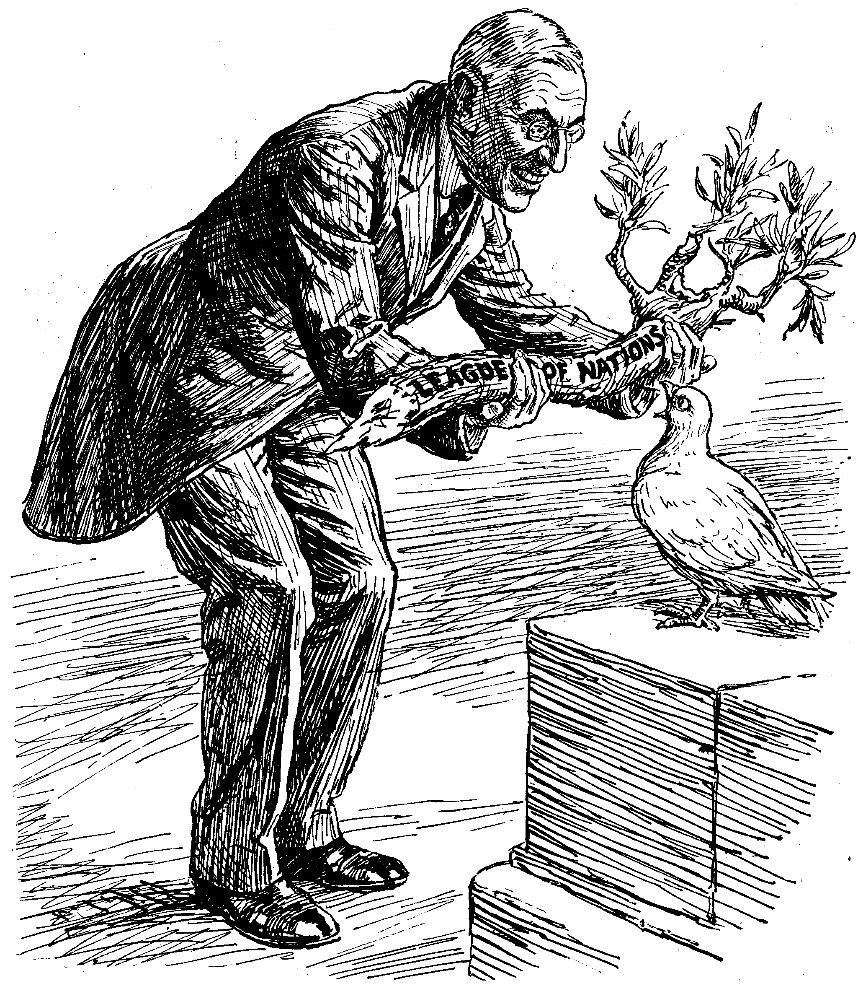
Under Stresemann's guidance, the government called off the strike, persuaded the French to leave the Ruhr and even got the rest of the world to allow Germany to join the League of Nations in 1926.

Slide 7
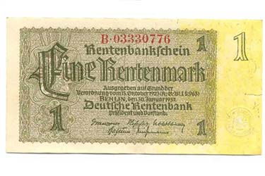
He knew that this was the only common sense approach to a crisis.
The mark was replaced with the new Rentenmark. This was issued in limited amounts and gradually restored confidence in the German currency.
In the following year the Rentenmark was converted into Reichsmark, a new currency backed by god reserves

Slide 8
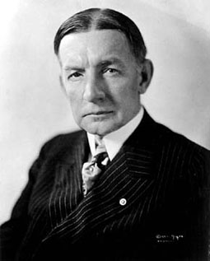
The Dawes Plan
Stresemann realised that Germany could not afford the reparations payments and persuaded the French, British and Americans to change the payment terms through Dawes Plan ,which was agreed in august 1924.
It was named after the US vice-president Charles Dawes, who played a leading role in setting up the plan.

Slide 9
The Dawes Plan - Terms
Reparations payments would begin at 1 billion marks for the first year and would increase over a period of four years to 2.5 billion marks per year.
These payments were far more sensible and manageable and were based on Germanys capacity to pay.

Slide 10
The Dawes Plan - Terms
The Ruhr area would be evacuated by Allied occupation troops. This was carried out in 1925
The German Reichsbank would be reorganised under allied supervision
The USA gave loans to Germany to help its economic recovery starting with a loan of 800 million marks.
Over the next six years US companies and banks gave loans of nearly 3,000 million dollars.

Slide 11
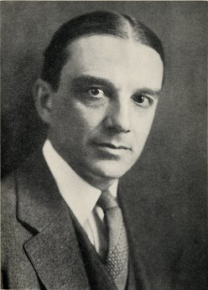
The Young Plan
Despite the Dawes Plan Germany still found it difficult to pay
In 1929 the Allied Reparations committee asked an American banker, Owen Young, to investigate and he came up with a new plan for payments

Slide 12
The Young Plan
The reparations figure was reduced form £6,600 million to £1,850 million.
The length of time Germany had to pay was extended to 59 years with payments at an average 2.05 billion marks per year.

Slide 13
How successful was the recovery?
Arguments to suggest that the Weimar had recovered
The economy improved due to the loans from America
Public works provided new stadiums, apartment blocks and opera housed
Big businesses had been able to pay off its debts due to hyperinflation and benefitted from a period of industrial growth

Slide 14
How successful was the recovery?
Arguments to suggest that the Weimar had recovered
Many workers were better off during this period as wages increased
There were better relations with workers and employers, there were fewer strikes between 1924-29

Slide 15
How successful was the recovery?
Arguments to suggest that the Weimar had NOT recovered
Germany was over dependent on US loans
Farmers in Germany were experiencing problems throughout the 1920s and particularly after 1927
The economic recovery did not affect everyone equally. The middle class never fully recovered from the hyperinfaltion

Slide 16
