Slide 1
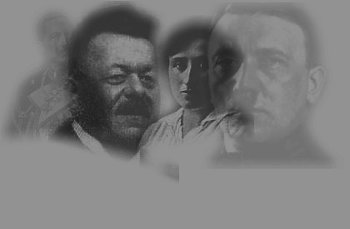
Impact of the
First
World War
WEAKNESSES OF THE WEIMAR REPUBLIC

Slide 2

Learning Outcomes
To understand what the Weimar Republic was and why it was created
To understand why the Weimar government was weak

Slide 3
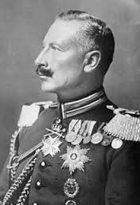
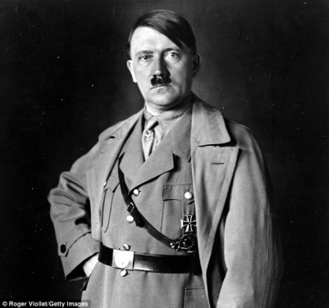
The Weimar Republic was set up in Germany after the Kaiser had been overthrown in 1918.
At the time, it was the most democratic government in the world – even women could vote.
However, only 15 years later it had collapsed into ruins, allowing Adolf Hitler to turn the country into one of the most brutal dictatorships the world has ever known.

Slide 4
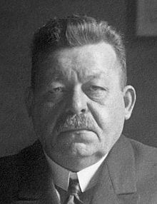
Problems of the Weimar
The Kaiser abdicated on the 9th November 1918
A new German Republic was
declared with Friedrich Ebert a
Chancellor
On 11th November the new politicians of the German Republic signed an armistice

Slide 5
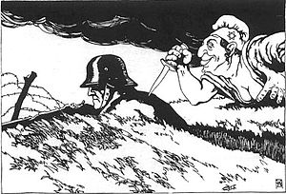
Problems of the Weimar
Many Germans believed that the army had not been defeated by the allies but had been ‘stabbed in the back’ by the politicians who had signed the armistice (the November Criminals)

Slide 6
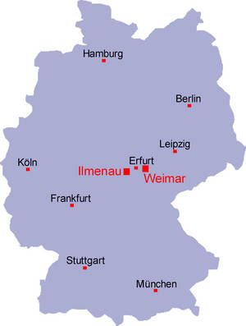
Elections for a Constituent Assembly were held on 19th January 1919
The first German Government
met in Weimar
(hence the name) in January
1919 as Berlin
was too dangerous due
to attacks from the left and
the right.
It immediately faced problems:

Slide 7
The Weimar Constitution
Following the abdication of the Kaiser, a new
constitution had to be drawn up . This was finalised in August 1919. This was the first time Germany had experienced a democracy.
President
Elected every seven years
Article 48
President could suspend the Constitution in an emergency. He could make laws and keep the Chancellor in office without the support of the Reichstag
Reichstag
421 member (1919)
647 member (1933)
Elected every 4 years
Chancellor
Chosen by the President. Had to have support of a majority in the Reichstag

Slide 8
Political problems: the constitution
One major problem for the Weimar Republic was that its constitution had two serious flaws.
Proportional representation (PR). All votes were counted up centrally to divide seats fairly between parties.
The number of seats a political party got depended on the percentage of the vote
E.g.
If the Centre Party got 25% of the votes and there were 100 seats they would have 25 seats.

Slide 9
Political problems: the constitution
Article 48. This was a clause that gave the president of the Weimar Republic the right to dismiss parliament and rule by himself if he decided there was a ‘state of emergency’.

Slide 10
 | Strengths | Weaknesses
Proportional Representation
Article 48
Voting system based on fairness
Decisions could be made quickly in an emergency
It could be misused to form a dictatorship and become non-democratic
Made it easier for small parties to be formed
Made it difficult for one party to win a majority and form a government
Led to weak coalition governments

Slide 11
Proportional Representation and Article 48
Proportional representation made it difficult for one party to get a majority. Weimar governments were usually weak coalitions of parties who had different ideas about how the country should be run.
Between 1919 and 1932 Germany had 21 different governments.
It was difficult to pass laws in the Reichstag because the government was so weak. The president increasingly used his powers to pass legislation.
In 1930, three times as many laws were passed by the president as were passed by the Reichstag

Slide 12
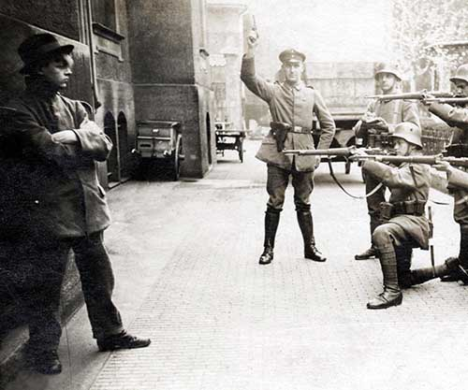
Political problems: revolts and rebellions
The first five years of the republic saw riots, strikes, shootings and attempts to overthrow Ebert’s coalition government. Two of the most important opposition groups were the Communists and the Friekorp.

Slide 13

Political problems: revolts and rebellions
Communists felt that Ebert and the socialists had failed to complete the revolution because they had not abolished private property.

Slide 14
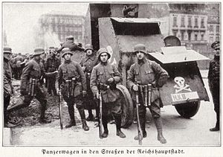
Political problems: revolts and rebellions
The Freikorps (private armies) felt that Ebert and the socialists had ‘stabbed Germany in the back’ by signing the Treaty of Versailles.

Slide 15
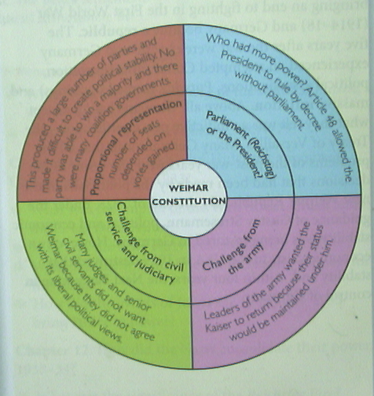
Exam question 1
[A diagram from a GCSE textbook illustrating the flaws of the Weimar Constitution]
Use Source A and your own knowledge to describe the weaknesses of the Weimar Constitution. [6]

