Slide 1
ENTERPRISE & EMPLOYABILITY CHALLENGE
ASSESSMENT TASKS:
SKILLS AUDIT
PROPOSAL & PITCH
CAREER PASSPORT
PERSONAL REFLECTION

Slide 2
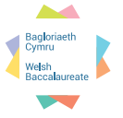

Essential and Employability Skills
These are skills that employers and next stage educators value and which you as learners need for learning, work and life.
Literacy
Numeracy | P
Digital Literacy | P
Critical thinking and problem solving
Planning and organisation
Creativity and innovation | P
Personal effectiveness | P
During this lesson you will be developing the skill of Planning and Organisation

Slide 3
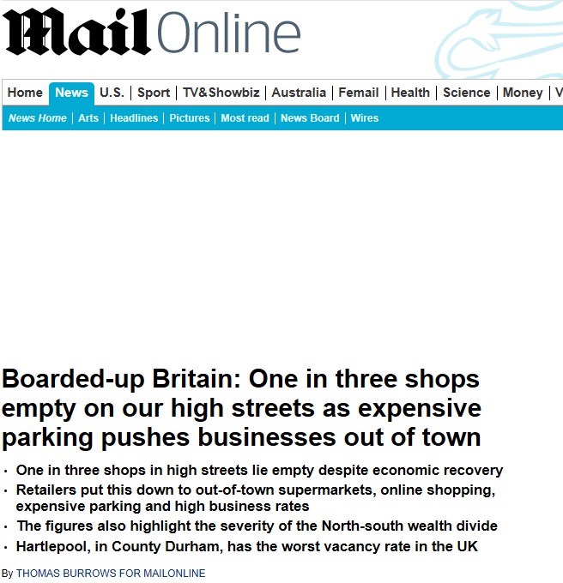


Slide 4


One in three shops in Britain's high streets lie empty. How serious is the problem in your local High Street? What are the reasons ?

Slide 5
Video clip here
Youtube BBC newsnight 6 Sept 2011

Slide 6

YOUR CHALLENGE! Brief: In many towns in Wales the traditional bustling High Street is currently declining with shops being left vacant. This is a consequence of the recession, on line shopping and the growth of out of town shopping developments. In an attempt to regenerate your local town, develop a business concept for a pop up shop on the High Street of your local town. Within this challenge you will be developing skills in Digital Literacy, Numeracy, Creativity and Innovation and Personal Effectiveness.

Slide 7
In your group, decide on a product/business/service for your local town. Remember to use all of the skills & techniques that you have been learning about in your lessons during the past few weeks.
You will need to keep all of the evidence generated individually and as a group for assessment purposes:
Skills audit & development, using ICT
Generating ideas & SWOT analysis of ideas
Market research & response
Innovative prototype
Evaluation of selection process
Action plan
Time management
Minutes of group meetings & working effectively as a group
Analysis of costings
Using social media to advertise
Creative visual display showing understanding of 5 x P’s
Effective proposal
Effective business pitch
Evaluation of own performance throughout the task

