Slide 1
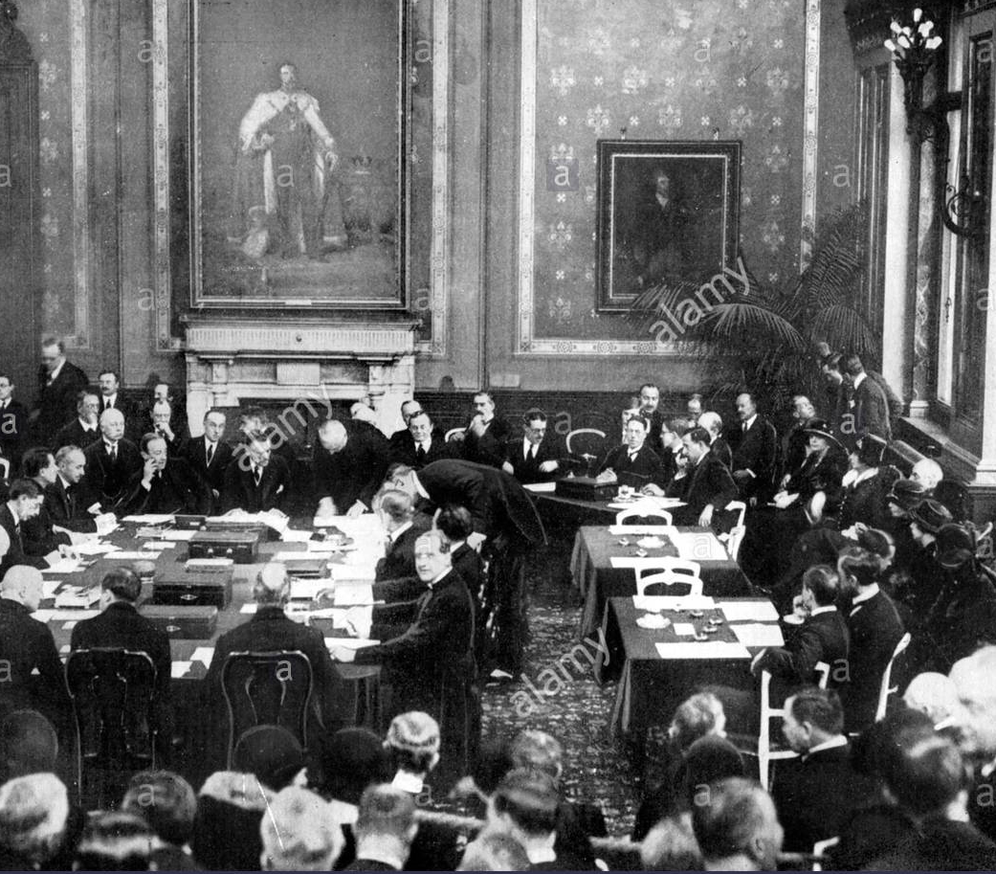
Recovery of the Weimar
Successes abroad

Slide 2
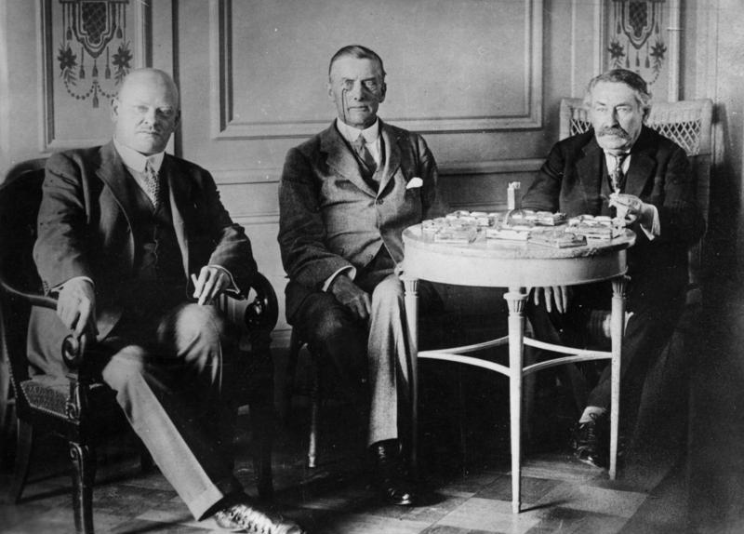
The Locarno act
In 1925 Germany signed the Locarno pact with Britain, Belgium, France and Italy.
According to the agreement countries agreed to keep existing borders between Germany, Belgium and France.

Slide 3
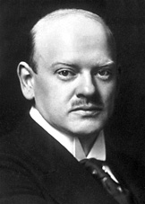
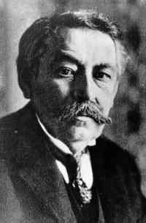
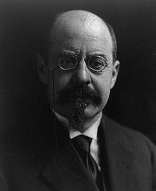
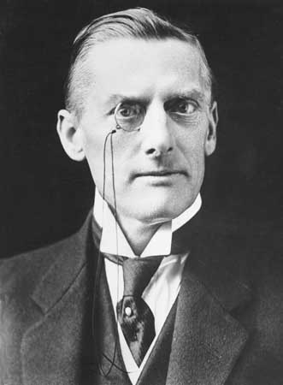
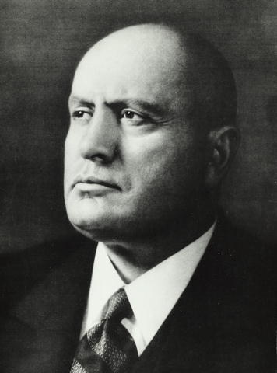
Main Representatives
Germany
  Gustav Stresemann
France
  Aristide Briand
Belgium
  Émile Vandervelde
Britain
  Austen Chamberlain
Italy
  Benito Mussolini
Notes:
The most important figures in the treaty: Gustav Stresemann and Aristide Briand.
Stresemann sent out the proposal of the Locarno Treaty on 9 February to the other nations.
For several months neither Britain nor France responded to these proposals.
Aristide Briand, the new French foreign minister, first urged that they should meet with Germany in spring of 1925.

Slide 4
Terms of the Treaty
Belgium, France & Germany promised to respect their joint frontiers
Ultimate cession of Alsace-Lorraine
Demilitarization of the left bank of the Rhine
Britain and Italy acted as the guarantors
Germany allowed to enter the League of Nations
In case of Germany's occupation of the demilitarized zone military action might be taken in response
Notes:
Belgium, France and Germany accepted western borders of Germany including the demilitarized zone in the Rhineland
‘Flagrant’ breaches of the treaty, by either France, or Belgium or Germany, would require Britain and Italy to intervene
Germany agreed to sign arbitration treaties with Poland and Czechoslovakia, committing itself to settle disputes with her eastern neighbors peacefully.

Slide 5
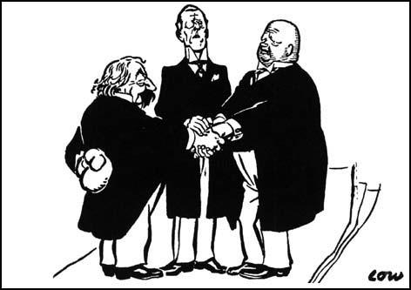
The Locarno act
This Pact marked Germany’s return to the European international scene and began a period of co-operation between Germany, France, Britain

Slide 6
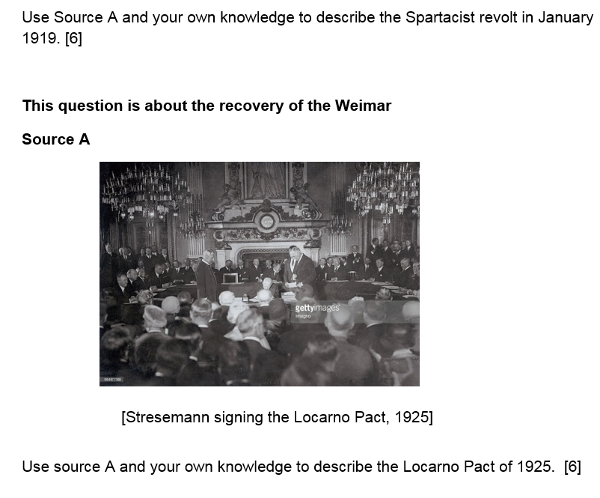
Exam question 1

Slide 7
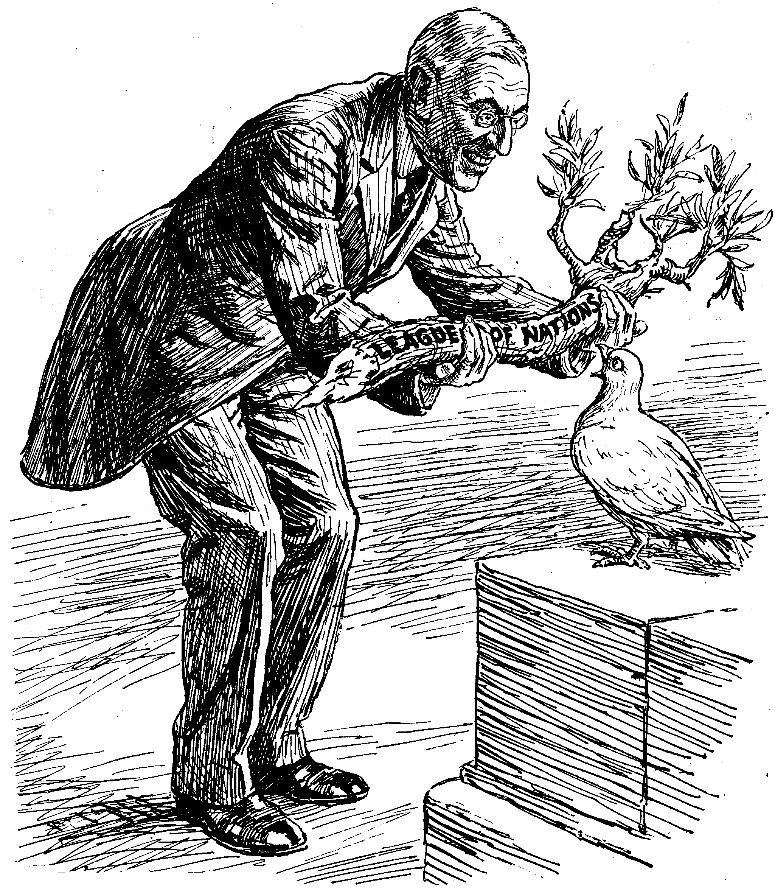
The League of Nations
The League of Nations was established in 1920; it’s purpose was to try and maintain peace
Germany became a member of the League of Nations following the Locarno Pact
This brought considerable prestige to Stresemann and helped Germany to negotiate the Young Plan

Slide 8
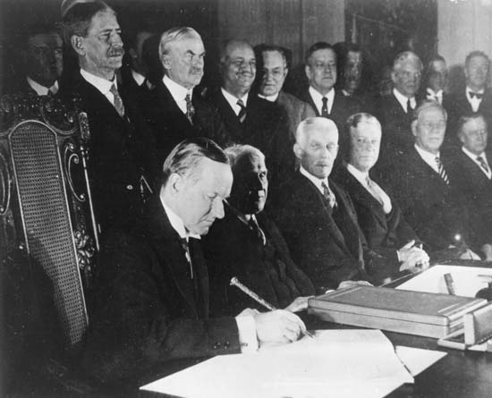
The Kellogg-Briand Pact
In 1928 Germany signed the Kellogg-Briand Pact along with 64 other nations. It was agreed that they would keep their armies for self defence and solve all international disputes ‘by peaceful means’.

Slide 9
Further successes
In 1925 France withdrew from the Ruhr
In 1927 Allied troops withdrew from the west bank of the Rhine, five years before the original schedule of 1933

Slide 10
Exam question 5
‘By 1929 the Weimar Republic had overcome its early problems and become firmly established in Germany.’
To what extent do you agree with this interpretation?

