Slide 1

Political Instability of the Weimar

Slide 2
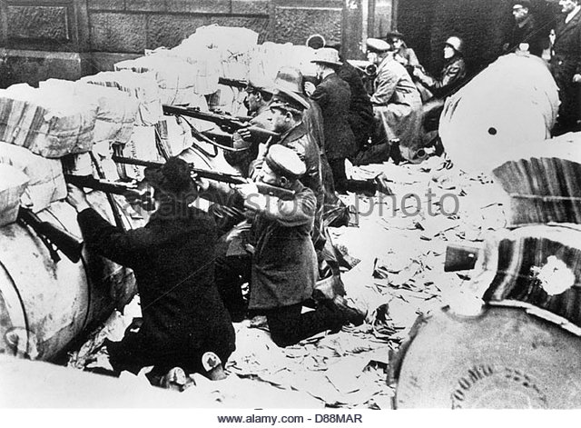
Learning Outcomes
To investigate the Spartacist and Kapp Putsches
To consider their causes, events and consequences

Slide 3
The Weimar was initially unpopular with many Germans because it:
Surrendered to the allies
Established a weak constitution
Failed to end food shortages
The Weimar faced constant threats from the left and right and there were several uprisings across Germany that threatened the Governments existence.

Slide 4
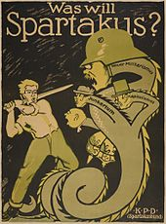
The Spartacist Rising January 1919
During the war, several groups emerged from the German Social Democratic Party (SPD)
The most radical was the Spartacist league, named after a famous Roman gladiator who led a revolt in ancient Rome. Their leaders were Karl Liebknecht and Rosa Luxemburg who wanted to create a state based on communist ideals.

Slide 5
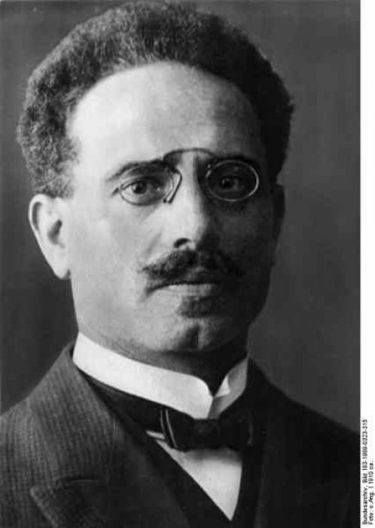
Karl Liebknecht
Liebknecht became a communist while studying at the universities of Leipzig and Berlin. Liebknecht was very opposed to Germany fighting in WWI, though he was essentially a lone voice in Germany as few shared his belief. One who did was Rosa Luxemburg and they formed an underground organisation called the ‘Spartacus League’ which printed an illegal newspaper called the “Spartacus Letters”. They got the name Spartacus after the slave who lead a failed revolt against the mighty Roman Army.

Slide 6
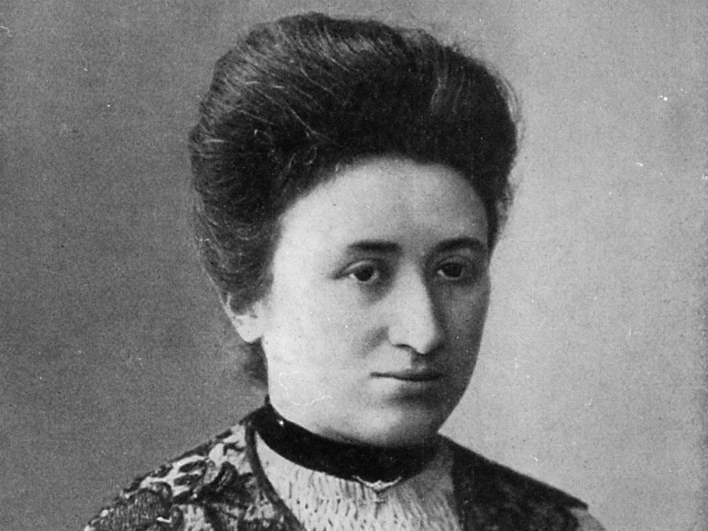
Rosa Luxemburg
Rosa Luxemburg was a revolutionary who had fled form Poland. She was a brilliant speaker and writer and was leading socialist in Germany and was known a Red Rosa.
She was imprisoned during WWI for spreading anti war propaganda and went Berlin once released to lead the Spartacists

Slide 7
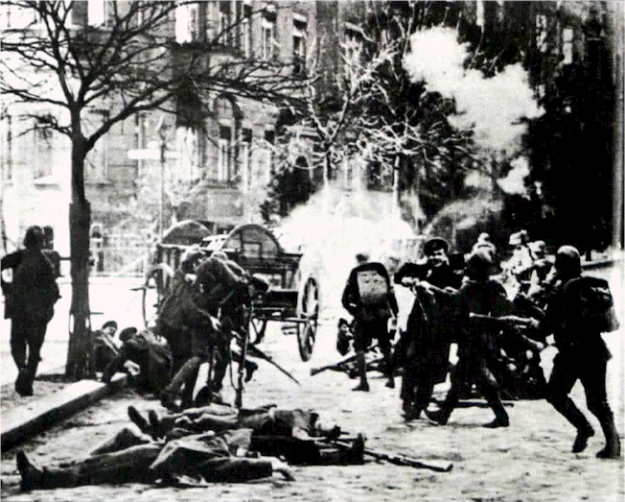
The Spartacist Rising – January 1919
In December 1918 the Spartacists demonstrations against the government led to clashes with the army and resulted in the deaths of 16 Spartacists.
At the end of the month
they formed the German
Communist Party KPD

Slide 8
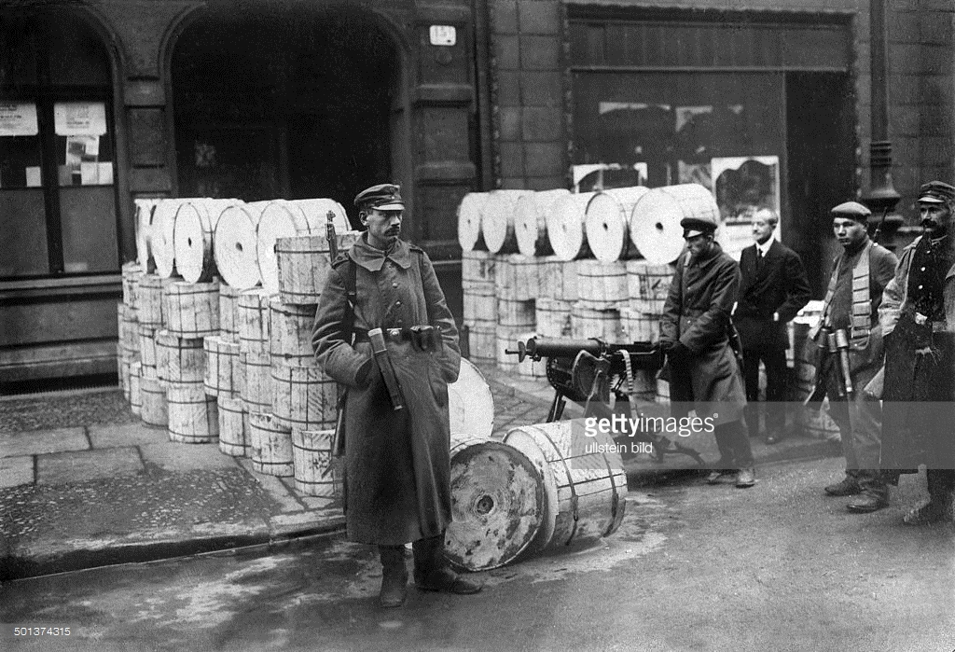
The Spartacist Rising – January 1919
On the 6th January the Spartacists began their attempt to overthrow Ebert and the Weimar Government to create a communist state.
They captured the headquarters of the governments newspaper and telegraph bureau, but they did not capture any other buildings.

Slide 9
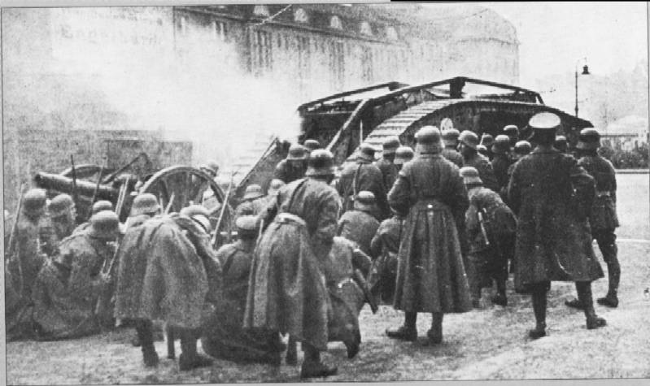
The Spartacist Rising – January 1919
Ebert used the regular army and the Berlin Freikorps to put down the rebellion.

Slide 10
The Spartacist Rising – January 1919
On the 10th January the Freikorps took over the Spartacist headquarters and by the 15th the rebellion was crushed.
A hundred Spartacists were killed compared to only thirteen Freikorps.

Slide 11
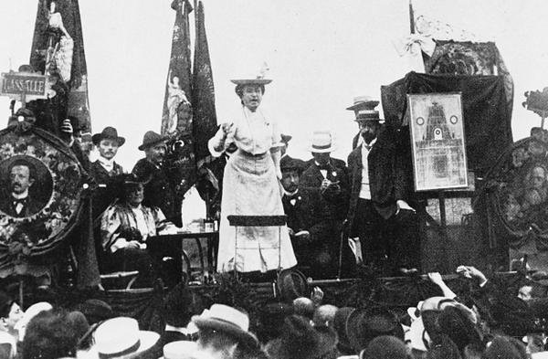
The Spartacist Rising – January 1919
Liebknecht and Luxemburg were captured and murdered

Slide 12
The Spartacist Rising – January 1919
Who
Why
What
When
Where

Slide 13
https://www.youtube.com/watch?v=zzOSf39wR_0

Slide 14
Exam question 1
[Spartacists outside the governments newspaper offices during their revolt in January 1919]
Use Source D and your own knowledge to describe the Spartacist revolt in January 1919. [6]

Slide 15
The Kapp Putsch – 1920
Having prevented a challenge from the left Ebert now faced on from the right.
The Weimar announced in March 1920 that the size of the army was to be reduced and the Freikorps disbanded.

Slide 16
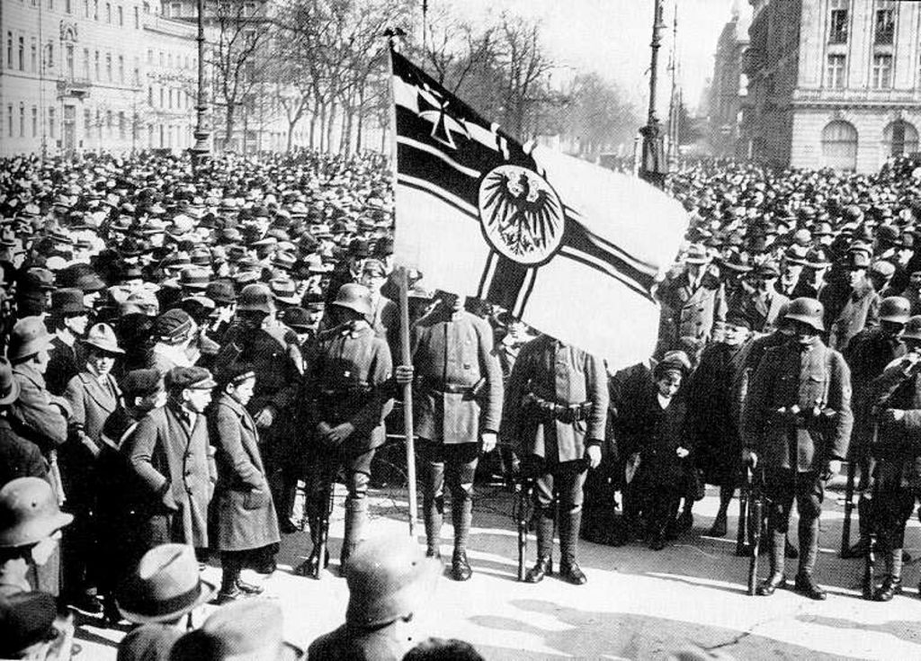
The Kapp Putsch – 1920
This led to uproar in Berlin
The leader of the Freikorps together with Wolfgang Kapp, a leading Berlin politician drew up a plan to seize Berlin and form a new right wing government with Kapp as chancellor.

Slide 17
The Kapp Putsch – 1920
Kapp successfully seized Berlin on 13th March 1920
The regular army refused to put down the rising
Ebert called on the people of Berlin not to support the Kapp Putsch and asked them to go on strike
Trade unionist and civil servants supported the government and the Putsch collapsed
Very few people were punished.

Slide 18
TASK
Who was Wolfgang Kapp?
Why did he call a revolt?
What was his plan?
How was the revolt put down?

