Slide 1
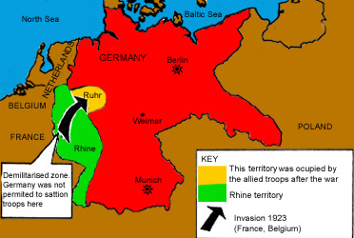
Learning Outcomes
To investigate events surrounding the occupation of the Ruhr in 1923
To consider the impact of the occupation

Slide 2
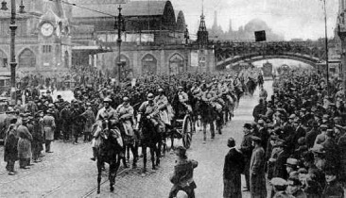
Events in the Ruhr
The problems facing the Weimar Republic worsened in 1923 due to the French occupation of the Ruhr and effects of hyperinflation

Slide 4
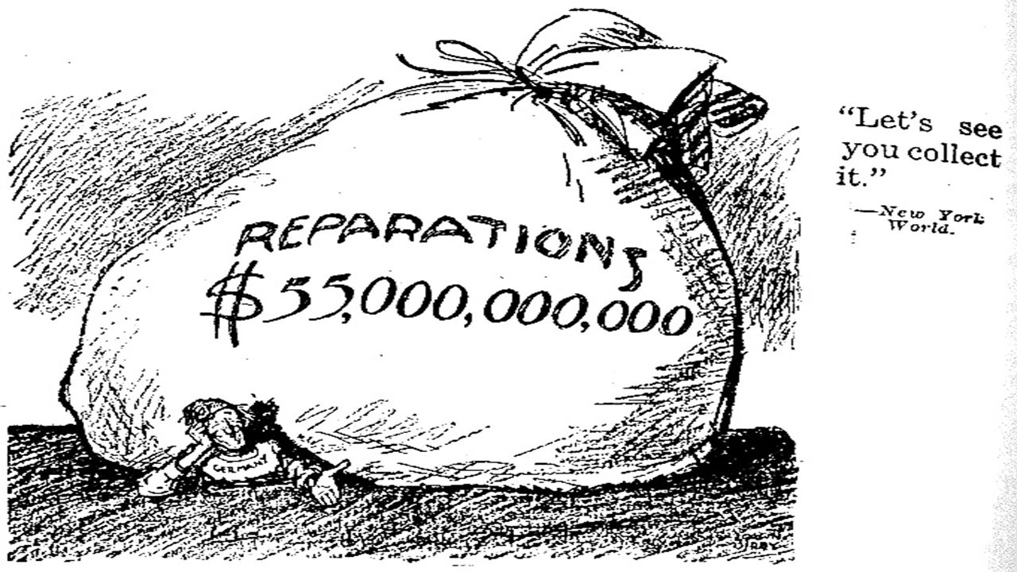
Economic problems: the 1923 crisis
Germany were expected to pay reparations of £6,600 million at £100 million per year.
The Weimar claimed that it could not pay
The Allies did not believe that the Germans could not afford to pay - especially France where anger towards Germany still ran deep.

Slide 5
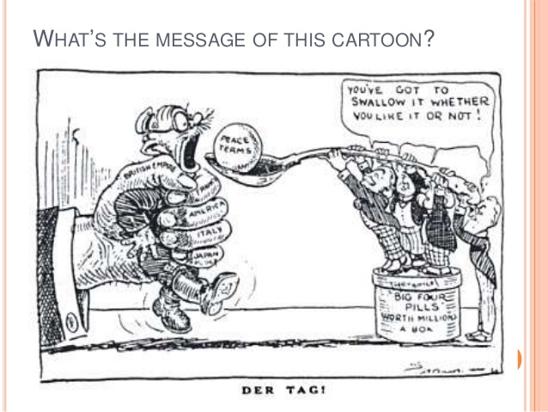
Economic problems: the 1923 crisis
The German government was accused of trying to get out of paying the reparations.
This was only four years after the end of the war, and Britain and France still did not trust Germany.

Slide 6
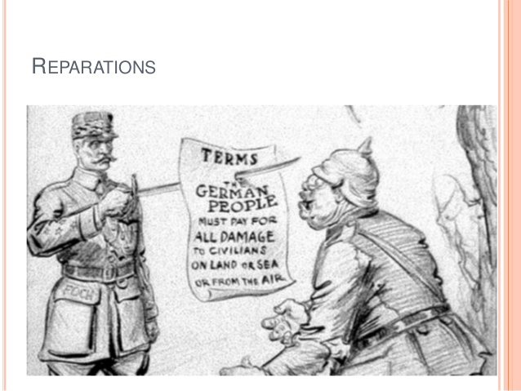
Economic problems: the 1923 crisis
The Weimar government began to print more money in order to pay France and Belgium as well as its own workers
The value of the currency started to drop rapidly

Slide 7
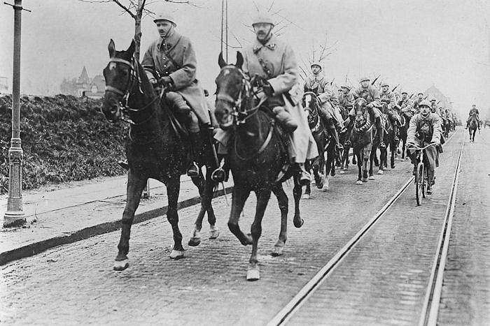
Economic problems: the 1923 crisis
In 1921 Germany failed to make a reparation payment and so France sent troops into the Ruhr, Germany's main industrial area
The Ruhr is sited in the Rhineland so there we no German troops to stop the invading troops.

Slide 8
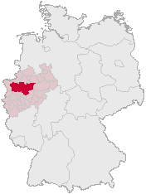
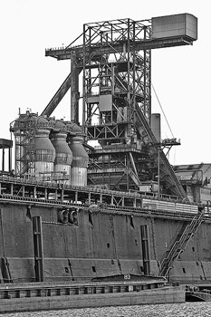
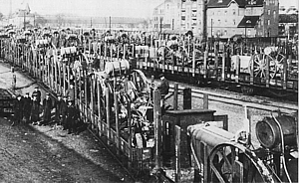
Invasion
A further occupation by French and Belgium troops took place in January 1923 when Germany failed again to pay reparations to both these countries
The French and Belgium troops took over the iron and steel factories, coal mines and railways.

Slide 9
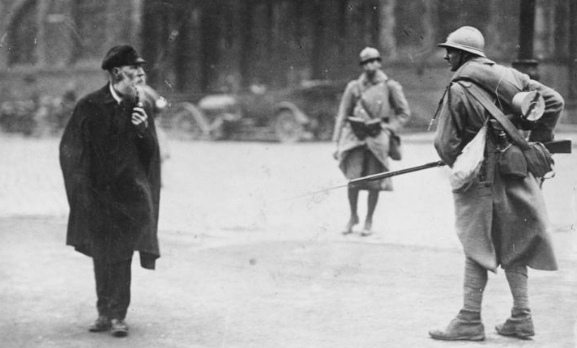
Invasion
Those Germans who lived in the Ruhr and did not do as the French told them to were imprisoned. Food was taken

Slide 10
Response from the German Government
The Weimar government ordered the workers in the Ruhr to go on strike and it ordered all people in the Ruhr to passively resist the French and Belgium soldiers.
They were not to openly confront the French and Belgium soldiers, but they were not to help them in any way whatsoever.
This led to violence and over the next 8 months of the occupation, 132 people were killed and over 150,000 Ruhr Germans expelled from their homes.

Slide 11
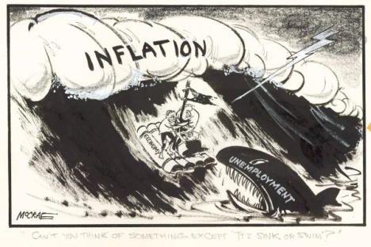
Germany economy suffers
The order for workers to go on a general strike may have been patriotic but it had disastrous consequences for Germany as a whole.
The Ruhr was Germany’s richest economic area and produced a great deal of wealth for the country as a whole. The huge Krupps steelworks was there.
By not producing any goods whatsoever,
Germany’s economy started to suffer.
The striking workers had to be paid and the
people expelled from their homes had to be
looked after.

Slide 12
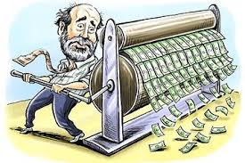
Germany economy suffers
To pay the striking workers and look after the homeless the government did the worst thing possible - it printed money to cover the cost.
This showed other countries that Germany did not have enough money to pay for her day-to-day needs.
Whatever money which had been invested in Germany was removed by the foreign investors.

Slide 13
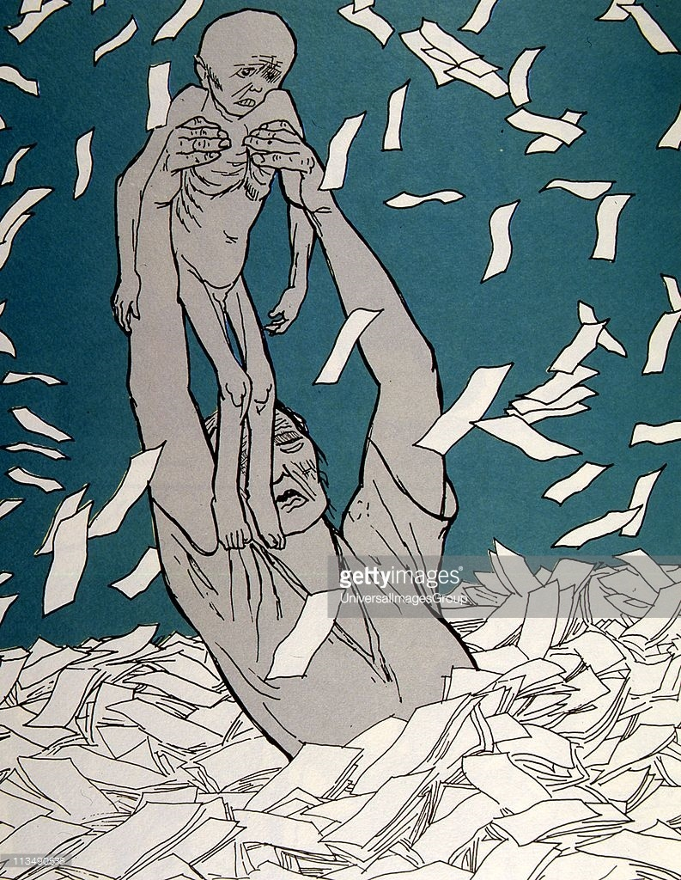
Hyperinflation
This drop in confidence also caused a crisis in Weimar Germany when prices started to rise to match inflation.
Very quickly, things got out of control and what is known as hyperinflation set in.

Slide 14
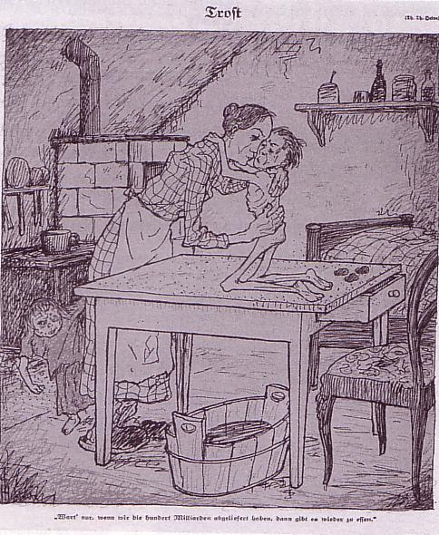
Hyperinflation
Prices went up quicker than people could spend their money.
In 1922, a loaf of bread - 163 marks.
By September 1923, this figure had reached 1,500,000 marks.
At the peak of hyperinflation, November 1923, a loaf of bread cost 200,000,000,000 marks.

Slide 15
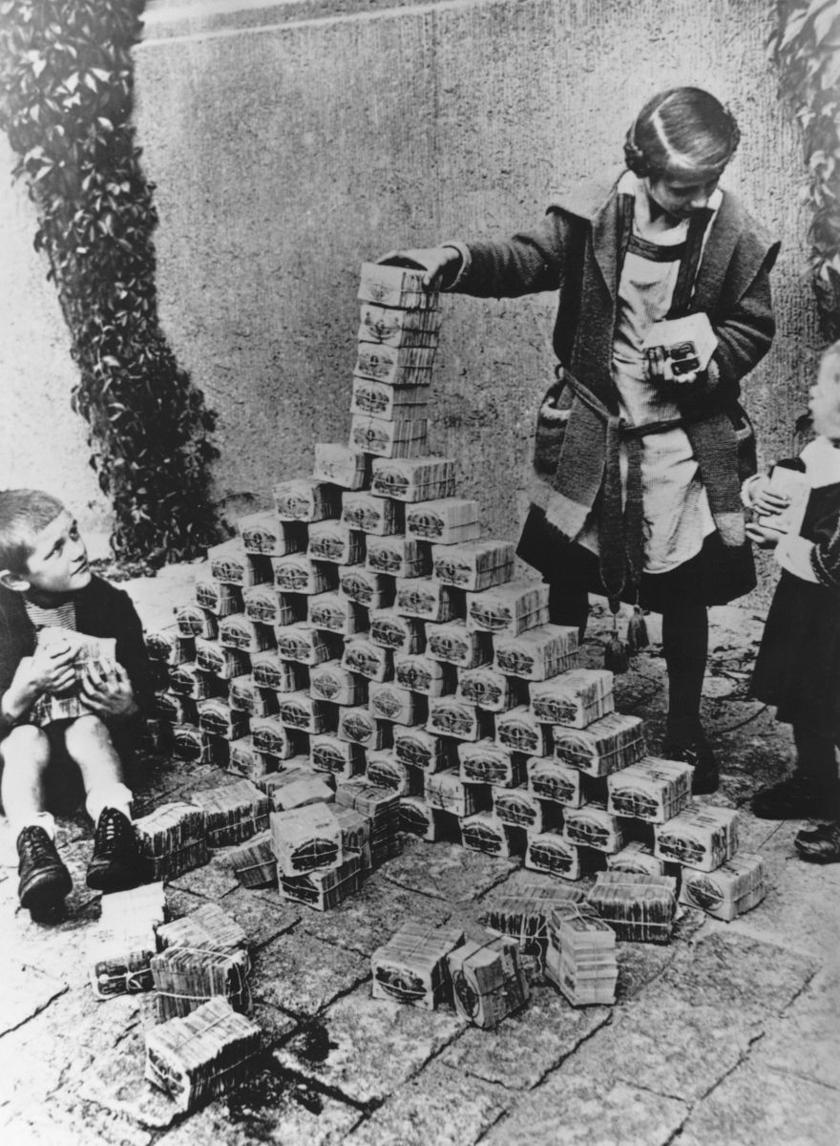

Slide 16
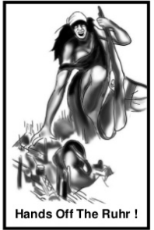
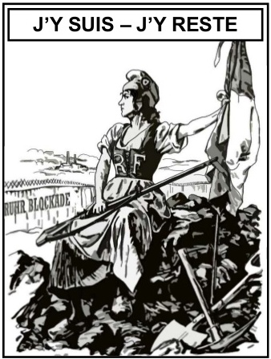
Look at both posters carefully. Which poster do you think is British and which is German? Explain your choice.

Slide 17
Here I am – Here I stay
What can we see in the background?
Which country does the figure portray?
What is written behind the women?
What is she sitting on?

Slide 18
Which country does the figure portray?
What is she holding?
What does the military helmet represent?
What type of buildings can you see?
How important were they to Germany after the war?

Slide 19

Study the source below and then answer the question which
follows.
Source B
What was the purpose of Source B? [8]
[Use details from Source B and your own knowledge and understanding of the
historical context to answer the question.]
[A British cartoon from Punch 1923, the writing translates ‘Here I am – Here I stay’]

Slide 20
