Slide 1
Lesson 4
Storing data safely

Slide 2
Learning outcomes for today
Consider how we store data
Consider what data is required and what isn’t
Overview of the Data Protection in the UK and its implications

Slide 3
How do we store data?
How do you store data
  On your computer
  On your phone
  In your diary????

Slide 4
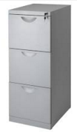
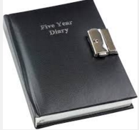
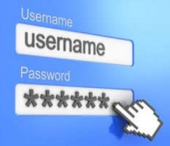

Keeping data secure
Notes:
Discussion how data security has developed over the years and the need to protect data and the responsibility we have when we collect data.
Discussion of SMART passwords, don’t share passwords, have different passwords for different logons.

Slide 5
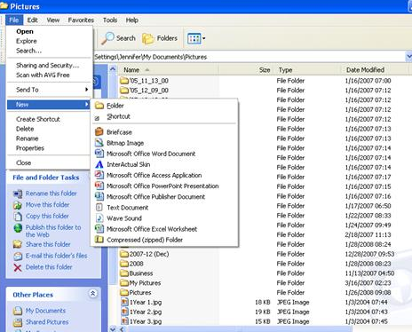
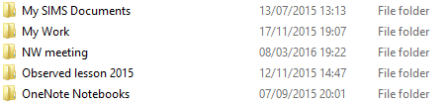
Which is your user area?
A mixture of files and folders. Names like Doc 1 or New folder 1, New folder 2. Lots of miss filled work.
A simplistic system of clearly named folders and files stating what they contain.
Notes:
Class discussion why is it important to organise folders and files- security aspect

Slide 6

Time for a tidy
Notes:
If in a computer room encourage students to clear out their user area.
Creat a new folder for IP split into subfolder “Class notes” “Research” and “IP”

Slide 7
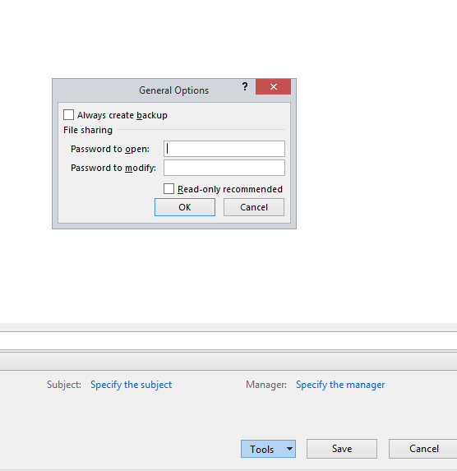
Storing data securely
Do you need to use names/ contact details? If not anonymise all data
Put a password on workbooks – BUT DON’T FORGET IT!
File- Save as- Tools- General options
Notes:
Students to complete activity sheet producing an excel sheet and securing it

Slide 8
Data Protection in the UK
What information can you keep about others?
What cant you keep?
How long can you keep it?
What if there is a mistake?
Notes:
https://www.gov.uk/data-protection/the-data-protection-act

