Slide 1
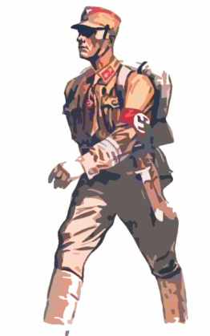
The Munich Putsch
8 - 9th
November
1923
http://www.youtube.com/watch?v=DvD8bbCiAVE

Slide 2
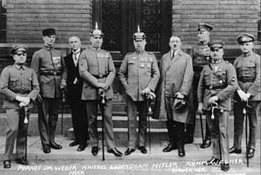
Learning Outcomes
To study the events of the Munich Beer Hall Putsch
To understand the consequences of the Munich Putsch and decide if it was a success or failure

Slide 3

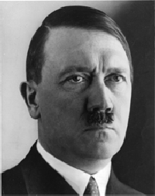
How did the Nazi party develop?

Slide 4
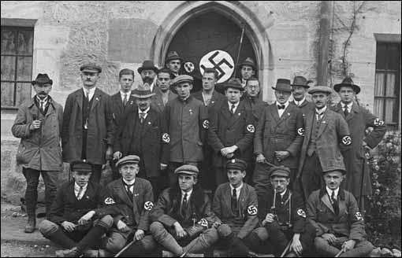
After the war Hitler was working for the Army as a political /propaganda agent and attended political meetings.
In 1919 he went to a meeting of the German Workers Party led by Anton Drexler and liked what he heard.
Hitler joined this small party and soon became its leader because of his ability to speak in public.
German workers Party 1920

Slide 5
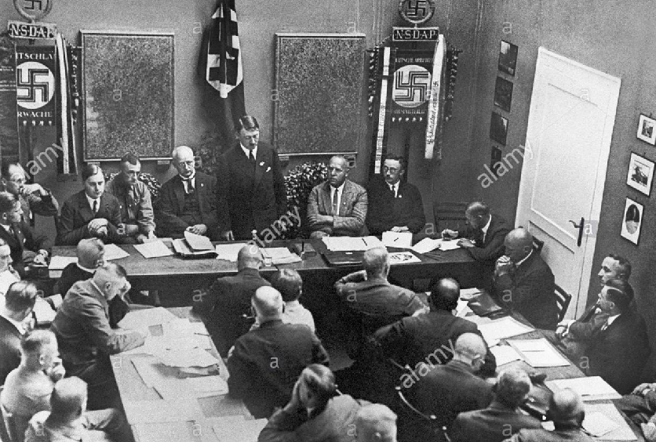
In 1920 he changed the party name to National Socialist German Workers Party (NSDAP or NAZI) and drew up a program of 25 points. These included Lebensraum, destruction of Versailles and a hatred for Jews and communists.
The NSDAP was both Nationalist (they believed in Germany’s greatness) and Socialist (they believed the state should benefit everyone equally).

Slide 6
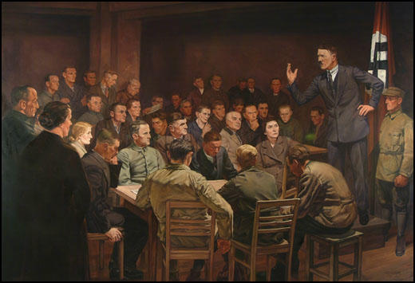
In 1923 Hitler felt that he Nazi party was strong enough to attack Berlin and take control of Germany in what became known as the Munich beer hall Putsch.

Slide 7
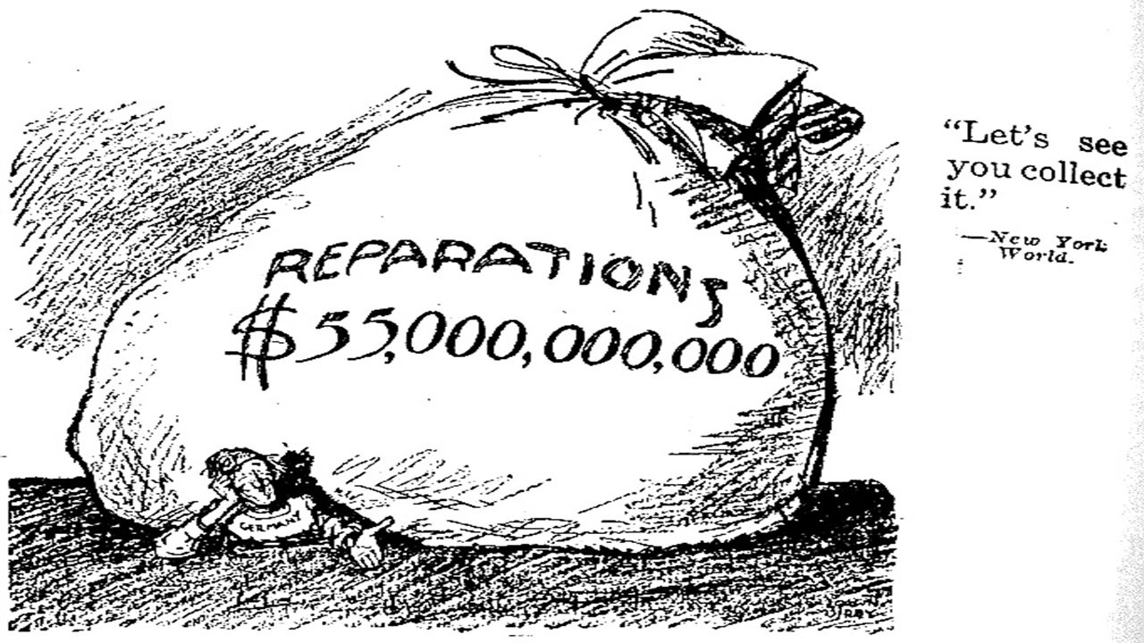
Reasons why Hitler felt strong enough to attempt his Putsch
The problems facing the Weimar Republic worsened in 1923 due to the French occupation of the Ruhr and the effects of hyperinflation
The Weimar claimed it could not pay the £6600 reparations bill
Hitler hated the Weimar Republic

Slide 8
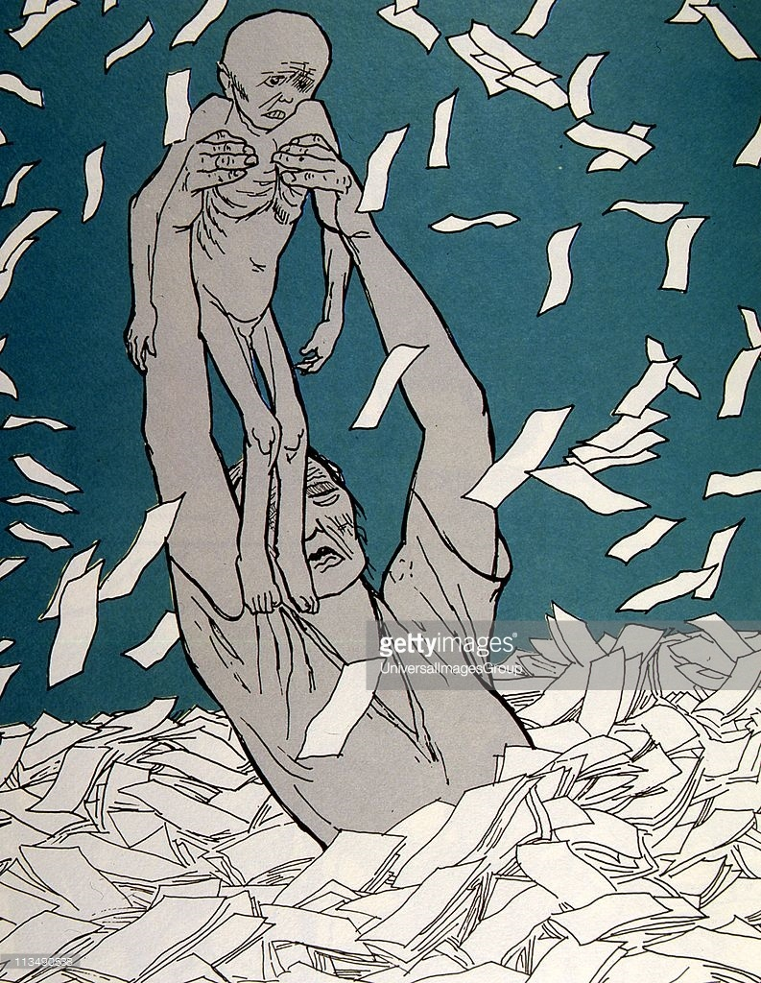
Reasons why Hitler felt strong enough to attempt his Putsch
The government started to print more money to pay France and Belgium as well as its own workers
The value of the German currency started to fall rapidly and the Germany failed to meet their reparation payments
France and Belgium invaded the Ruhr in 1923
Many German blamed the Weimar for this

Slide 9
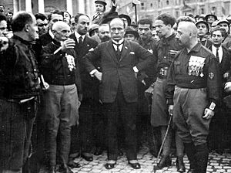
Reasons why Hitler felt strong enough to attempt his Putsch
Mussolini had seized power in Italy in 1922

Slide 10
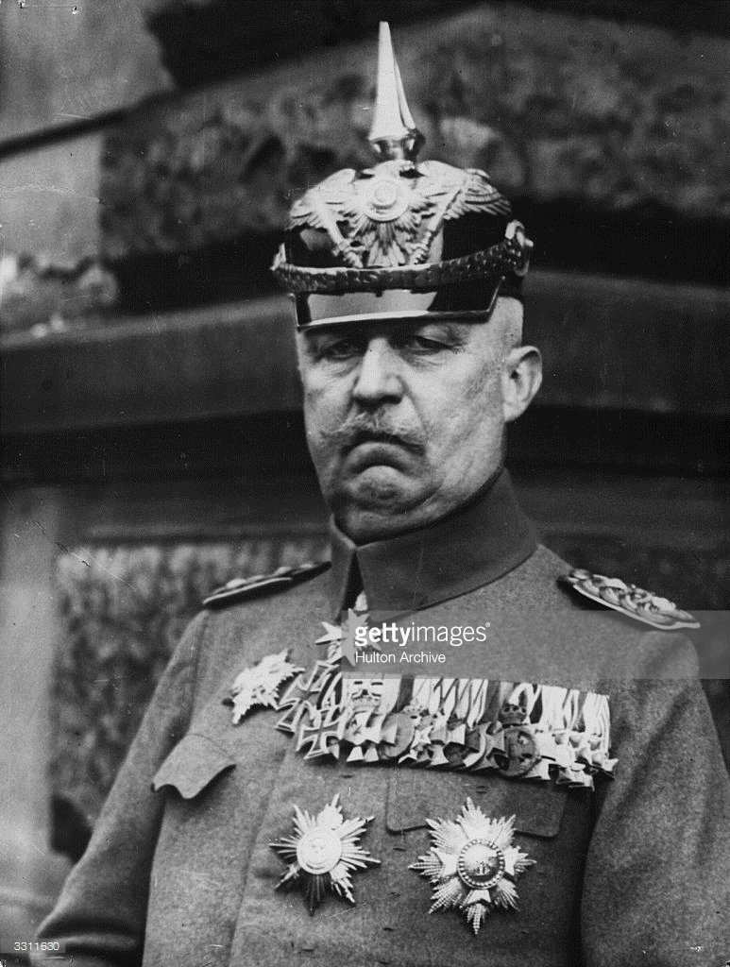
Reasons why Hitler felt strong enough to attempt his Putsch
Hitler had won the support of general Ludendorff, the former army Commander-in-Chief. Ludendorff was extremely popular.

Slide 11
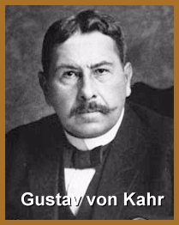
Reasons why Hitler felt strong enough to attempt his Putsch
Hitler was confident that von Kahr and the army in Bavaria would support him.
Hitler believed people across Germany would support him instead of he Weimar

Slide 12
What are the main interpretations of the Munich Beer Hall Putsch?
The Putsch was a badly organised fiasco which was easily put down and showed how weak the Nazis were.
The Putsch was a success for the Nazis as it put them on the national map and made Hitler famous.
In this lesson, you will decide which interpretation is the most accurate.

Slide 13
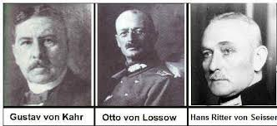
Key People
The events of the Munich Putsch
Head of the Bavarian Government
Army chief
Police chief

Slide 14
Von Kahr, von Seisser and von Lossow were attending a meeting at the Burgerbraukeller on the evening of the 8th November 1923 Hitler’s plan was to seize Kahr, Lossow and Seisser to persuade them to support the Nazis in overthrowing the government and replacing it with a strong, central government. Hitler with 600 SA troops stormed the meeting and took Kahr, Lossow and Seisser into a side room at pistol point forcing them to agree to his planned uprising the next day.
The events of the Munich Putsch

Slide 15
The events of the Munich Putsch
Von Kahr, von Seisser and von Lossow were allowed to leave the building and then changed their minds and organised troops and police to resist Hitler's planned armed march through Munich.

Slide 16
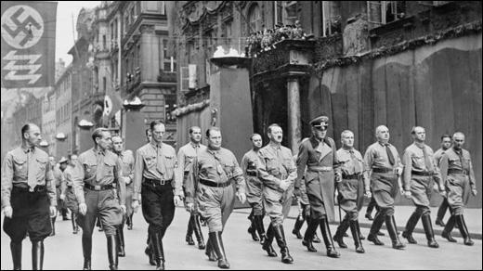
The events of the Munich Putsch
Despite his plans falling part Hitler continued with the march through Munich.
However, the Nazis had only about 2000 rifles and when they were challenged they were no math for the well armed police force.

Slide 17
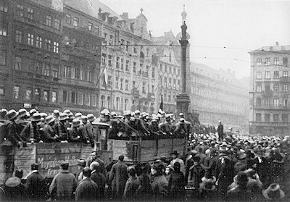
The events of the Munich Putsch
As the two opposing forces met, shots were fired and sixteen Nazis and four policeman were killed
The incident was soon over and the Nazis scattered.
Hitler disappeared but was arrested two days later, the same day that he Nazi party was banned.

Slide 18
Hitler’s trial and imprisonment
Hitler was arrested along with his main supporter General Ludendorff and tried for treason
The trail began in February 1924 and lasted one month

Slide 19
How successful was the Munich Putsch?
Source A
It was at this point that Hitler seemed to snatch some kind of victory out of the jaws of defeat. The trial gave him a national platform on which to speak…Newspapers throughout Germany and around the world reported his claim that he had led the movement against the ‘treasonable’ Weimar system…
Lacey and Shephard, 1997.

Slide 20
How successful was the Munich Putsch?
Source B
The court was also sympathetic to Hitler. Instead of sentencing him to death as it might have done, it gave him the minimum sentence for the offence – five years imprisonment. The judges also made it clear that he could expect an early release. In fact, Hitler served just nine months of his sentence…He spent much of the time dictating the first part of his book, Mein Kampf (‘My Struggle’). Imprisonment provided Hitler with a period of enforced leisure in which he was able to sort out his main ideas.
Stephen Lee, 1996.

Slide 21
Interpretations
The Putsch was a badly organised fiasco which was easily put down and showed how weak the Nazis were.
The trial gave Hitler nationwide publicity and introduced him to the German public via the national press.
It gave him the opportunity to pour scorn onto the Weimar republic, the November criminal, the Treaty of Versailles and the Jewish Bolsheviks that had betrayed Germany
The trial was used to put forward his political views Hitler became famous

Slide 22
Interpretations
The Putsch was a badly organised fiasco which was easily put down and showed how weak the Nazis were.
He was found guilty of treason
He was sentenced to five years in prison

Slide 23
Interpretations
The Putsch was a success for the Nazis as it put them on the national map and made Hitler famous
He was treated leniently and sentenced to the minimum of five years in prison; he only served 9 months
Ludendorff was not charged
He wrote his autobiography, Mein Kampf, in prison
Imprisonment gave him time to reflect on the Putsch and his future in politics an come to the conclusion that he was the leader needed to make Germany great again but he would gain power through legal means

Slide 24
Interpretations
The Putsch was a success for the Nazis as it put them on the national map and made Hitler famous
He had a relatively easy time in prison and was permitted as many visitors as he wanted
He received large amounts of mail and was able to access whatever books he required

Slide 25
What do the statements say about the Munich Beer Hall Putsch – success or failure?
Hitler was mistaken in his support from the army and police. | Hitler got much public support during his Munich march. | Hitler served out his sentence in a comfortable jail
Many Nazi supporters got light sentences. | Hitler’s time in prison allowed him to write Mein Kampf | Hitler changed his strategy to winning power to legal means.
Opposition within the Nazi Party melted. | Hitler was mistaken in his support from the Bavarian government. | Hitler’s trial made him into a national figure.
The Nazis did not have enough weapons to attempt a strong coup. | The Putsch failed and 16 Nazis were killed. | The Bavarian leaders were set free and betrayed Hitler.

Slide 26
Exam question 5
Was the Munich Beer Hall Putsch a great success for Hitler and the Nazis? [16]
Use your own knowledge and understanding of the issue to support your answer. Marks for spelling, punctuation and the accurate use of grammar and specialist language are allocated to this question.

