Slide 1
One App to lead them all!

Slide 2

About TCS
Tata Consultancy Services is an IT services, consulting and business solutions organisation
We have over 277,000 employees
Operating in 44 countries and we are part of the “Tata group”, India’s largest industrial conglomerate (a combination of two or more corporations).

Slide 3
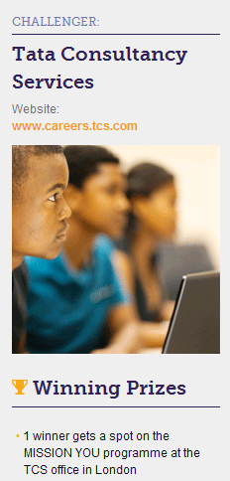

Online Challenge “TCS Appathon”
“TCS Appathon” is a challenge from TCS addressing young students 14-18 years old.
The best idea will be awarded with a spot in our annual MISSION YOU programme in London.
www.mykindacrowd.com/Challenges/tcs-appathon

Slide 4

What is MISSION YOU?
TCS’ work experience programme for young students aged 14 to 18 years old in the UK&I
5 days every August
at our
Head Office in London
Taster of what it’s like to work at one of the world’s leading technology firms

Slide 5
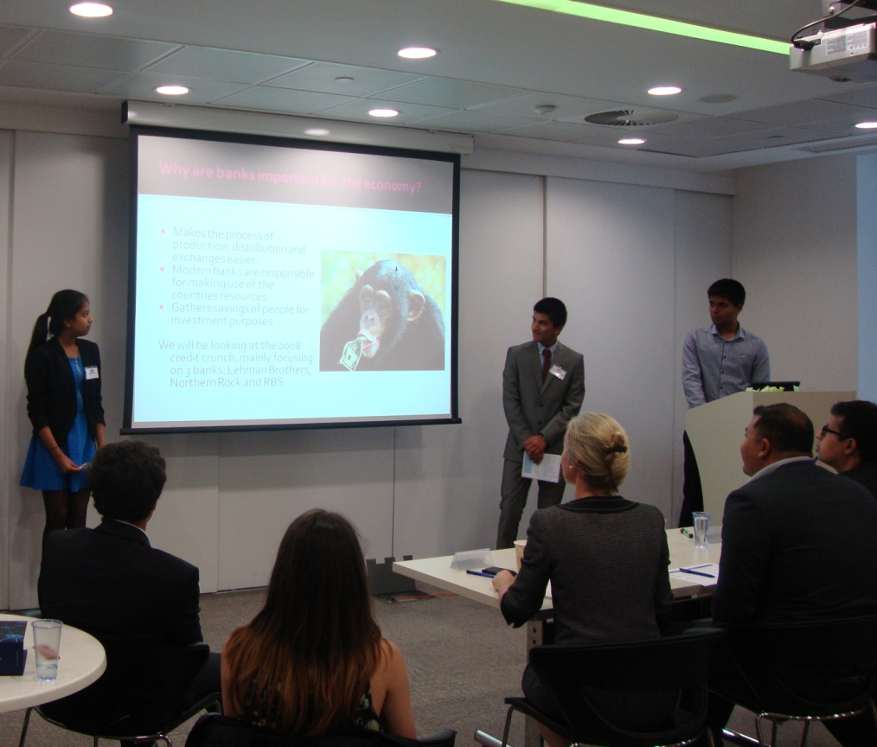
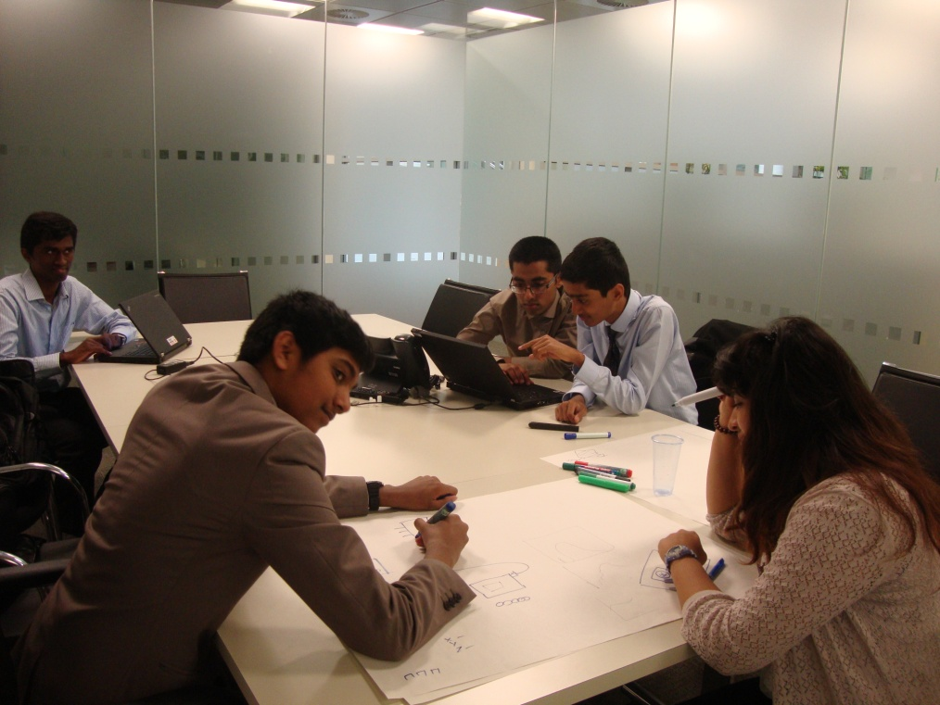
MISSION YOU last year
Last year was a huge success, with more than 30 passionate and eager students participating in a wide range of TCS functions!

Slide 6
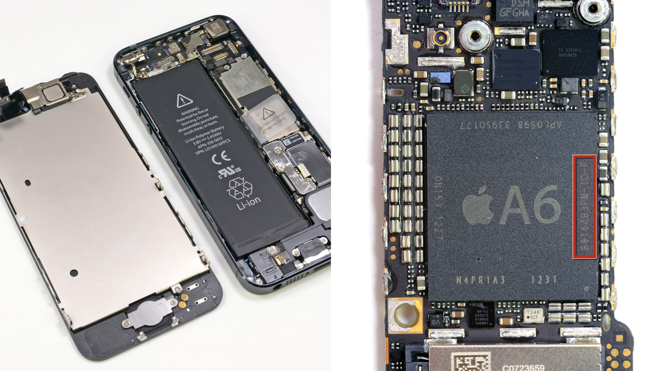
>1
>What makes a Smart Phone, “smart”?
Some people think it’s simply the powerful hardware and base a smart phone solely on that
Notes:
Ask students
Who has a smart phone? Get them to hold them up in the air then ask
What makes a smart phone smart?
Students call out ideas
http://jmango.net/2013/10/02/what-are-the-different-kinds-of-mobile-applications-2/

Slide 7


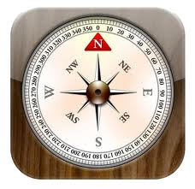



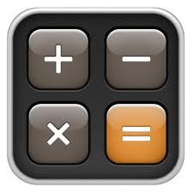



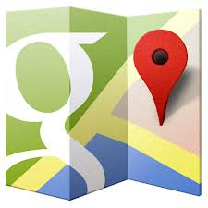




>1
>What makes a Smart Phone, “smart”?
“However, that’s only part of what makes a smartphone “smart”. The other half of the equation comprises of the applications that run the device”
Notes:
Ask students
Who has a smart phone? Get them to hold them up in the air then ask
What makes a smart phone smart?
Students call out ideas
http://jmango.net/2013/10/02/what-are-the-different-kinds-of-mobile-applications-2/

Slide 8
>1
> What is an App?
> Short for Application
> A piece of software designed to fulfill a particular purpose
> What are some examples of apps that you use?
Notes:
The are housed on the device, one downloaded from the App store / Google play store for android devices. These apps typically require access to phone features such as contacts, gps, calendar or other functions
Mobile apps were originally offered for general productivity and information retrieval, including email, calendar, contacts, and stock market and weather information.
However, public demand and the availability of developer tools drove rapid expansion into other categories, such as mobile games, factory automation, GPS and location-based services, banking, order-tracking, ticket purchases and recently mobile medical apps. The explosion in number and variety of apps made discovery a challenge, which in turn led to the creation of a wide range of review, recommendation, and curation sources, including blogs, magazines, and dedicated online app-discovery services.
App was “word of the year” in 2010
Ask students: estimate how many apps were downloaded in 2013
Answer – According to market research firm Gartner, 102 billion apps will be downloaded in 2013 (91% of them will be free) but they will still generate US$26 billion, up 44.4% on 2012's US$18 billion.
Ask students: how much revenue do you think the app economy generates?
Answer - it is estimated that the app economy creates revenues of more than €10 billion per year within the European Union, while over 529,000 jobs have been created in 28 EU states due to the growth of the app market
Creating a popular app is now the quickest way to become a millionaire

Slide 9
>1
>Why are apps so popular?
> Apps typically exist to solve a problem
> In the olden days people carried a whole host of things around with them…
Notes:
Ask students to give an example of each e.g.
Time wasters – games
Everyday – things like Twitter, Whatsapp – people use these each day to communicate
Occasional – things that you use at specific times e.g. Hailo to order a cab, Hipmunk to book plane tickets
These are three very broad categories but if you visit the apple store or android you can find lots of different categories – these include:
Entertainment
Personalization
Lifestyle
Books & Reference
Education
Tools
Business
Brain & Puzzle
Music & Audio
10. Travel & Local

Slide 10

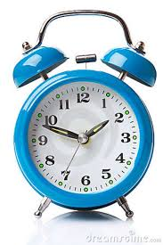
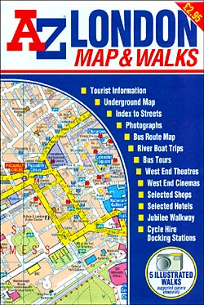
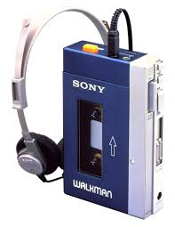
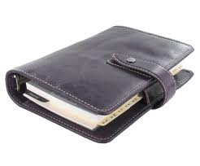

>1
>Remember these?
Notes:
Ask student how many of them own an alarm?
When was the last time they picked up a tube map or A-Z?
How many of them use their phone as their primary music device?
How many of them carry a calendar or diary to make booking?
All these things were bothersome to carry, but apps have made it possible to have them all in one place.
Most people no longer wear watches because they use their phone to tell the time

Slide 11






>1
>Types of Apps
1. “Time wasters”
2. Everyday
3. Occasional
Notes:
Ask students to give an example of each e.g.
Time wasters – games
Everyday – things like Twitter, Whatsapp – people use these each day to communicate
Occasional – things that you use at specific times e.g. Hailo to order a cab, Hipmunk to book plane tickets
These are three very broad categories but if you visit the apple store or android you can find lots of different categories – these include:
Entertainment
Personalization
Lifestyle
Books & Reference
Education
Tools
Business
Brain & Puzzle
Music & Audio
10. Travel & Local

Slide 12
>1
>Formula for success
The Problem
How the app solves the problem
How the app benefits users
Notes:
Ask students to give an example of each e.g.
Time wasters – games
Everyday – things like Twitter, Whatsapp – people use these each day to communicate
Occasional – things that you use at specific times e.g. Hailo to order a cab, Hipmunk to book plane tickets
These are three very broad categories but if you visit the apple store or android you can find lots of different categories – these include:
Entertainment
Personalization
Lifestyle
Books & Reference
Education
Tools
Business
Brain & Puzzle
Music & Audio
10. Travel & Local

Slide 13

>1
>Example of a “time waster” app
Flappy Bird
Problem – no real problem – it’s all about making a fun entertaining game for people to play in their spare time
App Solution – a highly addictive game that’s simple but very fun to play & well designed
Benefit – users are entertained & have fun playing
This game was perhaps a victim of its own success!
Notes:
Timewaster Apps? Take a bus or a train and you’ll what we mean. Everywhere you look children and adults alike are hunched over their gadgets killing time on these extremely addictive apps
Flappy Bird - The idea is to get a bird through some pipes, those of you who’ve played it will know it’s much harder than it sounds. You tap the screen to keep the bird alive, it’s gameplay is almost insultingly simple and uninteresting.
Here’s what Sarah Young of Mobile advertising firm NativeX has to say about the game “It’s extremely addictive, but beyond that, the game is competitive and challenging, requires skill, has fast sessions, is unwinnable, makes players feel nostalgic with 8-bit graphics, and is viral.”
Mention that some of the most popular and successful apps available for download are free. App creators in those instances generate income through advertising.
The game was a massive hit, topping all download charts. It became so popular the it’s creator removed it from the App and Play Store in February 2014. It’s creator felt it had gotten too big and wasn’t achieved it’s intended purpose, which was to make people relax!

Slide 14
>1
>Example of an every day app
Whatsapp
The problem – It’s expensive to send picture and video messages
App solution – An easy to use communications software that lets you send multimedia messages for free using 3G, 4G or Wi-Fi
Benefit – Cheaper, faster and easier to use, giving greater control to the user
Notes:
Problem – Allows people to communicate free of charge, send free pic messages and videos.
Company valued at about $2 billion. Not bad for an app that charges just 99cents for a year subscription
300 million current users of Whatsapp
Replicates instant messaging formula, you can see when your message has been viewed and when it’s being responded to. It’s fun, fast and cheap!
It’s a really quick way to share multimedia data

Slide 15

>1
>Example of an occasional app
Hailo
The problem – It’s difficult for customers to find black cabs and similarly for cabbies to locate customers as they trawl the streets
App solution – Allows customers to virtually “hail” a cab and connects customers and taxi drivers together
Benefits – Less wasted time for cabbies who are now more efficient, easier for customers who don’t have to wait and hope for a cab – they know one is on the way

Slide 16
>1
>Your turn to create an app

Slide 17
>1
>Task one – Benefit to user
> What problem have you identified?
> What does your app do?
> How will your app benefit the user?

Slide 18
>1
>Task two – Which category?
> Decide which category your app will fit – timewaster, everyday or occasional
Notes:
Who is your audience, what are they likely to use the app for

Slide 19
>1
>Task three – Name your app
> What’s it going to be called?
> Come up with a catchy name that will fully represent what your app is about
Notes:
Think about the most popular apps out there and the sort of things their names conjure
Facebook – a book of faces
Viber – vibrant, exciting
Twitter – The name and logo are it sync and conjure images of birds singing and communicating
Candy crush – An fascination with candy
Shazam – Almost like magic, you now know the name to that track you’re listening to on the radio or commercial

Slide 20
>1
>Task four – Design your app
> Think of its logo
> What does the home page look like?
> Annotate icons and tell us what each one does

Slide 21
Thank You

