Slide 1
Assessing Risk

Slide 2
Learning outcomes:
Carry out risk assessments with support.

Slide 3
Risk Assessments
Why do we need to carry out risk assessments before STARTING a physical activity?
WHEN do we need to review the risk assessments?
Why do you think risk assessments should be reviewed?

Slide 4
5 simple steps
Identify the hazards.
Decide who might be harmed and how.
Evaluate the risks and decide on precautions.
Record your findings and implement them.
Review your assessment and update if necessary.

Slide 5
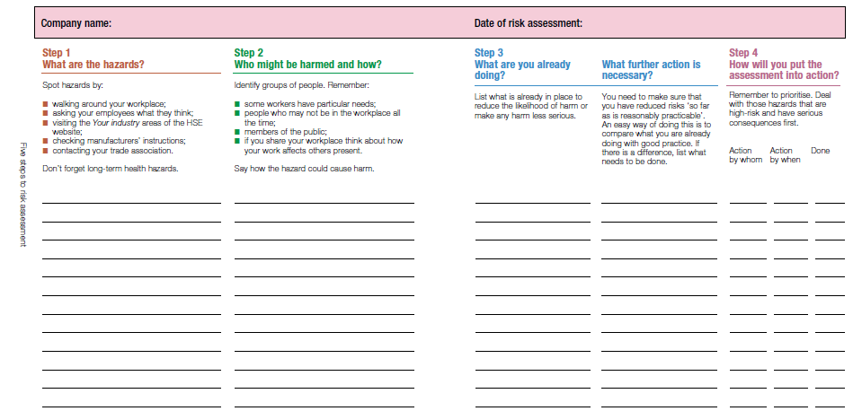
The risk assessment form is simplistic and self explanatory.

Slide 6
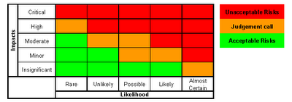
Likelihood and impacts/severity are graded from 1-5. You then multiply the two numbers.
If you get a risk rating of 1 it is acceptable and LOW,
The highest risk rating is …… ?

Slide 7
Even if it’s a risk rating of 25
Think about what you can do to reduce the risk. If it cannot be reduced DON’T DO IT.

Slide 8
Types of risks
How can we categorise or sort risks?

Slide 9
THINK
Equipment hazards – what are they? How can participants be protected?
Environmental hazards – such as the weather. How can the risk be minimised?
People – can the risk be eliminated?
REMEMBER –
Eliminate, Reduce and Protect

Slide 10
Give some examples of hazards
For each of the THREE list at least FIVE hazards.

Slide 11
Now do it.
Think about your challenge.
Create a mind map of the hazards related to the activity.
Next to each hazard write down WHO could be harmed.
Now give each hazard a risk rating (remember it is 1-25) refer back to the risk matrix.
For the hazards that have a risk rating “Judgement call” or “unacceptable risk” think about how you could ELIMINATE, REDUCE OR PROTECT.

