Slide 1

Teaching Block for Individual Project Welsh Baccalaureate Advanced
Teacher Guide

Slide 2
Teaching Block for Individual Project Welsh Baccalaureate Advanced
Teacher Guide
The following will provide guidance for a block of lessons designed to be delivered in 10 x 50 minute slots. The sequence of lessons allows the pupils to research and debate the topic of the ethics of downloading music. The pupils do not have to carry out the debate as an end product. This is more about the process and the skills that following this process will equip the learner with
This is an interactive approach, using one main site, with links to other resources. One particularly good link is to a lesson Inquiry on the Internet: Evaluating Web Pages for a Class Collection , which can be found on the same site.
Links to the website are included
Centres are advised to adapt to suit the learner/setting
Although the website used is English Medium, it could be used as a platform to adapt into the Welsh language.
The sessions facilitate the development of
Critical Assessment and development of Arguments
Identification of key information on factors, including consequences, similarities and differences
Formulating judgements
Analysis of credibility of information and sources, currency, comprehensiveness, validity, reliability, bias
These components meet the assessment criteria for LO2, LO3, LO5

Slide 3
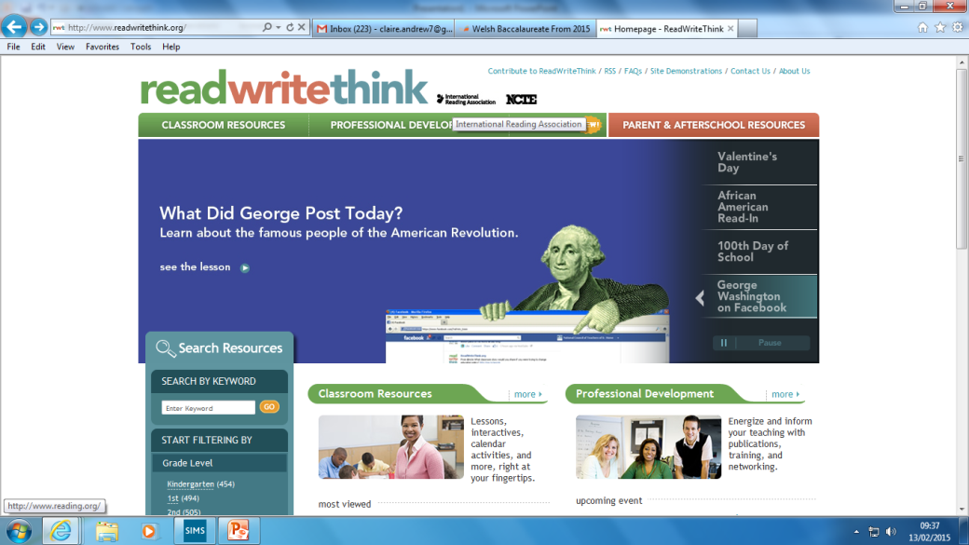

Here is the home page for the 10 sessions. It is worth a browse.
Web address
http://www.readwritethink.org/
Enter this into the search bar and it will take you to the page you require

Slide 4
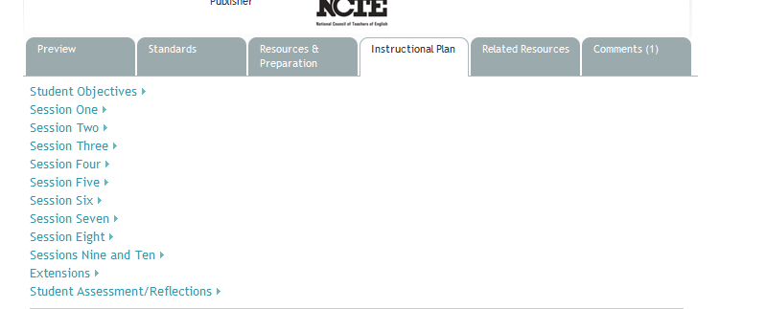
Clicking on “Instructional Plan” will take you to a lesson by lesson plan
“Related Resources” takes you to any printables you may need

Slide 5
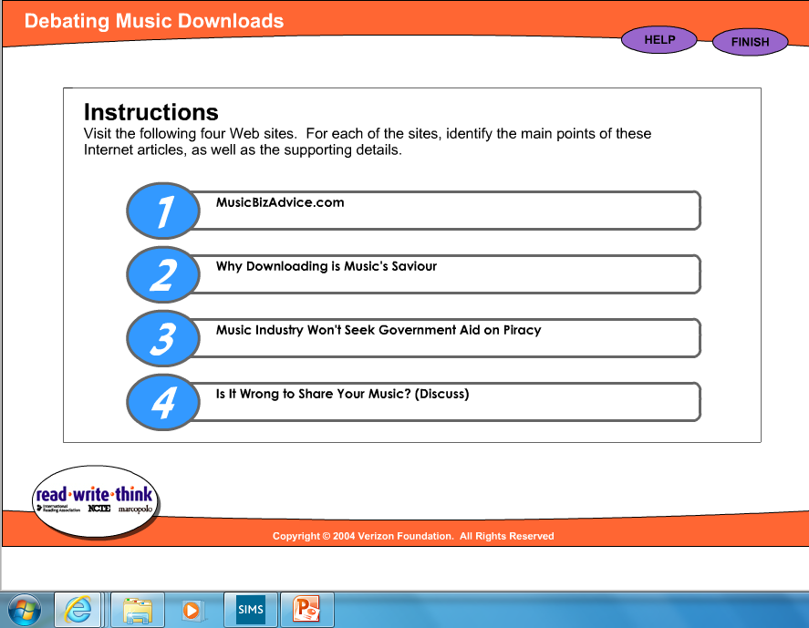
This is a page from session two. A cautionary note, two of the website links are no longer active. Pupils need to establish which ones these are, and go about finding two more to replace them. This is a useful exercise in helping them to negotiate problems they may face when researching for their own Project!)
For teacher info – it is the first two that no longer exist.

Slide 6
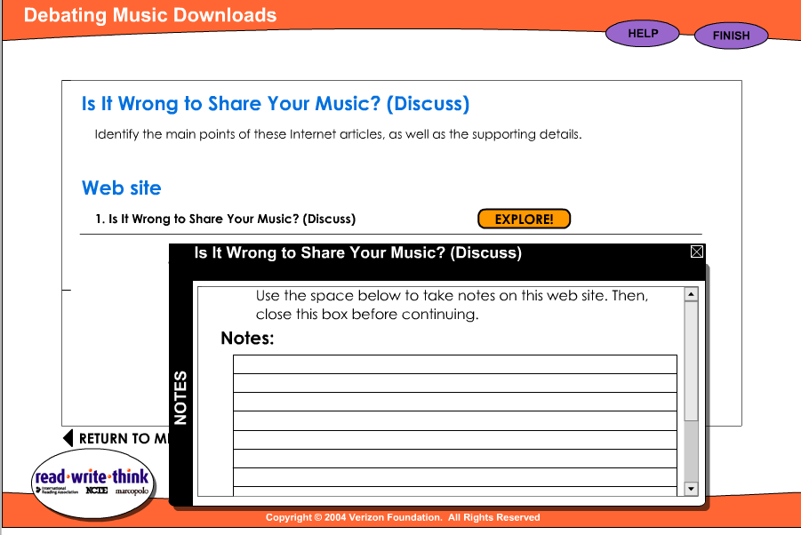
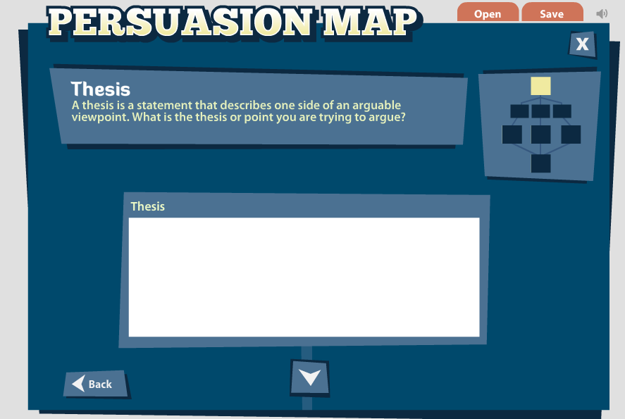
This box pops up and allows students to make notes while they explore a website
This is a pop up for session six. Pupils complete this on line and can print out their finished piece. This is a good planning tool

Slide 7
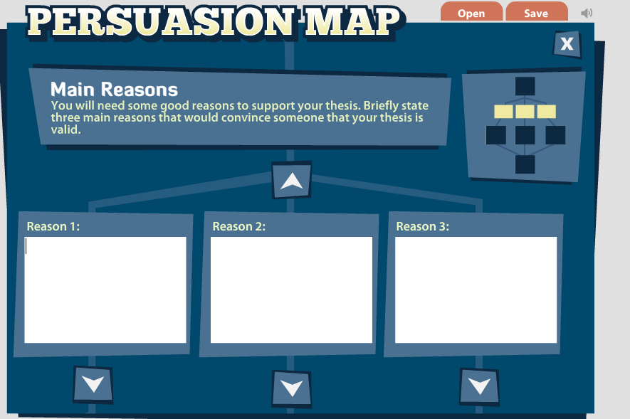
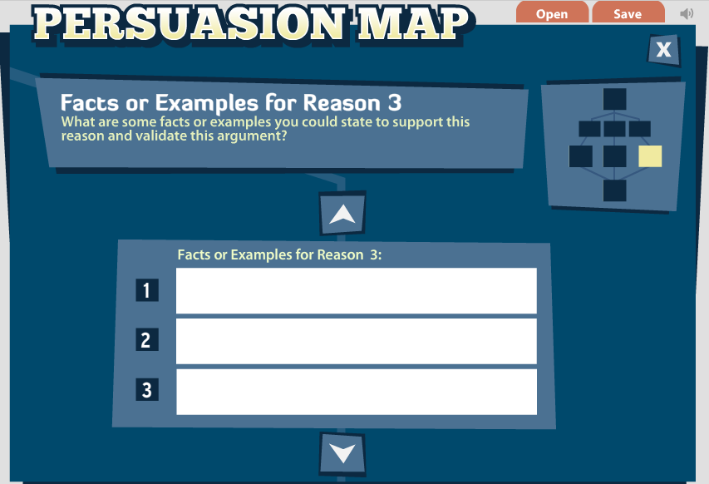
Next step
Followed by

Slide 8
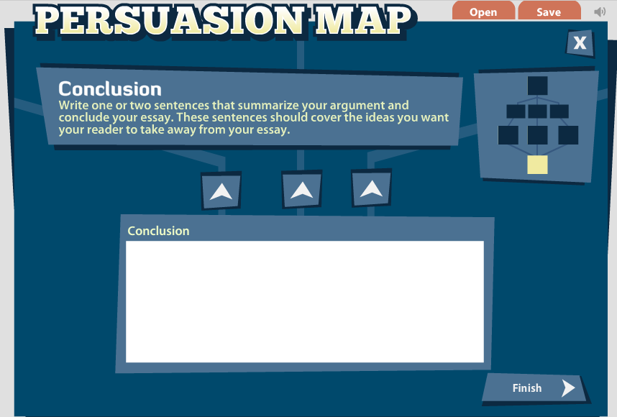
A very basic concept of a conclusion is being explored here, but it gets students thinking about what they will need to do, but in more depth later

Slide 9
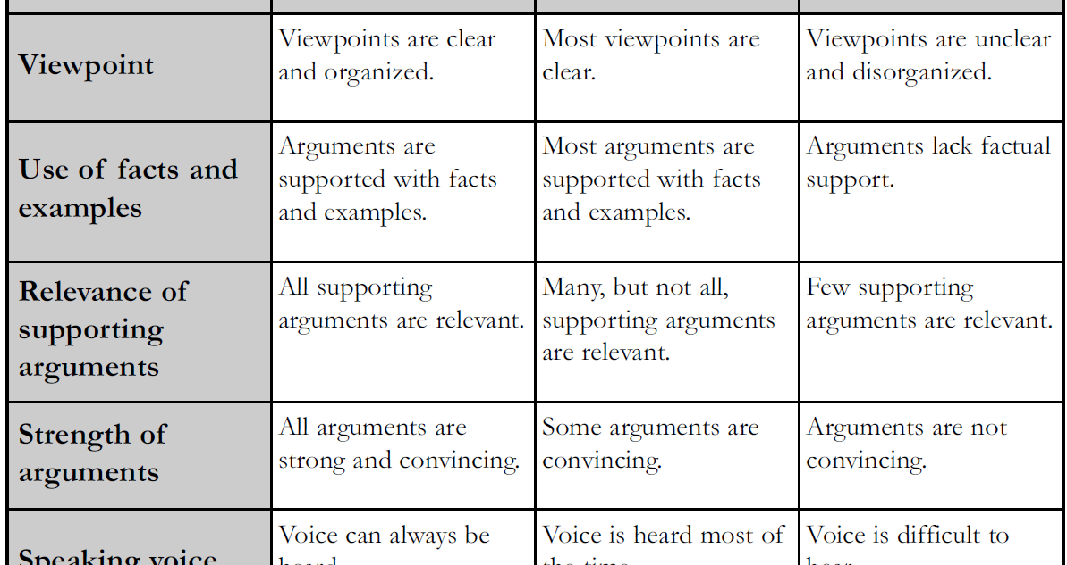
This forms part of session seven and is designed for peer assessing the actual debate. It does have value, however, as a teaching and learning tool to be used in the context of the written project. (Excuse American spelling. This is an American site!)

Slide 10
To conclude
There are lots of extension activities at the bottom of the web page, to further develop the skills required for the Project.
Furthermore, this website is well worth a browse for the development of various other skills across the curriculum.

