Slide 1

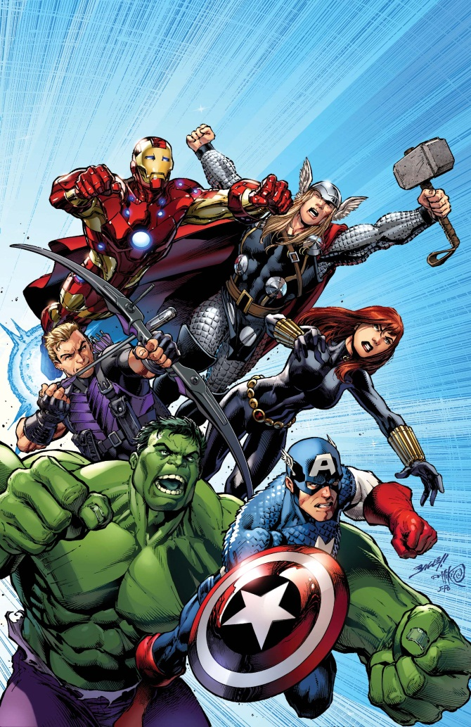



Super Hero Stratified Sampling

Slide 2
Super Hero Stratified Sampling - What's The Story?
In tough economic times the Super Heroes of the world are trying to make their operations more efficient. To do this they have decided to survey both members of the public and villains as to what works best.
There are far too many of each to survey all of them so have decided to take a sample from each group. It must be proportional so have decided to perform a stratified sample.
Can you help our heroes calculate the numbers from each group that they should choose?

Slide 3





Superman's Survey
Superman would like feedback from both friends and enemies on the service he offers, and would also like to know whether he is gender-biased in whilst fighting crime. He has listed how many people there are in each group in the table below. Superman would like a stratified sample of 50.
How many from each group should he choose?
In each group are:
Jimmy Olsen
Lois Lane
Lex Luther
The Contessa
Men | Women | Men | Women
40 | 120 | 160 | 80

Slide 4

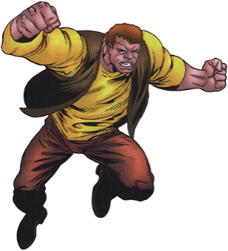




Spiderman's Survey
Spiderman is only going to get villains to answer his survey. They are in groups, the size of each being listed below in the table, and Spiderman would like a stratified sample of 30.
How many should he choose from each group?
In each group are:
Shriek
Ox
Whiplash
Beetle
Spot
Carnage Family | Enforcers | Femme Fatales | Sinister Syndicate | Legion of Losers
35 | 40 | 20 | 45 | 10

Slide 5
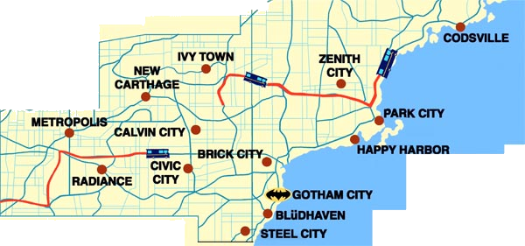

Batman's Survey
Batman has decided to ask people from various cities how he's doing. He has chosen 5 cities and wants a stratified sample of 120. The population of each city is in the table below.
How many should he choose from each group?
Gotham City | Metropolis | Zenith City | Calvin City | New Carthage
280,000 | 235,000 | 175,000 | 200,000 | 110,000

Slide 6
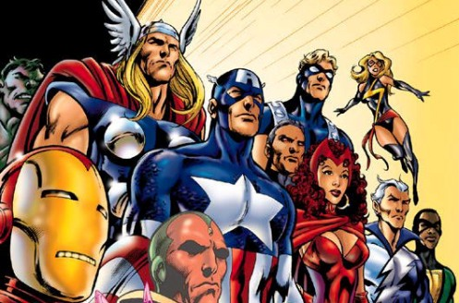
The Avengers' Survey
The Avengers are doing a survey of villains depending on their power and whether they are male or female. They can't decide whether to do a stratified sample of 50 or a 25% stratified sample.
Which would give them more responses and how many should they choose from each group for the sample you recommend?
 | Flight | Gadget | Element | Alien
Male | 27 | 48 | 32 | 18
Female | 13 | 26 | 53 | 7

Slide 7

The X-Men's Survey
X-Men are going to ask employees from their various bases on their performance, but they also want to break them down into males and females. They would like a stratified sample of 60 people. The number of employees at each base is listed in the table below.
How many people of each gender should the X-Men survey?
 | Utopia | X-Mansion | Australia | Graymalkin Industries
Male | 44 | 53 | 75 | 97
Female | 58 | 31 | 20 | 122

