Slide 1
How to display data in PowerPoint

Slide 2
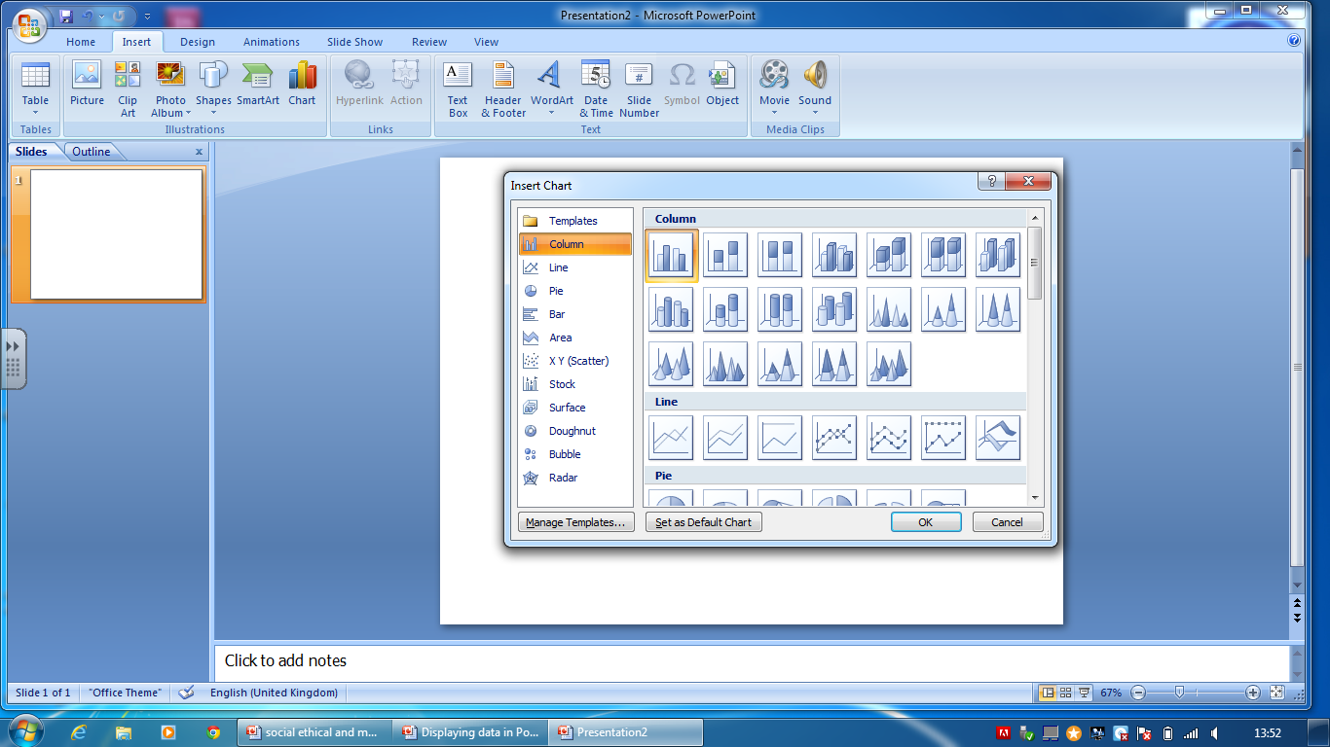
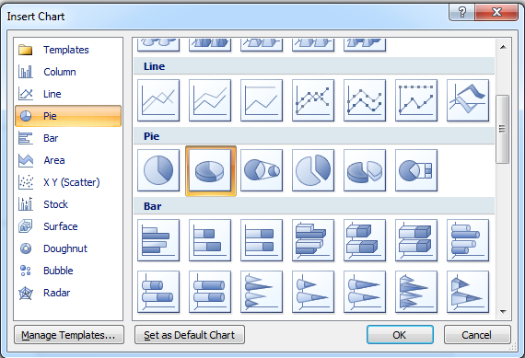
Displaying data in PowerPoint
To create charts in PowerPoint (PPT) first click on Insert and then chart. A window will appear showing the charts available.
For this exercise scroll down and pick the pie chart and click OK. Microsoft Excel will now open.

Slide 3
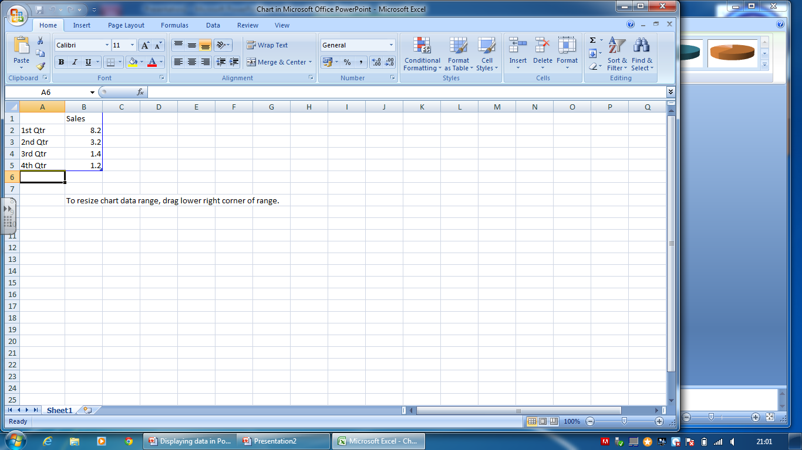
Displaying data in PowerPoint
To change the data in the pie chart you have to the data in Excel. You can add extra sections or take them away by editing the table.

Slide 4
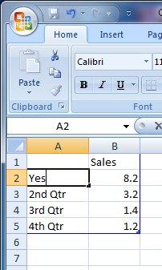
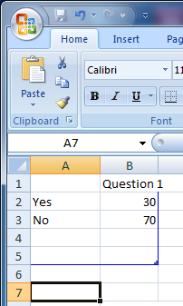
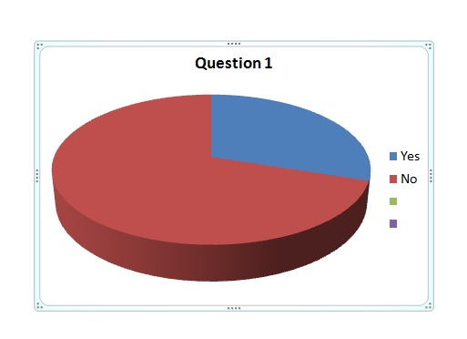
Displaying data in PowerPoint
Double click in a field and type in the name and value you want. When you’ve finished simple click and close Excel.
You can now finish the chart with additional editing.

Slide 5
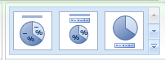

Displaying data in PowerPoint
To change the format of the chart double click on the chart at the bottom right corner. This will change the menu bar. Click as shown to insert the percentages and change the position of the title.

Slide 6
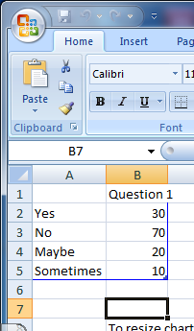
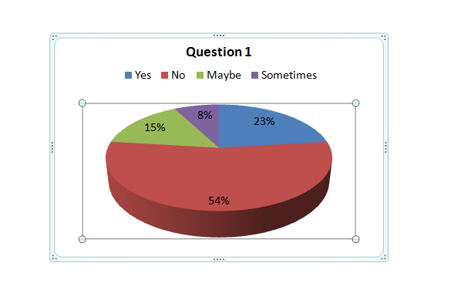
Displaying data in PowerPoint
If you need to amend the chart double click as before and click on you Edit Data in the menu.. This will bring up the original spreadsheet.
Finally to resize the chart simply click and drag the blue box.

