Slide 1
For goal setting to be effective, it’s important that you follow the SMART principle:
S – specific
M – measurable
A – agreed
R – realistic
T – time phased

Slide 2
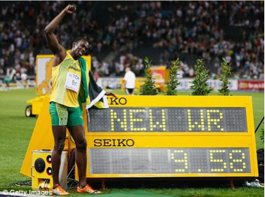
● SPECIFIC – Goals must be clear and specific. You therefore know exactly when you have achieved your goal.
● MEASURABLE – Goals need to be assessed and therefore they need to be measurable. The more specific they are the more measurable they are likely to be.

Slide 3
● AGREED - Goals that teachers / coaches and performers have talked about and shared are more likely to be achieved, because there is a common interest.
● REALISTIC – Goals must be within reach of the performer so that motivation remains high. But if they are too easy it can be de-motivating because the performer may not try as hard. They must be challenging but realistic.
● TIME PHASED – Goals should be split into short term goals leading to long term goals. You need to set yourself a date where you want to have achieved your goal so that you have a time frame to work towards. This ensures goals remain realistic and achievable.

