Slide 1
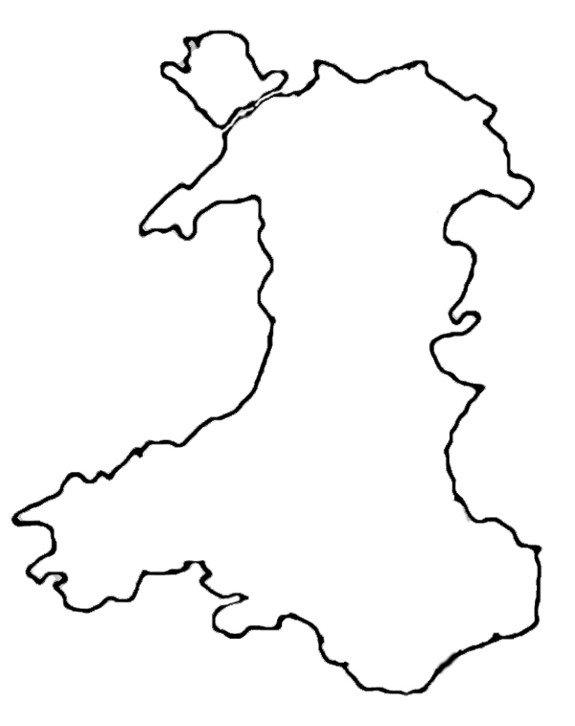

Slide 2
Wyt ti’n cofio?
Cyfieithwch y canlynol:
Translate the following:
Gallech chi
Mae pobl yn mynd i
Es i i
Fy hoff le ydy
Rydw i wrth fy modd efo
Rhaid i chi
Dylech chi
Beth am fynd i.....?
Wyt ti’n cofio?
Cyfieithwch y canlynol:
Translate the following:
Gallech chi
Mae pobl yn mynd i
Es i i
Fy hoff le ydy
Rydw i wrth fy modd efo
Rhaid i chi
Dylech chi
Beth am fynd i.....?

Slide 3
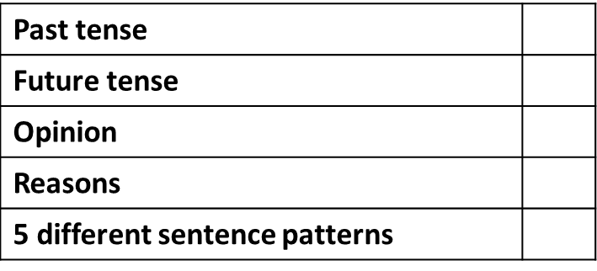


Beth ydy Cymru i ti?
What does Wales mean to you?
{5 + 5} = 10
_______________________________________________________________________________________________________________________________________________________________________________________________________________________________________________________________________________________________________________________________________________________________________________________________________________________________________________________________________________________________________________________________________________________________________________________________________________________________________________________________________________________________________________________________________________________________________________________________________________________________________________________________________________________________________________________________________________________________________
Have you used.?

