Slide 1


Bwcio
Nôd y wers:
Defnyddio iaith briodol er mwyn bwcio rhywbeth (ystafell mewn gwesty / bwyd ayb)
Use appropriate language to book something.

Slide 2


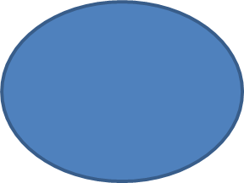


Ystafell mewn gwesty
Bws / trip
Bwcio - beth?
parti
Bwrdd mewn bwyty

Slide 3
Iaith
Hoffwn i – I would like
Hoffet ti – you would like
Hoffai o – he would like
Hoffai hi – she would like
Hoffai john – John would like
Hoffen ni – we would like
Hoffech chi – you would like
Hoffen ni – we would like
* + treiglad meddal *
Hoffwn i fynd i siopa
Hoffai John wylio’r teledu
Hoffwn i ddim
Hoffet ti ddim
Hoffai o ddim
Hoffai hi ddim
Hoffai john ddim
Hoffen ni ddim
Hoffech chi ddim
Hoffen ni ddim
* Dim treiglad meddal *
Hoffwn i ddim mynd i siopa
Hoffai John ddim gwylio’r teledu
Hoffet ti ddiod? – would you like a drink? + treiglad meddal
Beth hoffet ti gael? – what would you like to have?

Slide 4
Iaith
Baswn i’n hoffi – I would like
Baset ti’n hoffi – you would like
Basai o’n hoffi- he would like
Basai hi’n hoffi – she would like
Basen ni’n hoffi – we would like
Basech chi’n hoffi – you would like
Basen ni’n hoffi – we would like
* Dim treiglad *
Faswn i ddim yn hoffi
Faset ti ddim yn hoffi
Fasai o ddim yn hoffi
Fasai hi ddim yn hoffi
Fasen ni ddim yn hoffi
Fasech chi ddim yn hoffi
Fasen ni ddim yn hoffi
* Treiglad cychwynol yn unig*
Faset ti’n hoffi mynd i Ffrainc? - would you like to go to France?
Pryd faset ti’n hoffi mynd? - when would you like to go?

Slide 5
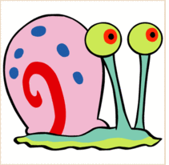
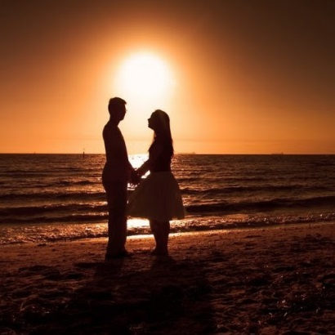
Ymarfer
___________ i fynd i Ffrainc
___________ o fwyta cyri i dê.
___________ hi wylio ffilm rhamant.
___________ i ddim bwyta malwod.
___________ ni ddim nofio bob dydd.

Slide 6
Ymarfer
___________ i’n hoffi mynd i Ffrainc
___________ o’n hoffi bwyta cyri i dê.
___________ hi’n hoffi gwylio ffilm rhamant.
___________ i ddim yn hoffi bwyta malwod.
___________ ni ddim yn hoffi nofio bob dydd.

Slide 7
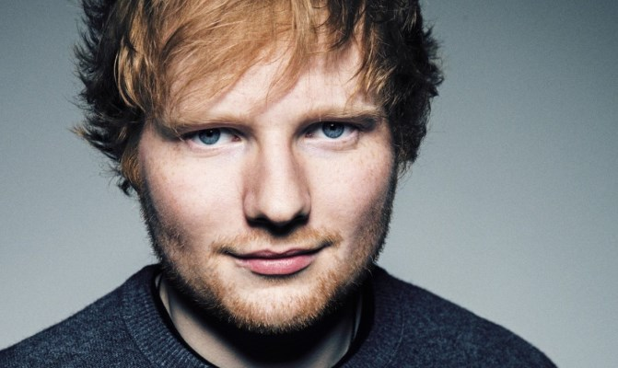

Ymarfer Cyfieithwch y brawddegau yma:
I would like to buy car
John would like to go to McDonald’s.
We would like to watch Ed Sheeran.
He wouldn’t like to walk to school.
Would you like a cake?

Slide 8
Tasg cywiro There are 8 mistakes. Write the corrections in the grid in the corresponding box. Spelling - language/mutation - punctuation - wrong words
Bore dda! Hoffwn i bwcio bwrdd yn y café dydd Iau, Gorffenaf tri i pimp o bobl.
Baswn i’n hoffi eistedd wrth y ffenest os gwelch yn dda. Dw i’n ddim yn bwyta cig, oes bwyd llysieuol?
Dyma fi rhif ffôn 07835189729. Diolch.
1. | 2. | 3. | 4.
5. | 6. | 7. | 8.

Slide 9
Sut i fwcio pethau
Cyfarch - greeting
Dweud pwy ydych chi – say who you are
Esbonio beth rydych chi eisiau – explain what you want
Manylion – details – what,when, where
Manylion cyswllt – contact details

Slide 10
Geirfa a patrymau iaith
Bore da / Pnawn da
Fy enw i ydy… - my name is…
Hoffwn i fwcio… - I’d like to book
Ar – on
Am – at (a time)
I – for (number of people)
Ar gyfer – for (something)
Yn – in
Yn y – in the
Hoffwn i gael… - I’d like to have…
Os gwelwch yn dda – please
Dyma fy rhif ffôn – this is my phone number
Os oes cwestiwn / problem – if you have a question/problem
Ffoniwch fi / Ebostiwch fi ar…- phone/email me on…
Ystafell – room
Bws – bus
Bwrdd – a table
Sut alla i helpu? – how can I help?
Pryd? - When
Faint o’r gloch? – what time?
Faint ?– how much/many?
Ar gyfer faint o bobl? – for how many people?
Hoffech chi…? – would yo ulike..?

Slide 11

Tasg Llafar
Say - good morning
Say – I’d like to book a bus for a trip
Say – on February 2 for fifteen people
Reply – We’d like to go to Cheshire oaks.
Reply – my phone number is 07963821662. Thank you for your help. Goodbye!
Reply - good morning
Reply – ok, when and for how many people?
Say – no problem, where would you like to go?
Say – of course, what’s your phone number?
Say – you’re welcome, goodbye!

Slide 12

Tasg Darllen
Megan: Hwre! Mae’r arholiadau wedi gorffen! Beth am drefnu trip?
Ceri: Syniad da! Ble hoffet ti fynd?
Megan: Hoffwn i fynd i’r sinema i wylio Wonder Woman!
Ceri: Wonder Woman! O na, dw i’n anhytuno, dw i’n meddwl bod mynd i’r sinema yn syniad ofnadwy. Hoffwn i fynd ar drip siopa, beth am fwcio bws i fynd i Cheshire Oaks? Dw i’n siwr basai Lois a Mali yn hoffi dod efo ni. Yn fy marn i mae Cheshire Oaks yn wych achos rydych chi’n gallu siopa, bwyta a mynd i’r sinema yno. Beth wyt ti’n feddwl?
Megan: Iawn, dw i’n cytuno efo ti. Pryd hoffet ti fynd?
Ceri: Beth am wythnos nesaf? Dydd Iau?
Megan: Syniad da. Hoffet ti fwcio’r bws?
Ceri: Iawn, hoffet ti wneud poster?

Slide 13
Tasg Darllen
1.Mae Ceri eisiau gwylio Wonder Woman yn y
sinema. Cywir √ Anghywir X
2. Pa fath o drip hoffai Ceri?
3. Sut mae nhw am fynd i Cheshire Oaks?
4. Yn Cheshire Oaks, dydych chi ddim yn gallu……
siopa sglefrio mynd i’r sinema
5. Mae Megan yn bwcio’r bws
Cywir √ Anghywir X

Slide 14

Tasg llafar grŵp
Mae hi’n wyliau hâf, rydych chi a’ch ffrindiau yn trafod beth hoffech chi wneud.
Meddyliwch am y math o iaith fyddwch yn ei ddefnyddio.
It’s the summer holidays, you and your friends are discussing what you would like to do.
Think about the type of language you will use.

Slide 15
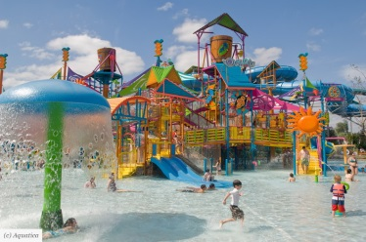

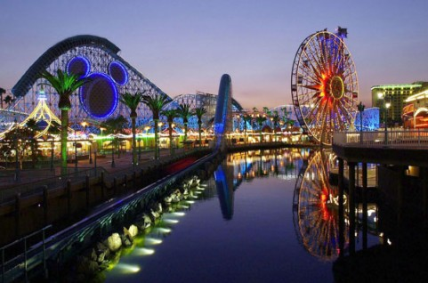
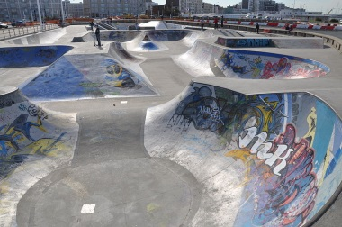


Geirfa
Mynegi barn
Gwyliau hâf
Cysyllteiriau/idiomau
Cwestiynau

Slide 16

Cofiwch! Remember!
Ask and answer questions
Respond to what other people in the group have said
Give your opinion
Agree / Disagree
Use a range of sentence starters
Connect sentences and use idioms where appropriate
Use different tenses if you can

