Slide 1
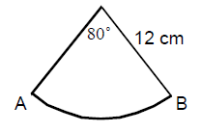
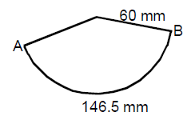
STARTER…
1. Calculate the length of the arc AB below:
Length of arc = $\frac{80}{360}$ x π x 2 x 12
= $\frac{16\text{π}}{3}$
= 16.8cm (1dp)
2. Calculate the angle at the centre of the sector below:
$\frac{θ}{360}$ x π x 2 x 60 = 146.5
120 x π x $θ$ = 146.5 x 360
$θ$ = 52740
120π
$θ$ = 139.9° (1 dp)
Notes:
Starter task to recap memory of arc length to assist with today’s task.

Slide 2
http://www.youtube.com/watch?v=xFntFdEGgws&feature=fvwrel
Notes:
Indiana Jones clip to illustrate taking risks and believing in yourself. Sand is the reflection upon the learning.

Slide 3
Objectives…
Today, we will:
Develop our ability to answer
challenging questions.
How?
Identify the information we know and the information we need.
Break down the task into smaller tasks.
Use prior knowledge/experiences to make connections.
Have a go! BELIEVE & TRUST in yourself!
Notes:
Objectives. Allow class to decide how this will be achieved – points given as support.

Slide 4
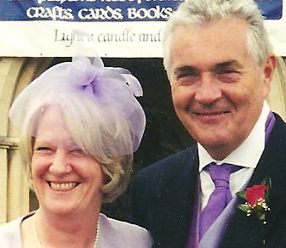
The Problem …
Notes:
Parents! Always causing a problem!

Slide 5
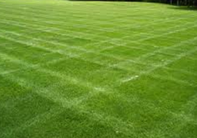
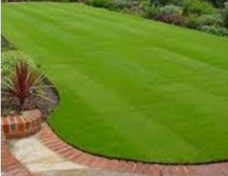
The Problem …
Notes:
Lovely garden but they want it edged with bricks. They have asked me to do the sums, I am asking you to do it!!

Slide 6
The Problem …
Notes:
Would be ok if their garden shape was like this.

Slide 7
What information do we need?
The Problem …
THINK
PAIR
SHARE
Notes:
However, it is more complex – like this. What info do we need to start these calculations?

Slide 8
The Problem …
35m
How much will it cost us?
20m
160°
Notes:
Here is most of the required information. The ‘big question’ is how much will it cost?

Slide 9
Notes:
Blank slide to allow space on board for any workings out if needed.

Slide 10
Objectives…
Today, we will:
Develop our ability to answer
challenging questions.
How did we do?
Identify the information we know and the information we need.
Break down the task into smaller tasks.
Use prior knowledge/experiences to make connections.
Have a go! BELIEVE & TRUST in yourself!
Notes:
Review objectives a s a class.

Slide 11
PLENARY…
☺
__________
☹
Notes:
What I liked / what I didn’t ike.

Slide 12
The following are NOT part of the presentation – they are the information cards and the clue cards.

Slide 13
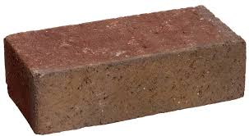
Information Card 1
65mm

Slide 14
Information Card 2
40p

Slide 15
Clue Card 1
160°

Slide 16
Clue Card 2
160°
What is this length?

Slide 17
Clue Card 3
Calculate this length.
160°

Slide 18
Clue Card 4

