Slide 1

INDIVIDUAL PROJECT
FOUNDATION/NATIONAL

Slide 2
40 HOURS (20 TEACHING & LEARNING, 20 HOURS INDEPENDENT)
SKILLS:
Digital Literacy
Planning & Organising
Critical Thinking
Problem Solving

Slide 3
When & How?
Second year of the WBQ teaching programme (e.g. Year 11) after completion of 3 other challenges.
Written project (word processed) 1000 – 2000 words
Or project (as above) & artefact
Must include: graphs, images, data, diagrams.

Slide 4
Topic
It must be based on one of the following:
Personal Interest
Future Educational aspiration
Future Career aspiration
Before the pupil starts to research, the teacher needs to confirm the topic with the pupil as well as aims & objectives. Will there be enough data/information about this topic?

Slide 5
Structuring the project
Deciding on project title
Research methods
Conclusion
Self-evaluation
Bibliography
Appendix
Introduction
Aims & Objectives
Data analysis
Analysis of information

Slide 6
How to teach the project?
1st Step: Research Skills Development
1. Consider how to identify suitable focus/topic and the purpose of a project
2. Understand how to structure and develop a plan for effective research
3. Consider how to devise a research question or statement for a successful project
4. Consider different sources of information, numerical data and materials that can be used in a project
5. Understand how to define and clarify appropriate aims and objectives
6. Learner produces Project title, introduction, aims and objectives

Slide 7
Step 2: Develop Research Methods
Understand types of numerical data that can be collected and their advantages and disadvantages
Understand research methods to collect primary information and numerical data
Understand credibility of sources and use of secondary information and numerical data
Learner produces Research Methods section

Slide 8
Step 3: Complete & present the project & develop research skills
Understand how to identify and explain features of different types of numerical data and use appropriate calculations
Understand how to present numerical data in tables, charts, diagrams and graphs
Understand how to use digital techniques to present research findings
Consider the use of a variety of media to record the production process of artefact
Understand how to analyse and summarise information into both a written format and a design format
Understand the importance of referencing sources of information and developing a bibliography
Learner presents main findings of the project and development of artefact

Slide 9
Step 4: Develop conclusion & evaluation
Understand how to make judgements and draw conclusions based on findings
Understand how to evaluate own strengths and weaknesses in carrying out the Project
Consider what should be included in the Appendix
Learner produces conclusion and reflection of own performance

Slide 10
Examples of project titles:
Personal Interest
Has the standard of Welsh football improved during the past few years?
Has there been an increase in the number of girls participating in sport?
What impact has social media had on family traditions?
Can Wales compete on a Global scale with its music?
What are the advantages of studying the arts?
What will be the future of the Welsh media?
Do pop stars help the image of young people or do they create more harm than good?
What has been the impact of EURO 2016 on Welsh football?
Is being sociable making us more anti-social?

Slide 11
Educational Aspirations
Which country provides the best standard of Education in the UK?
Will going to University guarantee us a successful career and a well paid job?
What is the best age to learn a foreign language?
What are the advantages of being bilingual?
Has the European referendum increased people’s interest in politics?
Should we be making more of an effort to recycle in our schools?
Should we as young people be making more of an effort to eat healthily?

Slide 12
Career Aspirations
What is the crime rate in Wales? Has this increased or decreased in the past 5 years?
Which country has the best education system?
Has our National Health Service improved or deteriorated in the past 5 years?
How much support is there for our youngsters with additional educational needs once they leave school?
Should the Death Penalty be reinstated ?
Reduce, re-use & recycling – how effective are recycling methods in my local area?
Energy or green energy?
What impact does the National Park have on protecting our Welsh environment?
How exactly do the Medecins Sans Frontière work and what impact do they have?

Slide 13
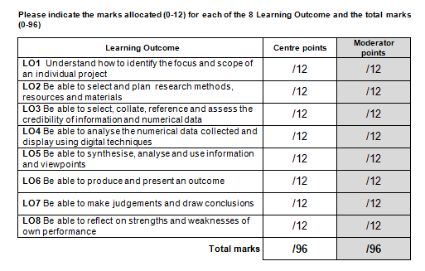
Assessing the project

Slide 14
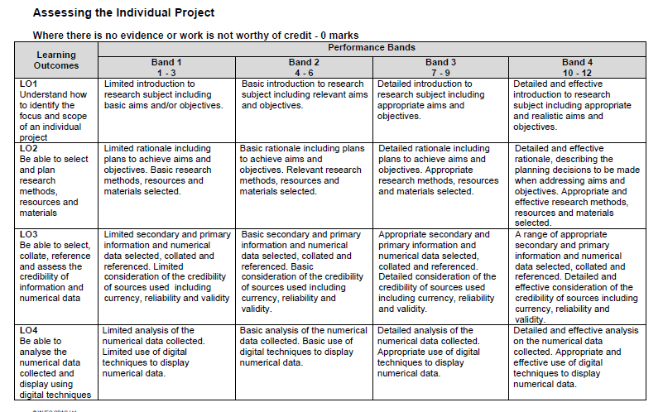

Slide 15
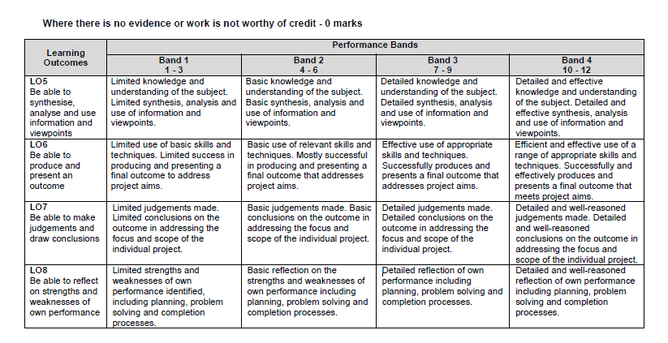

Slide 16
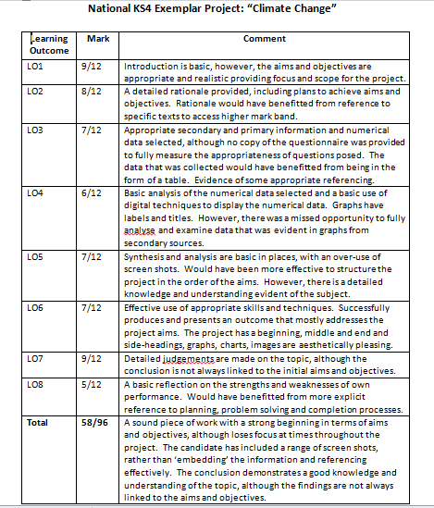
WJEC example of ‘Climate Change’
https://www.wjecservices.co.uk/default.asp

Slide 17
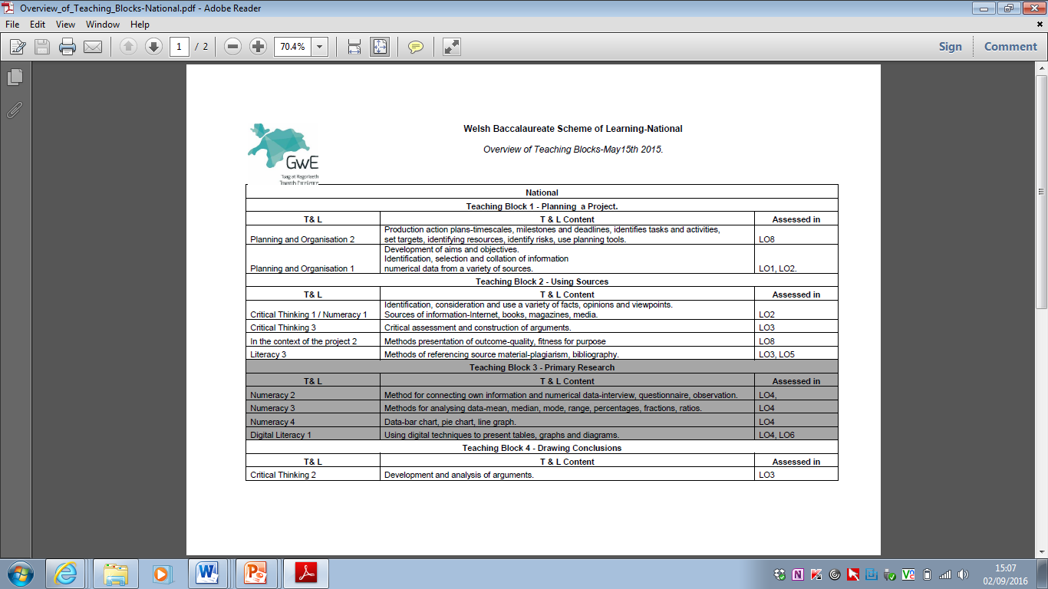
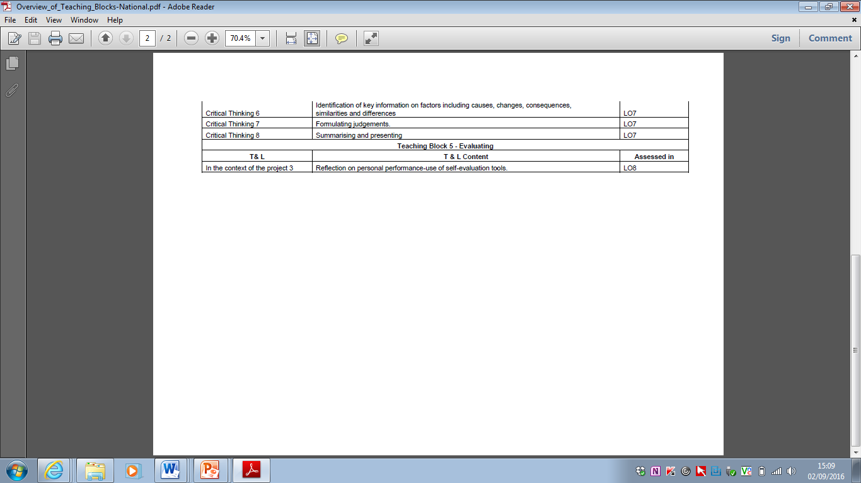
Resources for following lessons are on GwE website: http://bacvle.gwegogledd.cymru/national/individual-project

