Slide 1



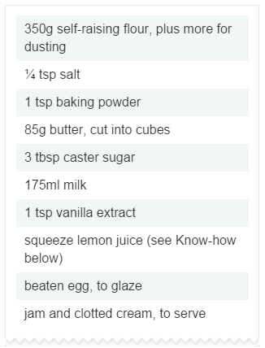
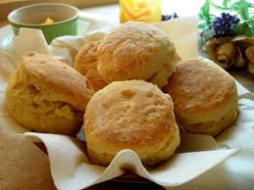


Starter Task…
These trainee chefs were asked to adapt this scone recipe so that it would make enough scones to serve 20 people. Can you help them?
Notes:
7 mins – sheet to go with this starter task, answers on next slide. Re-cap of ratio (already covered).
1

Slide 2
4
20
175g
875g
1/8 tsp
5/8 tsp
½ tsp
5/2 tsp
42.5g
212.5g
1.5tbsp
15/2tbsp
87.5ml
437.5ml
0.5tsp
5/2 tsp
Notes:
3 mins - Discuss final answers and how best to round them to be appropriate for a recipe.
2

Slide 3

Today we will …
Explore and interpret data
Develop our problem solving skills.

Slide 4
https://www.youtube.com/watch?v=VrSUe_m19FY&index=2&list=PL199535C10EE5A7A3
Notes:
5 mins - Stuck on escalator video clip; play & discuss links to this lesson. Using prior knowledge to help … move legs!! This is also in the folder – just incase the link doesn’t work!
4

Slide 5


Upcoming Event:
‘30 Minute Feast’
Bodnant want to check if this feast
really can be made in thirty minutes.
How could they test this?
They decide to record how long 20 people took to make this meal.
Notes:
2 mins discussion – encourage creative thought!
5

Slide 6

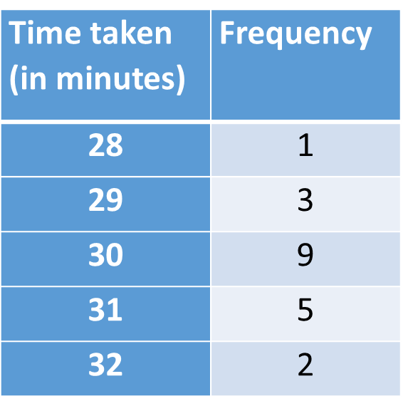

Bodnant have appointed YOU as their statistical adviser! What will you do with this data?
Notes:
Think: 3 mins, Pair: 8 mins, Share: 4 mins
6

Slide 7
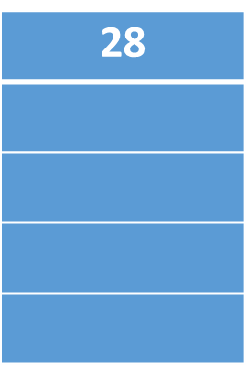
Notes:
Think: 3 mins, Pair: 8 mins, Share: 4 mins
7

Slide 8
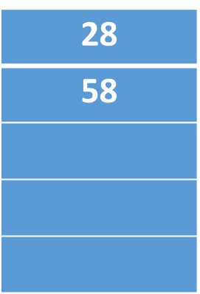
87
Notes:
Think: 3 mins, Pair: 8 mins, Share: 4 mins
8

Slide 9
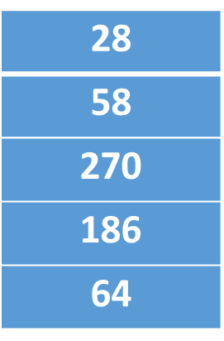

87
270
155
64
604
Mean =
= 604 / 20
= 30.2 mins
Notes:
Think: 3 mins, Pair: 8 mins, Share: 4 mins
9

Slide 10

Bodnant have decided to increase their sample size to 100.
Look at this new data and investigate how you can answer their question now.
Notes:
10

Slide 11
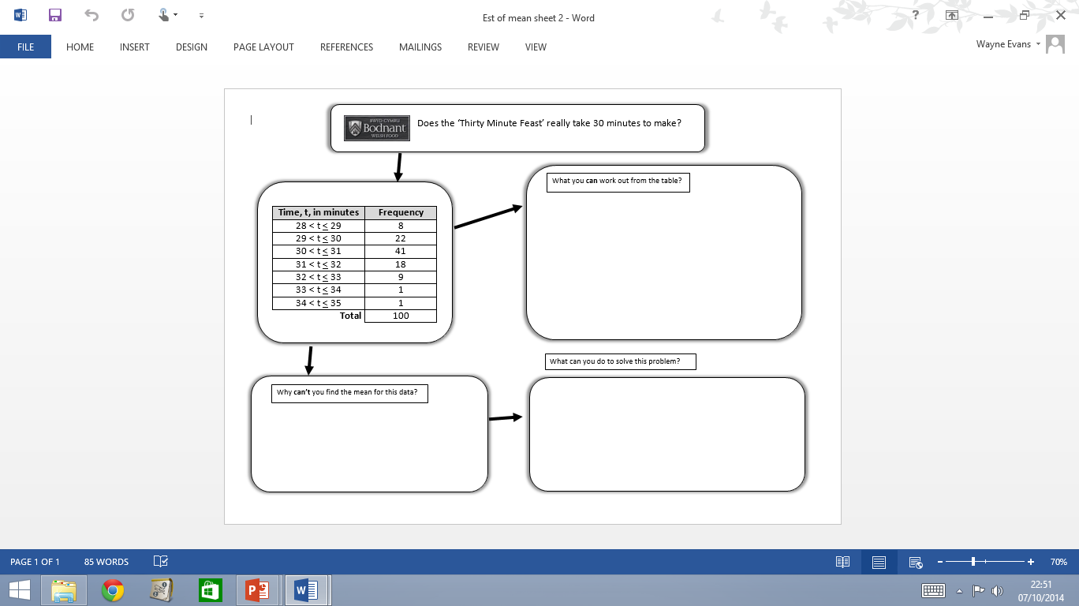
What can you work out from the table?
What can you do to solve this problem?
What can’t you find out from the table and why?
Notes:
5 mins -Discuss grouped data and framework questions for the investigation. 10 mins to begin investigating.
11

Slide 12



Notes:
Highlight the problems and hint that these can be turned into solutions. Link back to video clip.
12

Slide 13
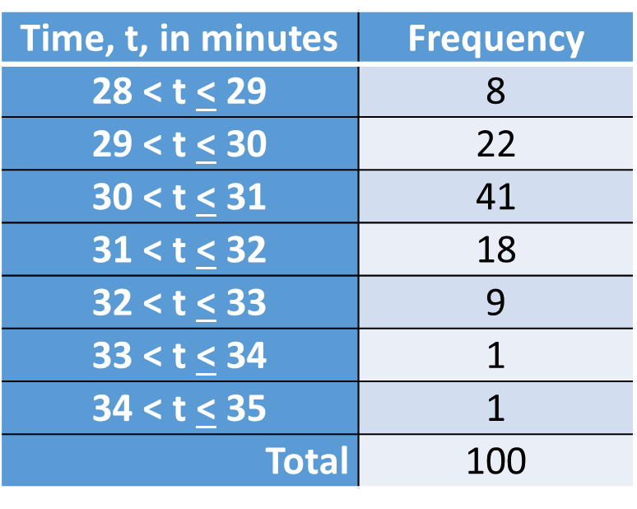
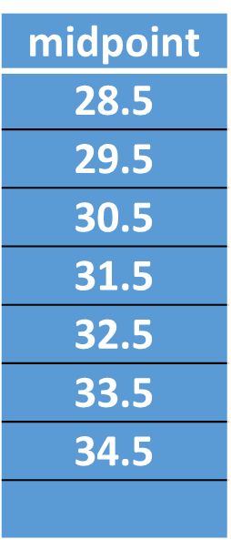
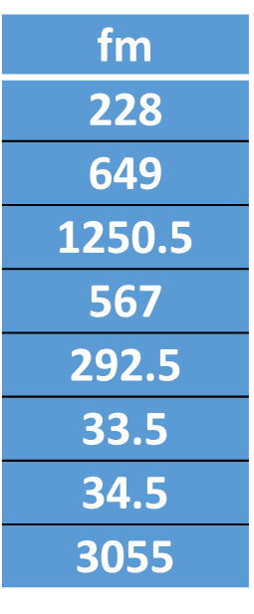
8 people who take between 28 and 29 mins.
22 people who take between 29 and 30 mins.
41 people who take between 30 and 31 mins.
18 people who take between 31 and 32 mins.
9 people who take between 32 and 33 mins.
1 person who takes between 33 and 34 mins.
1 person who takes between 34 and 35 mins.
3055 ÷ 100 = 30.55 mins
Notes:
5 mins summary. Encourage learners to explain their thoughts, use PPT answers to assist their explanations.
13

Slide 14
How did you do?
Explore and interpret data
Develop our problem solving skills.

Slide 15

Notes:
2 mins reflection.
15

