Slide 1
What is humanism?
A study of a secular philosophy

Slide 2
Our Learning Journey
Objective – What are the Key concepts of the Humanism Unit?
To know the key concepts involved in the Humanism unit of work | To have demonstrate understanding of the key concepts | To applied your knowledge of the key concepts to an exam style question.
Starter
How many words can you make from the letters of
HUMANISM
https://www.youtube.com/watch?v=DZN8Ne1nmr4&list=PLmy6S1K0vOcMKbQxHIn9w3TEDt0nQShc7
Ethics, Philosophy and Religion

Slide 3
Key Concept | Definition | How is it linked to humanism? | Explain/example/ apply to real life
empathy
humanism
philosophy | A love of wisdom, discussion important questions about life and the meaning of life. | Humanism is an example of a non religious philosophy | Humanists answer philosophical questions from a non religious perspective
happiness
worldview
ethics
Notes:
Print off next few slides, place the posters around the room use envoying technique to gather information to fill in the sheet

Slide 4
Key Concept | Definition | How is it linked to humanism | Explain/example/ Apply to real life
empathy
humanism
philosophy
happiness
worldview
ethics
Notes:
Print off

Slide 5
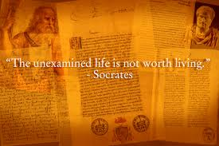
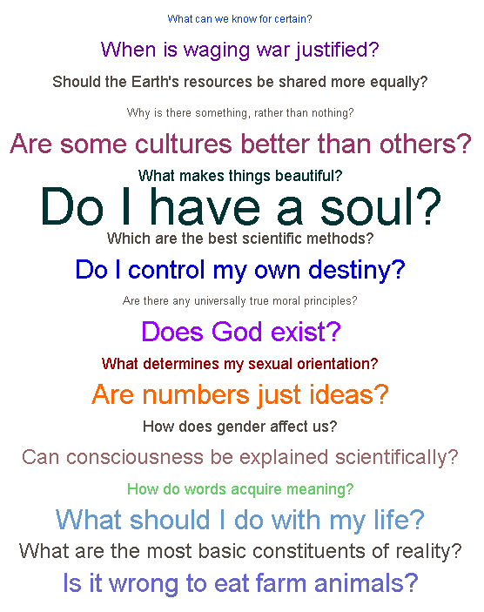
philosophy
Thinking about and discussing important questions about purpose and meaning
Humanism is a secular (non religious) philosophy or set of ideas that tries to answer philosophical questions from a non religious view.
May not come to any definite answers but we can learn to understand things in more depth

Slide 6
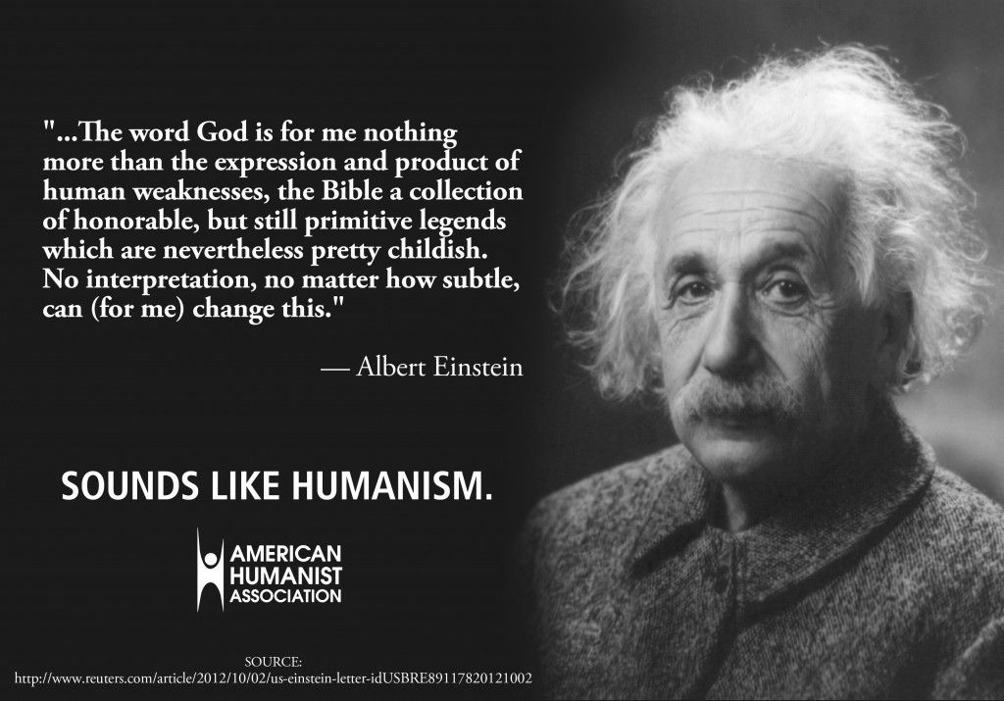
humanism
Humanism is a philosophical world view that seeks to answer important questions about ethics, meaning and purpose from a non religious point of view.
Humanists believe that things are right or wrong depending on how those action affect others.
Humanists try to use their empathy skills to imagine what it would be like in someone else’s shoes.

Slide 7
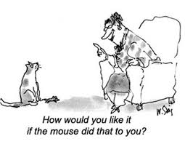
empathy
‘will my actions increase the happiness of others or increase their pain?’
Trying to consider what it feels like to be in someone else's position.
Humanists believe that when they are deciding on what is right and wrong they should use their empathy skills to decide how their actions may impact on others.

Slide 8
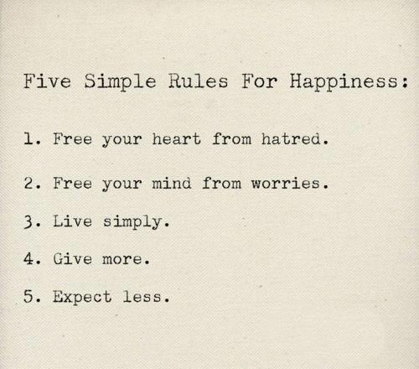
happiness
Absence of pain
Humanists believe that rather than looking to ancient scriptures for guidance such as the Bible, what is important is to act in such a way that increases happiness.
Being content or fulfilled in your life, enjoyment

Slide 9
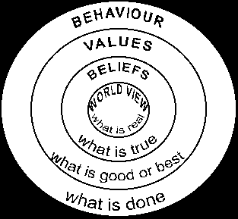
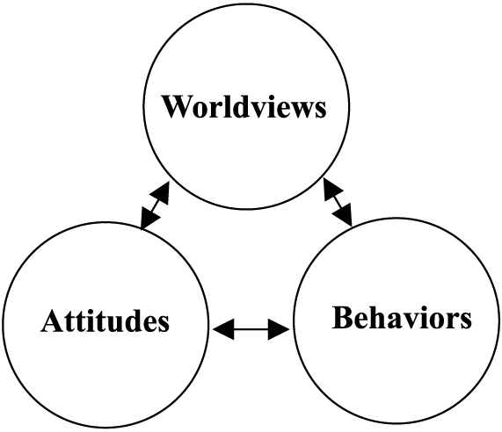
worldview
The way in which humans interpret the world around them, religious people for example see evidence of God in the world and interact with it according to what they believe are Gods laws.
Humanists interpret the world in completely non-religious ways, they base their interactions and judgements on their experiences and the knowledge that science provides.

Slide 10
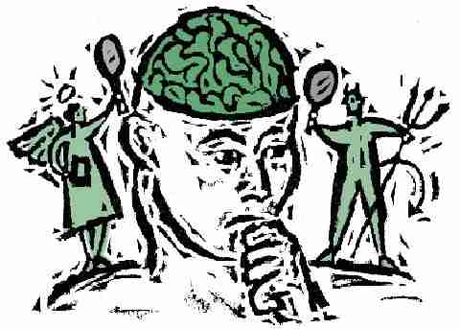
ethics
For humanists their moral decisions are based on the potential impact of their actions on others.
Treat others as you would like to be treated: The Golden Rule
Ethics are the rules by which we base our moral decisions, for Christians these are based on the values in the Bible

Slide 11
Our Learning Journey
Objective – What are the Key concepts of the Humanism Unit?
To know the key concepts involved in the Humanism unit of work | To have demonstrate understanding of the key concepts | To applied your knowledge of the key concepts to an exam style question.
Ethics, Philosophy and Religion

Slide 12
Exam Practice
Key concepts always come up as two mark questions in the GCSE exam.
Explain what humanists mean by the term happiness. (2)
Explain what humanists mean by the term world view. (2)
Explain what humanists mean by the term ethics. (2)
For two marks you need to define the word AND give an example or further explanation.
Even though these are only worth 2 marks, to get the top marks you also need to be using the key concepts in the longer exam answers.

Slide 13
Peer Assessment
Swap your book with someone else, look at the marking criteria below and give each answer a mark.
Nothing of relevance or an incorrect definition. | 0
Have they given a simple definition of the word that is correct? | 1
Have they given a relevant example? OR expanded on the definition by linking it to a religion? | 2
Extension Task:
Write down a crossword clue for the following words:
philosophy empathy humanism

Slide 14
Our Learning Journey
Objective – What are the Key concepts of the Humanism Unit?
To know the key concepts involved in the Humanism unit of work | To have demonstrate understanding of the key concepts | To applied your knowledge of the key concepts to an exam style question.
C-D | B-C | A*-B
Ethics, Philosophy and Religion

