Slide 1
Our Learning Journey
Objective –What is humanism?
Describe and explain the ‘happy human’ symbol for humanism | Explain what humanism is and what is meant by a secular philosophy | Evaluate the claim the claim that Britain is a Christian country.
C-D | B-C | A*-B
Ethics, Philosophy and Religion

Slide 2
British Humanist Association
This is the logo of the BHA.
1. What do you think it is supposed to represent?
2. If you were to think of a name of it what would be and why?
Notes:
The logo is called the Happy Human.

Slide 3
British Humanist Association
This is the logo of the BHA.
1. What do you think it is supposed to represent?
2. If you were to think of a name of it what would be and why?
3. It is actually called the ‘Happy Human’, what does this tell you about humanist philosophy?
https://www.youtube.com/watch?v=Tvz0mmF6NW4&feature=player_embedded
Notes:
The logo is called the Happy Human.

Slide 4
Humanist values
https://www.youtube.com/watch?v=jEnkHfiiKRg&feature=player_embedded
Write out the passage below and fill in the missing words from the list at the bottom.
Humanists do not believe in _________ or other ________ beings.
They believe in the Golden _______ which is to treat others as _______ want to be ________. They think that you should always consider how your ___________ will affect other people and you should think about how you would feel in someone else's _______. Imagining how others feel is called ___________.
Humanists believe that we should use our _________ nature to work out how to live, and that we should use __________ and ___________ when deciding on the what is right and wrong.
empathy actions rule God reason you shoes human empathy supernatural treated

Slide 5
Humanist values
Write out the passage below and fill in the missing words from the list at the bottom.
Humanists do not believe in God or other supernatural beings.
They believe in the Golden rule which is to treat others as you want to be treated. They think that you should always consider how your actions will affect other people and you should think about how you would feel in someone else's shoes. Imagining how others feel is called empathy.
Humanists believe that we should use our human nature to work out how to live, and that we should use empathy and reason when deciding on the what is right and wrong.
empathy actions rule God reason you shoes human empathy treated

Slide 6
Secular: something that is unconnected to religion
Humanism is a secular philosophy, what do you think is meant by this?
What is it that makes humanism a secular philosophy?
Philosophy: discussion of ideas to deepen our understanding

Slide 7
Humanism: A secular philosophy or worldview
Humanism is a secular philosophy because it seeks to answer important questions about the world and the purpose of human life without any reference to God or the supernatural.
Humanism is a world view that only uses science, evidence, reason and empathy to make sense of the world and to inform how they should act and care for others.

Slide 8
Our Learning Journey
Objective –What is humanism?
Describe and explain the ‘happy human’ symbol for humanism | Explain what humanism is and what is meant by a secular philosophy | Evaluate the claim the claim that Britain is a Christian country.
C-D | B-C | A*-B
Ethics, Philosophy and Religion

Slide 9
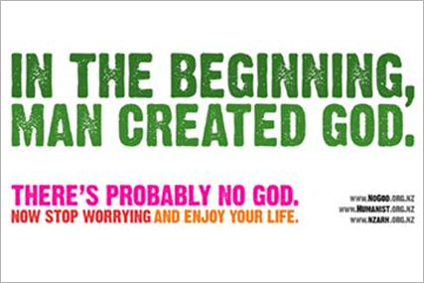
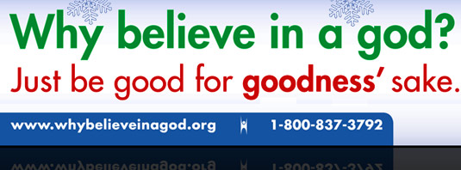
Census is a collection of data completed every 10 years
Leading up to the last census in 2011 The British Humanist Association lead a campaign to try and get people to be honest on their census forms. They wanted people to stop saying they were Christian if they were not as they felt many people just ticked Christian out of habit without even thinking about it.
https://www.youtube.com/watch?v=b1KUOksyYcA
Notes:
Print this slide off for discussion and play the video link in the middle of the page. It is of the creator of the campaign talking about why she put it together and with comments from Dawkins and Polly Toynbee.

Slide 10
discuss
Reflect on the campaign
What impression does it give you of humanists?
Do you think some people may have found it offensive? Who? Why?
How do humanists know there is probably no God?
Do we worry more today than in the past?
Is the meaning of life simply enjoyment?
Notes:
Ask learners to discuss in twos and be ready to feed back to the class their thoughts on each question

Slide 11
Questions on the 2011 Bus Campaign | Note down your thoughts on each of these questions.
What impression does it give you of humanists?
Do you think some people may have found it offensive? Who? Why?
How do humanists know there is probably no God?
Do we worry more today than in the past?
Is the meaning of life simply enjoyment?

Slide 12
Is Britain Christian?
In 1990 5,595,600 people, representing 10% of the UK population, regularly attended Church, by 2005 this number had reduced to 3,926,300, equating to 6.7% of the UK population
By 2015, the level of church attendance in the UK is predicted to fall to 3,081,500 people, or 5% of the population. Yet 70% of people in Britain circled “Christian” on the recent 2011 census.
Why do you think this is?

Slide 13
Evaluation
‘Britain is a Christian country’
Evidence to agree with the quote | Evidence to disagree with the quote

Slide 14
Our Learning Journey
Objective –What is humanism?
Describe and explain the ‘happy human’ symbol for humanism | Explain what humanism is and what is meant by a secular philosophy | Evaluate the claim the claim that Britain is a Christian country.
C-D | B-C | A*-B
Ethics, Philosophy and Religion

Slide 15
Humanists do not believe in _________ or other ________ beings.
They believe in the Golden _______ which is to treat others as _______ want to be ________. They think that you should always consider how your ___________ will affect other people and you should think about how you would feel in someone else's _______. Imagining how others feel is called ___________.
Humanists believe that we should use our _________ nature to work out how to live, and that we should use __________ and ___________ when deciding on the what is right and wrong.
Humanists do not believe in _________ or other ________ beings.
They believe in the Golden _______ which is to treat others as _______ want to be ________. They think that you should always consider how your ___________ will affect other people and you should think about how you would feel in someone else's _______. Imagining how others feel is called ___________.
Humanists believe that we should use our _________ nature to work out how to live, and that we should use __________ and ___________ when deciding on the what is right and wrong.

