Slide 1
Our Learning Journey
Objective –Do we need a God?
Explain the difference between a fact and a belief | Consider what humanists believe about God, purpose and human life | Evaluate the claim that people need God to live a full, moral life.
C-D | B-C | A*-B
Ethics, Philosophy and Religion

Slide 2
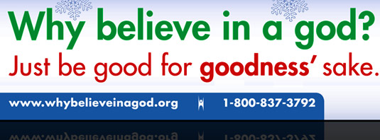
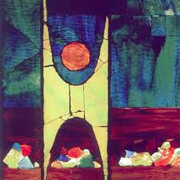
What did we learn last lesson?
Write down three things you learned last lesson
1. ________________________________
2._________________________________
3. _________________________________

Slide 3
Humanists…
Do not believe in God or gods.
Are not religious
Believe that part of the reason humans are special is that we are curious about the world and can ask questions and look for answers.
Believe that humans can create their own purpose, this can include to be happy, to raise a family, to succeed in work and education and to care for others.

Slide 4
Humanists…
Do not believe in God or gods.
Are not religious
Believe that part of the reason humans are special is that we are curious about the world and can ask questions and look for answers.
Believe that humans can create their own purpose, this can include to be happy, to raise a family, to succeed in work and education and to care for others.
1. Do you think humans are special? Why?
2. What do you believe is the purpose of humans?

Slide 5
How do we decide what is true?
How do we decide what is true?

Slide 6
How do we decide what is true?
Do an experiment
See, feel, smell, touch, hear it
Establishing facts
How could we find out something is true?
Written evidence?
Anything else?
Photo of it?

Slide 7
But …..belief differs…..
Evidence is not always conclusive, e.g. science can tell us how the world was made but not how to create matter. (though it may do at some point)
Do we need belief for unanswerable questions?
New evidence can contradict old evidence, so are there really any absolute truths in science? E.g. some scientists use proof to say global warming is taking place, while others use contradictory evidence to say global warming is part of a natural cycle!

Slide 8
Fact or belief Cut and sort the following into two groups. Be ready to explain your reasons.
Manchester United is the best football team in the world | The person now known as Caitlyn Jenner from the TV show the Kardashians was once an Olympian
United Kingdom will win the Eurovision song contest next year | God does not exist
The beatles were the best band in the world | Britain is a Christian country
When I die I will go to heaven | Religious people live better lives.
Dinosaurs once walked the earth | Birchwood is in Warrington
Henry the VIII had six wives | Smoking is bad for your health
God is a man | Our school day ends at 3pm
Notes:
Print for cut and sort activity

Slide 9
If we can’t prove it, then it’s a belief
BELIEF?
Sort the cards into 2 columns in groups – fact and belief.
How you can you prove the facts?
Do you disagree with anyone else in the group?
How would you argue your case?
FACT?

Slide 10
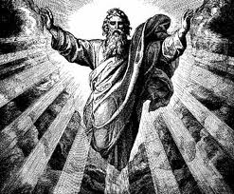
Watch the video clip of some humanists discussing God
https://www.youtube.com/watch?v=6POf8YyWty0
https://www.youtube.com/watch?v=IPcK-2BTvyA
What are their reasons for not believing that there is a God?
Make a note of them in your books
Could their minds be changed? How?

Slide 11
Our Learning Journey
Objective –Do we need a God?
Explain the difference between a fact and a belief | Consider what humanists believe about God, purpose and human life | Evaluate the claim that people need God to live a full, moral life.
C-D | B-C | A*-B
Ethics, Philosophy and Religion

Slide 12
Do we need God?
Create a “continuum” line with “strongly agree “at one end and “strongly disagree” at the other end.
Stand along the continuum to reflect what you believe.
AGREE DISAGREE
Be ready to give a reason for your position

Slide 13
Evaluation
‘You need God to give life true meaning and purpose’
Evidence to agree with the quote, include what a theist may say | Evidence to disagree with the quote, include what a humanist would say
What do you think?
Theist: Someone who believes in God
Notes:
TAG learners should do the task on the next slide, print it out and give it to them separately.

Slide 14
TAG TASK
‘You do not need God to give life true meaning and purpose’
Do you agree or disagree with this statement? You must show you have considered more than one point of view. You must refer to humanist and religious views in your answer. (8 Marks)
Follow the ADAM framework:
Agree- paragraph agreeing with the statement
Disagree- paragraph disagreeing with the statement
Add religion/humanist views- check you have included both views
My view- write your own view and give a reason

Slide 15
Our Learning Journey
Objective –Do we need a God?
Explain the difference between a fact and a belief | Consider what humanists believe about God, purpose and human life | Evaluate the claim that people need God to live a full, moral life.
C-D | B-C | A*-B
Ethics, Philosophy and Religion

