Slide 1
Literacy 3
Communication using language appropriate for purpose and audience

Slide 2
Learning objective
To identify audience and purpose.
To understand the impact audience and purpose has on writing.

Slide 3
What do we mean by audience and purpose?
Notes:
To help class discussion of purpose and audience use generic clip looking at PAF (Purpose, audience and form) https://www.youtube.com/watch?v=93eA7cttZCM

Slide 4
To Inform or Persuade
Look at the advertisements below, what is the key purpose of them to inform or persuade?
Advert 1: www.youtube.com/watch?v=p7qglkjxaL8
Advert 2: www.youtube.com/watch?v=yB8tgVqmKzw
What is this advert? (advert 3) https://www.youtube.com/watch?v=c_z-4S8iicc
Notes:
Watch advert 1 and 2- class discussion of the language used in them and if they are informative or persuasive. Discussion how this impacts on the language used.
1-https://www.youtube.com/watch?v=p7qglkjxaL8 - reebok fitness advert- Informative advert.
2-https://www.youtube.com/watch?v=yB8tgVqmKzw – audi R8 advert
Comparison of language used and presentation, what makes them different? What is similar?
Watch advert 3- https://www.youtube.com/watch?v=c_z-4S8iicc
Is this a combination of both informative and persuasive? In what ways?

Slide 5
Primary research results.
From the data collected it is concluded that 9 out of ten people liked shopping in large outlets with there m8s. This shows that there isn’t that much to do at the weekend other than going out with friends and hanging around in 2days world☹ . When asked 8 of these people said that a new shopping center would be gr8. I think this research shows that the local council needs to act ASAP to correct this. U can see from the results that young people don’t think there is a lot to do in the are, so my nxt ? Was to look at what people need.
Notes:
What do you think? Class discussion of news article on allowing text talk in exams- use this as a prompt for what is formal language and when should it be used?
http://www.dailymail.co.uk/news/article-413866/Exam-chiefs-ridiculed-allowing-text-speak-English-answers.html
Class discussions looking at the report on slide, identify the text talk and other errors.

Slide 6

Complex materials
Who is the audience of the document?
What is the purpose of the document?
How have they achieved clarity in delivering a complex subject matter?
Notes:
Government HSE document on COSHH- a complex issue written with clarity and assessable to none specialists- how have they achieved this?
http://www.hse.gov.uk/pubns/indg136.pdf

Slide 7
Thinking about the IP
Think Pair Share
What is the purpose of the Individual Project?
Who is the audience of the Individual Project?
Notes:
Purpose.
To present information- to inform
To present an argument- to persuade
Audience.
Is reflected in the title in some ways discussion of being a formal project in terms of its structure, language and contents.

Slide 8
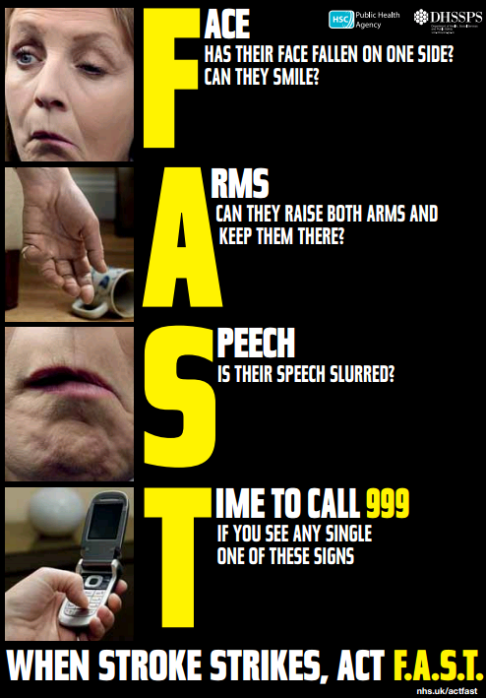
Progress Check
Look at the poster. Using what you have learnt today discuss the poster using the flowing terms:
  Complexity
  Audience
  Purpose
  Form
Notes:
Source of poster: http://www.publichealth.hscni.net/sites/default/files/Stroke_Female_Leaflet_A5_02_13.pdf

