Slide 1
Critical Thinking
Global Citizenship Challenge
Raising Awareness
“Those who cannot change their minds
cannot change anything.”
George Bernard Shaw

Slide 2
First Impressions
Load the film. Watch the first 35 seconds and then answer the first 5 questions on your sheet.
Then watch the rest of the film.
Question | Type your answer here
Do you think this man is famous?
Why do think they man is allowing himself to be filmed?
Do you have an opinion about his facial piercings?
What sort of job do you think he has?
Now watch the rest of the video
Did your opinion of him changed after seeing the rest of the video. Explain your answer.
Notes:
Show students the video but STOP at 35 seconds. Ask them to fill in their first form on page one of the booklet. Its important they don't see past this point to begin with.
The model changes completely back to his normal self with all the tattoos. The music is good so make sure your speakers are on!

Slide 3
Tattoo Man
His name is Rick Genest. People call him Rico or Zombie boy. He was born in Canada and was a street performer. He had a brain tumour at the age of 15. He has become a sought after model for high fashion and videos.
Did your opinion of him changed after seeing all the tattoos?
Notes:
Answers to who Tattor boy is.
Discuss first impressions and how we make them.

Slide 4

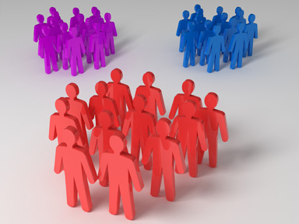
How are stereotypes formed?
Notes:
Researchers also believe we create stereotypes because we like to categorize the world. It seems people have the need to sort the world both socially and physically into preferable neat little groups. But sometimes people are put into groups with negative feelings associated with them....... Look on the next page
Benign decision making/connected to herd behaviour/ Cafe example/information cascade. Many psychologists Freud looked at this and if you beleive the stories Adolf Hitler used to put groups of SS soldiers dressed as civilians and get them to cheer for adolf. What do you think happened.

Slide 5
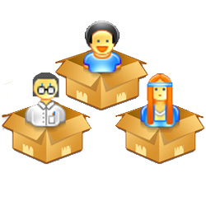
Associating characteristics with certain groups of people
We sometimes box people into categories to make it easier for us to understand them
She’s a doctor , she must be clever and very healthy
She’s wearing a headband, she must be sporty and active
Categorisation is a normal. It helps us understand the world better, but.......
Notes:
So getting back to the idea of categorising people to make our lives more organised and easier to cope with. Often when we are young, we follow our parents opinions, then as we get older our friends ideas about life can start to influence us.
You can see how that can be very helpful But what happens it maybe we are sticking to a negative idea about someone?

Slide 6
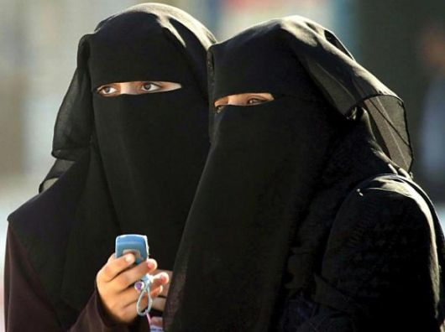
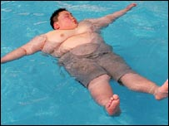
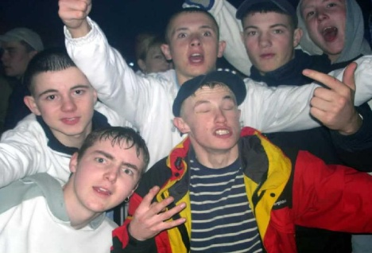
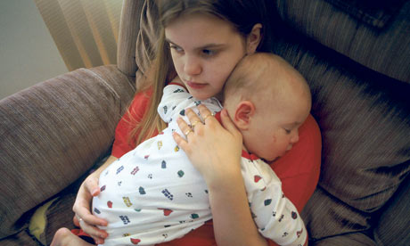
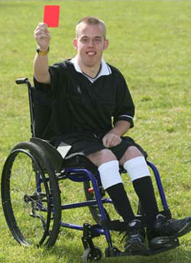
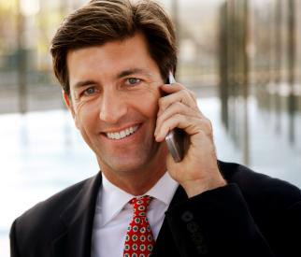
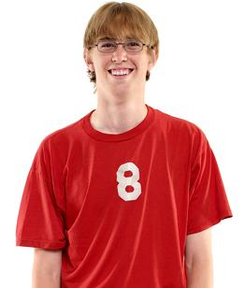
What about real people?
What opinions do you have these people and their lives?
What are those opinions based on?

Slide 7
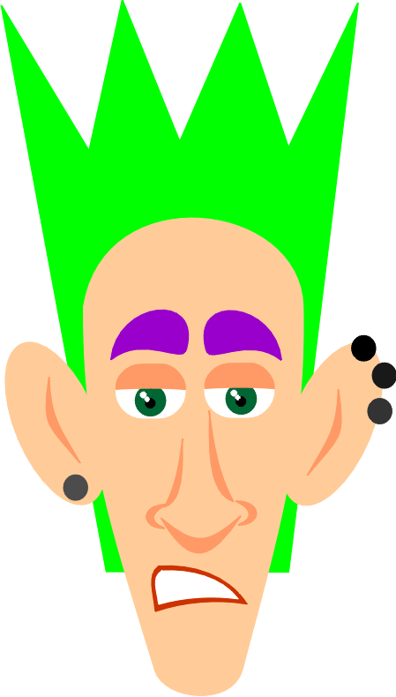
Watch the video. Things aren’t always what they seem.
People make their minds up about me, even before they have got to know me!
Notes:
This short advert shows a punk rocker seemingly going after a mans brief case. But he is not, he is saving his life.
Discuss how when things are seen from different points of view.

Slide 8

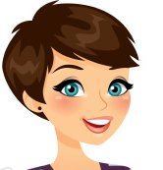

What do people think about me?
How many of you use Twitter, Facebook, Instagram etc?
Do you ever think people’s opinions
of you might be affected
by what you write?
Hey, what I put on my Twitter page is no one else’s business!!

Slide 9
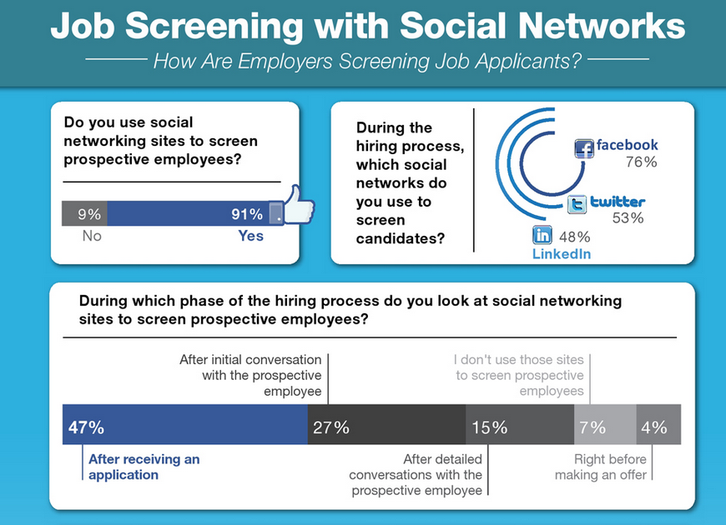

Slide 10
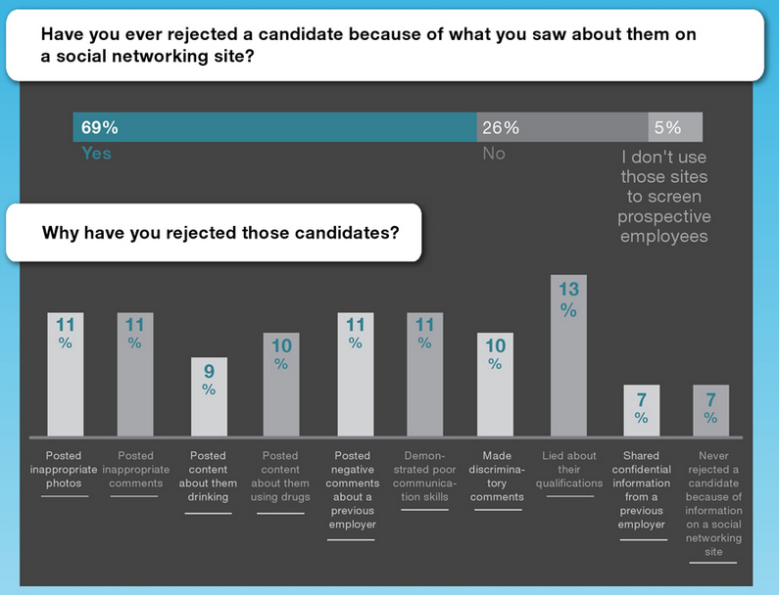

Slide 11
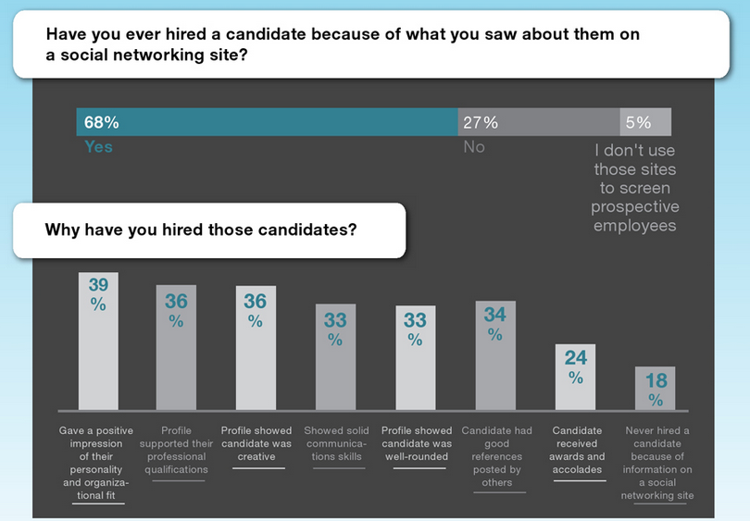
The source of this information about social networking is Media Bistro. They are an organisation who support people looking for jobs in media. They know what they are talking about!

Slide 12
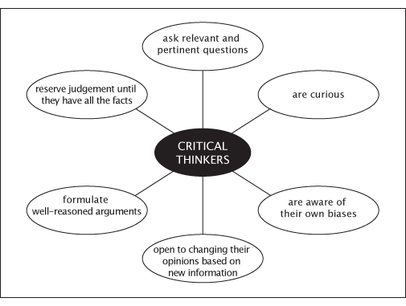

Slide 13
World Issues
Are these reliable sources of information?
www.bbc.co.uk/news
www.dailymail.co.uk
www.oxfam.org.uk

