Slide 1
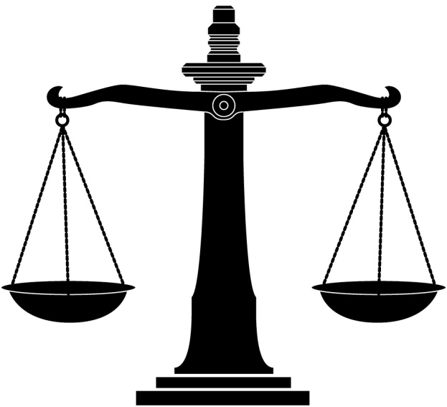
Legislation
How can the law affect people who live in poverty in Wales, Europe and the rest of the world?

Slide 2
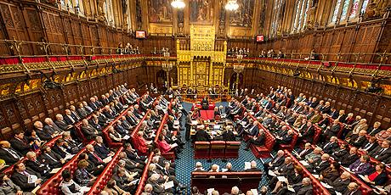
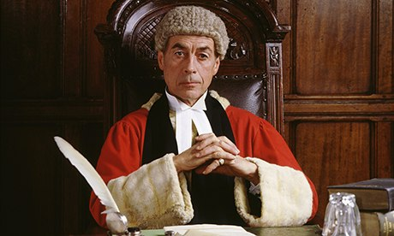
What are laws?
Laws are sets of rules that are made to protect people and create a civilized society.
Who makes the laws?
In our country laws are made by the Government and also by judges. In a court if a judge thinks a law needs adding to, they will ‘set a precedent’ and add an extra feature to the law they use in the court.

Slide 3
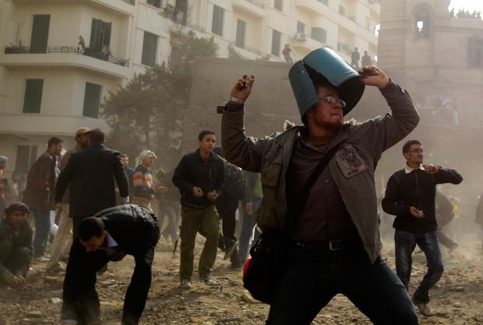
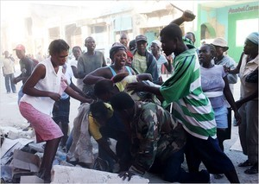
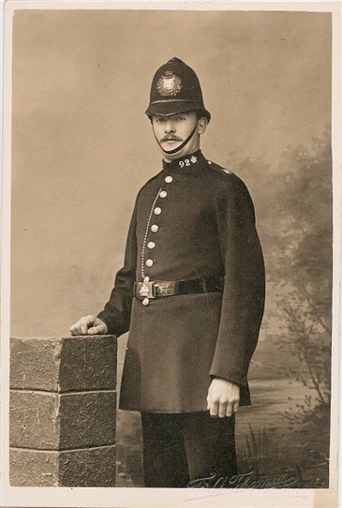
Do laws work?
Some laws are very old and people think they need changing. However, mostly in the UK, the laws are very good and protect us.
What about in other countries?
In some countries, laws are not set down as clearly as ours. Also in some countries there are no laws to protect people.

Slide 4
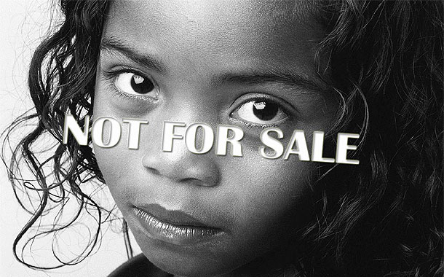
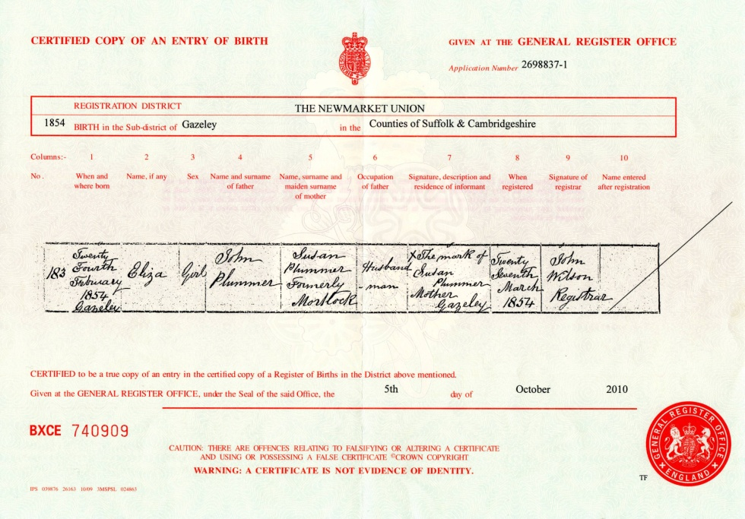
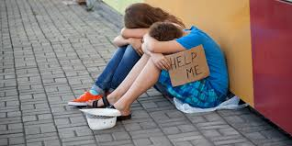
Problems
When people are not protected, they can be taken advantage of.
Tens of millions of people live without a legal form of identity, such as a birth certificate. This identity is the cornerstone of justice.
The vast majority of people living in poverty do not even know their rights.
Often established legal systems are corrupt and do not protect the vunerable.

Slide 5
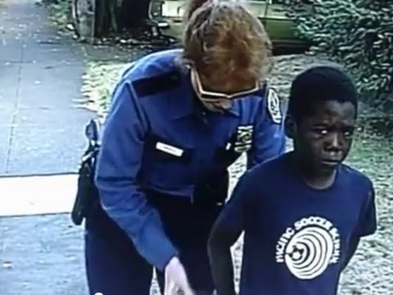
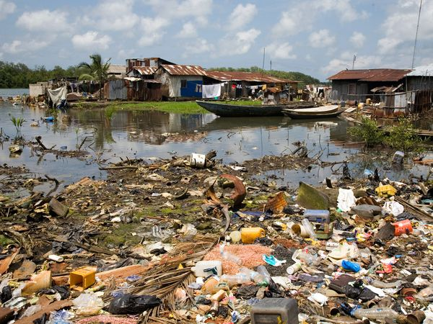
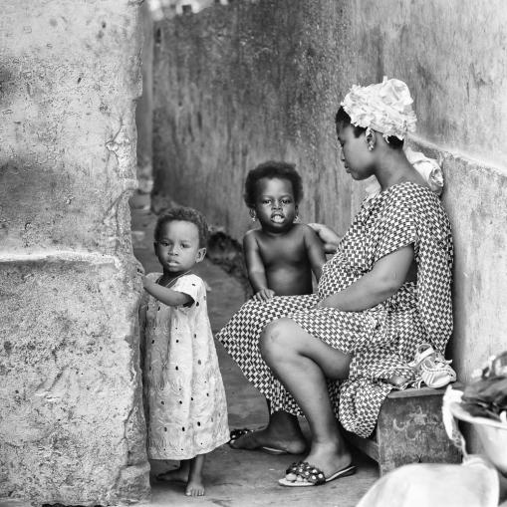
Examples
A juvenile is wrongfully detained by the police and loses time in school affecting his education
Village land is damaged by a mining company without compensation
An illiterate widow is denied the inheritance she is entitled to and is forced on to the streets with her children.

Slide 6

What can be done?
Whose responsibility is to protect the vulnerable people in the UK?
What about in places where corruption is evident, places such as Libya
What about in countries where there is war such as Afghanistan?
What would you do?

