Slide 1
The Environment
How can social the environment affect poverty in Wales, Europe and other parts of the world?

Slide 2
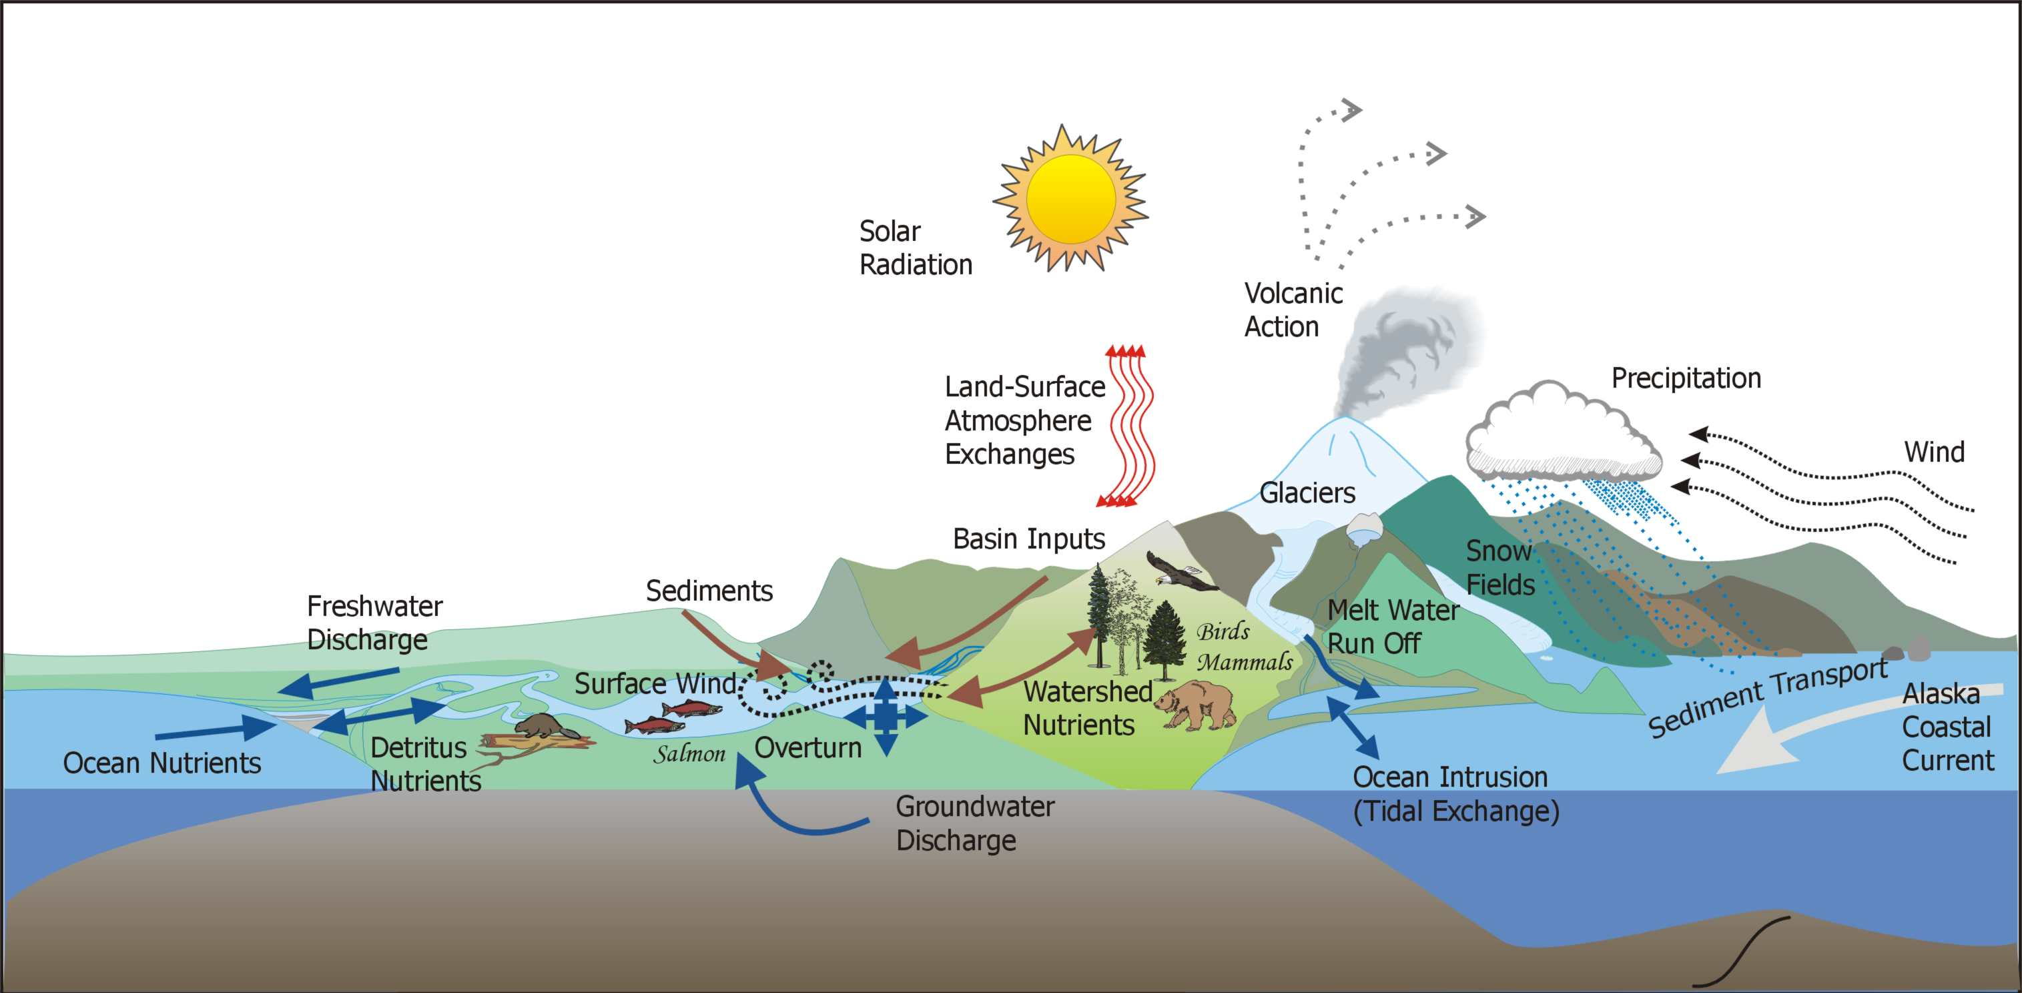

Ecosystems
Ok so what's with the science lesson?
An ecosystem is a complex set of relationships among the living resources, inhabitants and residents of an area. It includes plants, trees, fish, birds, micro-organisms, water, soil and people.
When an ecosystem is healthy scientists say it is sustainable. This means all the elements live in balance. There is usually biodiversity, meaning there are a variety of living organisms and species.

Slide 3
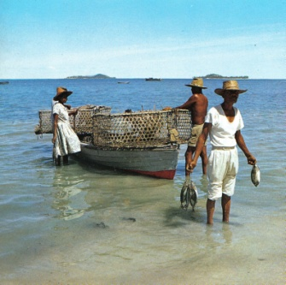
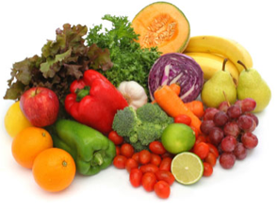
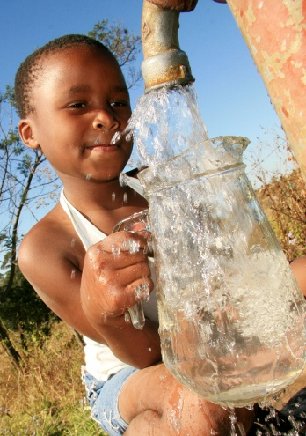

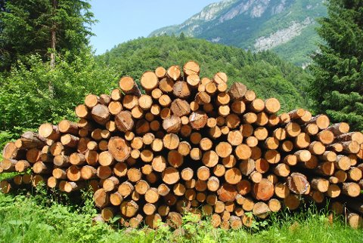
Ecosystems
So what has this got to do with poverty?
Ecosystems are important because they provide us with:-
Food
Wood
Fibres
Fuel
Medicines
Fresh water

Slide 4

Ecosystems also provide essential services such as:
Water purification
Air and soil quality
Pollination
Pest control
Climate regulation
Protection against floods, landslides and other natural hazards
So if these ecosystems are not protected things can go wrong.
Does this affect me? Or is it worse for other people?

Slide 5
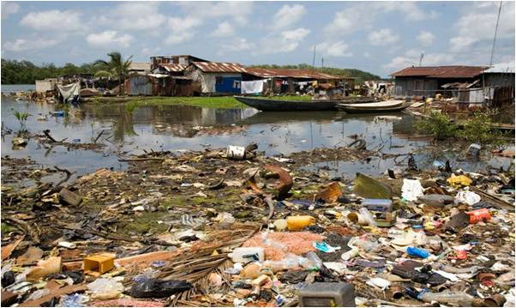
Poverty
Many poorer communities are most directly reliant on ecosystem services for their well-being. The livelihoods of more than one billion people depend directly on natural resources.

Slide 6
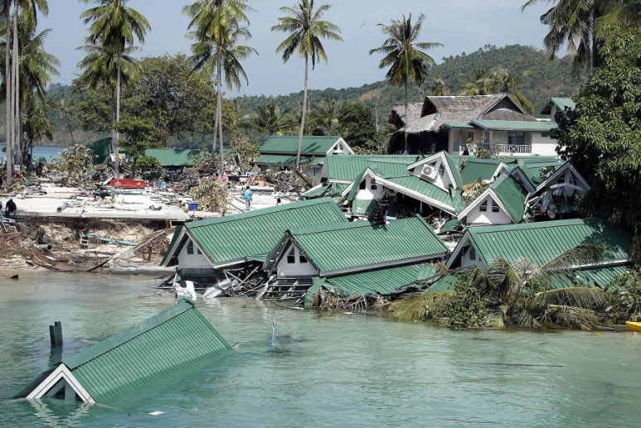
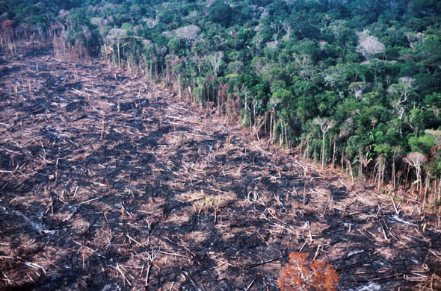
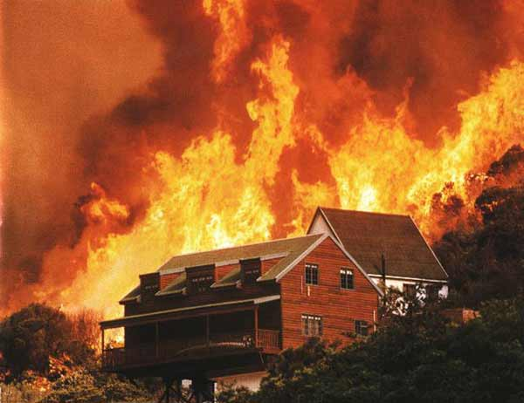
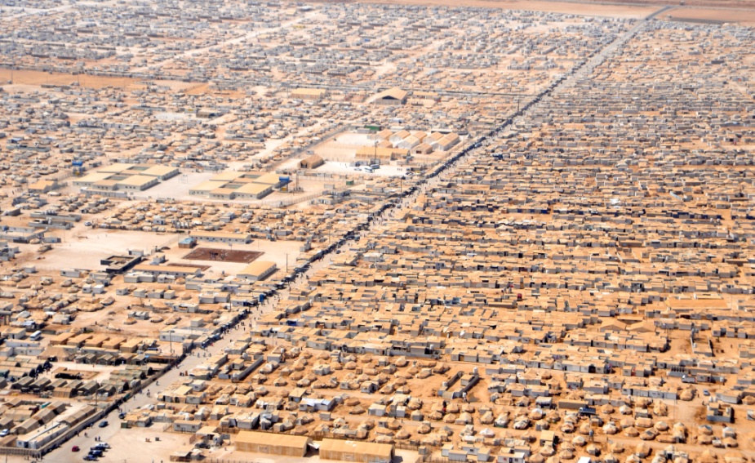
Natural or man made disasters
Tsunami Indonesia
Logging in Brazil
What’s happened to these ecosystems? Who will be affected
Bush fires Australia
Refugee camp Syria

Slide 7
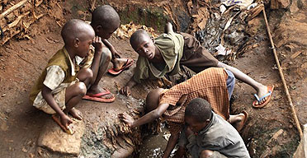
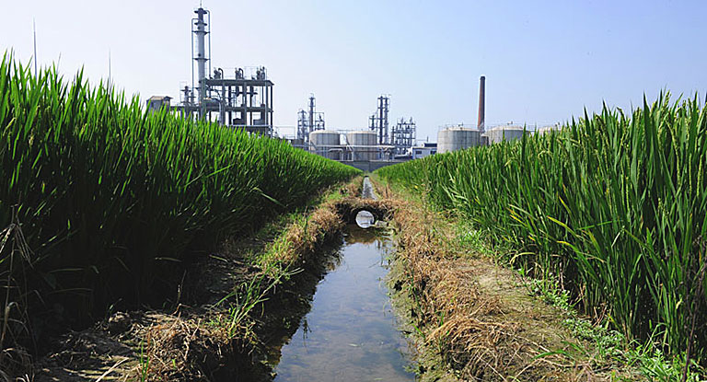
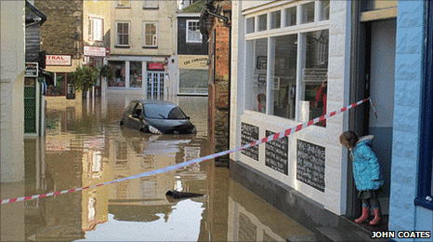
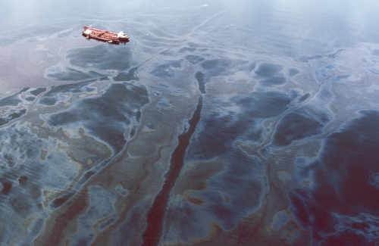
Kibera, Africa's biggest slum
A chemical factory beside a rice paddy in Yixing in Jiangsu Province
What’s happened to these ecosystems? Who will be affected
Floods in Cornwall
Exxon Valdiz Oil tanker – Massive oil spillage in Alaska

Slide 8
Who is responsibile?
In poor countries, protecting the environment is low on government priority lists.
In some countries corporate greed enables the misuse of land.
In some countries living in a war zone is a way of life.
Some countries have so few resources it seems impossible for them to enable their citizens to flee from poverty.
What can be done? Who is responsible?

