Slide 1
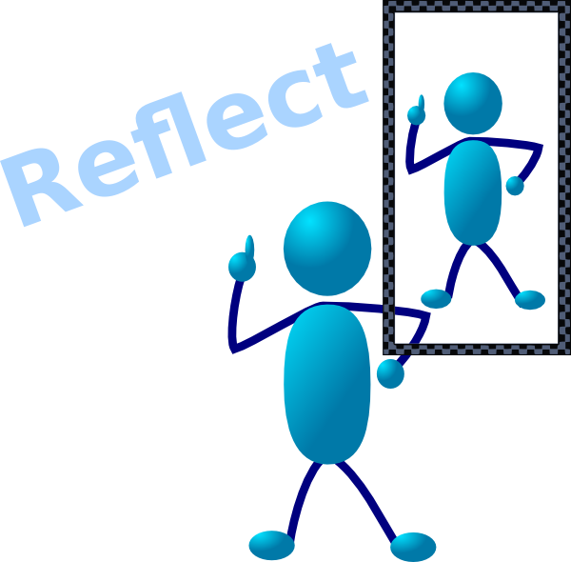

Slide 2


What is an reflection?
An reflection is an opportunity for you to look back over your work and think about the steps you went through.
As you think about each step you can think about what went well... and what didn’t go so well!
That work was really hard!
If you reflect back over your work you can improve next time!

Slide 3
How can I reflect on the work I have done?
First you need to think back to the very start.
Ask yourself – what did I know about this project and the things I was being asked to do?
You can score your answers and then put them into a radar graph
When you have finished your project, come back and update the data and see how things have changed.

Slide 4
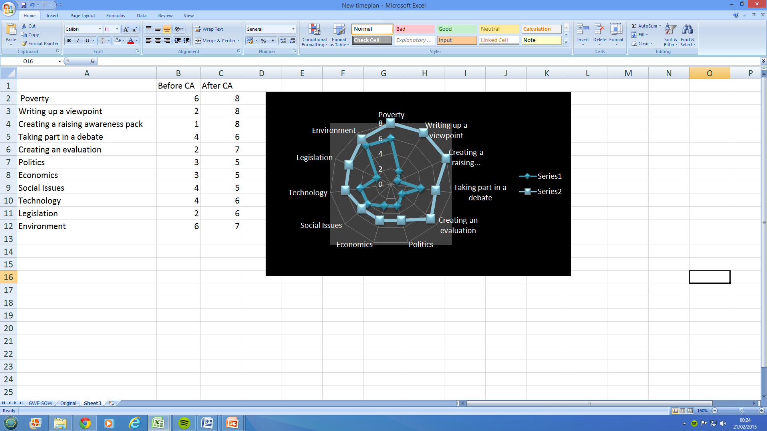
Using a radar graph can show you the results before and after and you can see how your skills levels have changed. That’s helpful in your reflection. You could include this graph in your CA reflection at the end

Slide 5
Writing up your reflection
A simple way to evaluate your work is to ask yourself a series of questions and to answer as honestly as you can.
You can use the reflection steps to guide you through this write up!

Slide 6
