Slide 1
Poverty
Global Citizenship Challenge
Raising Awareness
Lesson 2

Slide 2
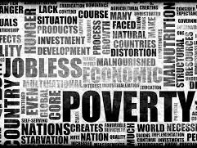
Overcoming poverty is not a task of charity, it is an act of justice. Like Slavery and Apartheid, poverty is not natural. It is man-made and it can be overcome and eradicated by the actions of human beings. Sometimes it falls on a generation to be great. YOU can be that great generation. Let your greatness blossom.”
Nelson Mandela

Slide 3
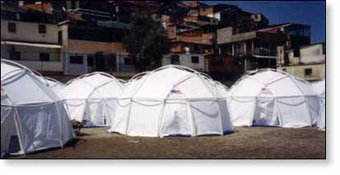

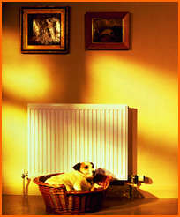


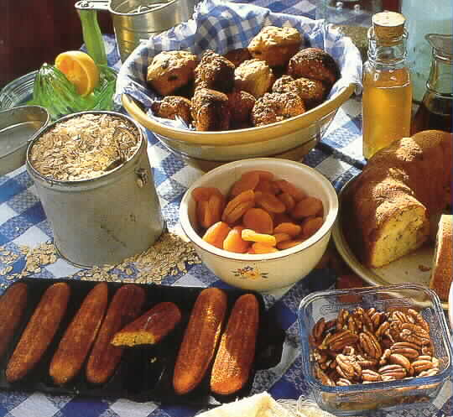
Is this what Poverty looks like?
If you live in absolute poverty you have none of these basic things for living.

Slide 4
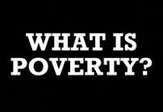

Poverty: A Time for Change
‘Poverty is the state of one who lacks a certain amount of material possessions or money’
‘The state of being extremely poor’
The state or condition of having little or no money, goods, or means of support; condition of being poor.

Slide 5
Task 1
Your first task is to write down what is meant by the term ‘Poverty’

Slide 6
Money
Material possessions
Education
Bankruptcy
Food
Shortage
Basic human needs
Hardship
Inadequacy
Lack of something
Poverty
Starvation
Debt
Health care
Famine
Shelter
Poor
Warmth
Clothing
Necessity
Shelter
Charity
Sanitation
Not enough
Basics
Deprivation
Water

Slide 7



Poverty Around the World

Slide 8
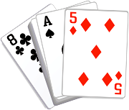
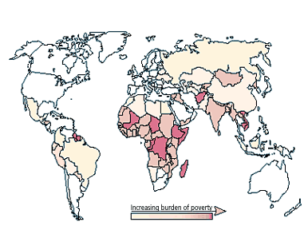
Play your cards right!
World Poverty
“Higher “
“Lower”

Slide 9
World Poverty
World Poverty
World Poverty
World Poverty
World Poverty
World Poverty
World Poverty
World Poverty
World Poverty
World Poverty

Slide 10
There are about 6.5 billion people who live in the world
World Poverty
World Poverty
World Poverty
World Poverty
World Poverty
World Poverty
World Poverty
World Poverty
World Poverty

Slide 11
There are about 6.5 billion people who live in the world
2.8 billion people live in poverty in the world
World Poverty
World Poverty
World Poverty
World Poverty
World Poverty
World Poverty
World Poverty
World Poverty

Slide 12
There are about 6.5 billion people who live in the world
2.8 billion people live in poverty in the world
World Poverty
World Poverty
2 billion people don’t have access to electricity
World Poverty
World Poverty
World Poverty
World Poverty
World Poverty

Slide 13
There are about 6.5 billion people who live in the world
2.8 billion people live in poverty in the world
World Poverty
2 billion people don’t have access to electricity
18 million people die each year because of poverty
World Poverty
World Poverty
World Poverty
World Poverty
World Poverty

Slide 14
There are about 6.5 billion people who live in the world
2.8 billion people live in poverty in the world
2 billion people don’t have access to electricity
18 million people die each year because of poverty
600 million children live in poverty
World Poverty
World Poverty
World Poverty
World Poverty
World Poverty

Slide 15
There are about 6.5 billion people who live in the world
2.8 billion people live in poverty in the world
2 billion people don’t have access to electricity
18 million people die each year because of poverty
600 million children live in poverty
World Poverty
World Poverty
World Poverty
World Poverty
1 billion people live on less than 70p a day

Slide 16
There are about 6.5 billion people who live in the world
2.8 billion people live in poverty in the world
2 billion people don’t have access to electricity
18 million people die each year because of poverty
600 million children live in poverty
10 million children die each year because of poverty
World Poverty
World Poverty
World Poverty
1 billion people live on less than 70p a day

Slide 17
There are about 6.5 billion people who live in the world
2.8 billion people live in poverty in the world
2 billion people don’t have access to electricity
18 million people die each year because of poverty
600 million children live in poverty
10 million children die each year because of poverty
World Poverty
World Poverty
130 million children don’t have a primary school to attend
1 billion people live on less than 70p a day

Slide 18
There are about 6.5 billion people who live in the world
2.8 billion people live in poverty in the world
2 billion people don’t have access to electricity
18 million people die each year because of poverty
600 million children live in poverty
10 million children die each year because of poverty
World Poverty
130 million children don’t have a primary school to attend
1 billion people live on less than 70p a day
1 billion people drink unclean water

Slide 19
There are about 6.5 billion people who live in the world
2.8 billion people live in poverty in the world
2 billion people don’t have access to electricity
18 million people die each year because of poverty
600 million children live in poverty
10 million children die each year because of poverty
½ million women die each year in pregnancy or childbirth
130 million children don’t have a primary school to attend
1 billion people live on less than 70p a day
1 billion people drink unclean water

Slide 20

Play your cards right!
UK Poverty
“Higher “
“Lower”

Slide 21
UK Poverty
UK Poverty
UK Poverty
UK Poverty
UK Poverty
UK Poverty
UK Poverty

Slide 22
UK Poverty
UK Poverty
UK Poverty
UK Poverty
There are about 65 million people who live in the UK
UK Poverty
UK Poverty

Slide 23
UK Poverty
UK Poverty
UK Poverty
There are about 65 million people who live in the UK
UK Poverty
13 million people live in poverty in the UK
UK Poverty

Slide 24
UK Poverty
UK Poverty
There are about 65 million people who live in the UK
9.5 million adults can’t afford proper housing
UK Poverty
13 million people live in poverty in the UK
UK Poverty

Slide 25
6.5 million adults go without essential clothing, e.g. shoes, coats
UK Poverty
There are about 65 million people who live in the UK
9.5 million adults can’t afford proper housing
UK Poverty
13 million people live in poverty in the UK
UK Poverty

Slide 26
6.5 million adults go without essential clothing, e.g. shoes, coats
There are about 65 million people who live in the UK
9.5 million adults can’t afford proper housing
13 million people live in poverty in the UK
4 million children live in poverty in the UK
UK Poverty

Slide 27
6.5 million adults go without essential clothing, e.g. shoes, coats
There are about 65 million people who live in the UK
9.5 million adults can’t afford proper housing
13 million people live in poverty in the UK
4 million children live in poverty in the UK
10.5 million people in the UK live in financial insecurity

Slide 28
Task 2
Does Poverty Exist in the Wales?

Slide 29
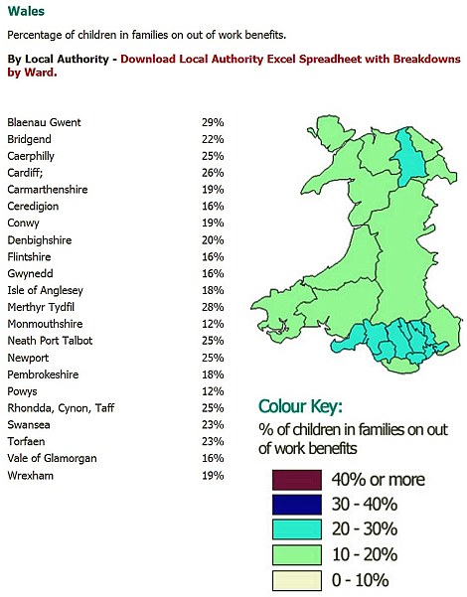
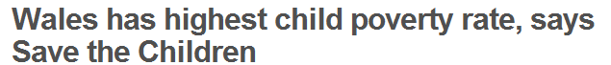
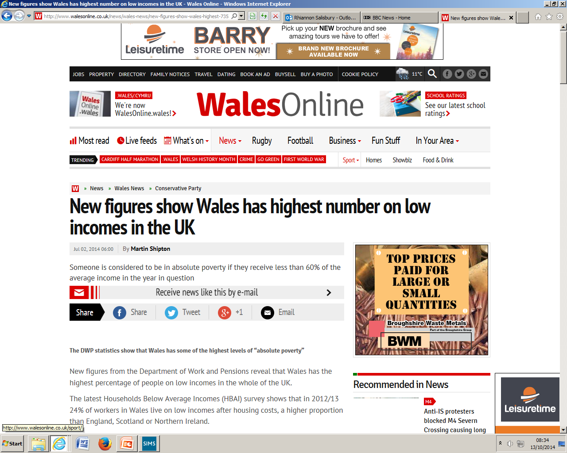
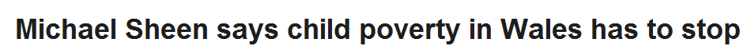
Does Poverty exist in Wales?
19% people living in poverty
200,000 more are in poverty
Two in Five Children, One in Five pensioners
One in Four working age adults

Slide 30
Task 3
What are the reasons for poverty?

Slide 31
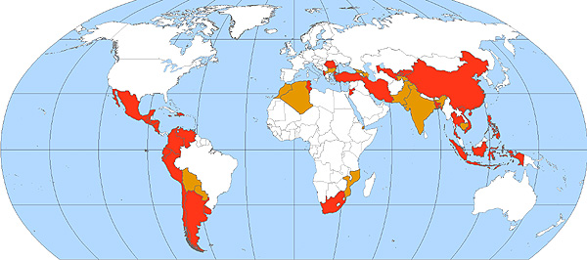
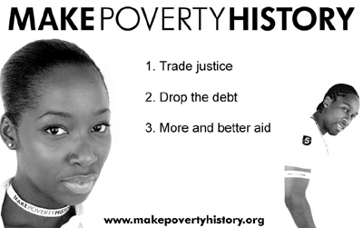

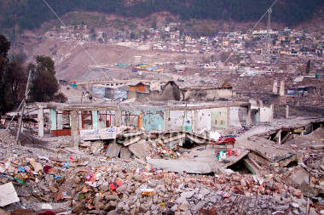

High Standards of Living and Costs of Living
Corruption
Environmental Degradation
Overpopulation
Global Distribution of Resources
Economic and Demographic Trends
Civil War
Reasons for Poverty
More wealth and resources
Climate
Natural Disaster
World Trade
Inadequate benefits
Low paid work
Inadequate Education and Employment
Individual Responsibility and Welfare Dependency

Slide 32
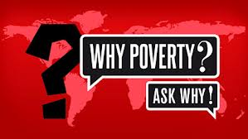
Poverty

Slide 33
Task 3
Who is affected by poverty the most in the UK?

Slide 34
Who is affected by poverty the most in the UK?
Those living in Inner London
Families with children
Lone parents
Certain ethnic minorities
Workless families or households
People with a disability
Why do you think that these particular groups are affected the most?

Slide 35

Critical Thinking
Over the next few weeks you will develop your
Critical Thinking and Problem Solving Skills through discussing Poverty
Who
What
Where
When
Why
How

Slide 36
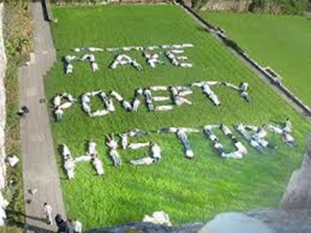

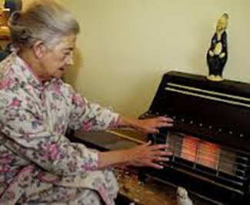
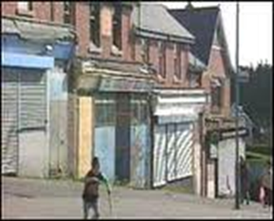
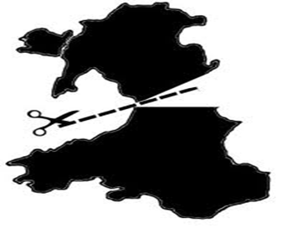
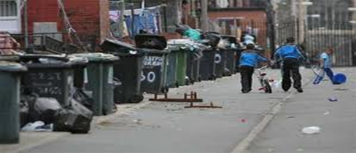
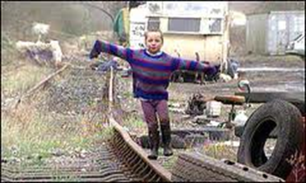
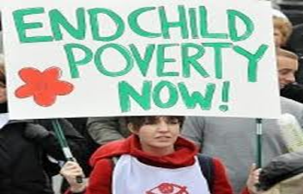
P
E
S
T
L
E
What do you think each letter stands for?

Slide 37
Political
Economic
Social
Technological
Legal
Environment

Slide 38
Political
Economic
Social
Technological
Legal
Environment
During the next few lessons you will find out more information about each element and how it is linked to Poverty

Slide 39

“It is not possible to ever stop world poverty”
Do you agree?
I agree because…
I disagree because…
AGREE DISAGREE

