Slide 1



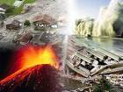

Political Economic Social Technological Legal Environmental
Natural and Human Disasters
What is Climate Change?
Can Natural
Disasters
be avoided?
What causes
Human
Disasters?
How can we live “Greener” lives?
Name...................................... ................. Tutor group........
Welsh Baccalaureate National Global Citizenship Challenge

Slide 2
Contents Page
Introduction
Section | Page Number
Critical thinking question starters | 3
Political | 4-10
Economic | 11-18
Social | 19-26
Technology | 27- 34
Legislation | 35- 42
Environment | 43- 50
Over the next few weeks you are going to be exploring information, news and ideas about
Natural and Human Disasters. The aim of this project is for you to develop your own
viewpoint about this important global issue and to develop the skills that you will need to
complete a controlled assessment on another global issue.
You will need to work swiftly but effectively in class. You will need to listen to your teacher,
make notes, read articles, take part in debates and then finally complete a controlled
assessment. In the CA you present your point of view about a global issue and then create
a product that will allow you to promote this point of view.
You will learn what PESTLE stands for and how to evaluate Strengths and Weaknesses.

Slide 3
 | Critical thinking question starters
CT1 | Who What Where Why When How Can you list three..? Can you recall..? How did... happen? How would you describe...? What can you say about.....? What facts of ideas show...?
CT2 | Can you explain what is happening? How would you compare....? How can you show your understanding of.....? What would results if...? Can you make use of the fact....? What approach would you use...? What would results if...? What elements would you choose to change...? How would you categorise...? Can you identify the different parts...? Can you make a distinction between...?
CT3 | What changes would you make to solve....? What could be done to minimise.....? Suppose you could .......? Can you predict the outcome if.....? What facts can you compile....? Can you elaborate on the reason for...? Do you agree with ....? How could you determine ....? How would you test...? Would it be better if...? How would you evaluate...? Based on what you know, how would you explain...? What information would you use to support the view...? How would you prioritise...?

Slide 4
Politics and Natural and Human Disasters
What do we mean by politics?
Listen to your teacher discussing this first and then make some notes here:-
There are two articles on the next pages about issues.
One is from the Wikipedia website and the second is from The Guardian Newspaper.
Are these reliable sources of information?
LO1 LO3
Wikipedia
Guardian
LO1 LO3

Slide 5
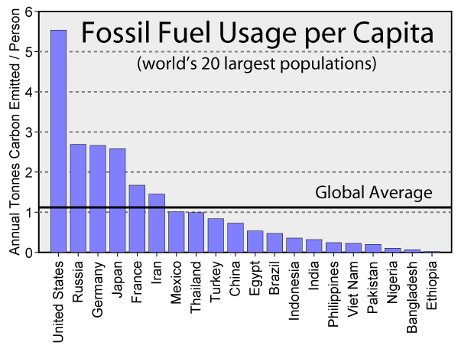
Politics and Natural and Human Disasters
The Kyoto Protocol is an international treaty , that commits State Parties to reduce greenhouse gas emissions, based on the premise that (a) global warming exists and (b) man-made CO₂ emissions have caused it. The Kyoto Protocol was adopted in Kyoto, Japan, on 11 December 1997 and entered into force on 16 February 2005. There are currently 192 Parties (Canada withdrew effective December 2012) to the Protocol. The Kyoto Protocol implemented the objective of the UNFCCC to fight global warming by reducing greenhouse gas concentrations in the atmosphere to 'a level that would prevent dangerous anthropogenic interference with the climate system‘. The Protocol is based on the principle of common but differentiated responsibilities: it puts the obligation to reduce current emissions on developed countries on the basis that they are historically responsible for the current levels of greenhouse gases in the atmosphere.
The Protocol’s first commitment period started in 2008 and ended in 2012. A second commitment period was proposed in 2012, known as the Doha Amendment, in which 37 countries have binding targets: Australia, the European Union (and its 28 member states), Belarus, Iceland, Kazakhstan, Liechtenstein, Norway, Switzerland, and Ukraine. Belarus, Kazakhstan and Ukraine have stated that they may withdraw from the Protocol or not put into legal force the Amendment with second round targets.
Japan, New Zealand, and Russia have participated in Kyoto's first-round but have not taken on new targets in the second commitment period. Other developed countries without second-round targets are Canada (which withdrew from the Kyoto Protocol in 2012) and the United States (which has not ratified the Protocol). Only certain European states have committed to further CO₂ reductions than in the first period. These targets add up to an average five percent emissions reduction compared to 1990 levels over the five-year period 2008 to 2012.
Negotiations were held in Paris in 2014 to agree on a post-Kyoto legal framework that would obligate all major polluters to pay for CO₂ emissions. China, India, and the United States have all signaled that they will not ratify any treaty that will commit them legally to reduce CO₂ emissions.
Source- Wikipedia Website November 2014

Slide 6
The Rough Guide to Climate Change
The Kyoto protocol was the first agreement between nations to mandate country-by-country reductions in greenhouse-gas emissions. Kyoto emerged from the UN Framework Convention on Climate Change (UNFCCC), which was signed by nearly all nations at the 1992 mega-meeting popularly known as the Earth Summit. The framework pledges to stabilise greenhouse-gas concentrations "at a level that would prevent dangerous anthropogenic interference with the climate system". To put teeth into that pledge, a new treaty was needed, one with binding targets for greenhouse-gas reductions. That treaty was finalized in Kyoto, Japan, in 1997, after years of negotiations, and it went into force in 2005. Nearly all nations have now ratified the treaty, with the notable exception of the United States. Developing countries, including China and India, weren't mandated to reduce emissions, given that they'd contributed a relatively small share of the current century-plus build-up of CO2.
Under Kyoto, industrialised nations pledged to cut their yearly emissions of carbon, as measured in six greenhouse gases, by varying amounts, averaging 5.2%, by 2012 as compared to 1990. That equates to a 29% cut in the values that would have otherwise occurred. However, the protocol didn't become international law until more than halfway through the 1990–2012 period. By that point, global emissions had risen substantially. Some countries and regions, including the European Union, were on track by 2011 to meet or exceed their Kyoto goals, but other large nations were falling woefully short. And the two biggest emitters of all – the United States and China – churned out more than enough extra greenhouse gas to erase all the reductions made by other countries during the Kyoto period. Worldwide, emissions soared by nearly 40% from 1990 to 2009, according to the Netherlands Environmental Assessment Agency.
The Guardian Newspaper

Slide 7
Politics and Natural and Human Disasters
Who benefits from high Fossil Fuel usage?
 | Why would some people / parties question that Global Warming is real?
A
Analyse the
effect
POLITICS has
on global warming
LO1 LO3
List the types of method currently Find out what the Green Party
used to generate electricity. feel about Global warming
and summarise your answer here.

Slide 8
Reflect on the following statements. What is your opinion?
Climate change is nothing to worry about for us – it will affect
Future generations.
LO1 LO3
Politicians have a very short term view of Global warming. They
Only care about events that will happen in this parliament and
not about future generations.
LO1 LO3
Now that you have stated your opinion – take part in a class debate to
see how other people feel. Remember – Hands up to speak.

Slide 9
Has your opinion changed?
Based on what you heard in the debate- has your opinion changed?
Record new information in the box below.
LO1 LO3
You should now record your Personal Standpoint. What is your
Opinion on Politics and Global warming? What is this based on?
Are your sources reliable?
.
LO1 LO2 LO3

Slide 10
You are to produce a poster to try to convey YOUR opinion
On Fossil Fuels ‘ impact on the environment. You should research some suitable statistics and record them in the box below, then produce your poster.
LO1 LO2 LO3
You should now reflect on the Strengths and Weaknesses of your
Poster in raising awareness of Politics and Global warming.
Strengths | Weaknesses

Slide 11
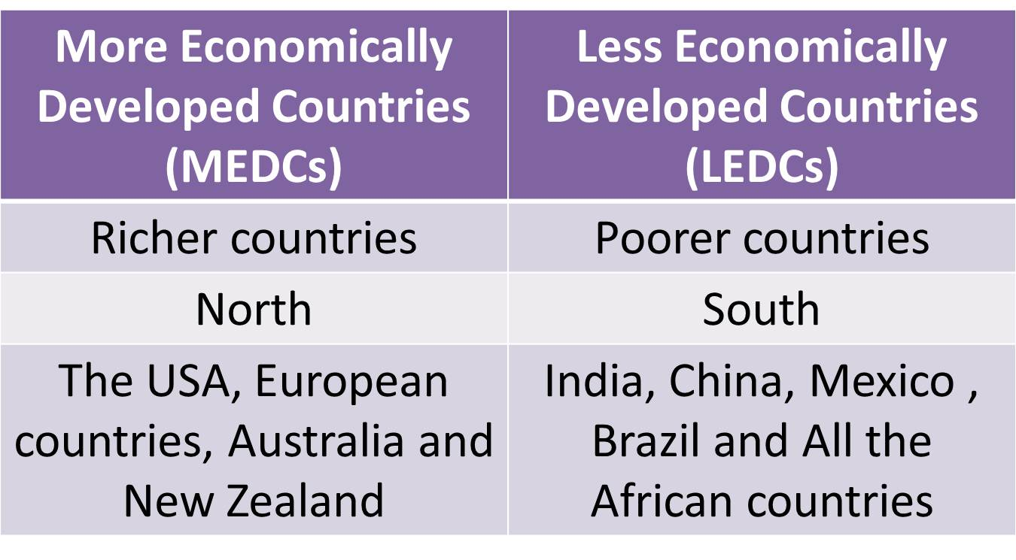
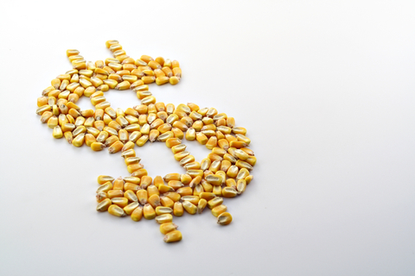
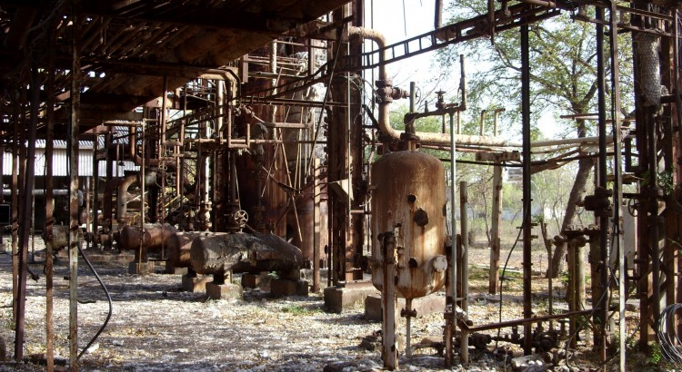
Economic Issues
&
Natural and Human disasters

Slide 12
How can ECONOMIC ISSUES have an impact on
Natural and Human disasters in Wales, Europe and the World?
What do we mean by economic issues? Listen to your teacher discussing this
first and then make some notes here:-
LO1 LO3
There are two articles on the next pages about The Bhopal disaster in India.
One is from the Greenpeace website and the second is from BBC News
Are these reliable sources of information?
Greenpeace Website
BBC News
LO1 LO3

Slide 13
The Bhopal Disaster (Greenpeace Website)
Since 1984, 20,000 people lost their lives in Bhopal, India after a chemical gas spill from a pesticide factory. More than 40 tons of methyl isocyante (MIC) gas created a dense cloud over a resident population of more than half a million people.
People woke in their homes to fits of coughing, their lungs filling with fluid. More than 8,000 people were killed in just the first few days following the leak, mainly from cardiac and respiratory arrest.
The chemical factory responsible for this disaster belonged to Union Carbide, which negotiated a settlement with the Indian Government in 1989 for $470 million - a total of only $370 to $533 per victim - a sum too small to pay for most medical bills. In 1987, a Bhopal District Court charged Union Carbide officials, including then CEO Warren Anderson, with culpable homicide, grievous assault and other serious offences. In 1992, a warrant was issued for Anderson's arrest.
But justice has eluded the people of Bhopal for more than 20 years. Dow, since its merger with Union Carbide, refuses to assume these liabilities in India - or clean up the toxic poisons left behind.
More than 20,000 people still live in the vicinity of the factory and are exposed to toxic chemicals through groundwater and soil contamination. A whole new generation continues to get sick, from cancer and birth defects to everyday impacts of aches and pains, rashes, fevers, eruptions of boils, headaches, nausea, lack of appetite, dizziness, and constant exhaustion.

Slide 14
1984: Hundreds die in Bhopal chemical accident – BBC NEWS
Hundreds of people have died from the effects of toxic gases which leaked from a chemical factory near the central Indian city of Bhopal.
The accident happened in the early hours of this morning at the American-owned Union Carbide Pesticide Plant three miles (4.8 km) from Bhopal.
Mr Y P Gokhale, managing director of Union Carbide in India, said that methyl isocyanate gas (MIC) had escaped when a valve in the plant's underground storage tank broke under pressure. This caused a deadly cloud of lethal gas to float from the factory over Bhopal, which is home to more than 900,000 people - many of whom live in slums.
Chaos and panic broke out in the city and surrounding areas as tens of thousands of people attempted to escape.
More than 20,000 people have required hospital treatment for symptoms including swollen eyes, frothing at the mouth and breathing difficulties.
Thousands of dead cats, dogs, cows and birds litter the streets and the city's mortuaries are filling up fast.
Bhopal resident, Ahmed Khan, said: "We were choking and our eyes were burning. We could barely see the road through the fog, and sirens were blaring.
"We didn't know which way to run. Everybody was very confused.
"Mothers didn't know their children had died, children didn't know their mothers had died and men didn't know their whole families had died.

Slide 15
Politics and Natural and Human Disasters
Why do you think the casualties were so high in
the Bhopal disaster?
 | Who was to blame for the Bhopal disaster in your opinion?
A
Analyse the
effect
Economics had
on the Bhopal
Disaster
LO1 LO3
Was the Bhopal factory a safe What do you understand by the
place to work before the phrase “Living in the slums”?
accident?

Slide 16
Reflect on the following statements. What is your opinion?
The Bhopal disaster would have been avoided if Company
executives had not been so greedy.
LO1 LO3
People should be grateful for any job, and working conditions
are not important.
LO1 LO3
Now that you have stated your opinion – take part in a class debate to
see how other people feel. Remember – Hands up to speak.

Slide 17
Has your opinion changed?
Based on what you heard in the debate- has your opinion changed?
Record new information in the box below.
LO1 LO3
You should now record your Personal Standpoint. What is your
Opinion on Economics and The Bhopal disaster? What is this based on?
Are your sources reliable?
.
LO1 LO2 LO3

Slide 18
You are to produce a Leaflet to try to convey YOUR opinion
On working conditions vary across the world . You should research some suitable statistics and record them in the box below, then produce your leaflet.
LO1 LO2 LO3
You should now reflect on the Strengths and Weaknesses of your
leaflet in raising awareness of working conditions across the world.
Strengths | Weaknesses

Slide 19
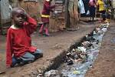



Social Issues
&
Natural and Human disasters

Slide 20
How are Social issues affected by Natural Disasters?
What do we mean by social issues? Listen to your teacher discussing this first and
then make some notes here:-
There are two articles on the next pagess about the social issues of Natural disasters
One from www.childfund.org and the other from a page in a web forum
Are these reliable sources of information?
LO1 LO3
Childfund.org
Extract from Web forum
LO1 LO3

Slide 21
The Devastating Impact of Natural Disasters – from www.childfund.org website
Millions of people are affected by natural disasters every year, and the impact can be calamitous. From the destruction of buildings to the spread of disease, natural disasters can devastate entire countries overnight. Tsunamis, earthquakes and typhoons do not just wreak havoc on land; they also disrupt people's lives, especially for those living in remote regions.
Displaced Populations
One of the most immediate effects of natural disasters is population displacement. When countries are ravaged by earthquakes and other powerful forces of nature, many people have to abandon their homes and seek shelter in other regions. A large influx of refugees can disrupt everything from accessibility of health care and education to food supplies and basic hygiene. Large-scale evacuations are common in light of the power of tsunamis and other natural disasters, and those fortunate enough to survive face a range of challenges following widespread destruction.
Health Risks
Aside from the obvious danger that natural disasters present, the secondary effects can be just as damaging. Typhoons, hurricanes and tsunamis often cause severe flooding, which can result in the spread of waterborne bacteria and malaria. As a result, health complications can be prevalent among survivors of natural disasters, and without the help of international relief organizations, death tolls can rise even after the immediate danger has passed.
Food Scarcity
After natural disasters, food can become scarce. Thousands of people around the world go hungry as a result of destroyed crops and a loss of agricultural supplies. The impacts of hunger following an earthquake, typhoon or hurricane can be tremendous, but fortunately, there are ways you can help. ChildFund's Child Alert Emergency Fund provides people affected by natural disasters with the food and nutritional support they need. Your donation of $25, $50 or $100 will be used to fulfill immediate needs on the ground.
Emotional Aftershocks
Natural disasters can be particularly traumatic for young children. Confronted with scenes of destruction and the deaths of friends and loved ones, many children develop post-traumatic stress disorder (PTSD), a serious psychological condition resulting from extreme trauma. Left untreated, children suffering from PTSD can be prone to lasting psychological damage and emotional distress. ChildFund works in countries around the world affected by natural disasters to help children receive the psychosocial care they need following these traumatic events.
Although nobody can prevent natural disasters, we can help people in need in their wake. By making a donation to ChildFund's Child Alert Emergency Fund, you can help us provide food, clean water, health care and emotional support to children and communities displaced by natural disasters.

Slide 22
Extracted from a web forum
Natural disasters have become so commonplace that they hardly receive passing notice on the news unless there have been a large number of casualties. Volcanoes, mudslides, tsunamis and floods are just a few of the ways nature strikes on a daily basis, leaving behind destruction and heartache. Humans have learned to prepare for the possibility of tornadoes, earthquakes, hurricanes and wildfires, but no amount of preparation can lessen the impact that natural disasters have on every aspect of society. Physical Destruction The biggest visible effect of natural disasters is the physical ruin they leave behind. Homes, vehicles and personal possessions are often destroyed within a short period of time, leaving families homeless and shutting some businesses down permanently. Tornadoes destroy structures at whim, earthquakes can cause structural damage that might not be apparent at first glance, and tsunamis and floods sweep homes off their foundations.
Emotional Toll Possessions are not hard to replace, as many people keep insurance on their property and tangible goods. The emotional toll of natural disasters is much more devastating. The death of a loved one may be the worst-case scenario but it's not the only lasting emotional effect victims experience. Whole communities may be displaced, separating friends and neighbours; victims face anxiety and depression as they wonder if it could happen again. In extreme cases, they may experience post traumatic stress disorder (PTSD).
Economic Concerns While the visible effects of natural disasters are immediate and strongly felt, communities that surround ground zero can be indirectly affected by them as well. Natural disasters almost always lead to a disruption in utility services around the area impacted. This can mean life or death for those who rely on dialysis or oxygen to live. Medical assistance is also often slowed, as emergency crews must focus on the victims of the disaster. Banks and other businesses might be closed, affecting a family's ability to withdraw money to pay bills and buy groceries. Geography
Geography plays a large role in how natural disasters affect an area. In rural or isolated communities, natural disasters can thrust families into a situation where they must do without modern conveniences like electric and running water. They may not be able to get to town to buy necessities and have to rely on what they have stocked up. Densely populated areas face their own unique problems from natural disasters. Hygiene becomes a concern, as people crowd into temporary relief centers and compete for limited resources. Environment

Slide 23
Society and Natural and Human Disasters
Why do Natural disasters have a longer lasting
Social impact on poorer communities?
 | Do you think enough is done to support communities that have been effected by Natural disasters?
A
Analyse the
Social Impact of
Natural
Disasters
LO1 LO3
What kind of community suffers What more could be done to
most from natural disasters and create awareness of the impact of
why ? Natural disasters on communities?

Slide 24
Reflect on the following statements. What is your opinion?
If people choose to live near volcanoes/ flood plains they should
accept the consequences.
LO1 LO3
A lot of money has been raised to support victims of Natural
disasters. Shouldn’t people start helping themselves?
LO1 LO3
Now that you have stated your opinion – take part in a class debate to
see how other people feel. Remember – Hands up to speak.

Slide 25
Has your opinion changed?
Based on what you heard in the debate- has your opinion changed?
Record new information in the box below.
LO1 LO3
You should now record your Personal Standpoint. What is your
Opinion on the Social impact of Natural disasters? What is this based on?
Are your sources reliable?
.
LO1 LO2 LO3

Slide 26
You are to write a letter to a World leader . Your letter should include
some statistics about the social impact of Natural disasters. Your
letter should try to persuade the World Leader to donate more money
to supporting victims of Natural disasters. Research some statistics and note
them in the space below before writing your letter.
LO1 LO2 LO3
You should now reflect on the Strengths and Weaknesses of your
letter in raising awareness of the social impact of Natural disasters.
Strengths | Weaknesses

Slide 27


Technological Issues
&
Natural and Human disasters

Slide 28
How can Technological ISSUES have an impact on
Natural and Human disasters in Wales, Europe and the World?
What do we mean by Technological issues? Listen to your teacher discussing this
first and then make some notes here:-
LO1 LO3
There are two documents on the next pages about Natural Disaster warning systems.
One is from the livescience website and the second is from a Japanese Goverment website
Are these reliable sources of information?
Livescience.com
www.jma.go.jp
LO1 LO3

Slide 29
When Tsunami Warning System Works, And When It Doesn't
While experts say current warning systems work well to detect tsunami risks, get information out and form emergency plans, sometimes the process just can't work quickly enough. Minutes matter when waves are about to hit shore — especially since predicting big quakes is so tough.
"Earthquakes don't come with a warning," Craig Fugate, chief of the United States' Federal Emergency Management Agency (FEMA), told reporters today. "That's why being prepared is so critical.“
To help detect and characterize these destructive waves, NOAA has deployed a phalanx of sentinel buoys. The first six Deep-Ocean Assessment and Reporting of Tsunami (DART) buoys were put out in 2001, and 32 were in place throughout the Pacific by 2008. (NOAA has deployed 39 DART buoys worldwide.)
Each DART station consists of a floating buoy moored to a monitoring instrument on the ocean floor. This sensor measures temperature and pressure every 15 seconds, detecting tsunamis by the pressure changes they cause. The device converts pressure readings into estimates of sea-surface height, giving researchers an idea of how big the coming waves will be.
These monitoring devices relay their readings to the surface buoys, which beam the information to scientists in real time. Researchers combine this information with seismic information about the quake and data from tidal gauges along various coasts to gain an integrated, detailed picture of any incoming tsunami.
Spreading the word
Detecting and characterizing a tsunami are only half the battle. To help keep people out of harm's way, this information needs to be disseminated quickly and efficiently.
Extract from www.live science.com

Slide 30
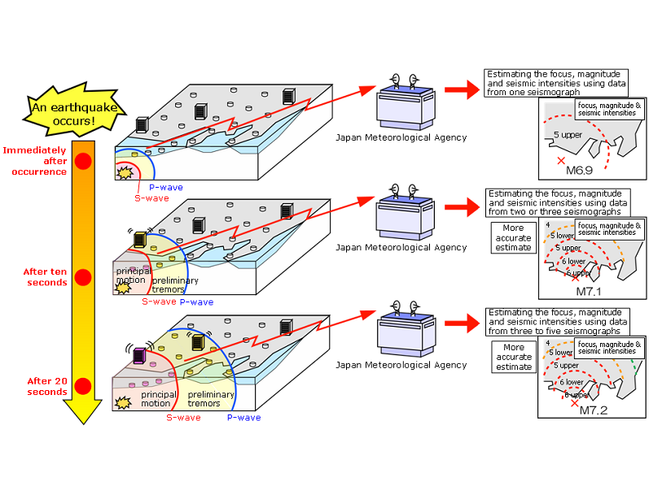
www.jma.go.jp The Earthquake Early Warning system provides advance announcement of the estimated seismic intensities and expected arrival time of principal motion. These estimations are based on prompt analysis of the focus and magnitude of the earthquake using wave form data observed by seismographs near the epicenter. The Earthquake Early Warning is aimed at mitigating earthquake-related damage by allowing countermeasures such as promptly slowing down trains, controlling elevators to avoid danger and enabling people to quickly protect themselves in various environments such as factories, offices, houses and near cliffs.
The Earthquake Early Warning system provides advance announcement of the estimated seismic intensities and expected arrival time of principal motion

Slide 31
Technology and Natural and Human Disasters
Why are scientists trying to predict when Natural
disasters will occur?
 | Do you think technology can help reduce the impact of natural disasters?
A
Analyse the
Impact technology
may have on
Natural
Disasters
LO1 LO3
What role do you think social How effective are current methods
media might have in reducing the for predicting Natural disasters?
impact of Natural disasters?

Slide 32
Reflect on the following statements. What is your opinion?
We should not try and warn people about Natural disasters as
they are part of life.
LO1 LO3
Human beings have had a big impact on the planet and are
responsible for some Natural disasters.
LO1 LO3
Now that you have stated your opinion – take part in a class debate to
see how other people feel. Remember – Hands up to speak.

Slide 33
Has your opinion changed?
Based on what you heard in the debate- has your opinion changed?
Record new information in the box below.
LO1 LO3
You should now record your Personal Standpoint. What is your
Opinion on the Technological impact on Natural disasters? What is this based on?
Are your sources reliable?
.
LO1 LO2 LO3

Slide 34
You are to research “Earthquake Preparation” . You should then design a poster to show people how to prepare for/ deal with an eartquake.Research some statistics / advice and record them in the space below before producing your poster.
LO1 LO2 LO3
You should now reflect on the Strengths and Weaknesses of your
Poster in raising awareness of the impact of Technology on Natural disasters
preparation.
Strengths | Weaknesses

Slide 35


Natural and Human Disasters
&
LEGISLATION

Slide 36
How can LEGISLATION have an impact on
Natural and Human Disasters in Wales, Europe and the World?
What do we mean by legislation? Listen to your teacher discussing this
first and then make some notes here:-
There are two articles on the next pages about the legislation.
One is from The African Business Journal, the second is from insurancejournal.com
Are these reliable sources of information?
LO1 LO3
The African Business Journal
insurancejournal.com
LO1 LO3

Slide 37
Mining Health and Safety in South Africa
Otherwise known as The People’s Republic of South Africa, this resource-rich region is home to the deepest mines in the entire world. This 4.8 million (UN 2008) people strong country is a leading source of diamonds, gold, PGM, vanadium, coal, and precious metals such as platinum. But these resources are blighted by a tumultuous mining health and safety record.
"The number of deaths due to mining incidents for the period of June 1, 2008 to June 1, 2009 were 142 deaths of miners lawfully employed (and) 135 deaths of illegal miners" South Africa’s Mines Minister Susan Shabangu said in a written reply to government on July 2nd.
This total has been viewed as disappointing despite reports that the total of legal mining deaths is down 24 per cent from its’ total of 221 for the year 2007. In the weeks leading up to June 11th this year, the Harmony Gold-owned disused Eland Shaft Mine in The Central Free State Province took a tough hit. In total 76 bodies of illegal miners were recovered after an underground fire broke out. The death toll climbed following days of rising fatalities, visits from the Department of Minerals and energy, pleas from trade union Solidarity and The Congress of South African Trade Unions (COSATU), and worldwide headlines of horror. While this tragedy opened eyes all over the world to the dangers of illegal mining, it also raised wider concerns over the mining health and safety standards for the South Africa within more legal realms too. A paramount concern within the South African mining industry is the rising infection of Tuberculosis and other diseases. Continual exposure to silica dust in mine shafts has resulted in a high prevalence of silicosis. Similarly, continued cramped, hot and poorly ventilated working conditions coupled with the spread of HIV infection has also exacerbated tuberculosis infection. Asthma is also a similar concern.
The South African government has estimated that the T.B.. infection rates in their mines are amongst the highest in the world. T.B. and Malaria are already a problem within the communities in which the mines are situated, and as a result mining environments can provide breeding grounds for an already rooted problem.
The mining industry within these regions can also attract mass-migration as people desperate for work seek to gain employment within the mines. This leads to further cramped, sub-standard living conditions and again coaxes the potential spread of these diseases.
As the number of men working in a mining area grows, so does the number of commercial sex workers, and with that the threat of HIV and AIDs.
Taken from The African Business Journal www.tabj.co.za

Slide 38
Disasters strike in many forms. Insured disasters often arrive in the wake of natural catastrophes – floods, earthquakes, drought, tornadoes and hurricanes. But disasters are also man-made as in the terrible tragedy that occurred at the Rana Plaza factory in Bangladesh on April 24.
On that day in Savar, Bangladesh, more than 1,100 people perished when the factory building collapsed. The disaster highlights the risks that labor conditions can pose not only to workers but also to the reputations and supply chains of the organizations that use their services.
For many of the world’s largest suppliers and retailers the tragedy brought widespread negative attention to the use of outsourcing textile goods following the Rana Plaza incident.
A recent report by Marsh Risk Management Research, Bangladesh Factory Collapse: Lessons in Risk for the Retail Industry, provides an overview of the risks retailers face when sourcing textile goods from Bangladesh and other low-cost markets.
Poor working conditions are a threat to more than workers.
“Even though major retailers and suppliers have sourced from Bangladesh for decades and have worked to improve labor conditions in the past, the Rana Plaza incident clearly reinforces to organizations that labor-related globalization risks require robust oversight efforts, greater visibility, increased vigilance, and continuous improvement,” said Tracy Knippenburg Gillis, Global Reputational Risk and Crisis Management Practice Leader for Marsh Risk Consulting. Gillis says retailers and suppliers should use this tragedy as a catalyst to more fully understand their operational and supply chain risk exposures, strengthen workforce safety practices and improve supply chain and reputational risk resiliency.
Bangladesh’s textile industry plays an important role in the retail industry’s supply chains due to its low-cost production capability.
But while the country may be home to the world’s lowest minimum hourly wages (Bangladesh workers make just 23 cents per hour at minimum wage), according to Maplecroft’s “Working Conditions Index” it also ranks as the eighth-worst country for industrial working conditions – resulting in significant reputational, compliance and supply chain risks for retailers.
Bangladesh remains one of the most attractive global markets from which to source primary retail goods for demanding consumers because costs to produce remain low.
But retailers should beware, the Marsh report said. Retailers should carefully consider their approach to reputational risk, crisis management, and supply chain resiliency, and focus on improving compliance efforts and transparency.
Taken from www.insurancejournal.com

Slide 39
Legislationand Natural and Human Disasters
How do poor working conditions worsen the
impact of an industrial accident?
 | What role do governments have to play in making Working conditions fair for everyone?
A
Analyse the
Impact legislation
may have on
Human
Disasters
LO1 LO3
Should people avoid buying goods How should copmpanies that
from companies that do not have poor working conditions be
have good Workforce legislation? sanctioned?

Slide 40
Reflect on the following statements. What is your opinion?
Large companies should make as much profit as they can at any
cost.
LO1 LO3
People should work harder in school to avoid having to get a job
with poor working conditions.
LO1 LO3
Now that you have stated your opinion – take part in a class debate to
see how other people feel. Remember – Hands up to speak.

Slide 41
Has your opinion changed?
Based on what you heard in the debate- has your opinion changed?
Record new information in the box below.
LO1 LO3
You should now record your Personal Standpoint. What is your
Opinion on Workforce Legislation and Human disasters? What is this based on?
Are your sources reliable?
.
LO1 LO2 LO3

Slide 42
You are to research “Working conditions in the UK” . You should then produce
a storyboard for a TV advert to show workers how the law can protect them in
work and what they are entitled to. Research some statistics / guidelines and
record them in the space below before producing your storyboard.
LO1 LO2 LO3
You should now reflect on the Strengths and Weaknesses of your
Poster in raising awareness of the impact of Technology on Natural disasters
preparation.
Strengths | Weaknesses

Slide 43


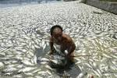
Natural and Human Disasters
&
The Environment

Slide 44
How do Natural and Human disasters impact on the Environment?
What do we mean by the environment? Listen to your teacher discussing this
first and then make some notes here:-
There are two articles on the next pages about the environment.
One is from www.greenfacts.org, the second is from www.imascientist.org
Are these reliable sources of information?
LO1 LO3
www.greenfacts.org
www.imascientist.org
LO1 LO3

Slide 45
How has the environment been affected by the Chernobyl accident?
Some areas of Europe were substantially contaminated, particularly in current Belarus, Russia, and Ukraine by the large quantities of radioactive materials released from the damaged reactor. Most of these materials have since transformed into stable, non-radioactive materials but some will remain radioactive for a long time.
3.1 The urban areas near the reactor were heavily contaminated and rapidly evacuated. Since the accident, surface contamination has decreased and levels of radiation measured in the air are now the same as before the accident in most of these areas.
3.2 Regarding agriculture, the contamination of crops, meat, and milk with short-lived radioactive iodine was a major concern in the early months after the accident. Now and for decades to come, contamination with longer-lived radioactive caesium is the main concern in some rural areas.
3.3 Forest food products such as berries, mushrooms, and game contain particularly high levels of long-lived radioactive caesium and this contamination is expected to remain high for several decades. For instance, the accident led to high contamination of reindeer meat in Scandinavia.
3.4 As a result of the accident, water bodies and fish became contaminated with radioactive materials The contamination soon decreased as a result of dilution and decay but some of the materials remained trapped in the soils around contaminated rivers and lakes. Today, most water bodies and fish have low radioactivity levels, although the levels in some closed lakes remain high.
3.5 The accident immediately affected many plants and animals living within 30 km of the site. There was an increase in mortality and a decrease in reproduction and some genetic anomalies in plants and animals are still reported today. Over the years, as the radioactivity levels decreased, the biological populations started to recover and the area has become a unique sanctuary for biodiversity.
Taken from the website www.greenfacts.org

Slide 46
Do volcanoes pollute the environment?
Volcanoes can produce a lot of pollution when they erupt. Sometimes, if volcanoes emit a lot of sulphuric gasses they can lead to acid rain. The Skaftá volcano in Iceland erupted in 1793, releasing lots of toxic gasses that killed a lot of people, as well as poisoning the land so that nothing could grow. About 50% of livestock on Iceland died, and 25% of the population died in the resulting famine. The effects were felt all over Western Europe.
The ash and dust the volcanoes can emit can also have severe environmental effects. The dust clouds from large volcanoes can partially block out the sun, reducing temperatures and stopping crop growth. For example, when Tambora erupted in 1815, we had what is called the year without summer, because of all the volcanic dust blocking the sun’s rays. Crops failed all over the world, leading to famines.
Also, volcanoes can emit lots of CO2. The emission rates are smaller than the emission rates from fossil fuels, so we know that volcanoes are not causing the current rate of global warming. But they can build up over time if rates of volcanism increase. For example, in the Cretaceous, when the dinosaurs lived, rates of volcanism were higher, creating more CO2 in the atmosphere. This lead to increased temperatures, so much so that there was barely any ice at the poles at all.
Extract from www.imascientist.org

Slide 47
The Environment and Natural and Human Disasters
Do Natural or Human disasters have the biggest
Impact on the environment?
 | What do we mean by the phrase “We are still being affected by the Chernobyl disaster”?
A
Analyse the
Impact Natural
and Human
Disasters have on
The
Environment
LO1 LO3
Is Carbon Dioxide pollution a How has our reliance on cheaper
Problem created by humans? sources of energy impacted on the
Environment?

Slide 48
Reflect on the following statements. What is your opinion?
The Chernobyl disaster didn’t affect us.
LO1 LO3
Volcanoes only affect the people that live close to them.
LO1 LO3
Now that you have stated your opinion – take part in a class debate to
see how other people feel. Remember – Hands up to speak.

Slide 49
Has your opinion changed?
Based on what you heard in the debate- has your opinion changed?
Record new information in the box below.
LO1 LO3
You should now record your Personal Standpoint. What is your
opinion on How Natural disasters affect the Environment? What is this based on?
Are your sources reliable?
.
LO1 LO2 LO3

Slide 50
You are to research “Nuclear Energy” . You should then produce
a “pros and Cons” poster to show how useful/harmful Nuclear energy is.
Research some statistics and details and record them in the space below before
producing your poster.
LO1 LO2 LO3
You should now reflect on the Strengths and Weaknesses of your
Poster in raising awareness of the Pros and Cons of Nuclear Energy.
Strengths | Weaknesses

Slide 51
End of unit summary
In the space below, identify 5 key words you would use when producing a piece of work on Natural and Human disasters in relation to the following areas:
Politics and Natural and Human disasters
2. Economics and Natural and Human disasters
3. Social Issues and Natural and Human Disasters
4. Technological issues and Natural and Human disasters
5. Legislation and Natural and Human disasters
6. The Environment and Natural and Human disasters
LO1 LO2 LO3

