Slide 1
Politics
What is politics?
How does is affect our lives?

Slide 2
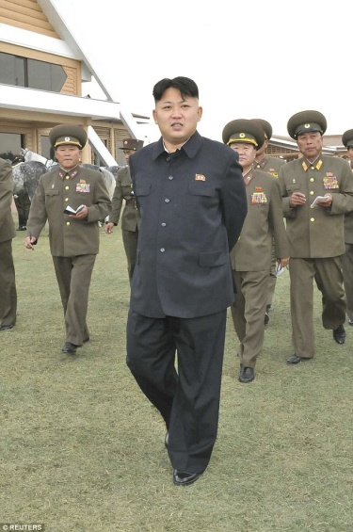
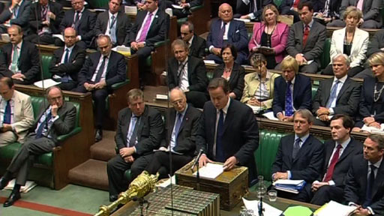
In the UK we have a democratically voted government.
The government make decisions about how the country is run.
In other countries they have different types of government.
North Korea – Dictator Kim Jong-Un
British Parliament

Slide 3
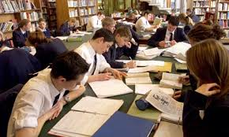
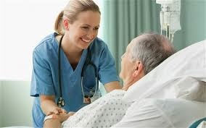
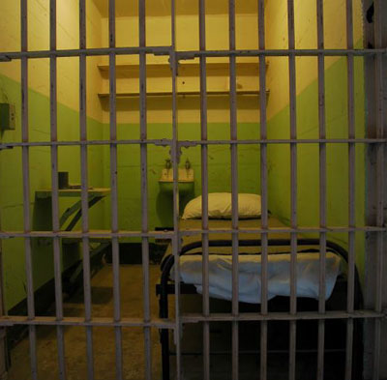
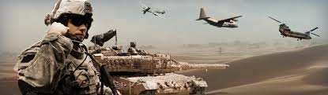
Tax breakdown for £25,500 salary
£2,080 Pensions and Benefits
(including £212 on Housing Benefit and £296 on Incapacity Benefits)
£1,094 on the NHS
£824 on Education
£339 on Defence
£160 on the Police
£44 on Prisons
£92 on Roads
£71 on Railways
What do you think about this spending?

Slide 4
Watch the video to see where the government spends money and how it affects us.
Do they spend money in the right place? What do you think?
Do you think the decisions the government
makes can lead to poverty?

