Slide 1
Economics
How can economics affect poverty in Wales, Europe and the World?

Slide 2
Economics is sometimes considered a complicated thing! Its not really... Economics is about people swapping things they have, for other things they want or need.
In the olden days, a caveman might have swapped a cow for sheep! Then he might have swapped a sharp stone for some hay!
Does that sound a bit bonkers? Ok, look at the story on the next page....

Slide 3
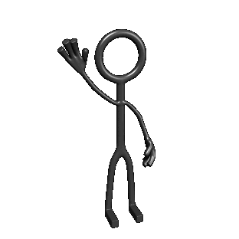
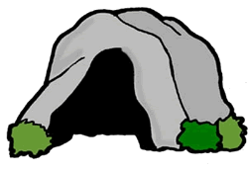


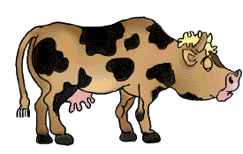

I’m a cave man and I live happily on berries and milk from my cow
Now I’ve got a family I need more food, so I will swap my cow and berries for 2 sheep
I make a tasty meal and you can use my coat to make clothes

Slide 4
Over time this method of ‘Bartering’ has changed.
Now we use money in exchange for things.
We usually swap our skills as an employee for our wages . Then we go off to the shops and swap our money for things we want or need.
Now the truth is, for economics to work you need other stuff, (land, labour, capital and enterprise).

Slide 5

In the modern world, we import a lot of goods from other countries, and that’s because we cant grow or make them here.
We exchange our money for goods.
Imagine growing orange or bananas in Wales?

Slide 6
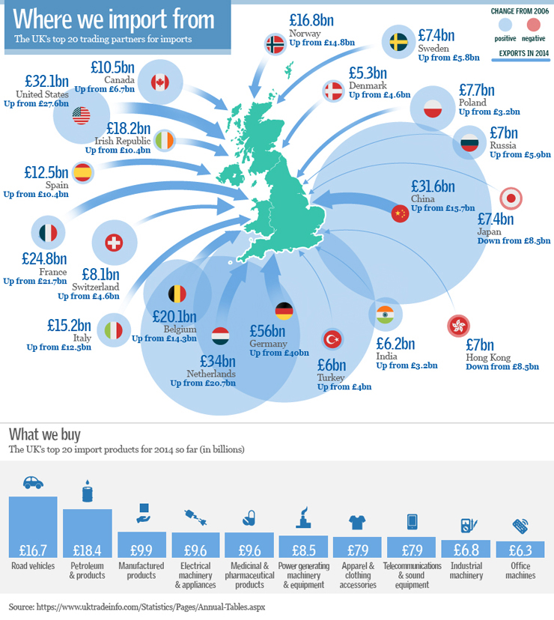
Look at how much stuff comes from other countries

Slide 7
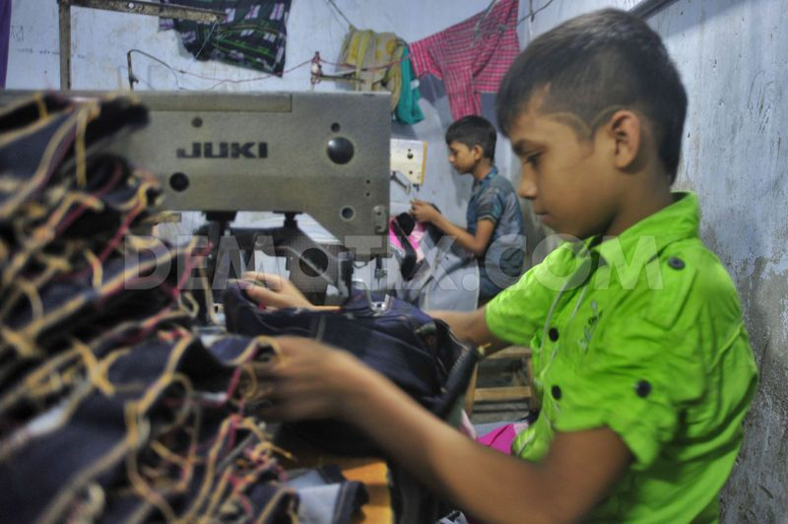
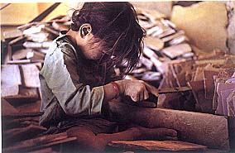
The money we spend in that country, creates jobs and wealth for that country – or does it???
Sometimes the exchange of goods between countries, can be unfair. Ever heard of sweat shops and child labour?
Read through the articles in your project book with your teacher to identify new information about how
economics can affect poverty.

