Slide 1
Social Issues
How can social issues affect poverty in Wales, Europe and other parts of the world?

Slide 2
Here’s a question.....
If you could change the world, what would you do? Hands up!

Slide 3
How many different things did the class suggest?
All the items mentioned are what we call social issues.
Do you think if the same question had been asked in an American class room then the list of things would be the same, what about in an African country?

Slide 4
Abortion
Affirmative Action
Affordable Care Act (Obamacare)
Ageism / Age Discrimination
Airport Screening Procedures
Airport Security
Alcoholism
Animal Rights
Anorexia Nervosa
Anti-Muslim Discrimination
Binge Drinking
Birth Control
Bulimia Nervosa
Bullying
Campus Crime
Capital Punishment / Death Penalty
Ebola Virus Disease
Embryonic Stem Cell Research
Environmental Pollution
Environmental Racism
Equal Pay
Euthanasia / Mercy Killing / Assisted Suicide
Excessive Force By Law Enforcement
Felony Disenfranchisement
Gang Violence
Gay Rights
Genetic Engineering
Genetically Modified Food
Gentrification
Global Warming
Gun Control
Gun Rights
Hate Crimes
Examples of social issues

Slide 5
HIV/AIDS
Home Forclosures
Homelessness
Honor Killings
Human Trafficking
Hunger
Identify Theft
Illegal Immigration
Legalization of Marijuana
Legalization of Prostitution
Mall Shootings
Mass Murder
Meth Labs (Methamphetamine Laboratories)
Militarization of Police
Minimum Wage
Steroid use in sport
Stereotyping
Suicide
Sweat Shops
Teen Pregnancy
Terrorism
Texting While Driving
Texting While Walking
Unemployment
Union Busting
Vigilantism
Violence in Schools
Violence in Music Videos
Violence in Video Games
Voter Disenfranchisement
Voting Rights Restrictions
Wife Abuse
Workplace Violence

Slide 6
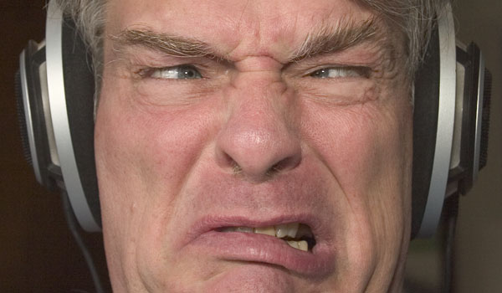
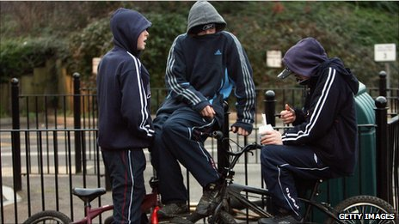
The way we react to social issues depends on our own circumstances. For example old people may think loud music played by teenagers is a social issue, where as a teenager may be more worried about gangs in their town.

Slide 7
Inequality is often at the heart of social issues. This means one group of people feel that they are not treated fairly or have the same advantages as other people.
What creates the problems in the first place?
Some people believe governments are at fault, some people think businesses don’t help enough, other suggest its no ones fault; it just happens. What do you think?
Go back to slide 4 and see if you can decide what is the main cause of some of the social problems listed!

