Slide 1
Techology
How can technology affect poverty in Wales, Europe and other parts of the world?

Slide 2
What is technology?
Technology is something that is man made and helps to make a task easier and more efficient. Technology can help humans adapt to their environment. Technology doesn't have to be an electrical item.
Technology began when stone age men starting using their basic tools in more innovative ways.
Watch the video

Slide 3
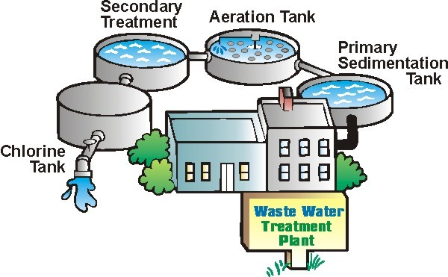

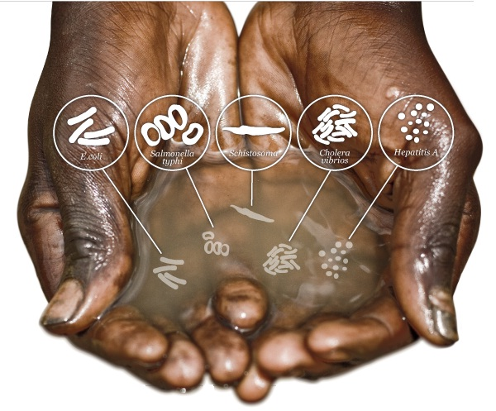
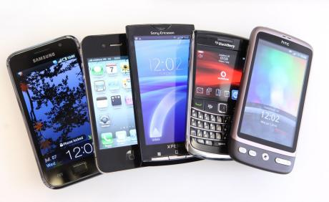
Nowadays many people consider a mobile phone as an essential, but in other parts of the world technology that provides clean water and sanitation would be more important.
Us
Technology that we take for granted
Them

Slide 4
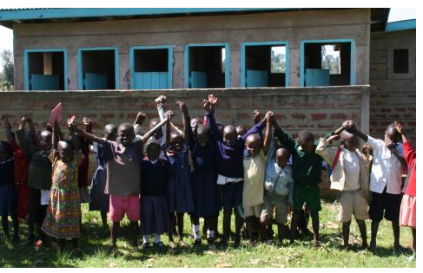
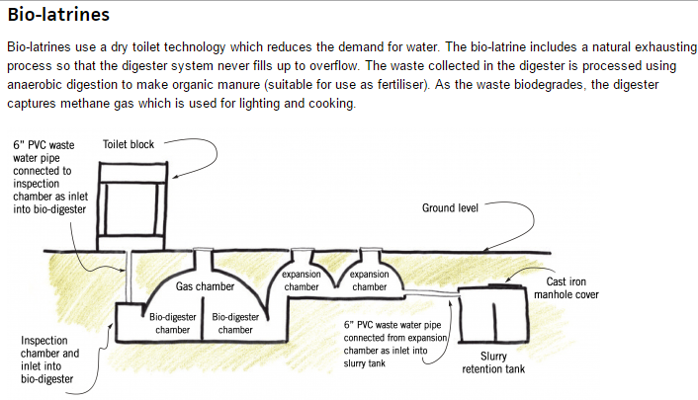
Can technology solve poverty?
Many governments e.g Chile are now thinking the new technologies can help to reduce poverty and so are investing in things like better Internet connections. How do you think this could help poor people in Chile?
In India money is being spent setting up Internet banking from phones. How might this help people who are struggling (hint think of farmers maybe?)
Practical Action a charity that informs on the use of technology to solve problems has helped villages in Africa build bio latrins (toilets to me and you) to help reduce disease.

Slide 5
Who can access technology?
This will depend on where you live.
LEDC’s are still struggling to make progress with technology.
Perhaps the responsibility rests with MEDC’s to share our technology more widely so as to benefit other countries.
What do you think?

