Slide 1
Christianity GCSE
Unit 1: Part A
Practices
Name:

Slide 2
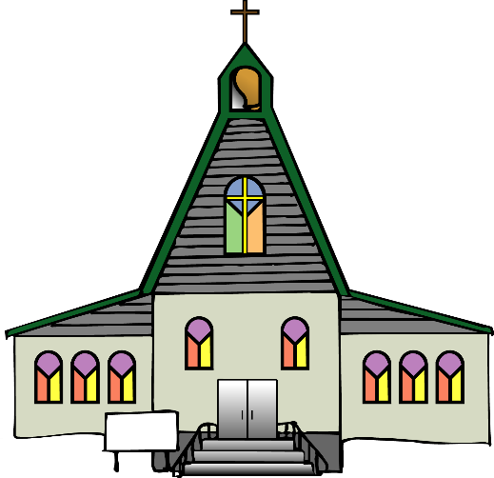
Unit contents:-
Church
Diversity of Christianity: Catholic, Anglican, Church in Wales, non-conformist churches and chapels
Role of the local church
Diverse features of churches and chapels and diversity of worship practices.
Importance of prayer, communal and private (Matthew 6:5-13, Matthew 18:20)
Social and community functions of churches, examples in Wales: food banks, the work of the Salvation Army, the work of Shelter Cymru
Christian groups working for Social Justice, Reconciliation, Inter-faith dialogue e.g. Interfaith Council for Wales, World Council of Churches, Christian-Muslim Forum, Council of Christians and Jews
Persecution of Christians in the modern world (Matthew 10:22)

Slide 3
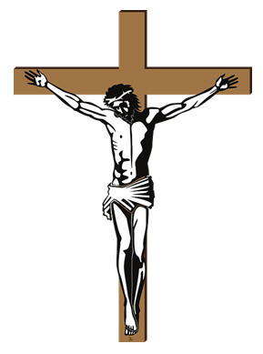
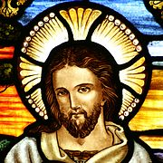
Christianity
Christianity began around 35 A.D and spread gradually until there are Christians in every country in the world today.
The word Christianity comes from the name of Jesus Christ, a man who spent some years preaching God’s message until he was crucified. As Christianity spread, it developed in different ways, and today there are three main branches, and hundreds of sub-branches.
The three main branches are:
The Catholic Church
The Orthodox Church (The Greek Orthodox Churches and the Russian Orthodox Church)
The Protestant Church (Anglicans, Presbyterians, Methodists, Baptists)
Many new religions in the twentieth century also have their origins in Christianity as the follow the Christian teaching of the Bible.
Christians and Wales - There are churches and chapels in every city, town and village in Wales which belong to the various denominations.

Slide 4
The diversity of Christianity
The history of Christianity has been one of expansion and division. The religion is practiced by 2.4 billion people – a third of the world’s population – in 197 of the 232 countries of the world.
The last census to be conducted in the United Kingdom in 2011 found that 59.3% of the population of England and Wales declared themselves to be Christian. The figure was not significantly different in Wales at 57.6%.
The first major division in the Church occurred in the eleventh century (the Great Schism), between the Churches that are today called the Eastern Orthodox Churches and the Catholic Church. Again, in the sixteenth century, disputes in the Catholic Church led to the foundation of Protestant Churches, which broke away from the Roman Catholic Church (the Reformation).
The Catholic Church in England and Wales was called the Church of England. At the time of the Protestant Reformation, King Henry VIII objected to the authority of the Pope and took over leadership of the Church of England himself.
As the British Empire spread to nations across the world, the Churches that were formed in those countries based themselves on the model of the Church of England. They linked themselves together as a community of Churches known as the Anglican Communion.
The Anglican Church in Wales is called the Church in Wales. Whereas the Church of England still has close ties with the British government as the established Church in England, The Church in Wales broke its ties in 1920 and became disestablished.
Protestant Churches that refused to conform or agree with all of the teachings and practices of the Anglican Church are known as Nonconformist. Dissatisfaction with the Church of England in Wales in the 18th and 19th centuries led to the growth of Nonconformist groups, including Methodists, Baptists and Independents.
The different groups and branches of the Christian Church are called denominations.

Slide 5
The Roman Catholic Church
About half of all Christians in the world belong to the Catholic Church. The Catholic Church is led by the Pope. The Catholic Church teaches that the Pope has special authority that descends from Jesus himself. Catholic worship tends to be formal and ritualised. Local leaders are called priests; they are not allowed to marry, and women cannot become priests.
33
The Anglican Church
The Anglican Communion is an organisation of Churches from many nations that are in some way connected to the Church of England. The Anglican Church does not recognise the authority of the Pope and has the Archbishop of Canterbury as its figurehead. It allows a fair degree of freedom of belief, interpretation and practice, so there is a broad diversity of views and forms of worship. Most Anglican Churches allow women to become priests, but not all of them. Local leaders are usually called vicars. Priests, male or female, are allowed to marry.
The Church in Wales
The Church in Wales is the Anglican Church in Wales. It has the same range of diversity as the other Anglican Churches. It is led by the Archbishop of Wales, who is also one of the Church’s bishops, and it is estimated to have about 84,000 members.
Nonconformist Churches and Chapels
Nonconformist Churches are those Protestant Churches that split from the Catholic Church and also refused to conform to the teachings of the Anglican Church. There is a variety of them represented in Wales. Nonconformity started in the 18th century when Welsh Anglicans became unhappy that the Church of England in Wales had so few Welsh bishops and ministers. The three largest Nonconformist groups in Wales are the Union of Welsh Independents, the Baptist Church and the Calvinistic Methodist Church, or the Presbyterian Church of Wales. Men and women can be ministers in the Welsh Nonconformist Churches, and they can marry. Although they have differences, the Churches all consider the authority of the Bible to be their core principle. Many Nonconformist Church buildings are called chapels. Nonconformist denominations, especially those where worship is conducted in Welsh, are often called Chapel to distinguish them from the Anglican Church in Wales.

Slide 6
Diversity of Christianity
Write three facts about each one
Catholic
_____________________________________________
_____________________________________________
_____________________________________________
_____________________________________________
Anglican
_____________________________________________
_____________________________________________
_____________________________________________
_____________________________________________
Church in Wales
_____________________________________________
_____________________________________________
_____________________________________________
_____________________________________________
Nonconformist churches and chapels
_____________________________________________
_____________________________________________
_____________________________________________
_____________________________________________

Slide 7
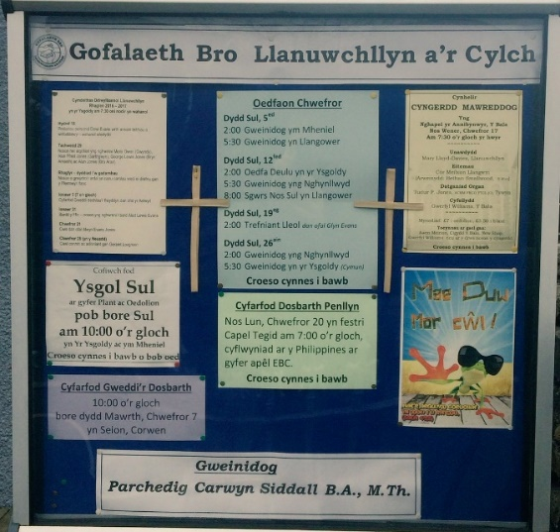
Role of the local church in the community
What is a Church?
http://request.org.uk/life/church/what-is-church/
A Church is mainly a place of worship, but in order to act upon Jesus Christ’s values as they are seen in the Gospels, Churches can reach out into the community in a variety of ways.
Some of the services provided by the Churches are religious in nature, perhaps noting important milestones for individuals and families. Services such as baptisms, confirmations, marriages and funerals are held in church. A number of churches have ‘church halls’ where a number of activities are held:-
Refreshment after Sunday morning service
Weekly meal for the homeless
Food banks
Coffee morning for elderly
Youth clubs
Mother’s union meetings
Nursery for young mums and children
Fund-raising fairs
Brownies, Guides
Fitness clubs/ weight loss groups
Christmas parties for the elderly
Birthday parties, community/family centres
Shelter during emergencies
Task: EDUQUAS website – digital resources – Christianity – The Church and the local community. Are the activities religious or social?

Slide 8
Ebeneser Church Events
Sunday
Led by our Minister
Service, Sunday School in morning 10.30 a.m
The band will practise at 9.45 a.m before the service
Afternoon service at 3 o’clock.
Monday
Fun in the Evening. 6 o’clock at Groes chapel. For children aged 6-11.
Tuesday
Sisters Meetings. Ebeneser 2 p.m.
Talk and exhibition of craftwork by Mrs. Gwyneth Roberts, St Asaph
Wednesday
Lunch Club in Groes Chapel during term time 2 p.m.
Talks on Welsh History
Thursday
Creative writing group Denbigh Library 6-9 p.m.
Merched y Wawr St David’s Dinner in the Oriel hotel.
Sunday
Led by our Minister. Morning service 10.30 a.m.
Sunday School will not be held during school holidays, but children and young people are welcome to attend the service.
Afternoon service at 3 o’clock
Forthcoming event
Shrove Tuesday evening – Pancake night at 6 p.m in Ebeneser chapel, children £1 adults £3 – proceeds towards the Children’s Ward, Ysbyty Glan Clwyd

Slide 9
Task
Choose five different events which are held by churches (for example, coffee morning for the elderly). Outline how each one serves the community.

Slide 10
Examination question answer: Here is an example of a 5 mark question from a GCSE exam
Describe the role of the church in its local community [5]
In your answer, you could include the following :-
To believers, it is a place of worship
It provides fellowship
Activities for children/educates children through the Sunday School
Youth Club, ‘Ti a Fi’, Pensioners lunch club, Food Bank etc.
Hold community events for young people, e.g. Scouts, Guides
Moral and spiritual guidance
A place to celebrate changing world rites/sacraments and/or festivals
Supporting community causes
The priest/minister can be a voice for the community
Focus for charitable events and contact with schools.
Remember you will have to answer in full sentences!
Band 3 answer – this is what is required to be awarded 5 marks:
Excellent description, coherent and demonstrating awareness and
understanding of the religious idea, creed, practice, teaching
or concept.
Using a range of language and specialist religious terms and
sources of wisdom and authority, broadly, correctly and appropriately.
(4-5 marks)
Extended Task
‘You must go to church in order to be a Christian.’
Look at the task on the EDUQUAS website (Digital resources) and decide if the statements are for or against the statement.

Slide 11
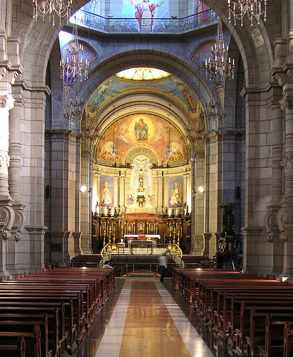
Diverse features of churches and chapels
Watch True Tube: Holy Cribs Anglican Church
https://www.truetube.co.uk/film/holy-cribs-anglican-church
http://request.org.uk/people/places/a-tour-of-a-welsh-chapel-english-and-cymraeg/
Why worship in particular buildings?
Why do Christians worship in a church or chapel? Here are some answers.
Worship means ‘putting value to’ and every religion wants to worship God.
Worshipping in a particular building means that:
there is a special atmosphere there
there is a sense that God is present
it provides a focus for prayers.
An opportunity to worship with others and develop a sense of community.
Family members can worship together.
It is a place which is used to celebrate life events, such as births, marriages and deaths.
It provides an opportunity to put religious teaching in prayers.
It provides an opportunity for people to sing and worship in diverse ways, rather than just pray.
The artefacts in the building can assist the the act of worship.
It is a strong tradition.
Religious buildings are often very striking.
What symbols can you see in this photograph?

Slide 12
Sacred buildings are an important feature of every religious tradition. In your opinion, why is this the case?
What is so special about a sacred building?
What’ in them which makes them fulfill their purpose?
What creates an appropriate atmosphere for worship in a building? Places of worship have been designed for that purpose. Often they are quiet places where believers are surrounded by artefacts, images and objects which are associated with their religion. Sometimes there will be scents in the building to help worship, or even sounds, such as music which is familiar to worshippers. It is very important that a sacred place conveys the appropriate atmosphere for worship as that is the main purpose of the building.
PP Presentation Church Features Lesson (click on the presentation)

Slide 14
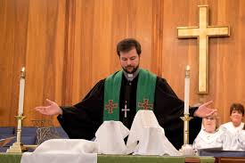
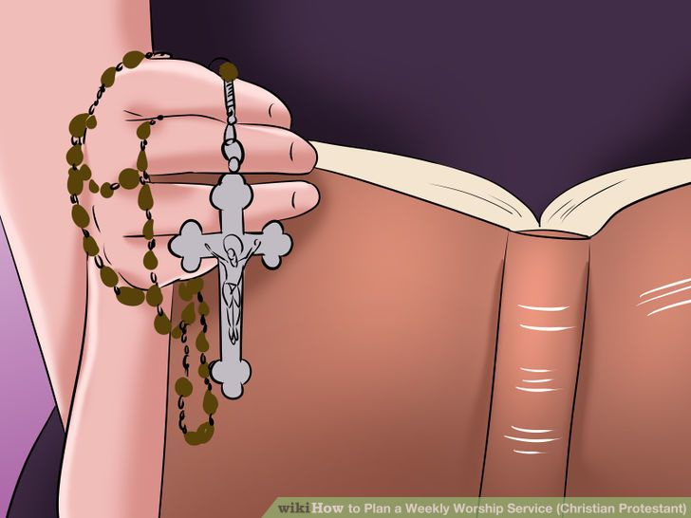
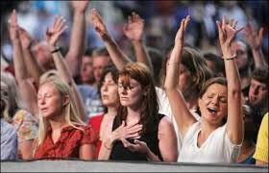
Diversity of Worship Practices
Worship Practices
Worship is an expression of praise to God. Worship and its importance is often expressed in the Bible. In the Ten Commandments, it says that the ‘Sabbath should be kept holy.’ This has been interpretd as a command to worship God.
There are many different ways of worship and different Christian traditions worship in different ways.
Worship Practices:
Liturgical Worship – where worshippers follow a strict structure, which is more or less the same every time. An example of this is the Eucharist service.
Informal Worship – there is no definite structure and the worship of far more spontaneous than the liturgical worship. Services in evangelical denominations are often more informal than more traditional forms of worship.
Private Worship – private worship takes place in addition to communal worship in churches. Christians believe that it is importnat to form a personal relationship with God, and private worthip is often part of this.
Not every worship includes prayer or listening to a sermon. For some denominations such as the Salvation Army, music is central to the worship and communal hymn singing is an important part of worship.

Slide 15
Liturgical Worship
Liturgical worship is a type of worship which follows a strict pattern, which has established practices as part of church worship. This can be a particular set of prayers, or the use of a set book. Most denominations include the Lord’s Prayer in their services and because of its Biblical roots, it has a special significance to every Protestant denomination.
The majority of Christian Churches have some form of Liturgical worship. A good example is the Eucharist/ Holy Communion. In the Catholic Church the Eucharist service includes:-
The Liturgy of Word: this includes readings from the Bible, homily, public confession of faith prayers of advocacy (for those in need)
The Liturgy of the Eucharist: in this part of the service the altar is prepared with bread and wine. The Eucharist and the Lord’s Prayer are said and people share the bread and wine. The service ends with a blessing from the priest.
Informal worship
A number of churches have moved away from liturgical workship and take a more informal approach, with no definite structure. In some denominations where informal worship is more common, it would be difficult to recognise any form of definite structure or liturgy at all. An evangelical and charismatic approach has distanced itself from the more traditional Protestant practices. They emphasise the importance of the Holy Spirit and spontaneous action, and this is shown in the worship and prayer services. Although informal worship appears modern, it is likely that this was the type of worship which was offered by Christians in the early decades of the Church before practices and traditions had been established. Some Christian organisations have moved away from a church building as a place of worship. Instead, they emphasise that is is possible to worship anywhere where Christians meet. However, this is similar to worship in the early church.
Private Worship
A number of Christians believe that a personal relationship with God is possible and is important, and private worship is therefore important to them. Traditionally, worship was seen as a formal process which should take place where Christians congregated at a particular time, and in a particular place (chapel/church). This is ‘communal worship’ and this is what truly makes a church.
However, as society changes over the centuries and individuals were given more responsibilities and freedom, the idea of private worship has gained ground.

Slide 16
The importance of prayer, communal and private
Prayer was extremely important in Jesus’s life. Christians today believe that is is an essential part of their faith. Jesus says in the Gospel of John 4:23
^{‘23} Yet a time is coming and has now come when the true worshippers will worship the Father in the Spirit and in the truth, for they are the kind of worshippers the Father seeks.’
Jesus says that Christians should worship God in the spirit and the truth. For Christians, this means that worship would not be superficial, but that they should worship God with all his mind, action and words. Worship includes prayer, and prayer involves developing a special relationship with God. Prayer has several purposes and there are several different forms of prayer within Christian denominations. The most important types of prayer are :-
Adoration – deep love and respect towards God
Confession – statement of faith through prayer
Reflection – contemplation
Repentance – saying sorry
Praise – give praise, this can include singing hymns
Thanksgiving – saying thank you very much
Desire – ask for something
People are familiar with the idea of someone sitting or kneeling on their own in a church, deep in thought and surrounded with silence. Perhaps many more people, including those with no faith are familiar with the need to say a prayer quietly, particularly at difficult times, often because of a sense of hopelessness.

Slide 17
Importance of Prayer
Worshippers are speaking to God in their own way, and prayer is way in which Christians communicate with God. For some, they truly feel that they are speaking to God, and for other is it a more mysterious way of communicating.
Jesus taught the early disciples to pray, and encouraged them to pray to God as the Father, and this suggests that prayer is something which can be learnt.
“And when you pray do not be like the hypocrites, for they love to pray standing in the synagogues and on the street corners to be seen by others. Truly, I tell you they have received their reward in full! ⁶ But when you pray, go into your room, close the door and pray to your Father, who is unseen. Then your Father, who sees what is done in secret, will reward you. ⁷ And when you pray, do not keep on babbling like pagans, for they think they will be heard because of their many words. ⁸ Do not be like them, for your Father knows what you need before you ask him.” Matthew 6:5-8
For protestants, private prayer is crucial. They believe that every Christian has direct access to God through Jesus Christ, and that they do not need to communicate via a priest.
Prayer is a significant factor in making faith something wholly personal. Some people pray together, but many decide to gain spiritual support by praying together. They believe they are following Christ’s instructions, for he encouraged his followers to pray together.

Slide 18
The Lord’s Prayer
This is most important prayer for Christians. These are Jesus’ words to his disciples when he was asked to teach the to pray.
Our Father, in heaven,
hallowed be your name.
Your kingdom come.
Your will be done,
on earth, as it is in heaven.
Give us today our daily bread.
And forgive us our debts,
as we also have forgiven our debtors.
And lead us not into temptation,
but deliver us from evil.
For the kingdom, the power and the glory,
are yours. Now and forever.
Amen.
(Digital Task: EDUQUAS Digital Resources - Christianity Practices- Lord’s Prayer)
Read the Lord’s Prayer. Explain, by using quotations if needed, three different things which it tells Christians about God.
__________________________________________________________________________________________________________________________________________________________________
____________________________________________________________________________________________________________

Slide 19
Tasks
What is the meaning of worship?
______________________________________________________
______________________________________________________
______________________________________________________
______________________________________________________
Give the definition of the different types of prayer in the table.
Adoration
Confession
Reflection
Repentance
Praise
Thanksgiving
Desire

Slide 20
After his second goal, the Hindu defender of Bali United, the Christian forward, and the Muslim striker celebrate by performing their own prayers. What does this photograph convey to you?

Slide 21
3. Recreate the diagram below, analysing the different types of prayer. For each one, give the definition/description, and suggest advantages and disadvantages for each one.
Disadvantages
This is when...
This is when...
Private
Liturgical
Type of worship
Advantages
Prayer
This is when...
Why is the Lord’s Prayer so important to Christians?

Slide 22
Prayers – www.request.org
What is prayer? Different types of prayer
Set Prayers
Set prayers allow the worshippers to understand and repeat prayers which have significant meaning. When Christians recite the Lord’s Prayer together, their individual voices becomes a communal voice. As Jesus’ disciples, many people feel that set prayers are extremely useful. They are part of a tradition and worship practices which go back hundreds of years. Originally, prayers were recited orally before they were written down, so that they could be repeated and used by more than one person.
Prayers which have not been prepared
These are spontaneous prayers which do not have a set formula. Some Christians prefer these types of prayers as they believe that they are more spiritually honest. Some Christians believe that when praying like this, their choice of words is influenced by the presence of the Holy Spirit. Some Christian denominations go so far as to reject set prayers, as the true meaning can be lost, and people repeat words without thinking carefully about the meaning.
Informal prayers
Some Christians do not like formal prayers, so they have adopted an informal voice in their prayers, speaking with God in everyday language.
How do Quakers worship?
Informal prayers tend to be private and contain more than communication with God. They can include reflection and Quakers simply appreciate being in God’s presence. A Quaker service does not include set prayers, instead they sit in silence and peace.
They believe that this enables them to have the opportunity to listen and reflect and get closer to God and other members of the congregation. There is no official leader of worship, anyone who feels the need to speak may do so; this is called ‘ministry’. Others can listen quietly or speak if they feel the need to.
Evangelical worship – What does it mean to be an evangelist?
In many Evangelical churches e.g. Pentecostal, the worship is informal. Christians feel that they are being led by the Holy Spirit. This can include falling into a trance or speaking in tongues (speaking an intelligible language). Movement and participation is encouraged among the congregation as well as music, dance and song.

Slide 23
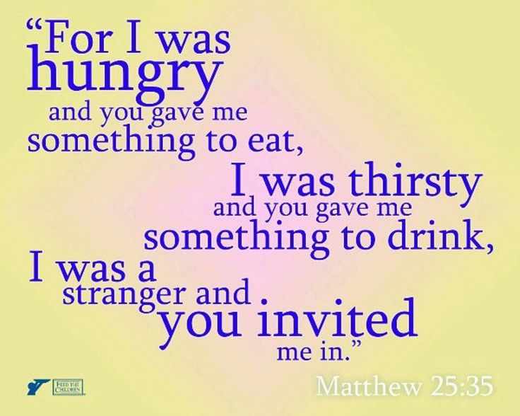
The social and community functions of churches
We have seen that, for Christians, spirituality and morality are closely linked. Jesus taught that his followers have a duty to God to do good to other human beings.
Although life in the twenty-first century is very comfortable for many people in the West, it is not comfortable for a significant number. Worldwide, more than three billion people live on less than £2.50 a day. Hunger is the greatest cause of death in the world.
The Churches consider it their duty to provide help for people who need it. This may take the form of food banks, advice on immigration or legal matters, help with accommodation or money management, or health information. Luke’s Gospel tells of Jesus reading from the Jewish prophet, Isaiah, in a synagogue:
"The Spirit of the Lord is on me, because he has anointed me to proclaim good news to the poor. He has sent me to proclaim freedom for the prisoners and recovery of sight for the blind, to set the oppressed free, to proclaim the year of the Lord’s favour”.
(Luke 4.18–19)
The Churches, too, consider this to be their mission in the world.
³⁵ For I was hungry and you gave me something to eat; I was a stranger
and you invited me in;’ Matthew 25:35

Slide 24
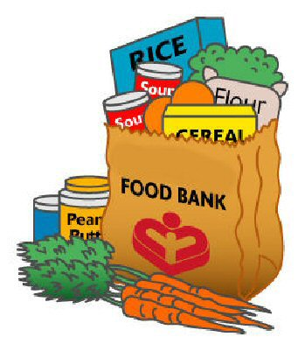
Food Banks
Food banks provide food packages for people who are at risk of not being able to afford to feed themselves and their families.
The Trussell Trust is a charity that co-ordinates a nationwide network of food banks. They work in partnership with local communities to alleviate the effects of poverty. Their aim is to eliminate poverty altogether. The work of the Trust is based on Christian principles, in particular those expressed by Jesus in Matthew’s Gospel:
"For I was hungry and you gave me something to eat, I was thirsty and you gave me something to drink, I was a stranger and you in- vited me in, I needed clothes and you clothed me, I was sick and you looked after me, I was in prison and you came to visit me”. (Matthew 25.35–36)
Church Action on Poverty is also committed to tackling poverty in the UK. It works in partnership with churches of different denominations and with people in poverty themselves to find solutions to poverty, locally, nationally and globally. They believe they have a duty to help all people, as creations of God:
At Church Action on Poverty, we believe that everyone is created in the image and likeness of God, and deserves equal treatment. (Church Action on Poverty website, October 2016)
Between 1998 and 2010, there were 16 food banks in Wales. This increased to 157 in 2016. The rest of the UK has seen a similar increase.
https://www.youtube.com/watch?v=4ysoRXuzAT8
Cardiff Food Bank

Slide 25
Homework Research the Food Banks in your area
https://pwyntteulu.cymru/eich-ardal/sir-ddinbych/
https://www.trusselltrust.org/get-help/find-a-foodbank/
Create an information pamphlet on how food banks show their social and communal functions.

Slide 26
Salvation Army
The Salvation Army is a Christian denomination. It uses military structures in the organisation of its personnel, declaring that it is at war against sin and social evils, such as poverty. It was founded in London in 1865 and today has over 1.5 million members in 127 countries in the world. Its mission is expressed in these words:
The Salvation Army... exists to save souls, grow saints and serve suffering humanity.
(Salvation Army website, October 2016)
‘Salvationists’ work to bring salvation to the poor, by preaching the Word of God and
offering material support. The ways in which they support people include:
helping people who have lost the ability to provide for themselves
helping in the rehabilitation of prisoners and providing
probation care
meeting the needs of the elderly, providing adult education, day
care, regular meals and residential care
fighting sexual exploitation and human trafficking
reuniting families through tracing missing persons
providing food for the poor
providing food and accommodation for the homeless
providing emergency disaster relief.

Slide 27
Does is all happen in the UK?
At the moment the Army is working in more than 120 countries – United States of America, Canada and Australia – but the largest number of groups are working in Africa.
In the event of a natural disaster such as an earthquake or floods, the Salvation Army will provide love and support to those in need. The Salvation Army works in a number of poor countries. They help people to grow their own food and get clean water. They run programmes to help them become self-sufficient.
Schools, hospitals and clinics have been provided and help has been given to a number of people who wish to build a better life and future.
To learn more about the history, work and beliefs of the Salvation Army, go to www.salvationarmy.org.uk/uki/schools_students
Homelessness
Housing Justice is a Christian charity that aims to ensure that everyone has access to a suitable home. The charity describes itself as ‘the national voice of Christian action to prevent homelessness and bad housing’ (Housing Justice website, October 2016). It is multi-denominational, being the result of a merger between the Catholic Housing Aid Society (CHAS) and the Churches’ National Housing Coalition (CNHC).
Housing Justice Cymru was launched in September 2016 to work independently with and for homeless and badly housed people, and to support churches in meeting their needs. One of its projects aims to create affordable homes from the sale of disused churches, and it works with the Church in Wales to achieve this.
Another housing charity to be born from CHAS is Shelter, and Shelter Cymru works as an independent organisation. Its aim is that everyone in Wales should have a decent, affordable home. They provide advice and offer support services to those people who have no home or live in poor housing. They work with councils to ensure that they support people with housing needs and challenge bad landlords. They campaign to influence legislation in the Welsh Assembly to improve the housing situation in Wales.

Slide 28
Shelter Cymru http://request.org.uk/issues/social-issues/big-issues-homelessness/ What is the Christian response to homelessness?
Shelter Cymru is a Welsh charity which works on behalf of the homeless. It co-operates with the English charity Shelter. Shelter Cymru was established in 1981, and has been an independent organization since 1986. It provides advice on homelessness, finding a place to live, paying for housing, renting and leasing, mortgage repossessions, repairs and poor conditions and for families and relatives. They have a help line and also provide face-to-face appointments.
Read the articles below.
http://www.bbc.co.uk/news/uk-wales-37600937
http://www.bbc.co.uk/news/uk-wales-south-east-wales-37595862
What can you say about the work of Shelter Cymru?
Go to the website https://sheltercymru.org.uk/get-advice/ and design an information pamphlet about the social and community functions of the work of Shelter Cymru.
You should include information about:-
Who they are and how they help?
Homelessness
Finding somewhere to live
Families and relations
Financial advice
Advice for young people

Slide 29
Christian Groups working on behalf of social justice http://request.org.uk/life/church/churches-together/
Key terms: Reconciliation: Reconciliation after an argument or dispute, and beginning to co-operate once more. Religions teach about forgiveness as it leads to moving forward and finding solutions. Inter-faith Dialogue: Different faith groups speaking to each other. There are many examples of local and national inter-faith networks and these help to solve misunderstandings.
Within the Christian Church there are a number of denominations, and in the past the differences have lead to conflict and tension. Many Christians believe that it is important for different denominations to work together. Today, living in a multi-religious society means that there is more need than every before for people to work together. Unless religious believers come together and understand each other, and share their common beliefs in peace, conflict will always exist. One way of doing this is by visiting each other’s places of worship and seeing what they have in common. They can go to Inter-faith Network meetings and hold Inter-faith Weeks. When people respect each other’s identity and faith, then it is possible to work together and get along, regardless of any differences.
Forgiveness Sometimes forgiveness takes a lot of time; it eventually comes, but people never forget. Services to aid forgiveness are held to make this possible. Forgiveness must come, no matter how difficult it is or it will not be possible for people to move on with their lives. Forgiveness is an important part of the Lord’s Prayer.

Slide 30
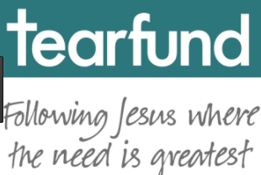
Christian groups working for social justice, reconciliation and inter-faith dialogue
Social justice
The Universal Declaration of Human Rights is international recognition that all people, throughout the world, no matter who they are, have freedoms and entitlements that nobody has the right to take away. The rights are basic needs that contribute to happiness and wellbeing. Justice means fairness. When the rights and entitlements of humans are not met, it is said to be unjust. Social injustice occurs when certain rights and entitlements are denied or not met for groups of people. Examples of social injustice are unequal distribution of resources, unequal access to healthcare and unequal access to education. Social justice, on the other hand, is about equality of opportunity and treatment. All Christian Churches actively support the promotion of social justice and fight against issues of social injustice. Many charities work in the field of social justice to ensure that people’s rights and fair access to justice are met. Some of these charities have Christian foundations.
Tearfund
Tearfund is a Christian charity whose aim is to put Christian beliefs and Jesus’ command to ‘love your neighbour’ into action. Christians believe they are putting into practice the unconditional or unselfish love (agape) Jesus talks about in the Gospels. The charity works through local church groups, giving help to the poor in many countries. Tearfund currently works in over 50 countries providing emergency aid when natural disasters occur and carrying out long-term projects to support local communities. In the UK many people support Tearfund by raising money through coffee mornings and buying Tearfund Christmas cards. There is a lot of information about the work of Tearfund on its official website at tearfund.org.
Why is Tearfund important?
▶ Tearfund has a role in raising public awareness of social issues, such as poverty and discrimination in the world.
▶ Tearfund campaigns against the causes of poverty worldwide.
▶ Tearfund gives practical help in order to act out the teachings of
Jesus to help others.
▶ Tearfund encourages self-help for both individuals and
communities.
One example of how Tearfund puts Christian beliefs into action is their work with children and teenagers in Columbia. By working with partner agencies, churches and youth groups in the country, Tearfund has set up 30 sports clubs where children can attend football training. These clubs provide safe spaces for young people who are at risk of joining gangs to come and socialise. They also offer mentoring to equip them with life skills.

Slide 31
Reconciliation
Reconciliation is the idea that people should make up after an argument and move on. In the Christian Church some of the differences between the many denominations have led to conflict and tension in the past. Many Christians believe it is important for these denominations to resolve their conflicts and work together towards common goals. Today, living in a pluralist society, the need for the different Christian denominations to work together is greater than ever.
‘Ecumenical’ means relating to a number of different Christian Churches, and the ecumenical movement is an attempt to bring closer together the different Christian denominations and promote Christian unity throughout the world. It began at the World Missionary Conference at Edinburgh in 1910. The movement aimed to unify the Protestant Churches of the world and ultimately all Christians. As a result of the work of the ecumenical movement, there is increased co-operation between different Christian denominations, such as different Churches sharing a common building and holding ecumenical services. Although denominational differences still exist, today some Christians believe there should only be one Church. At a local level, many churches genuinely cooperate and work together.
Task
Go to the website www.interfaithwales.org.uk
Click on the link ‘Inter-faith Week’ in the news link.
Create an information poster about the things which are taking place during ’Inter-faith Week’
I would like you to include information about:
Who?
What?
Why?
Aim of the week?
Look in particular at the Inter-faith Council for Wales and not what happens in Wales.

Slide 32
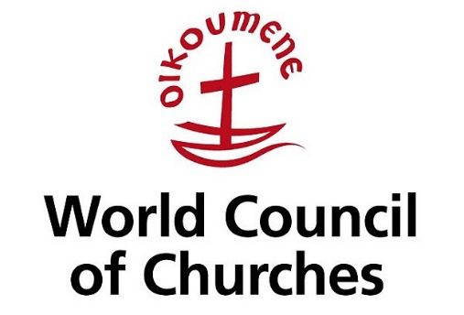
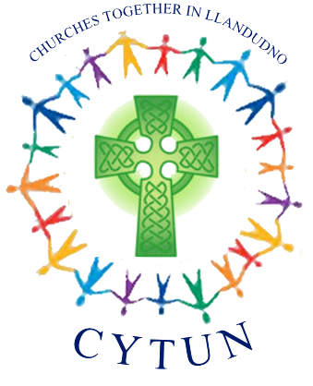
The World Council of Churches
The World Council of Churches is:
A worldwide fellowship of churches seeking unity, a common witness and Christian service.
The aim of these Churches is to be ‘a visible sign ... deepening communion ... sharing the Gospel together ... making connections’.
Each year, the World Council of Churches holds a special week of prayer for Christian unity. It brings together churches, denominations and church fellowships in more than 110 countries.
The Catholic Church is not a member of the World Council of Churches, but does take part in some national and local organisations.
Churches Together in Wales is a practical attempt to focus locally on the fellowship of those who share the Christian faith. Churches Together in Wales is named Cytûn, meaning ‘of one accord’, signifying togetherness. The aim is to offer practical ways of achieving greater unity. For example, Cytûn has coordinated the Churches of Wales to provide common responses to the arrival of asylum seekers to Wales. It has also brought the Welsh Churches together to mark national and international events and tragedies with acts of worship. The organisation offers advice, comment and assistance to support the activities of Welsh Churches as a means by which the Churches can be accessed and approached.

Slide 33
Inter-faith dialogue
The differences between the religions of the world can lead to tensions between them. These tensions can take the form of intolerance, prejudice and discrimination. They can develop into violence and war. Those who promote inter-faith dialogue believe that tension between religious groups can be reduced through communication, and that communication can bring about peace. Inter-faith dialogue is not an attempt to remove difference between religions, but rather to understand the differences and respect them, while remaining true to one’s own faith.
Inter-faith Wales
Inter-faith Wales is an organisation made up of three separate bodies: the Faith Communities Forum (which is an agency of the Welsh government), the Interfaith Council for Wales and the Wales Inter-faith Network. It was set up after 9/11 to promote better understanding and respect between communities. Its membership comprises representatives of the major world faiths; the Welsh government is represented on the Interfaith Council by the First Minister.
The Council has the following aims:
To advance public knowledge and mutual understanding of the teaching, traditions and practices of the different faith communities in Wales.
To promote good relations between persons of different faiths and to be of service to the people of Wales.
To promote awareness of the distinctive features of these faith communities and of their common ground.
An example of the work of Inter-faith Wales is its coordination of Inter-faith Week. This is a series of events that takes place annually to increase awareness and understanding of different faiths. So, for example, a 'Question Time' was held at Cardiff University at which representatives from a range of the University's faith and belief societies, as well as audience members, engaged in dialogue on a number of topics. The Inter-faith Council also organised 'Youth and the Rising Generation' at the Cardiff United Synagogue, with contributions from members of the Jewish, Christian, Hindu and Mormon communities.

Slide 34
The Christian Muslim Forum
The Christian Muslim Forum is the leading national forum for Christian–Muslim relations. It was launched in 2006, realising an initiative of the Archbishop of Canterbury. Its aim is ‘to help Christians and Muslims to live and work together creatively and harmoniously in our plural society’.
Through the Forum, Christians and Muslims communicate with each other to respond to national and international events that may otherwise test their relationship. They are then able to present shared perspectives for the good of their communities and society as a whole.
The Council of Christians and Jews
The Council of Christians and Jews (CCJ) was founded during World War II, in 1942, when Jews across Europe were experiencing severe persecution from the Nazis. Today, Christians and Jews work together on the Council to fight against religious and ethnic intolerance. The CCJ works to create constructive dialogue between Jews and Christians on a wide variety of topics, including the Israel-Palestine situation and the global economic crisis, providing a safe space for respectful dialogue, especially on difficult issues. It also encourages Jewish and Christian communities to work together on social action projects in the UK. For example, the CCJ has participated in high- level dialogues with the Parliamentary Committee against Anti- Semitism. It also organises an annual Christian/Jewish Leadership Study Tour of Israel/Palestine to equip participants with the knowledge that can help improve understanding between them.

Slide 35
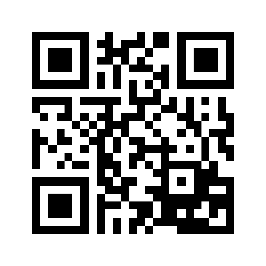
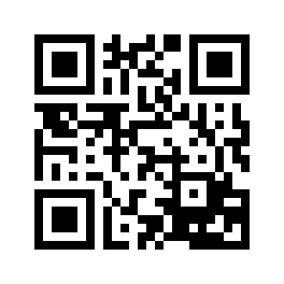
The Persecution of Christians in the modern world
Persecution = constant cruel treatment because of religion or creed.
²² You will be hated by everyone because of me, but the one who stands firm to the end will be saved.’ Matthew 10:22
Christians have always been persecuted, and the word martyr is used for someone who dies or is killed for their religious beliefs. Jesus was himself a martyr, and he warned the disciples that they would also be persecuted for their faith; the majority were martyred. Christians themselves believe that they received a divine command from Jesus to spread the gospel, and they continue to to this in the face of constant danger in the 21st century, in a number of countries across the world.
In some parts of the world, Christians are treated unfairly in societies where the Christian faith is a minority religion - e.g. Terrorist organisations such as Islamic State in the Middle East have targetted Christians, forcing them to leave their homes and attacking them violently. Evengelical organisations such as the Christian Freedom International and Open Doors try to help Christians who are facing persecution. These organisations offer practical support, provide Bibles and take action to defend the human rights of those Christians who are suffering because of persecution.
Oscar Romero - http://www.romerotrust.org.uk/who-was-romero
Article about the persecution of modern Christians http://www.breitbart.com/big-government/2016/01/20/report-2015-saw-most-violent-persecution-of-christians-in-modern-history/
Make a connection between
campaigns for Social Justice
and the persecution of Christians
in the modern world

Slide 36
Open Doors
Open Doors was established in 1955 when Brother Andrew, a Dutch missionary, smuggled Bibles into the Soviet Union. Under the communist system in the Soviet Union, Christian Churches were persecuted. It trains Christians and church leaders to deal with the trauma they may be suffering while maintaining their faith. It provides practical support for Christians who have been the victims of disasters.
Today Open Doors still supports persecuted Christians across the world in different ways:
It distributes Bibles and other resources to those who might not have access to Bibles, or may have had them confiscated.
It speaks on behalf of persecuted Christians to raise awareness of their situation and gather support, for examples, by lobbying MPs in the UK government.
People in the UK support their work both practically and financially.

