Slide 1
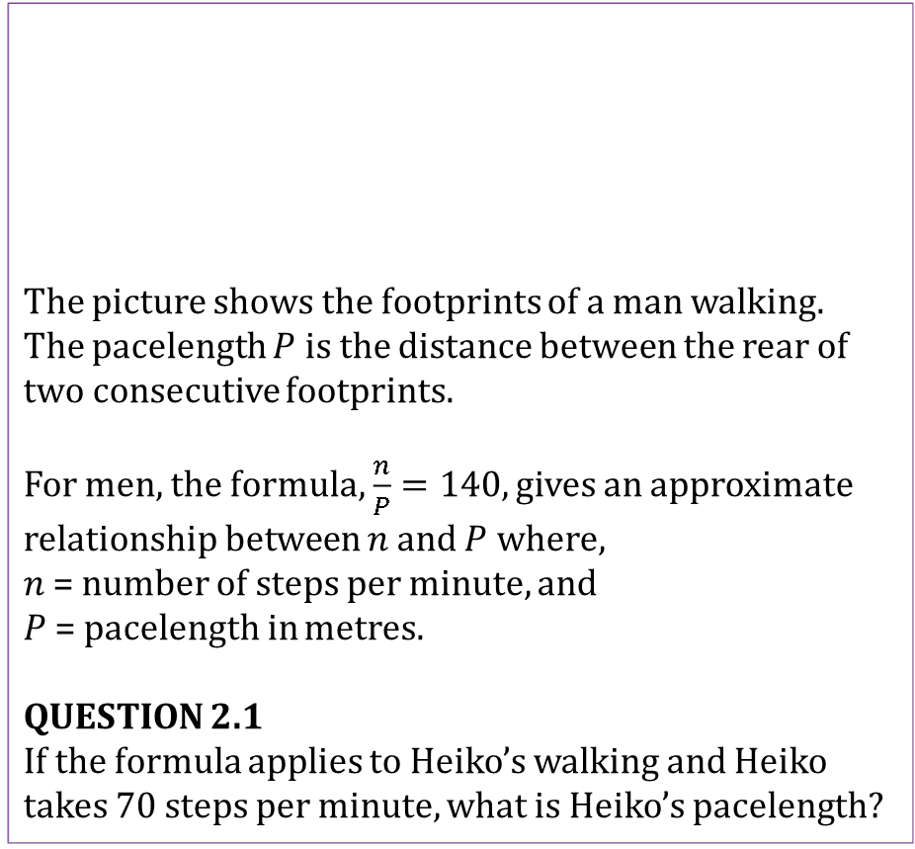
Mathematics Unit 2: Walking
The picture shows the footprints of a man walking. The pacelength $P$ is the distance between the rear of two consecutive footprints.
For men, the formula, $\frac{n}{P}=140$, gives an approximate relationship between $n$ and $P$ where,
$n$ = number of steps per minute, and
$P$ = pacelength in metres.
QUESTION 2.1
If the formula applies to Heiko’s walking and Heiko takes 70 steps per minute, what is Heiko’s pacelength?
What do we want to find out?
What useful information do we know?
What other mathematical techniques do we need to apply?
What have we learned?

Slide 2
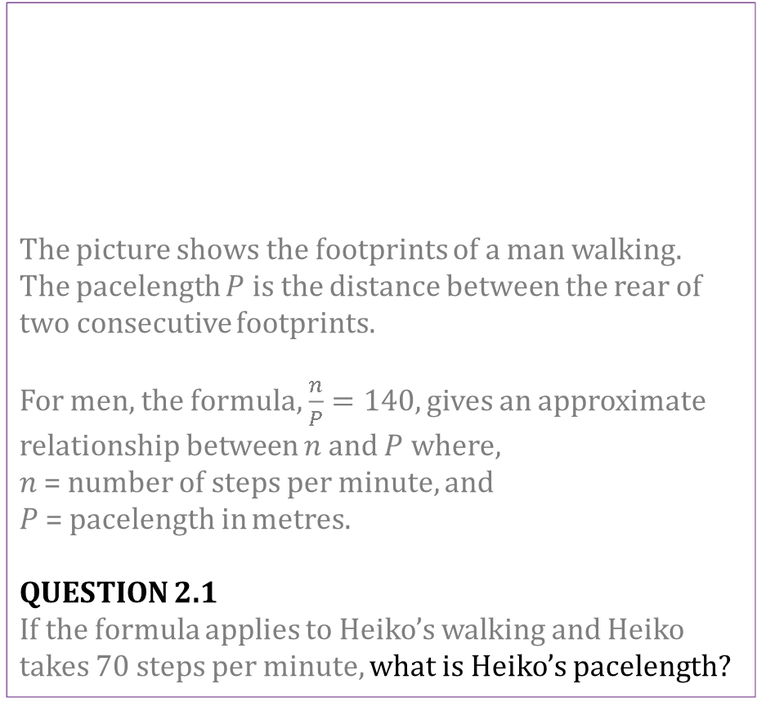
Mathematics Unit 2: Walking
The picture shows the footprints of a man walking. The pacelength $P$ is the distance between the rear of two consecutive footprints.
For men, the formula, $\frac{n}{P}=140$, gives an approximate relationship between $n$ and $P$ where,
$n$ = number of steps per minute, and
$P$ = pacelength in metres.
QUESTION 2.1
If the formula applies to Heiko’s walking and Heiko takes 70 steps per minute, what is Heiko’s pacelength?
What do we want to find out?
What useful information do we know?
What other mathematical techniques do we need to apply?
What have we learned?
Back to start

Slide 3
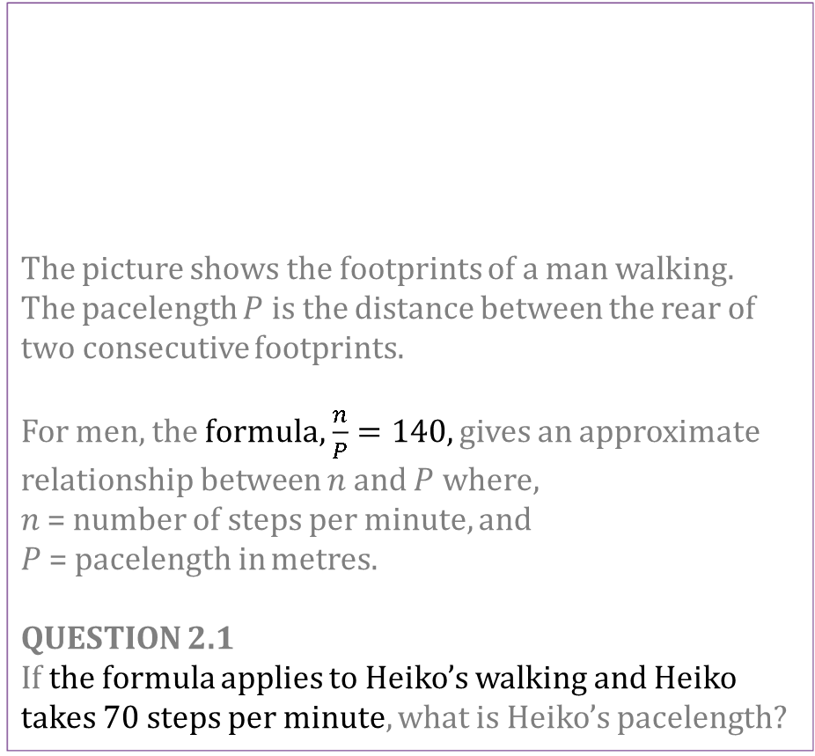
Mathematics Unit 2: Walking
The picture shows the footprints of a man walking. The pacelength $P$ is the distance between the rear of two consecutive footprints.
For men, the formula, $\frac{n}{P}=140$, gives an approximate relationship between $n$ and $P$ where,
$n$ = number of steps per minute, and
$P$ = pacelength in metres.
QUESTION 2.1
If the formula applies to Heiko’s walking and Heiko takes 70 steps per minute, what is Heiko’s pacelength?
What do we want to find out?
What useful information do we know?
What other mathematical techniques do we need to apply?
What have we learned?
Back to start

Slide 4
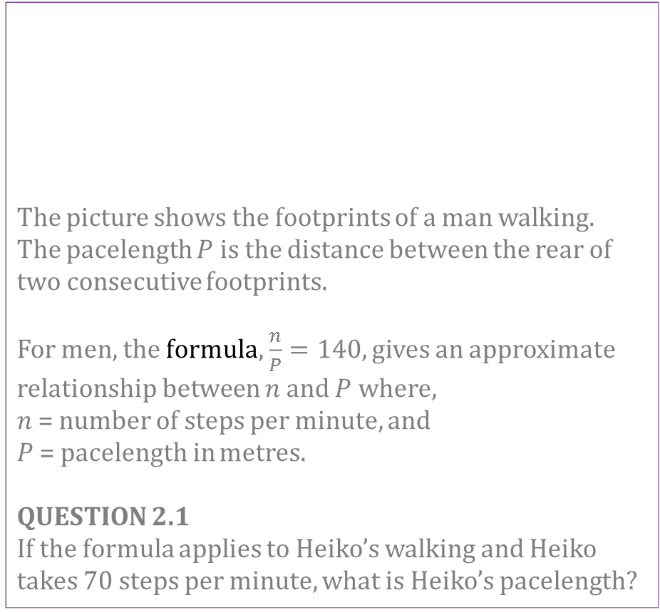
Mathematics Unit 2: Walking
The picture shows the footprints of a man walking. The pacelength $P$ is the distance between the rear of two consecutive footprints.
For men, the formula, $\frac{n}{P}=140$, gives an approximate relationship between $n$ and $P$ where,
$n$ = number of steps per minute, and
$P$ = pacelength in metres.
QUESTION 2.1
If the formula applies to Heiko’s walking and Heiko takes 70 steps per minute, what is Heiko’s pacelength?
What do we want to find out?
What useful information do we know?
What other mathematical techniques do we need to apply?
What have we learned?
Back to start

Slide 5
Mathematics Unit 2: Walking
The picture shows the footprints of a man walking. The pacelength $P$ is the distance between the rear of two consecutive footprints.
For men, the formula, $\frac{n}{P}=140$, gives an approximate relationship between $n$ and $P$ where,
$n$ = number of steps per minute, and
$P$ = pacelength in metres.
QUESTION 2.1
If the formula applies to Heiko’s walking and Heiko takes 70 steps per minute, what is Heiko’s pacelength?
What do we want to find out?
What useful information do we know?
What other mathematical techniques do we need to apply?
What have we learned?
Back to start

Slide 6
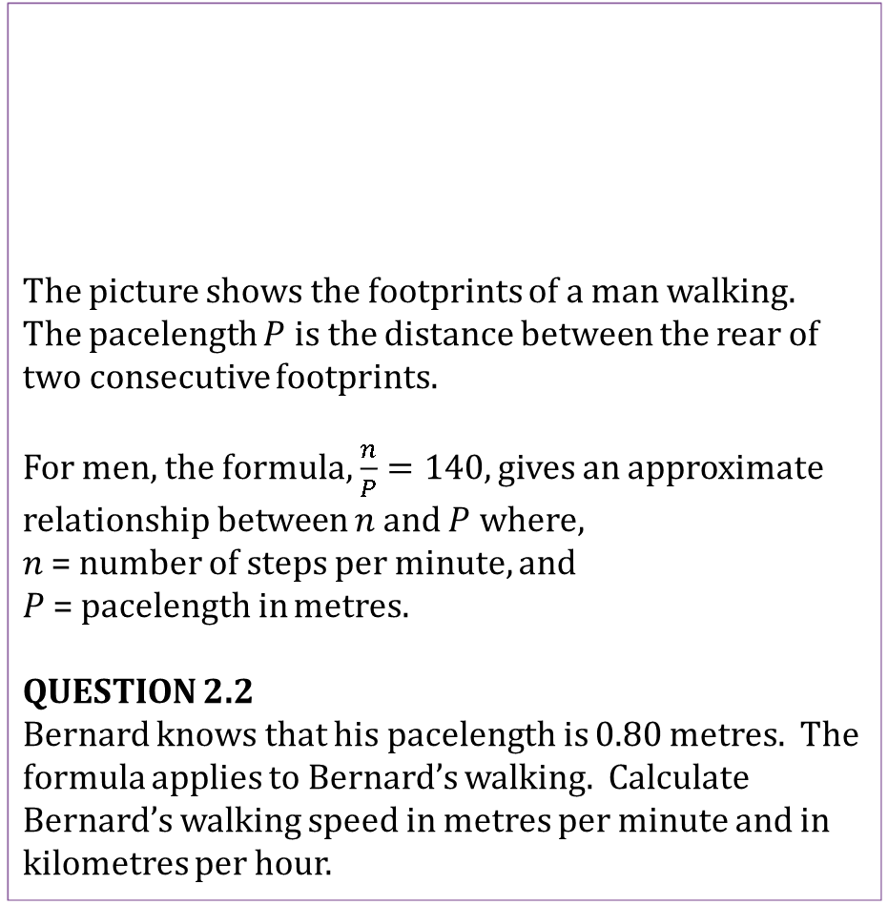
Mathematics Unit 2: Walking
The picture shows the footprints of a man walking. The pacelength $P$ is the distance between the rear of two consecutive footprints.
For men, the formula, $\frac{n}{P}=140$, gives an approximate relationship between $n$ and $P$ where,
$n$ = number of steps per minute, and
$P$ = pacelength in metres.
QUESTION 2.2
Bernard knows that his pacelength is 0.80 metres. The formula applies to Bernard’s walking. Calculate Bernard’s walking speed in metres per minute and in kilometres per hour.
What do we want to find out?
What useful information do we know?
What other mathematical techniques do we need to apply?
What have we learned?

Slide 7
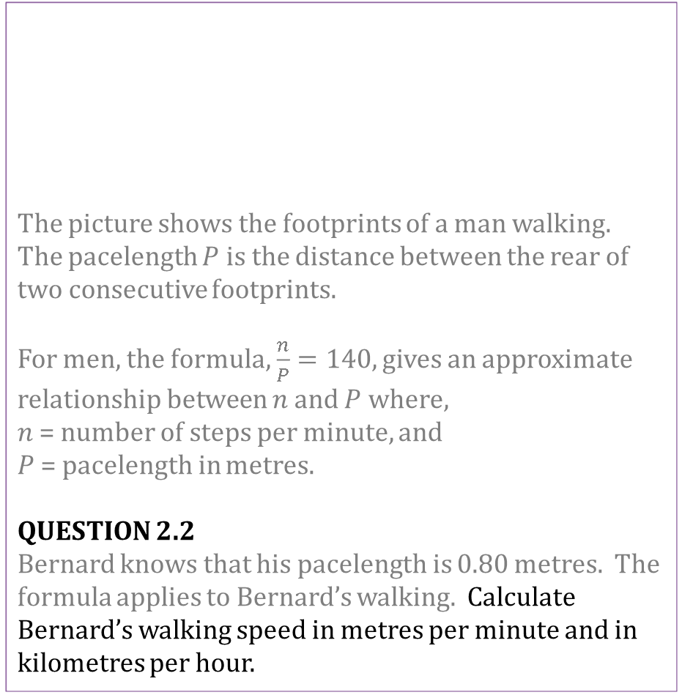
Mathematics Unit 2: Walking
The picture shows the footprints of a man walking. The pacelength $P$ is the distance between the rear of two consecutive footprints.
For men, the formula, $\frac{n}{P}=140$, gives an approximate relationship between $n$ and $P$ where,
$n$ = number of steps per minute, and
$P$ = pacelength in metres.
QUESTION 2.2
Bernard knows that his pacelength is 0.80 metres. The formula applies to Bernard’s walking. Calculate Bernard’s walking speed in metres per minute and in kilometres per hour.
What do we want to find out?
What useful information do we know?
What other mathematical techniques do we need to apply?
What have we learned?
Back to start

Slide 8
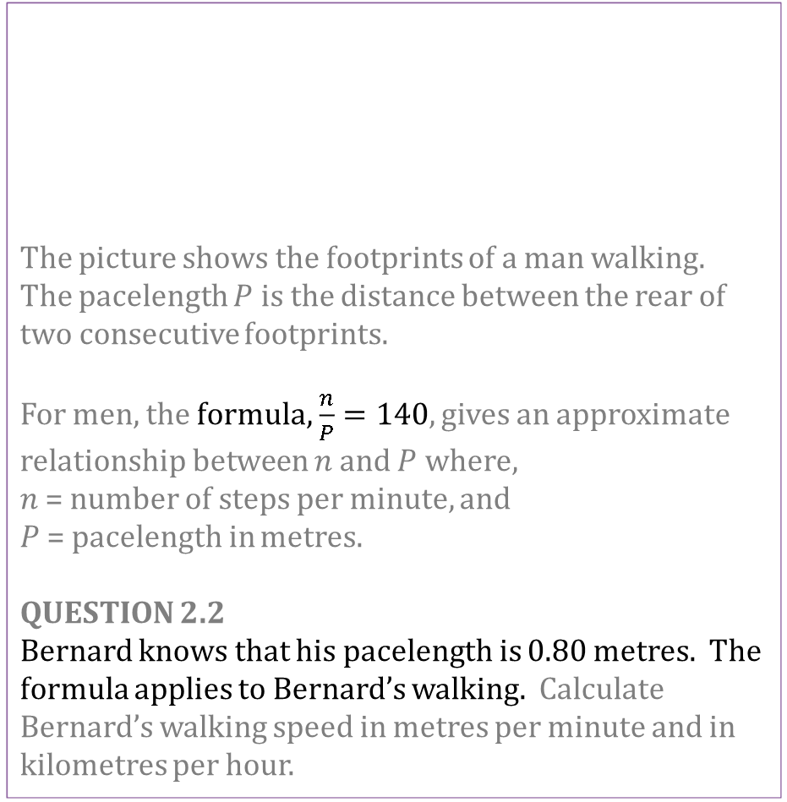
Mathematics Unit 2: Walking
The picture shows the footprints of a man walking. The pacelength $P$ is the distance between the rear of two consecutive footprints.
For men, the formula, $\frac{n}{P}=140$, gives an approximate relationship between $n$ and $P$ where,
$n$ = number of steps per minute, and
$P$ = pacelength in metres.
QUESTION 2.2
Bernard knows that his pacelength is 0.80 metres. The formula applies to Bernard’s walking. Calculate Bernard’s walking speed in metres per minute and in kilometres per hour.
What do we want to find out?
What useful information do we know?
What other mathematical techniques do we need to apply?
What have we learned?
Back to start

Slide 9
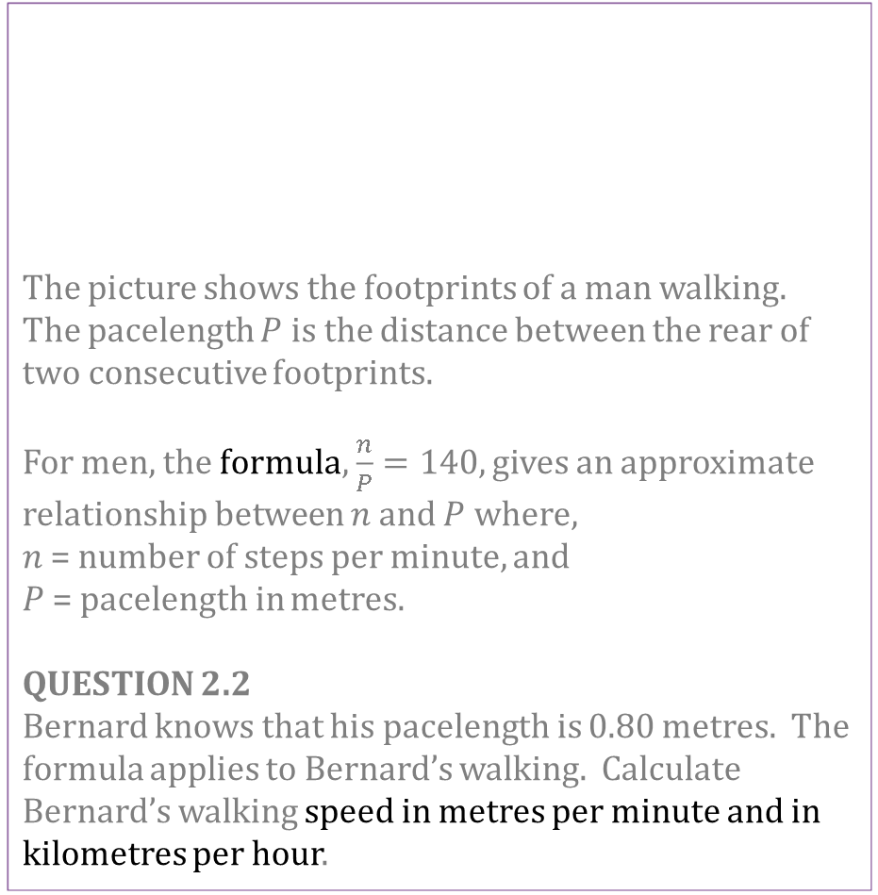
Mathematics Unit 2: Walking
The picture shows the footprints of a man walking. The pacelength $P$ is the distance between the rear of two consecutive footprints.
For men, the formula, $\frac{n}{P}=140$, gives an approximate relationship between $n$ and $P$ where,
$n$ = number of steps per minute, and
$P$ = pacelength in metres.
QUESTION 2.2
Bernard knows that his pacelength is 0.80 metres. The formula applies to Bernard’s walking. Calculate Bernard’s walking speed in metres per minute and in kilometres per hour.
What do we want to find out?
What useful information do we know?
What other mathematical techniques do we need to apply?
What have we learned?
Back to start

Slide 10
Mathematics Unit 2: Walking
The picture shows the footprints of a man walking. The pacelength $P$ is the distance between the rear of two consecutive footprints.
For men, the formula, $\frac{n}{P}=140$, gives an approximate relationship between $n$ and $P$ where,
$n$ = number of steps per minute, and
$P$ = pacelength in metres.
QUESTION 2.2
Bernard knows that his pacelength is 0.80 metres. The formula applies to Bernard’s walking. Calculate Bernard’s walking speed in metres per minute and in kilometres per hour.
What do we want to find out?
What useful information do we know?
What other mathematical techniques do we need to apply?
What have we learned?
Back to start

