Slide 1
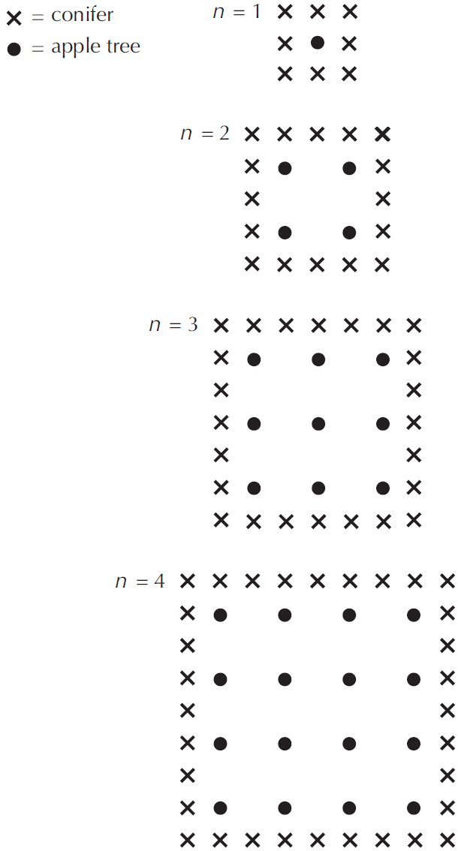
Mathematics Unit 3: Apples
A farmer plants trees in a square
pattern. In order to protect the
apple trees against the wind he
plants conifer trees all around the
orchard.
Here you see a diagram of this
situation where you can see the
pattern of apple trees and conifer
trees for any number (n) of rows
of apple trees:
QUESTION 3.1
Complete the table:
What do we want to find out?
What useful information do we know?
What other mathematical techniques do we need to apply?
What have we learned?

Slide 2
Mathematics Unit 3: Apples
A farmer plants trees in a square
pattern. In order to protect the
apple trees against the wind he
plants conifer trees all around the
orchard.
Here you see a diagram of this
situation where you can see the
pattern of apple trees and conifer
trees for any number (n) of rows
of apple trees:
QUESTION 3.1
Complete the table:
What do we want to find out?
What useful information do we know?
What other mathematical techniques do we need to apply?
What have we learned?
Back to start

Slide 3
Mathematics Unit 3: Apples
A farmer plants trees in a square
pattern. In order to protect the
apple trees against the wind he
plants conifer trees all around the
orchard.
Here you see a diagram of this
situation where you can see the
pattern of apple trees and conifer
trees for any number (n) of rows
of apple trees:
QUESTION 3.1
Complete the table:
What do we want to find out?
What useful information do we know?
What other mathematical techniques do we need to apply?
What have we learned?
Back to start

Slide 4
Mathematics Unit 3: Apples
A farmer plants trees in a square
pattern. In order to protect the
apple trees against the wind he
plants conifer trees all around the
orchard.
Here you see a diagram of this
situation where you can see the
pattern of apple trees and conifer
trees for any number (n) of rows
of apple trees:
QUESTION 3.1
Complete the table:
What do we want to find out?
What useful information do we know?
What other mathematical techniques do we need to apply?
What have we learned?
Back to start

Slide 5
Mathematics Unit 3: Apples
A farmer plants trees in a square
pattern. In order to protect the
apple trees against the wind he
plants conifer trees all around the
orchard.
Here you see a diagram of this
situation where you can see the
pattern of apple trees and conifer
trees for any number (n) of rows
of apple trees:
QUESTION 3.1
Complete the table:
What do we want to find out?
What useful information do we know?
What other mathematical techniques do we need to apply?
What have we learned?
Back to start

Slide 6
Mathematics Unit 3: Apples
QUESTION 3.2
There are two formulae you can
use to calculate the number of
apple trees and the number of
conifer trees for the pattern
described:
Number of apple trees = $n^{2}$
Number of conifer trees = $8n$
where $n$ is the number of rows of
apple trees.
There is a value of $n$ for which the number of apple trees equals the number of conifer trees. Find the value of $n$ and show you method of calculating this.
What do we want to find out?
What useful information do we know?
What other mathematical techniques do we need to apply?
What have we learned?

Slide 7
Mathematics Unit 3: Apples
QUESTION 3.2
There are two formulae you can
use to calculate the number of
apple trees and the number of
conifer trees for the pattern
described:
Number of apple trees = $n^{2}$
Number of conifer trees = $8n$
where $n$ is the number of rows of
apple trees.
There is a value of $n$ for which the number of apple trees equals the number of conifer trees. Find the value of $n$ and show you method of calculating this.
What do we want to find out?
What useful information do we know?
What other mathematical techniques do we need to apply?
What have we learned?
Back to start

Slide 8
Mathematics Unit 3: Apples
QUESTION 3.2
There are two formulae you can
use to calculate the number of
apple trees and the number of
conifer trees for the pattern
described:
Number of apple trees = $n^{2}$
Number of conifer trees = $8n$
where $n$ is the number of rows of
apple trees.
There is a value of $n$ for which the number of apple trees equals the number of conifer trees. Find the value of $n$ and show you method of calculating this.
What do we want to find out?
What useful information do we know?
What other mathematical techniques do we need to apply?
What have we learned?
Back to start

Slide 9
Mathematics Unit 3: Apples
QUESTION 3.2
There are two formulae you can
use to calculate the number of
apple trees and the number of
conifer trees for the pattern
described:
Number of apple trees = $n^{2}$
Number of conifer trees = $8n$
where $n$ is the number of rows of
apple trees.
There is a value of $n$ for which the number of apple trees equals the number of conifer trees. Find the value of $n$ and show you method of calculating this.
What do we want to find out?
What useful information do we know?
What other mathematical techniques do we need to apply?
What have we learned?
Back to start

Slide 10
Mathematics Unit 3: Apples
QUESTION 3.2
There are two formulae you can
use to calculate the number of
apple trees and the number of
conifer trees for the pattern
described:
Number of apple trees = $n^{2}$
Number of conifer trees = $8n$
where $n$ is the number of rows of
apple trees.
There is a value of $n$ for which the number of apple trees equals the number of conifer trees. Find the value of $n$ and show you method of calculating this.
What do we want to find out?
What useful information do we know?
What other mathematical techniques do we need to apply?
What have we learned?
Back to start

Slide 11
Mathematics Unit 3: Apples
There are two formulae you can
use to calculate the number of
apple trees and the number of
conifer trees for the pattern
described:
Number of apple trees = $n^{2}$
Number of conifer trees = $8n$
where $n$ is the number of rows of
apple trees.
QUESTION 3.3
Suppose the farmer wants to make a much larger orchard with many rows of trees. As the farmer makes the orchard bigger, which will increase more quickly: the number of apple trees or the number of conifer trees? Explain how you found your answer.
What do we want to find out?
What useful information do we know?
What other mathematical techniques do we need to apply?
What have we learned?

Slide 12
Mathematics Unit 3: Apples
There are two formulae you can
use to calculate the number of
apple trees and the number of
conifer trees for the pattern
described:
Number of apple trees = $n^{2}$
Number of conifer trees = $8n$
where $n$ is the number of rows of
apple trees.
QUESTION 3.3
Suppose the farmer wants to make a much larger orchard with many rows of trees. As the farmer makes the orchard bigger, which will increase more quickly: the number of apple trees or the number of conifer trees? Explain how you found your answer.
What do we want to find out?
What useful information do we know?
What other mathematical techniques do we need to apply?
What have we learned?
Back to start

Slide 13
Mathematics Unit 3: Apples
There are two formulae you can
use to calculate the number of
apple trees and the number of
conifer trees for the pattern
described:
Number of apple trees = $n^{2}$
Number of conifer trees = $8n$
where $n$ is the number of rows of
apple trees.
QUESTION 3.3
Suppose the farmer wants to make a much larger orchard with many rows of trees. As the farmer makes the orchard bigger, which will increase more quickly: the number of apple trees or the number of conifer trees? Explain how you found your answer.
What do we want to find out?
What useful information do we know?
What other mathematical techniques do we need to apply?
What have we learned?
Back to start

Slide 14
Mathematics Unit 3: Apples
There are two formulae you can
use to calculate the number of
apple trees and the number of
conifer trees for the pattern
described:
Number of apple trees = $n^{2}$
Number of conifer trees = $8n$
where $n$ is the number of rows of
apple trees.
QUESTION 3.3
Suppose the farmer wants to make a much larger orchard with many rows of trees. As the farmer makes the orchard bigger, which will increase more quickly: the number of apple trees or the number of conifer trees? Explain how you found your answer.
What do we want to find out?
What useful information do we know?
What other mathematical techniques do we need to apply?
What have we learned?
Back to start

Slide 15
Mathematics Unit 3: Apples
There are two formulae you can
use to calculate the number of
apple trees and the number of
conifer trees for the pattern
described:
Number of apple trees = $n^{2}$
Number of conifer trees = $8n$
where $n$ is the number of rows of
apple trees.
QUESTION 3.3
Suppose the farmer wants to make a much larger orchard with many rows of trees. As the farmer makes the orchard bigger, which will increase more quickly: the number of apple trees or the number of conifer trees? Explain how you found your answer.
What do we want to find out?
What useful information do we know?
What other mathematical techniques do we need to apply?
What have we learned?
Back to start

