Slide 1
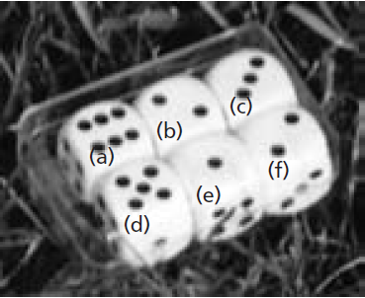
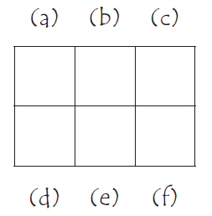
Mathematics Unit 4: Cubes
QUESTION 4.1
In this photograph you see six dice, labelled (a) to (f). For all dice there is a rule:
The total number of dots on two opposite faces of each die is always seven.
Write in each box the number of dots on the bottom face of the dice corresponding to the photograph.
What do we want to find out?
What useful information do we know?
What other mathematical techniques do we need to apply?
What have we learned?

Slide 2
Mathematics Unit 4: Cubes
QUESTION 4.1
In this photograph you see six dice, labelled (a) to (f). For all dice there is a rule:
The total number of dots on two opposite faces of each die is always seven.
Write in each box the number of dots on the bottom face of the dice corresponding to the photograph.
What do we want to find out?
What useful information do we know?
What other mathematical techniques do we need to apply?
What have we learned?
Back to start

Slide 3
Mathematics Unit 4: Cubes
QUESTION 4.1
In this photograph you see six dice, labelled (a) to (f). For all dice there is a rule:
The total number of dots on two opposite faces of each die is always seven.
Write in each box the number of dots on the bottom face of the dice corresponding to the photograph.
What do we want to find out?
What useful information do we know?
What other mathematical techniques do we need to apply?
What have we learned?
Back to start

Slide 4
Mathematics Unit 4: Cubes
QUESTION 4.1
In this photograph you see six dice, labelled (a) to (f). For all dice there is a rule:
The total number of dots on two opposite faces of each die is always seven.
Write in each box the number of dots on the bottom face of the dice corresponding to the photograph.
What do we want to find out?
What useful information do we know?
What other mathematical techniques do we need to apply?
What have we learned?
Back to start

Slide 5
Mathematics Unit 4: Cubes
QUESTION 4.1
In this photograph you see six dice, labelled (a) to (f). For all dice there is a rule:
The total number of dots on two opposite faces of each die is always seven.
Write in each box the number of dots on the bottom face of the dice corresponding to the photograph.
What do we want to find out?
What useful information do we know?
What other mathematical techniques do we need to apply?
What have we learned?
Back to start

