Slide 1
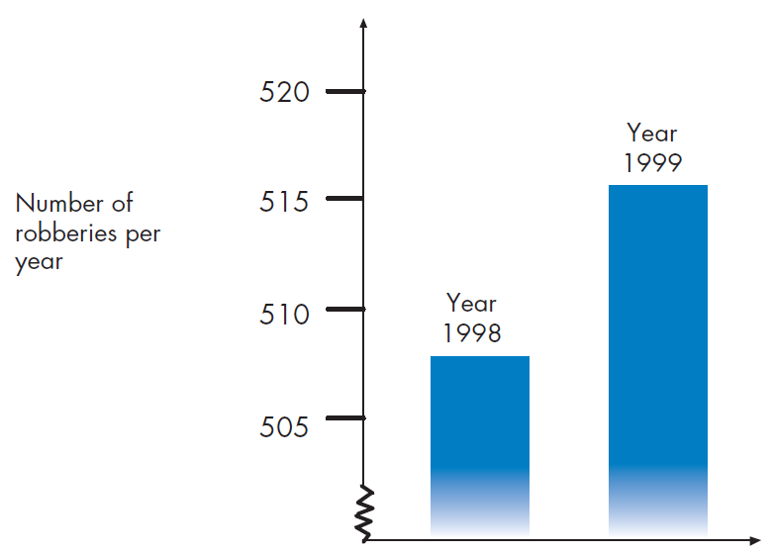
Mathematics Unit 9: Robberies
QUESTION 9.1
A TV reporter showed this graph and said: “The graph shows that there is a huge increase in the number of robberies from 1998 to 1999.”
Do you consider the reporter’s statement to be a reasonable interpretation of the graph? Give and explanation to support your answer.
What do we want to find out?
What useful information do we know?
What other mathematical techniques do we need to apply?
What have we learned?

Slide 2
Mathematics Unit 9: Robberies
QUESTION 9.1
A TV reporter showed this graph and said: “The graph shows that there is a huge increase in the number of robberies from 1998 to 1999.”
Do you consider the reporter’s statement to be a reasonable interpretation of the graph? Give and explanation to support your answer.
What do we want to find out?
What useful information do we know?
What other mathematical techniques do we need to apply?
What have we learned?
Back to start

Slide 3
Mathematics Unit 9: Robberies
QUESTION 9.1
A TV reporter showed this graph and said: “The graph shows that there is a huge increase in the number of robberies from 1998 to 1999.”
Do you consider the reporter’s statement to be a reasonable interpretation of the graph? Give and explanation to support your answer.
What do we want to find out?
What useful information do we know?
What other mathematical techniques do we need to apply?
What have we learned?
Back to start

Slide 4
Mathematics Unit 9: Robberies
QUESTION 9.1
A TV reporter showed this graph and said: “The graph shows that there is a huge increase in the number of robberies from 1998 to 1999.”
Do you consider the reporter’s statement to be a reasonable interpretation of the graph? Give and explanation to support your answer.
What do we want to find out?
What useful information do we know?
What other mathematical techniques do we need to apply?
What have we learned?
Back to start

Slide 5
Mathematics Unit 9: Robberies
QUESTION 9.1
A TV reporter showed this graph and said: “The graph shows that there is a huge increase in the number of robberies from 1998 to 1999.”
Do you consider the reporter’s statement to be a reasonable interpretation of the graph? Give and explanation to support your answer.
What do we want to find out?
What useful information do we know?
What other mathematical techniques do we need to apply?
What have we learned?
Back to start

