Slide 1
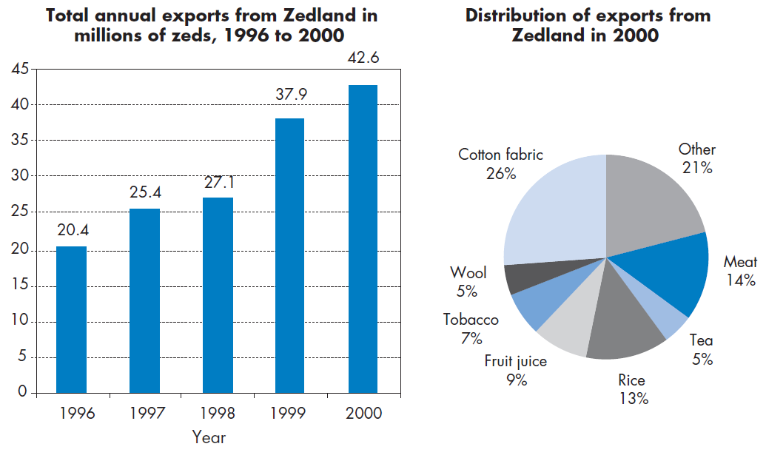
Mathematics Unit 13: Exports
The graphics below show information about exports from Zedland, a country that uses zeds as its currency.
QUESTION 13.1
What was the total value (in millions of zeds) of exports from Zedland in 1998?
What do we want to find out?
What useful information do we know?
What other mathematical techniques do we need to apply?
What have we learned?

Slide 2
Mathematics Unit 13: Exports
The graphics below show information about exports from Zedland, a country that uses zeds as its currency.
QUESTION 13.1
What was the total value (in millions of zeds) of exports from Zedland in 1998?
What do we want to find out?
What useful information do we know?
What other mathematical techniques do we need to apply?
What have we learned?
Back to start

Slide 3
Mathematics Unit 13: Exports
The graphics below show information about exports from Zedland, a country that uses zeds as its currency.
QUESTION 13.1
What was the total value (in millions of zeds) of exports from Zedland in 1998?
What do we want to find out?
What useful information do we know?
What other mathematical techniques do we need to apply?
What have we learned?
Back to start

Slide 4
Mathematics Unit 13: Exports
The graphics below show information about exports from Zedland, a country that uses zeds as its currency.
QUESTION 13.1
What was the total value (in millions of zeds) of exports from Zedland in 1998?
What do we want to find out?
What useful information do we know?
What other mathematical techniques do we need to apply?
What have we learned?
Back to start

Slide 5
Mathematics Unit 13: Exports
The graphics below show information about exports from Zedland, a country that uses zeds as its currency.
QUESTION 13.1
What was the total value (in millions of zeds) of exports from Zedland in 1998?
What do we want to find out?
What useful information do we know?
What other mathematical techniques do we need to apply?
What have we learned?
Back to start

Slide 6
Mathematics Unit 13: Exports
QUESTION 13.2
What was the value of fruit juice exported from Zedland in 2000?
1.8 million zeds.
2.3 million zeds.
2.4 million zeds.
3.4 million zeds.
3.8 million zeds.
What do we want to find out?
What useful information do we know?
What other mathematical techniques do we need to apply?
What have we learned?

Slide 7
Mathematics Unit 13: Exports
QUESTION 13.2
What was the value of fruit juice exported from Zedland in 2000?
1.8 million zeds.
2.3 million zeds.
2.4 million zeds.
3.4 million zeds.
3.8 million zeds.
What do we want to find out?
What useful information do we know?
What other mathematical techniques do we need to apply?
What have we learned?
Back to start

Slide 8
Mathematics Unit 13: Exports
QUESTION 13.2
What was the value of fruit juice exported from Zedland in 2000?
1.8 million zeds.
2.3 million zeds.
2.4 million zeds.
3.4 million zeds.
3.8 million zeds.
What do we want to find out?
What useful information do we know?
What other mathematical techniques do we need to apply?
What have we learned?
Back to start

Slide 9
Mathematics Unit 13: Exports
QUESTION 13.2
What was the value of fruit juice exported from Zedland in 2000?
1.8 million zeds.
2.3 million zeds.
2.4 million zeds.
3.4 million zeds.
3.8 million zeds.
What do we want to find out?
What useful information do we know?
What other mathematical techniques do we need to apply?
What have we learned?
Back to start

Slide 10
Mathematics Unit 13: Exports
QUESTION 13.2
What was the value of fruit juice exported from Zedland in 2000?
1.8 million zeds.
2.3 million zeds.
2.4 million zeds.
3.4 million zeds.
3.8 million zeds.
What do we want to find out?
What useful information do we know?
What other mathematical techniques do we need to apply?
What have we learned?
Back to start

