Slide 1
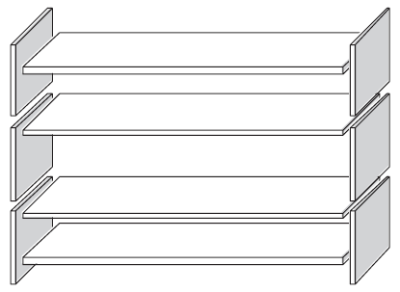
Mathematics Unit 16: Bookshelves
QUESTION 16.1
To complete one set of bookshelves a carpenter needs the following components:
4 long wooden panels,
6 short wooden panels,
12 small clips,
2 large clips and
14 screws.
The carpenter has in stock 26 long wooden panels, 33 short wooden panels, 200 small clips, 20 large clips and 510 screws.
How many sets of bookshelves can the carpenter make?
What do we want to find out?
What useful information do we know?
What other mathematical techniques do we need to apply?
What have we learned?

Slide 2
Mathematics Unit 16: Bookshelves
QUESTION 16.1
To complete one set of bookshelves a carpenter needs the following components:
4 long wooden panels,
6 short wooden panels,
12 small clips,
2 large clips and
14 screws.
The carpenter has in stock 26 long wooden panels, 33 short wooden panels, 200 small clips, 20 large clips and 510 screws.
How many sets of bookshelves can the carpenter make?
What do we want to find out?
What useful information do we know?
What other mathematical techniques do we need to apply?
What have we learned?
Back to start

Slide 3
Mathematics Unit 16: Bookshelves
QUESTION 16.1
To complete one set of bookshelves a carpenter needs the following components:
4 long wooden panels,
6 short wooden panels,
12 small clips,
2 large clips and
14 screws.
The carpenter has in stock 26 long wooden panels, 33 short wooden panels, 200 small clips, 20 large clips and 510 screws.
How many sets of bookshelves can the carpenter make?
What do we want to find out?
What useful information do we know?
What other mathematical techniques do we need to apply?
What have we learned?
Back to start

Slide 4
Mathematics Unit 16: Bookshelves
QUESTION 16.1
To complete one set of bookshelves a carpenter needs the following components:
4 long wooden panels,
6 short wooden panels,
12 small clips,
2 large clips and
14 screws.
The carpenter has in stock 26 long wooden panels, 33 short wooden panels, 200 small clips, 20 large clips and 510 screws.
How many sets of bookshelves can the carpenter make?
What do we want to find out?
What useful information do we know?
What other mathematical techniques do we need to apply?
What have we learned?
Back to start

Slide 5
Mathematics Unit 16: Bookshelves
QUESTION 16.1
To complete one set of bookshelves a carpenter needs the following components:
4 long wooden panels,
6 short wooden panels,
12 small clips,
2 large clips and
14 screws.
The carpenter has in stock 26 long wooden panels, 33 short wooden panels, 200 small clips, 20 large clips and 510 screws.
How many sets of bookshelves can the carpenter make?
What do we want to find out?
What useful information do we know?
What other mathematical techniques do we need to apply?
What have we learned?
Back to start

