Slide 1
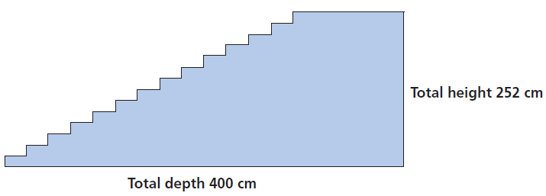
Mathematics Unit 22: Staircase
QUESTION 22.1
The diagram above illustrates a staircase with 14 steps and a total height of 252 cm:
What is the height of each of the 14 steps?
What do we want to find out?
What useful information do we know?
What other mathematical techniques do we need to apply?
What have we learned?

Slide 2
Mathematics Unit 22: Staircase
QUESTION 22.1
The diagram above illustrates a staircase with 14 steps and a total height of 252 cm:
What is the height of each of the 14 steps?
What do we want to find out?
What useful information do we know?
What other mathematical techniques do we need to apply?
What have we learned?
Back to start

Slide 3
Mathematics Unit 22: Staircase
QUESTION 22.1
The diagram above illustrates a staircase with 14 steps and a total height of 252 cm:
What is the height of each of the 14 steps?
What do we want to find out?
What useful information do we know?
What other mathematical techniques do we need to apply?
What have we learned?
Back to start

Slide 4
Mathematics Unit 22: Staircase
QUESTION 22.1
The diagram above illustrates a staircase with 14 steps and a total height of 252 cm:
What is the height of each of the 14 steps?
What do we want to find out?
What useful information do we know?
What other mathematical techniques do we need to apply?
What have we learned?
Back to start

Slide 5
Mathematics Unit 22: Staircase
QUESTION 22.1
The diagram above illustrates a staircase with 14 steps and a total height of 252 cm:
What is the height of each of the 14 steps?
What do we want to find out?
What useful information do we know?
What other mathematical techniques do we need to apply?
What have we learned?
Back to start

